Slide 1
Media, Technology and Politics
Media Organizations and Technologies
Erik Chevrier
March 2nd, 2016

Slide 2
Guest Speaker
Sarah Deshaines
Radio Producer art CJAD
Formerly worked art CKUT, CUP and The Concordian

Slide 3
Media As a Business
Subject to:
Discipline of the market
Laws of the Land
Cultural and ideological rules of the land
Media organizations have:
Corporate structures
By-Laws
Board of Governors
Erving Goffman
Official and unofficial bureaucracy
Gaye Tuchman
Journalists don’t always like to admit that they are not in control
Media anchors are touchy about objectivity
Presentation of facts – 5 Ws
Edward Jay Epstein
These critical demands structure the scope and form of the news
Budgetary constraints
Sustain the interest of the audience (flow of programming)
Government and its actions establish general parameters that condition news
To break away from organizational filters you need to tell a great story and attract an audience
Peter Desbarats
News professionals rely on instinct and gut feeling.
They don’t always like to share trade secrets (competition)
Guilt for questionable practices

Slide 4
CJAD Organizational Structure
Owned By Bell Media
Bell owns 106 stations in eight provinces
CJAD
Bell Media Executives
BCE

Slide 5
Structure of Media Organizations
Media organizations can be conceptualized as consisting of four principal classes:
1 – The upper class: Large scale owners and senior managers
2 – Media working class: Routine tasks of media work; sound recording, cleaning up, etc.
3 – Middle class professionals: Journalists, managers, production staff
4 – Self employed independent journalists

Slide 6
The Bottom Line - Profit
Since media are businesses, they sell viewers to advertisers
They MUST satisfy their shareholders
They are mindful of how to please audiences and construct stories that ‘sell’
A great deal of energy is put into attracting and keeping audiences
Newsrooms must continuously construct products ‘news content’
The business is fast pace and deadlines are strict

Slide 7
Making a Story Newsworthy
More of an art than a science
Make sure your story is relevant to the current time
Stage an event – events attract news
Write a press release – spin your piece into a newsworthy story
Organize a press conference around your event – invite an array of journalists (you’ll need contacts)
Prepare newsworthy soundbites
Follow up with journalists – keep their contact information

Slide 8
Selling the System
Media are in the business of selling views to advertisers
Advertisers are in the business of selling products to viewers
Media is the vehicle to transmit commercial messages
Media has become an important player in organizing consumption
Product placement
Lifestyle advertising
Event marketing
Anxiety advertising
Keeping up with the Jonses

Slide 9
Effects of Advertising
Erik Chevrier’s Masters Thesis: An Inquiry into How Individuals are Affected by Profuse Amounts of Publicity
Page 68 onward looks at subjective accounts of the perceived effects of advertising.

Slide 10
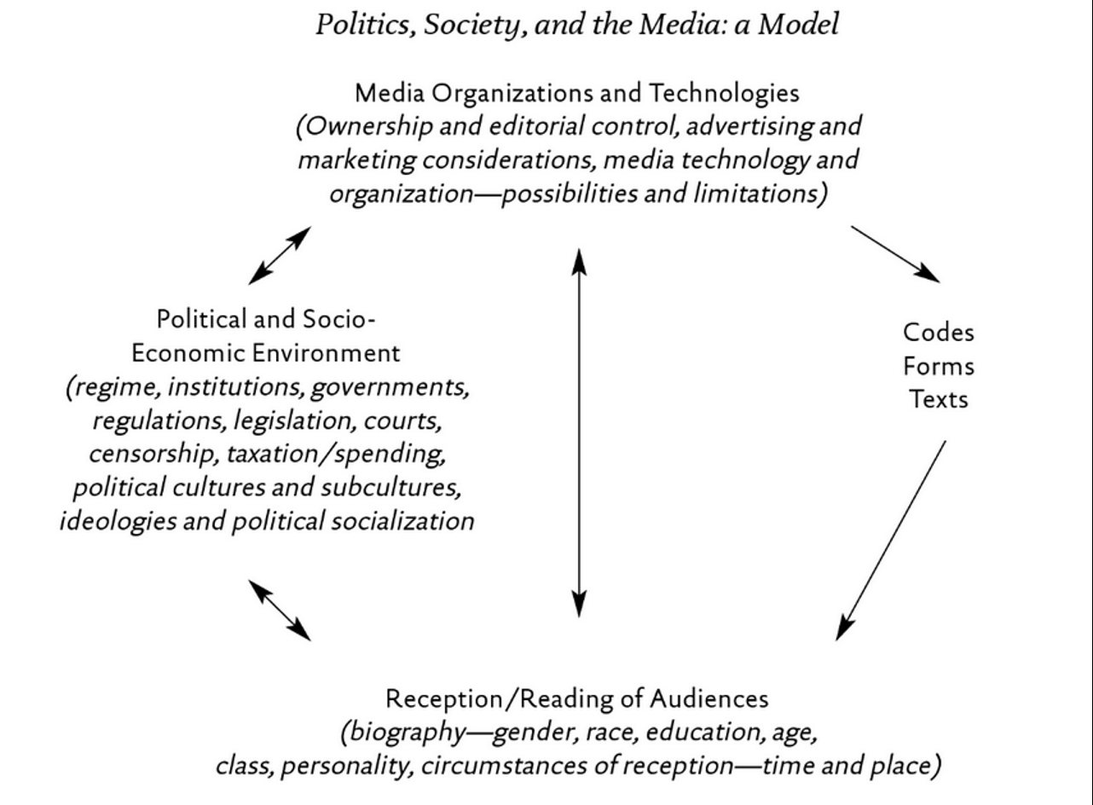
The Medium is the Message

Slide 11
Media Technology and Shaping Society
How social media can make history
Future technologies
How can media technology change social relations?
What innovations are being developed that will revolutionize the future?
What are the consequences (positive and negative) of these media technologies?
Printing press
Television
Radio
Internet
Cell Phones
Social media platforms

Slide 12
Thanks
Questions?
Reminder: You need to bring your bibliography to class on March 9th

