Slide 1
Media, Technology and Politics
Gatekeeping, Agenda Setting, Framing & Priming
Erik Chevrier
March 23th, 2016

Slide 2
Gatekeeping, Agenda Setting, Framing & Priming
Attention and awareness are important
Reporters often repeat key words, phrases and/or sayings
New stories can be found on newswires and recycled or tweaked
Priming effect
The power of words in regards to memory
Context can make us understand things in specific ways
Advertising and priming – page 18

Slide 3
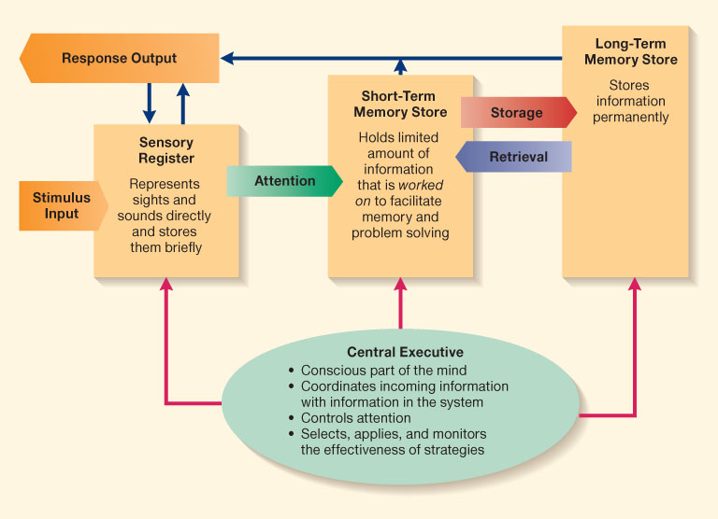
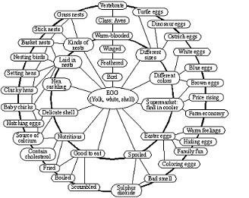
Priming/Framing/Schema
Cognitive Model
Schema

Slide 4
Factors that Influence News Content
Relation between the state and broadcasters
Formal & Informal
Symbolic relationship between media companies, parties, and politicians
Discretionary fiscal policy on the part of the state
Executive, judicial and regulatory agency laws and regulations about the media and their conduct
News management techniques on the part of political actors

Slide 5
The State and the Media (Nesbitt-Larking)
The state has multiple roles in relation with media apparatuses.
Proprietor
Custodian of national heritage
Regulator
Censor
Patron (awards, prizes and grants)
Catalyst (subsidies)
Actor (providing content)
Masseur (managing news releases)
Ideologue (shaping political reality)
Conspirator

Slide 6
Media and Politics – Dual Control
Jamieson and Campbell identify a number of ways where media organizations and politicians control each other:
1 – Use of spin-doctors
2 – Staging of press conferences
3 – Venues, seating arrangements and camera angles
4 – Timing of statements to be released to the general public
5 – Negative announcements timed for release
6 – Trial balloons used to deal with proposals when a politician is uncertain
7 – Leaks employed to weaken an enemy
8 – Direct recipient addresses
9 – Access and denial of access to reward journalists who are supportive and punish those that are critical

Slide 7
Discussion
What is objectivity and truth?

Slide 8
The Credibility of a Journalist
Journalists are touchy about objectivity (Tuchman)
They defend attacks on objectivity via: 1 – presentation of both sides of a story even if facts cannot be verified 2 – presentation of supporting evidence to back up weaker evidence 3 – judicious use of attempts to separate opinions expressed from the reporters own 4 – the use of ‘expert’ opinion 5 – presentation of the most facts regarding the 5Ws

Slide 9
The ‘Media Factory’
Suppliers of raw materials – Those whose daily practices produce the requisite news value to be registered as eligible for inclusion. Those more elevated in social status usually get more priority.
Builders of news machinery – Technical operatives who make it possible for experience to be converted into editorial.
Suppliers of liquid capital – Those who invest in and purchase the services of media enterprises.
Principal owners and bosses – Allocative vs operational owners
Workers (and semi-employed workers) – Those doing the groundwork
State inspector – The regulator
Costumers – Those who engage with media
Those affected by externalities – The general public

Slide 10
Tactics to Resist the Influence of Agenda Setting (Nesbitt-Larking)
You can tune messages out
Be on the lookout for slogans and clichés
Be alert of infotainment techniques
Remind yourself about the artificial nature of news broadcasts
Talk back to new pieces
Understand what has been ignored or downplayed
Understand what voices are missing
Understand what is said to be impossible
Understand if the news piece favors a conventional idea of the elite
Demand better news content
*Become a producer of news yourself

Slide 11
Discussion – Media and Democracy
What is the relationship between media and democracy?
Can media that assists voting help foster better democratic practices?
How do we ensure that people get reliable information about political affairs?

Slide 12
Group Project Discussion
How are you doing?
Are you following your schedule?
Where are you at now?
Do you have questions or concerns?

