Slide 1
Media, Technology and Politics
Ethics, Participation, Political Activism, and Media
Erik Chevrier
March 30th, 2016

Slide 2
Contents of Final Exam
Class discussions – Study the PowerPoint slides as well as what was discussed in class
Politics, Society and Media (Paul Nesbitt-Larking) – Chapters 7, 8, 9, 10, 11, 13, 14
Ideas from chapter 8 and 9 were discussed in class many times, however, there are no PowerPoint slides that detail these ideas. If you were not present for the discussion, I suggest you read those chapters carefully and/or rely on the notes you took in class.

Slide 3
Format for Final Exam
Two sections:
Short answer (answer 8 of 9 questions)
Essay question (1 question)
Exam time
Short answer – 10 minutes per question X 8 questions (80 minutes)
Essay question – 20 minutes (20 minutes)
Exam Time = 100 Minutes – 1 Hour and 40 min

Slide 4
Exam Weight
Point Allocation
Short answer – 8 points per question (40 marks total)
Essay Question – 20 points (20 points)
40 + 20 = 60 Points
X / 60 * 100 = your grade on 100

Slide 5
Examples of How Points are Allocated
Short Answer – Scale of (0 – 5)
0 = You wrote nothing
1 = You wrote something but it is not right at all
2 = You wrote something that is partially true but mainly wrong
3 = You are correct but extremely vague
4 = You are correct but slightly vague
5 = You are correct, clear and complete. You provide examples to back up your claim(s), when necessary.

Slide 6
Examples of How Points are Allocated
Essay Question – Points (0 – 20)
0 = You wrote nothing
1 – 10 = You wrote something but it is not right at all
10 – 12 = You wrote something that is partially true but mainly wrong
12 – 14 = You are correct but extremely vague
14 – 16 = You are correct but slightly vague
16 – 18 = You are correct and are clear. You provide examples to back up your claim(s).
18 – 20 = You are spot on. You provide a range of examples to back up your claim(s). Your answer is full. You don’t leave anything out. Each part of your answer is completely correct.

Slide 7
Discussion
What are your political ambitions?
How can media assist you?

Slide 8
Media Today
People have greater access to equipment that produce media
Co-op Collective Vision
Web platforms provide a variety of educational resources:
Coursera
MIT Open Courseware
People have greater access to information
People have greater access to broadcasting
Media technologies are innovating rapidly
People can communicate rapidly across long distances

Slide 9
Politics and the Internet
Zeynep Tufekci: Online social change: easy to organize, hard to win
Clay Shirky: How social media can make history
Rebecca MacKinnon: Let's take back the Internet!
Wael Ghonim: Let's design social media that drives real change
Clay Shirky: How the Internet will (one day) transform government
Evan Williams: The voices of Twitter users

Slide 10
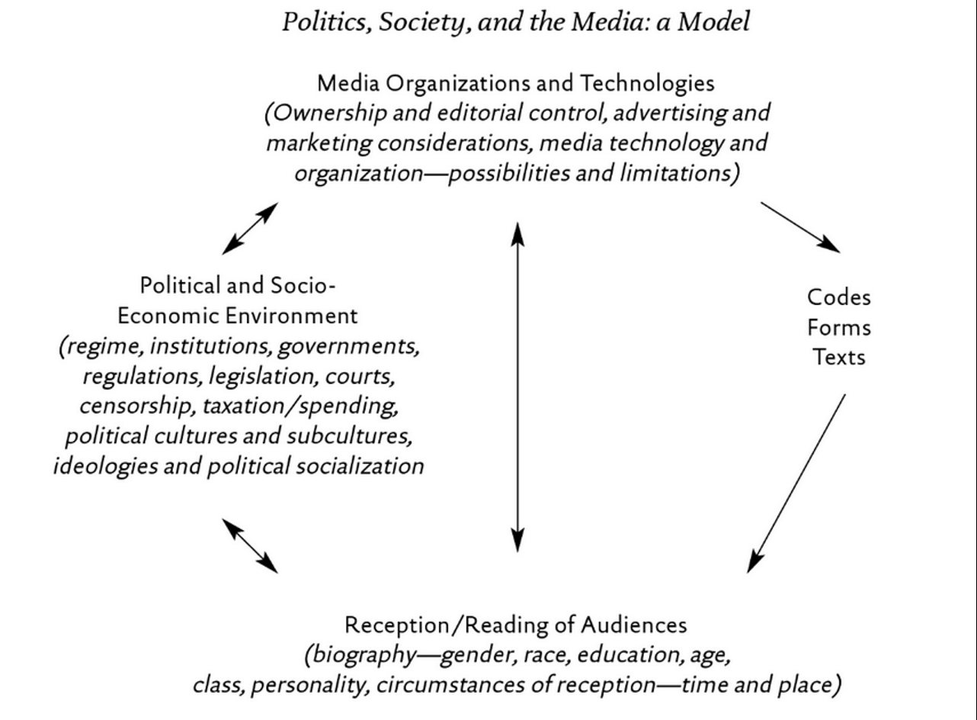
Wrap-Up

