Slide 1
Media, Technology and Politics
Construction and Deconstruction of Texts
Erik Chevrier
March 9nd, 2016

Slide 2
Guest Speaker
Ethan Cox & Nicky Young
From Ricochet

Slide 3
Texts
Encoding
Decoding

Slide 4
Content Analysis
The scientific exploration of texts in order to test inferences about the content of that text
Provides an accurate statement of what is in the text
Does not reveal the true intentions of the ‘producer’ nor explain how it will affect every individual
While designing a content analysis experiment, you should:
Devise a testable hypothesis
Operationalize and code your variables
Chose a method of analysis
Some things to keep in mind:
Internal validity
External validity
Sampling

Slide 5
Discourse Analysis
An analysis of a text that goes beyond its overt elements
Semiotic analysis
Nesbitt-Larking
Semiotic analysis of discourse is centred on the deconstruction of those codes that are invoked in the communication of meaning
Codes are signs that have been culturally and ideologically organized in order to attach them to certain referents.
Signs come in 3 forms
Icons – Resemble objects to which they refer
Indexes – Signs that are immediately implied in their referent
Symbols – Bear no obvious resemblance to their referents but come to be associated to them

Slide 6
Recap - Political Culture, Ideology, and Media
Signs – A combination of signifier and signified
Signifier – The physical existence of what carries meaning
Signified – The mental representation that is the meaning
Denotative meaning – Common sense, obvious meaning
Connotative - Interaction of denotative meaning and one’s subjective feelings
Counter ideology?
Factors that influence the extent to which people are impacted by cultural symbols (Schudson)
Retrievable in memory (priming)
Rhetorical force (ability to move us)
Resonance (ability to tie to other cultural symbols)
Institutional retention (linking to existing structures of power and influence)
Resolution (ability to motivates, convinces, structures understanding)

Slide 7
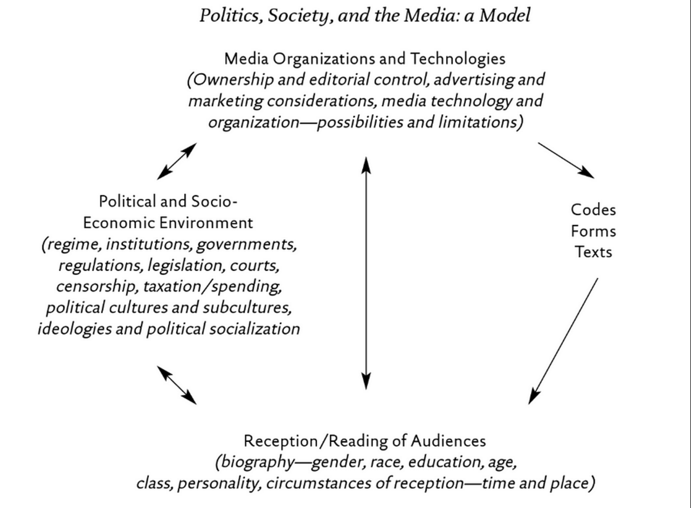
Recap - Semiology

Slide 8
Deciphering Advertisements (Jib Fowles, (1996) Deciphering Advertisements)
Context for the ad
Product category?
Which medium does it appear?
Who is the intended audience?
Implications for the ad
What is the ad implying about relationships between people?
What is this ad saying about identity and gender relations?
What does the ad convey about social status?
What kind of cultural beliefs are displayed in the ad?
How does the ad attempt to commodify human experience?
Looking at the ad
What are the aesthetic properties of the ad?
Photograph or drawing (retouching?)
What is in the foreground?
What is the commodity?
Subtract the commodity and look at the ad’s symbolic appeal
List various elements pictured in the symbolic appeal
What are the meanings of these symbols in relation to the intended audience?
What are the inferred states of mind of humans in the ads?
Where is the space in which the ad is situated?
What is the timeframe in which the ad is situated?
Consider the ad as a narrative, can we tell the story?
What is missing?
Does the symbolic appeal idealize anything?
Imagine someone looking at the ad, what state of mind would they be in? What does the ad supplement to their state?
Is there intertextual referents from something earlier?
What is in frame, what is framed out?

Slide 10
Questions?
Office hours for next week
Wednesday before class by request
Watch
We are Legion: The Story of Hacktivists (2012) – Brian Knappenberger

