Slide 1
Edible Activism!
Erik Chevrier
September 12, 2016

Slide 2
Videos
Concordia Food Coalition Interview with Vandana Shiva

Slide 3
Edible Activism! – Brainstorm/Breakout Groups
Goals and objectives of the course?
Group project?
Reading/documentary material?
Teaching Methods/Learning activities?
Topics and schedule?
Assignments and evaluations?

Slide 4
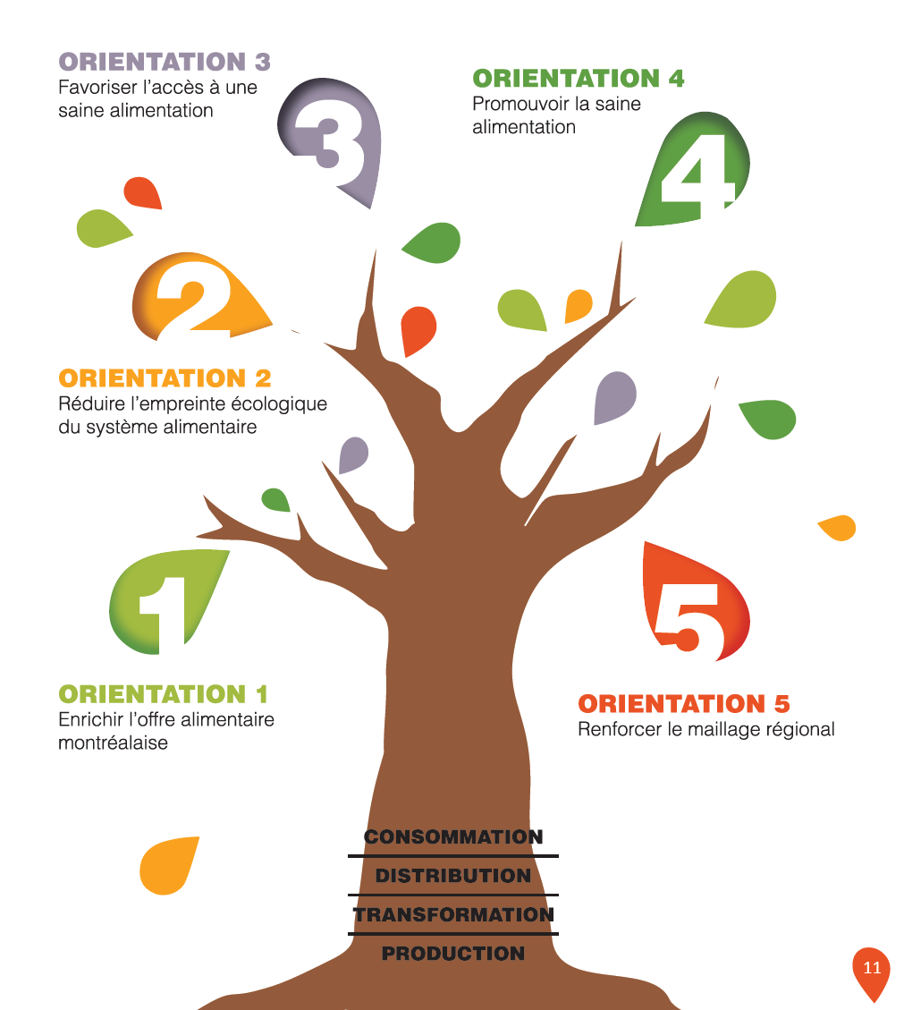

Slide 5
