Slide 1
Edible Activism
Erik Chevrier
September 19, 2016

Slide 2
Food Preparation Activity
You must prepare a food dish for the class
Be weary of different diets
You will write out the recipe and steps to prepare the dish
This will be included on the website
You will discuss the following elements of your dish
Production – How was the food produced (grown, labour, company, use of fertalizers or pesticides)
Transportation – Where did the food come from (how far do the products travel)
Distribution – Where did you acquire the ingredients
Processing – How did you make the food (recipe and steps to prepare the dish)
Health – How healthy are the ingredients?
Environmental sustainability – How sustainable is the food?

Slide 3
Reading Report
1 – Read the chapter and take notes when necessary
2 – Come to class prepared to lead a discussion about the chapter
In your discussion, you should:
1 – Provide a summary of the chapter
2 – Think of some questions or points taken from the article to discuss with the class
3 – Lead a discussion about the readings (should last about 45 minutes)

Slide 4
Nurturing Food Sovereignty in Canada
Some key points:
2.5 million Canadians are food insecure
Biodiversity is rapidly diminishing
Small farms are being replaced by large industrial farms
We are a large agricultural exporter
We also import a great deal of food
Canada is a major contributor to environmental pollution via agriculture

Slide 5
What is Food Sovereignty?
Food security – when all people, all the times, have physical, social and economic access to sufficient, safe, and nutritious food that meets their dietary needs and food preferences for an active and healthy lifestyles.
Food Sovereignty – The right of nations (or communities) and peoples to control their own food systems, including their own markets, production modes, food cultures, and environments.
Food sovereignty refers to sustainable food production and genuine food security are a function of a community-based control over the food system, local, regional, and national strategies are absolutely necessary.
It is a critical alternative to the dominant neoliberal models for agriculture and trade
Takes into consideration the power relations that determine production, distribution and consumption patterns within the food system
Takes into account who owns and controls food production and distribution
Was established at the Second International Assembly of La Via Campesina (1996)
No single model for food sovereignty

Slide 6
Pitfalls of Food Sovereignty in Canada
1 – Canada does not have a long history of farming. Indigenous food production process have been replaced by large scale farming (monocrops).
2 – Large scale agriculture is replacing family farms
3 – The majority of Canadians live in urban centers and do not partake in farming
4 – Canadian farming is mainly set for exportation
5 – Large scale agricultural farms rely on expensive production elements like, machinery, pesticides and chemicals
6 – Canada has signed free trade agreements and follows the rules of neoliberal economies
To achieve food sovereignty in Canada, we must redesign the entire system.

Slide 7
How to be More Food Sovereign in Canada
We should look to the ways of Indigenous people
We should build a food system that is local
We should not harm biodiversity – permaculture instead of monoculture
We should embrace the slow food movement
We should not rely on products and processes that pollute the environment
We need to implement four policy pillars:
The incorporation of agriculture into a comprehensive national food policy
Include a bottoms up policy development process
Constitutional right to food
New agriculture policy oriented towards local food systems and environmental sustainability
We need a paradigm shift

Slide 8
Discussion Questions
Is Dawson a food sovereign campus?
How can we begin to address food sovereignty at Dawson?
What can we do as a class to help Dawson become completely food sovereign?
What local producers are available at Dawson?
Café?
Farms?
Bake sales?

Slide 9
Growing Microgreens
Let’s grow some sunflower greens.
Tasks:
Watering schedule (everyday)
Friday we need to water in the evening
Monday we need to water in the morning
Steps (lightly spray the microgreens every day)
Place sunflower seeds in about an inch of dirt
Lightly dampen the seeds – too much water may cause mold, too little will prevent them from growing
Cover the seeds with a lid until they begin to sprout
Remove the lid and put in the sun
After a week, they are ready to trim and eat

Slide 10
Discussion about the Documentary
Cowspiracy: The sustainability secret
Next documentary ?

Slide 11
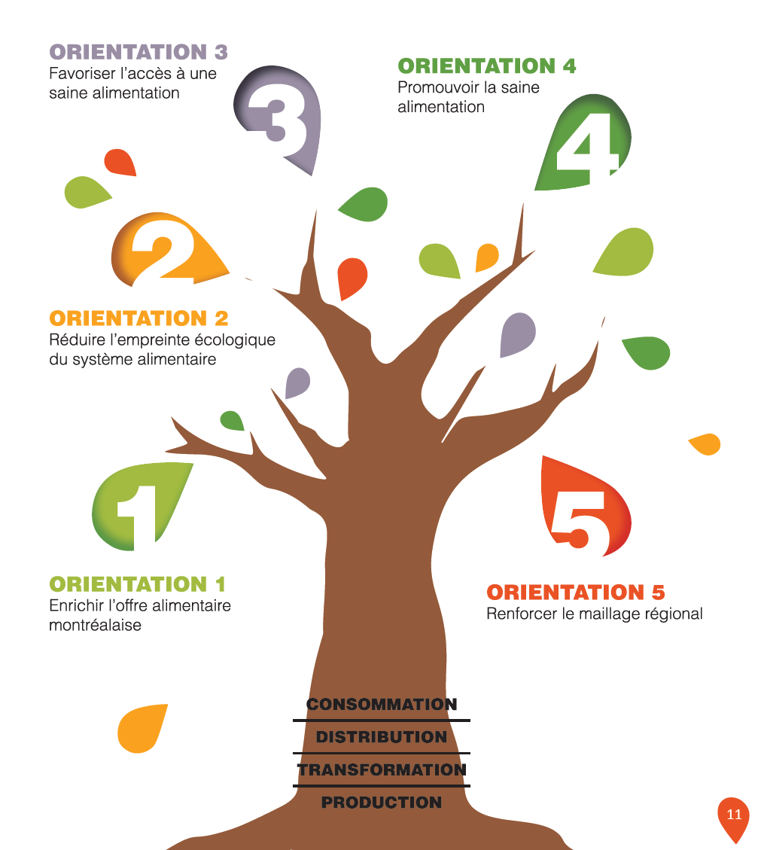

Slide 12
