Slide 1
Edible Activism!
How to understand Advertising
Erik Chevrier
November 14, 2016

Slide 2
Advertising and Food
First MacDonald's Commercial
Nag Factor

Slide 3
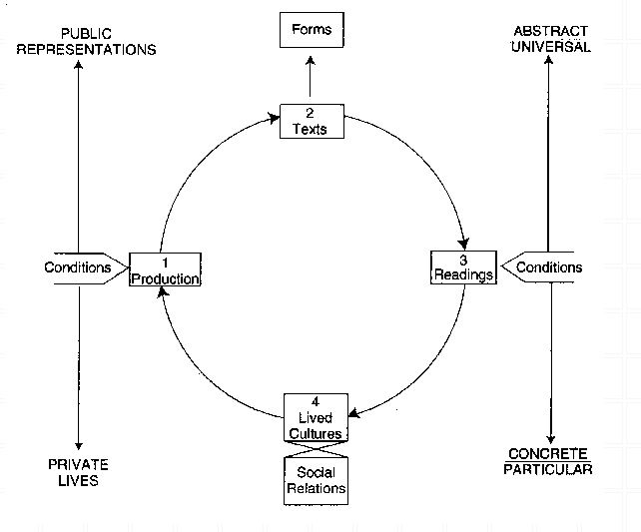
General Framework
Richard Johnson What is Cultural Studies Anyways, Social Text, (1986-87)

Slide 4
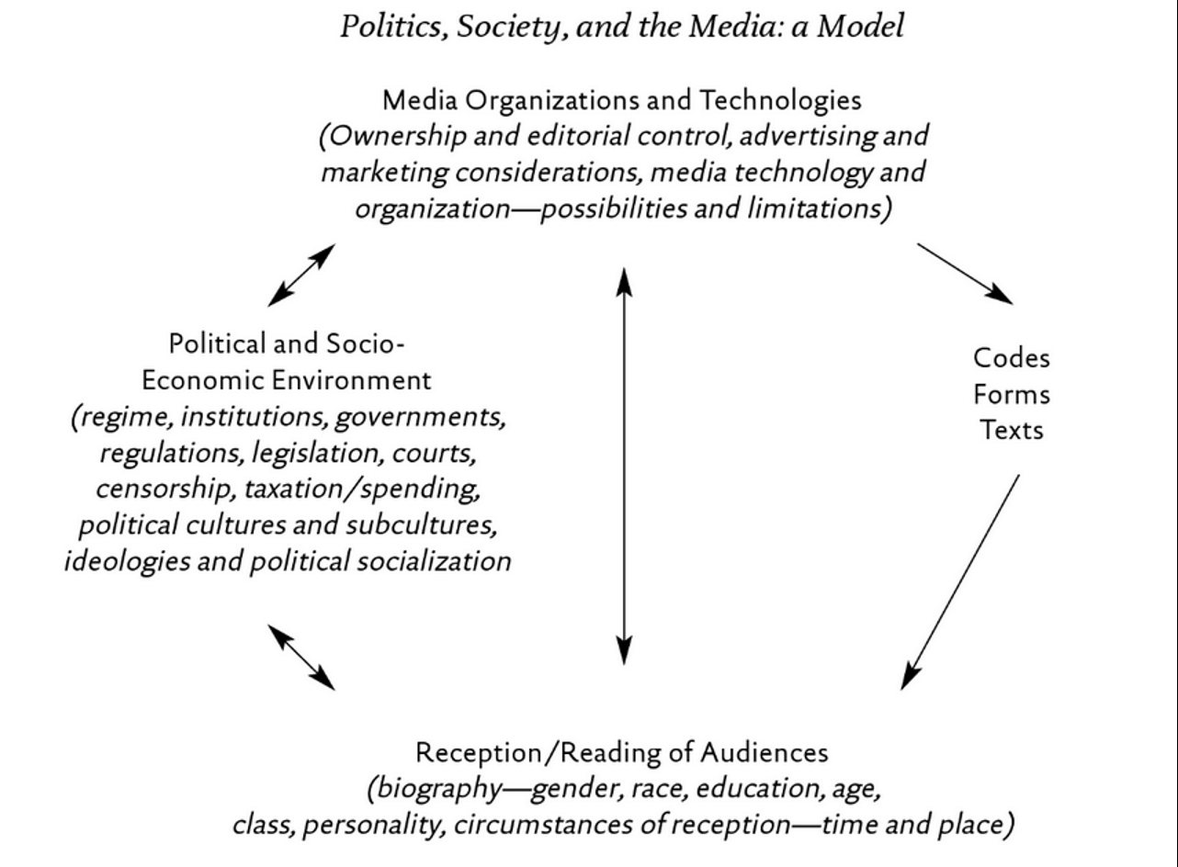
General Framework
Paul Nesbitt-Larking. Politics, Society and the Media (2nd Edition). Broadview Press. 2009.

Slide 5
Compare and contrast ad campaigns!
Dove
Dove Evolution Video
Dove Onslaught Video
Axe
Axe Music Video
Axe Television Ad Diner Party
Axe Television Ad Dentist

Slide 6
General Framework

Slide 7
Analyze the Red Campaign!
Red Campaign
Jimmy Kimmel
Bike Ride with Bono
Red Song
Bono & Oprah News
Bono on Oprah

Slide 8
General Framework

Slide 9
Theories
Bronfenbrenner’s
Bio-ecological Systems Theory

