Slide 1
Edible Activism!
Social Persuasion
Erik Chevrier
November 21, 2016

Slide 2
Activism and Social Persuasion
Effective activists use a variety of social persuasion tools. This class will provide an overview of these tools.

Slide 3
Media Effects
Media effects research usually describes the reception/reading of codes/forms/texts
Receivers are also affected by (and have an effect on)
Media organizations and technology
Political and socio-economic environment

Slide 4
How are you Affected by Media General Examples
Very basic examples of how I can affect your emotional state via video
Example 1
Example 2
Example 3
Small variations in media texts produce different interpretations
Example
People are fallible
Example
What do people learn from media?
Example

Slide 5
Looking at Nesbitt-Larking
Moral panic
Magic bullet/hypodermic
War of the Worlds
War of Worlds follow up
Manufacturing Consent
Colin Powell Speech about Weapons of Mass Destruction
Leni Riefenstahl’s Triumph of Will – Nazi Propaganda Video
Donald Trump Pledge
Limited effects/uses and gratifications
Two-step communication flow/discursive elaboration
Selective attention/cognitive beliefs/selective recall
Critical perspective
Freedom within determining conditions
Personality
Polysemic
Gendered reading formations
Ontological
Engagement with Media

Slide 6
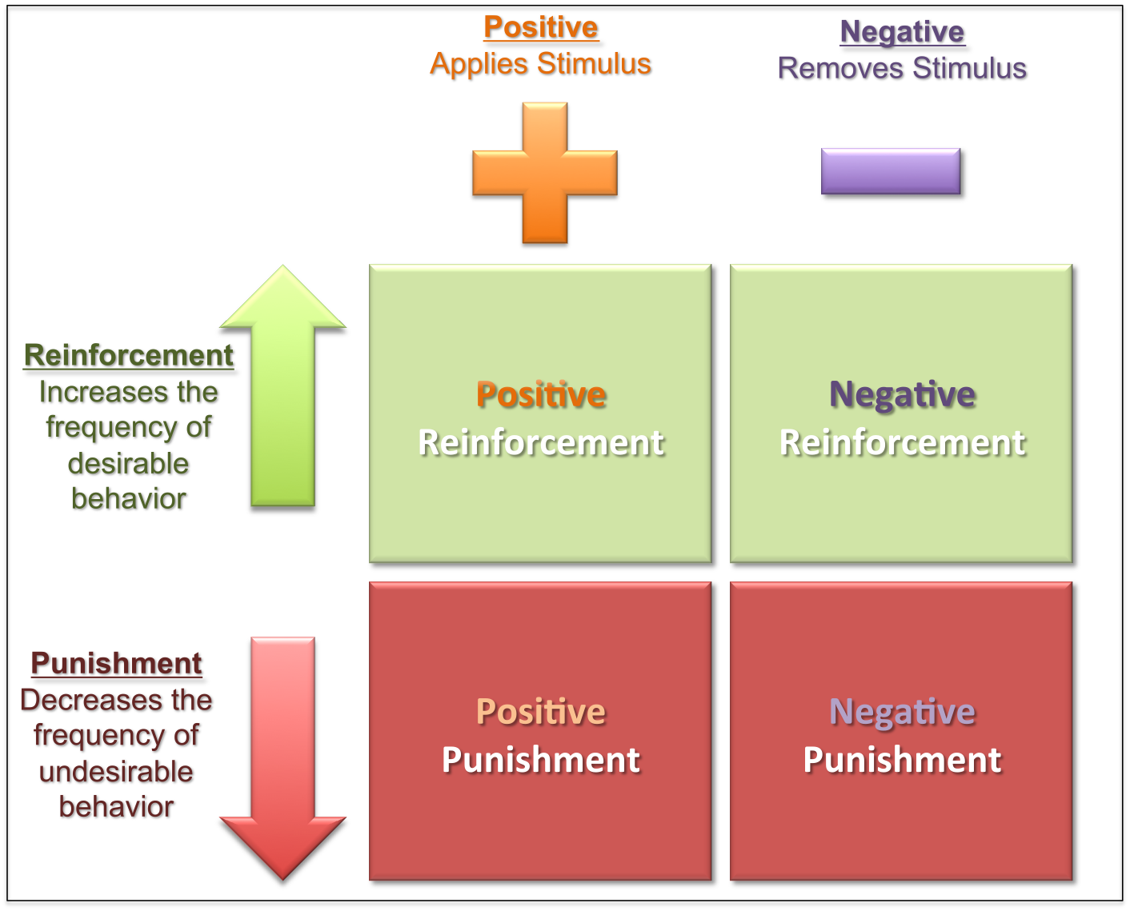
Learning Theories
Social modeling
Operant conditioning
Classical conditioning
Internal vs external motivation

Slide 7
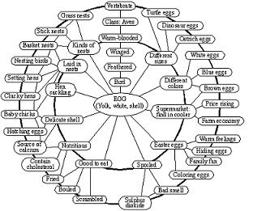
Priming/Framing/Schema
Cognitive Model
Schema

Slide 8
The Psychology of Influence
Robert Cialdini
Six weapons of influence
1 – Reciprocation
2 – Commitment and consistency
3 – Social proof
4 – Liking
5 – Authority
6 – Scarcity

Slide 9
The Power of Suggestion
An Inquiry Into How People Are Affected by Profuse Amounts of Publicity: A Multidisciplinary Approach
Advertising as a suggestion – Page 26
Suggestions can bypass critical thought because there is no direct request to conflict with

Slide 10
Changing Values and Attitudes
Values:
Desirable, trans-situational goals, varying in importance, that serve as a guiding principles in people’s lives
Attitudes:
An internal state that, given the occurrence of certain stimulus events, will ultimately result in some sort of response or behaviour.
Cognitive dissonance:
Cognitive dissonance is a state of psychological tension occurring when thoughts, beliefs, attitudes, and/or behaviours are in conflict with each other.
Key Factors:
Ratio of dissonance Importance of factors in dissonance
Avoiding dissonance
1 – Modify 2 – Change importance 3 – Rationalize 4 – Add new consonant beliefs to bolster

Slide 11
Compliance Techniques
Foot in the door: An individual who agrees to carry out a small request is subsequently more likely to agree to carry out a larger request
Door in the face/reciprocal concessions: When the person making the larger request reduces it to a smaller one, the other person feels obliged to make a matching concession
Low-ball/bait and switch: When an agreement is made, the offer reduces in value
Improving the deal: When a product is offered at a high price, then after a brief pause, another product is offered to the deal or the price is reduced
Guilt: People comply to reduce feelings of guilt

Slide 12
Factors that Help Influence
Groupthink
In group vs out group
Conformity to group
Social Roles – Stanford prison experiment
Physical Factors
Appearance/attractiveness
Likability
Similarities
Non-verbal communication
Emotional Appeal
Fear
Sadness
Embarrassment
Confidence
Savvy Media Consumer Appeal:
Honest about media influence
Contagion:
When large crowds form, people may behave in ways that is extreme and unlike their normal behaviour

