Slide 1
Edible Activism
What is an economy?
Erik Chevrier

Slide 2
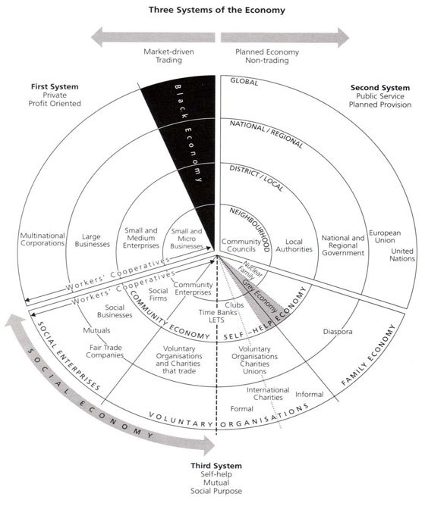
Social Economy

Slide 3
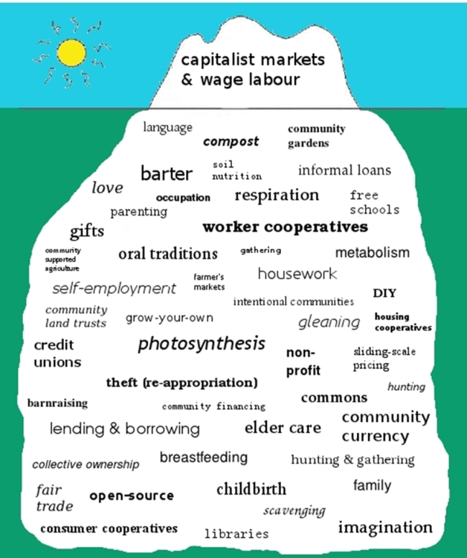
Diverse Economy

Slide 4
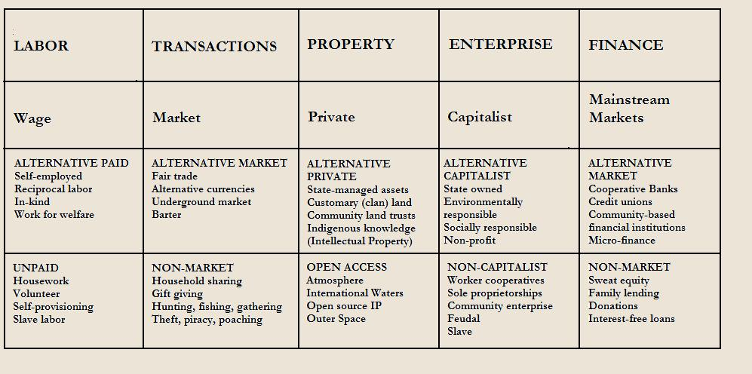
Diverse Economy

Slide 5
Polanyi
Reciprocity
Redistribution
Markets
Householding

Slide 6
Marx – Money & Value
C-C
C-M-C
M-C-M’
M-M’

