Slide 1
Media, Technology and Politics
Introduction
Erik Chevrier
June 28, 2017

Slide 2
Erik Chevrier
Erik Chevrier Website
Projects:
Coop Collective Vision
Concordia Food Groups Research Project
Concordia Against Austerity
Research for the CSU on Concordia’s Investment Practices
Masters Thesis:
How Individuals are Affected by Profuse Amounts of Publicity: A multidimensional approach

Slide 3
Who are you?
What is your name?
What is your program major and minor?
What is your level of knowledge about media technology and/or politics?
Why are you interested in this course?
What do you want to get out of this course?
Where do you get your news media? What kind of media platforms do you use? How much time do you spend with different media platforms?

Slide 4
Course Overview
Politics and media studies are interrelated and multifaceted topics. Newspapers, radio, TV, and the internet are some of many media forms that carry messages about political ideas, social relations and prevailing power structures. Signs and symbols can be creative and/or coercive. They can be used to educate people about world issues so that people can participate in political platforms as informed citizens; however they can also be used to misinform the public in order to manage public opinion and push a specific political agenda. A variety of political actors, such as political parties, pressure groups, people with wealth and influence, and concerned citizens everywhere use media to their advantage – some with more, others with less success.
Changes in technology have revolutionized the social, economic and political landscape. Global communication has been facilitated by the proliferation of portable communication devices and social media platforms. Internet sites, like Facebook and Twitter have allowed people to become amateur journalists and political commentators. In 2014, in Ferguson, Missouri, protesters themselves broadcast the demonstrations against police brutality allowing the world to witness their uprising; recently in Syria, civilians have been livestreaming the aftermath of the bombing campaigns and gas attacks; even the president of the U.S.A Donald Trump, has been informing citizens about policy reforms and executive orders via Twitter.
In this course, we will examine the interaction between politics and media by looking at how technological changes in communication has shaped political life. We will use a multidimensional framework considering the complex relationship between media producers, spectators, messages and technologies as well as the political and socio-economic environment from which media is produced and received.
In this course, we will address questions like: What is the key to effective media management? Who controls what gets onto the media and what gets excluded? What makes something newsworthy? Why are some issues covered and many others ignored? How does the media shape our political culture, our minds and identities as a people? What can we do to ensure, that this instrument that plays such a powerful role in the formation of our political consciousness, remains fair, and factual? How can we ensure that the media does not fall into the hands of those who are driven by selfish or vested interests?

Slide 5
Learning Objectives
By the end of this course, students will:
- Understand the complex inter-relationship between the media and politics and the impact of technological changes on democratic governance
- Be sensitive to the language of political deception, the use of illusion as an instrument to manufacture consent
- Understand the use of marketing, advertising, public relations, public opinion research as tools of political persuasion
- Be familiar with the ideas of the most significant theorists in this field
- Know how the news agenda is set and how media managers filter the news
- Understand the emerging role of the internet in the political electoral process
- Have explored ways to enhance the social responsibility of the media

Slide 6
Pedagogical Methods
Lectures
Guest Speakers
Class Participation
Class Activities
Community Service Learning
Interacting with various media campaigns/sources

Slide 7
The Course Evaluation
Exam 1 30%
Exam 2 30%
Short Paper 20%
Group Project 15%
Class Participation 5%

Slide 8
Course Materials
Course Materials and Text:
Students are expected to complete ALL the designated readings and watch ALL of the assigned videos BEFORE EACH CLASS. Students are also expected to attend ALL classes, and participate in class discussions.
The required readings for this course is contained in a course-pack available at the library bookstore. Please see the course schedule below for the dates the readings are due.
The professor’s power-point lecture notes will be posted on the course site on a weekly basis before each class.
Students are required to watch at least two of the following documentary movies:
The Century of the Self (2002) – Adam Curtis
The Persuaders (2003) – Barak Goodman and Rachel Dretzin
Manufacturing Consent (1992) – Mark Achbar and Peter Wintonick
Control Room (2004) – Jehane Noujaim
Operation Hollywood (2004) – Emilio Pacull
This Film is Not Yet Rated (2006) – Kirby Dick
We are Legion: The Story of Hacktivists (2012) – Brian Knappenberger

Slide 9
Schedule
This is a TENTATIVE schedule and is subject to change. Be sure to consult the course website regularly to be aware of any changes.
June 28th Introduction
Nesbitt-Larking, P. (2009) Politics, Society and the Media (2nd Edition), Broadview Press. (Pages 15, 16 and 17)
July 3rd History of the Canadian Mass Media
Vipond, M. (2011) The Mass Media in Canada (4nd Edition). James Lorimer & Company. (Chapters, 1, 2 and 3)
July 5th Media Ownership and Concentration in Canada
Winseck, D. (2016) Media Ownership in Canada. In Who Owns the World’s Media, Oxford University Press. (Chapter 17)
Guest - Steve Faguy: Fagstein Blog (Media Ownership) http://blog.fagstein.com/
July 10th Media in the Political, Socio-Economic Environment
Nesbitt-Larking, P. (2009) Politics, Society and the Media (2nd Edition), Broadview Press. (Chapter 4)
Taras, D. (2015) Digital Mosaic; Media, Power and Identity in Canada, University of Toronto Press, (Chapter 1)
Guest – Ethan Cox: Ricochet, Alternative Media – https://ricochet.media/en
July 12th State and Political Regulating of the Media
Nesbitt-Larking, P. (2009) Politics, Society and the Media (2nd Edition), Broadview Press. (Chapter 6)
July 17th Mid-Term Exam

Slide 10
Schedule
This is a TENTATIVE schedule and is subject to change. Be sure to consult the course website regularly to be aware of any changes.
July 19th Group Project – Short Paper Due
July 24th Media Organizations
Nesbitt-Larking, P. (2009) Politics, Society and the Media (2nd Edition), Broadview Press. (Chapter 7)
Guest – Sarah Deshaines – Station Manager at CJAD
July 26th Construction and Deconstruction of Texts
Nesbitt-Larking, P. (2009) Politics, Society and the Media (2nd Edition), Broadview Press. (Chapter 9)
July 31th Media Effects – Politics of Reading
Nesbitt-Larking, P. (2009) Politics, Society and the Media (2nd Edition), Broadview Press. (Chapter 10 & 11)
Taras, D. (2015) Digital Mosaic; Media, Power and Identity in Canada, University of Toronto Press, (Chapter 4)
August 2nd Media, Technology and Privacy
Dwyer, T., (2016), Convergent Media and Privacy, Palgrave MacMillan. (Chapter 5)
Goggin, G. (2012), New Technologies and the Media, Palgrave MacMillan. (Chapter 2)
Taras, D. (2015) Digital Mosaic; Media, Power and Identity in Canada, University of Toronto Press, (Chapter 5)
Guest – Lex Gill
August 7th Group Presentations

Slide 11
What is media?
Media is a pleural noun that describes a form of communication
Media are vehicles for the transmission of meaning
Media consist of a vast array of signs and symbols
Popular media forms consist of:
Television
Internet
Radio
Music
Newspapers
Movies
Phones
Tablets

Slide 12
General Framework
Richard Johnson What is Cultural Studies Anyways, Social Text, (1986-87)

Slide 13
General Framework
Paul Nesbitt-Larking. Politics, Society and the Media (2nd Edition). Broadview Press. 2009.

Slide 14
Compare and contrast ad campaigns!
Dove
Dove Evolution Video
Dove Onslaught Video
Axe
Axe Music Video
Axe Television Ad Diner Party
Axe Television Ad Dentist

Slide 15
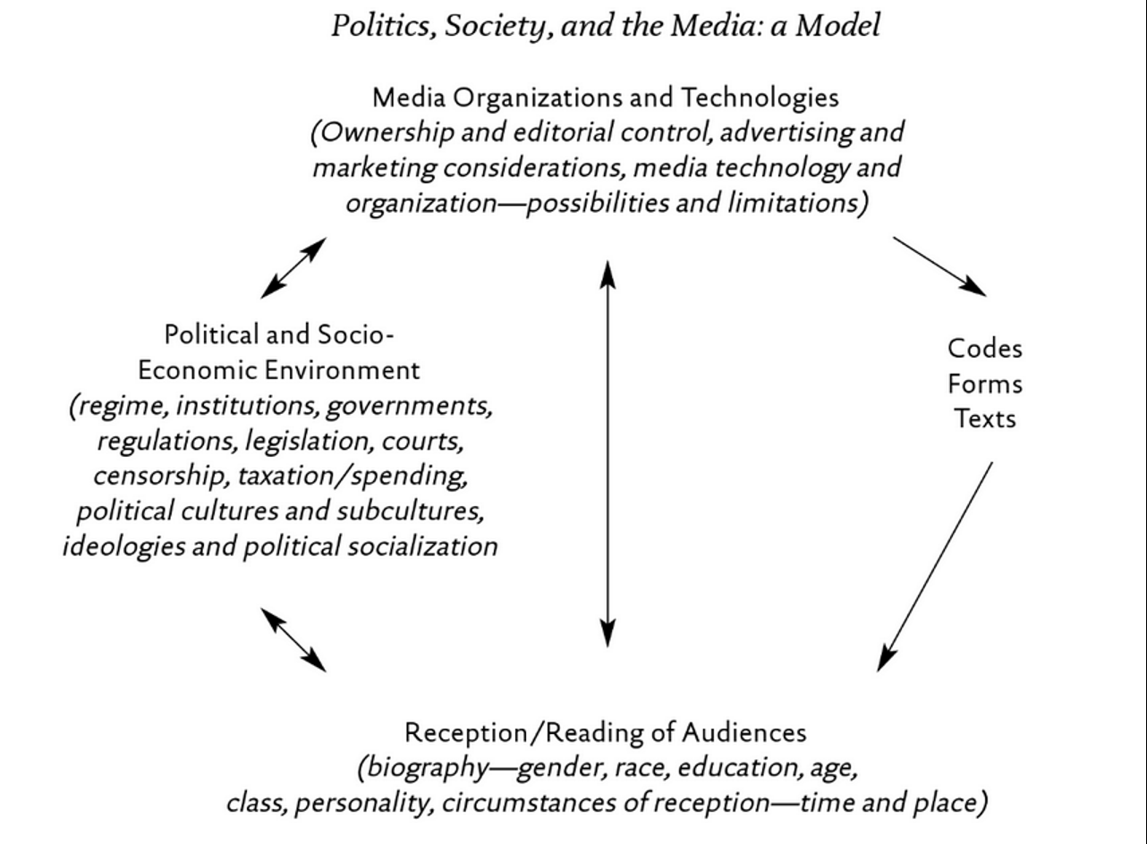
General Framework

Slide 16
Analyze the Red Campaign!
Red Campaign
Jimmy Kimmel
Bike Ride with Bono
Red Song
Bono & Oprah News
Bono on Oprah

Slide 17
General Framework

Slide 18
Addressing False Assumptions
There is a liberal bias in the media
People are brainwashed by the media
The mass media controls how people think
We should be careful of subliminal messages
Advertising has no effect on me
The goal of news media is to provide balancing points of view in every story
Watching violent media will make you a violent person
News media is just propaganda
I am really smart therefore, media does not affect me at all
CNN is ‘Fake News’ – as suggested by Donald Trump

Slide 19
The General Realities of Media
Media organizations are not all the same, they complete with each other for your attention
Media forms change with advances in technology – Advances in technology shape social and political spheres
People are active agents and capable of deciphering complex messages
Perceptual biases and cognitive overload lead us to make judgement errors
Media organizations are devising sophisticated tools to make their messages more effective
Media sources direct our attention to specific messages and suggest how to think about these topics
Media produces and reflects the socio-economic conditions in society
Both the left and right use an array of propaganda tactics
Media is a key factor in social movements
Advertising revenue is a key factor that determines what media gets produced
Media can produce an array of visceral responses
A proper analysis of media messages evaluate what is shown as well as what is left out

Slide 20
Characteristics of ‘Media Shock’(Taras, 2015)
1 – Media changes rapidly and suddenly 2 – Web-based media have permeated virtually every aspect of life 3 – Individuals can alter top down flows of information 4 – There is a greater concentration of media than ever before 5 – Media is converging 6 – Traditional media is loosing audience 7 – Television continues to dominate public and cultural life but in radically new ways 8 – Media facilitates global communication 9 – Social media have created a new cultural, business and political dynamic 10 – Government, political parties and corporations are gathering vast amounts of personal information

Slide 21
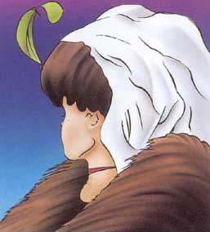
Perception of Media is Subjective

Slide 22
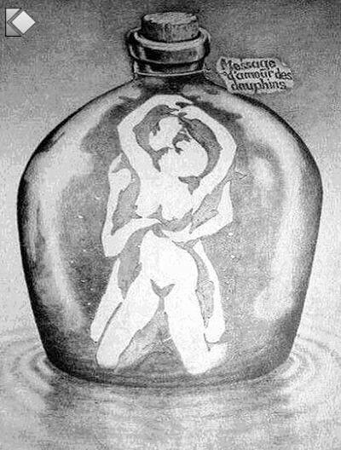
Perception of Media is Deceptive

Slide 23
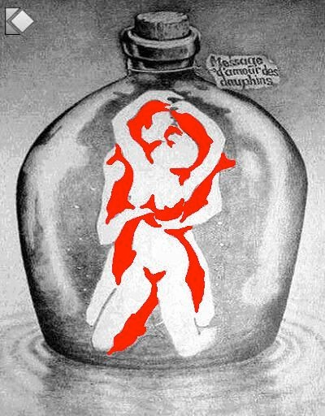
Perception of Media is Deceptive

Slide 24
Media can cause Visceral Reactions
Experiment 1
Experiment 2
Experiment 3

Slide 25
Sometimes we cannot see what’s right in front of us!

Slide 26
Thanks!
Questions?

