Slide 1
Media, Technology and Politics
Media Organizations
Erik Chevrier
July 19, 2017

Slide 2
What is Newsworthy?
What makes a story newsworthy?

Slide 3
Objectivity vs Bias

Slide 4
Media As a Business
Subject to:
Discipline of the market
Laws of the Land
Cultural and ideological rules of the land
Media organizations have:
Corporate structures
By-Laws
Board of Governors
Erving Goffman
Official and unofficial bureaucracy
Gaye Tuchman
Journalists don’t always like to admit that they are not in control
Media anchors are touchy about objectivity
Presentation of facts – 5 Ws
See next slide for a more elaborate explanation
Edward Jay Epstein
These critical demands structure the scope and form of the news
Budgetary constraints
Sustain the interest of the audience (flow of programming)
Government and its actions establish general parameters that condition news
To break away from organizational filters you need to tell a great story and attract an audience
Peter Desbarats
News professionals rely on instinct and gut feeling
They don’t always like to share trade secrets (competition)
Guilt for questionable practices

Slide 5
The Credibility of a Journalist
Journalists are touchy about objectivity (Tuchman)
They defend attacks on objectivity via: 1 – Presentation of both sides of a story even if facts cannot be verified 2 – Presentation of supporting evidence to back up weaker evidence 3 – Judicious use of attempts to separate opinions expressed from the reporters own 4 – The use of ‘expert’ opinion 5 – Presentation of the most facts regarding the 5Ws
Tuchman Objectivity, given the incredible pressures of deadlines, are mere rituals to cover news professionals against attacks on their bias.
- who gets a voice and who does not?
Over and above assigned reading

Slide 6
Structure of Media Organizations
Media organizations can be conceptualized as consisting of four principal classes:
1 – The upper class: Large scale owners and senior managers
2 – Media working class: Routine tasks of media work; sound recording, cleaning up, etc.
3 – Middle class professionals: Journalists, managers, production staff
4 – Self employed independent journalists

Slide 7
The ‘Media Factory’ (Nesbitt-Larking)
Suppliers of raw materials – Those whose daily practices produce the requisite news value to be registered as eligible for inclusion. Those more elevated in social status usually get more priority.
Builders of news machinery – Technical operatives who make it possible for experience to be converted into editorial.
Suppliers of liquid capital – Those who invest in and purchase the services of media enterprises.
Principal owners and bosses – Allocative vs operational owners
Workers (and semi-employed workers) – Those doing the groundwork
State inspector – The regulator
Costumers – Those who engage with media
Those affected by externalities – The general public
Over and above assigned reading

Slide 8
The Bottom Line - Profit
Since media are businesses, they sell viewers to advertisers
They MUST satisfy their shareholders
They are mindful of how to please audiences and construct stories that ‘sell’
A great deal of energy is put into attracting and keeping audiences
Flow is important
Newsrooms must continuously construct products ‘news content’
The business is fast pace and deadlines are strict
Stories are relatively simple
Stories follow a typical story structure – beginning, middle, end, conflict, resolution

Slide 9
Making a Story Newsworthy
More of an art than a science
Make sure your story is relevant to the current time
Stage an event – events attract news
Write a press release – spin your piece into a newsworthy story
Organize a press conference around your event – invite an array of journalists (you’ll need contacts)
Prepare newsworthy soundbites
Follow up with journalists – keep their contact information

Slide 10
An Example of a Newswire Posts
Canadian Newswire
Example of a Newswire Story
How was the story covered?
Montreal Gazette

Slide 11
Selling the System
Media are in the business of selling views to advertisers
Advertisers are in the business of selling products to viewers
Media is the vehicle to transmit commercial messages
Media has become an important player in organizing consumption
Product placement
Lifestyle advertising
Event marketing
Anxiety advertising
Keeping up with the Jonses

Slide 12
News Gatekeeping, Agenda Setting, Framing & Priming
Attention and awareness are important
Reporters often repeat key words, phrases and/or sayings
New stories can be found on newswires and recycled or tweaked
Priming effect
The power of words in regards to memory
Context can make us understand things in specific ways
Advertising and priming – page 18

Slide 13
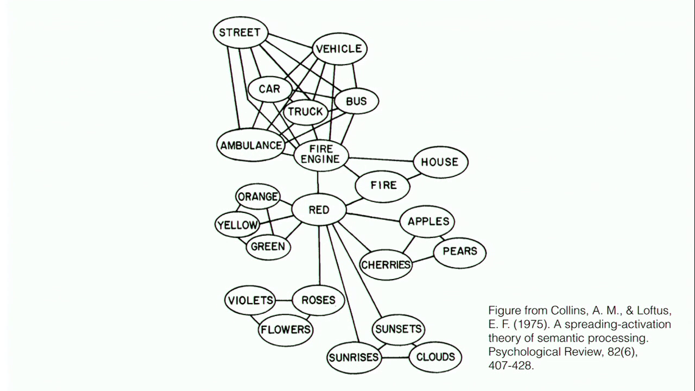
Priming/Framing/Schema
Cognitive Model
Semantic Processing – Spreading Activation

Slide 14
Tactics to Resist the Influence of Agenda Setting (Nesbitt-Larking)
You can tune messages out
Be on the lookout for slogans and clichés
Be alert of infotainment techniques
Remind yourself about the artificial nature of news broadcasts
Talk back to news pieces
Understand what has been ignored or downplayed
Understand what voices are missing
Understand what is said to be impossible
Understand if the news piece favors a conventional idea of the elite
Demand better news content
*Become a producer of news yourself
Over and above assigned reading

Slide 15
Effects of Advertising
Erik Chevrier’s Masters Thesis: An Inquiry into How Individuals are Affected by Profuse Amounts of Publicity

Slide 16
Guest Speaker
Sarah Deshaines – July 24th
Radio Producer art CJAD
Formerly worked art CKUT, CUP and The Concordian

Slide 17
CJAD Organizational Structure
Owned By Bell Media
Bell owns 105 stations
CJAD
Bell Media
Bell Media Executives
BCE
BCE Corporate Structure

Slide 18
Thanks
Questions?
Reminder: You need to bring your bibliography to class on July 24th
You may hand in your short paper on July 26th – This is the final extension
You will get back your exams on July 26th

