Slide 1
Media, Technology and Politics
The history of Canadian mass media
Erik Chevrier
July 3rd, 2017

Slide 2
General Framework
Paul Nesbitt-Larking. Politics, Society and the Media (2nd Edition). Broadview Press. 2009.

Slide 3
Analyze the Red Campaign!
Red Campaign
Jimmy Kimmel
Bike Ride with Bono
Red Song
Bono & Oprah News
Bono on Oprah

Slide 4
Important Questions
Who owns the means of production in communication?
What is the political and economic environment?
What technological advances have occurred?
What communications infrastructure has been built?

Slide 5
General History of Media
Rituals/oral history/drawings/festivals
1300s – Moving metallic types
1400s – Printing press
1900s – Radio
1880s – Motion picture
1920s – Motion picture with sound
1950s – Television
1980s – Internet
1990s – Proliferation of Telecommunications

Slide 6
General Outlook of History of Canadian Media
Aboriginal communication until colonization
Colonizers replace traditional aboriginal communication
Feudalism is changing to capitalism
United States colonies declare independence from Brittan
Loyalists clash with reformers in Canada
Canada is concerned about American media intrusion
English and French clash over status of Quebec and language
Development of public broadcasting corporations and regulators
Neo-liberalism: shifting away from publicly funded broadcasting
Private media concentration

Slide 7
Precolonial History of Media
Aboriginal Populations
Appropriation of voice - Lee Maracle
Reclaiming voice – Idle No More Flash Mob Round Dance
Oral Tradition Icons/symbols Rituals/festivals Music/singing Elder knowledge The means of communication do not belong to anyone
Inukshuk (1970) First attempts to create Inuit film and video production centers in the North to counter the negative impact of American television on young Inuit audiences.

Slide 8
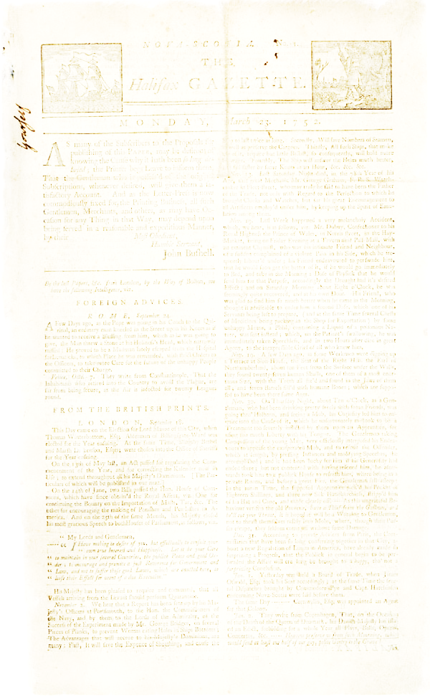
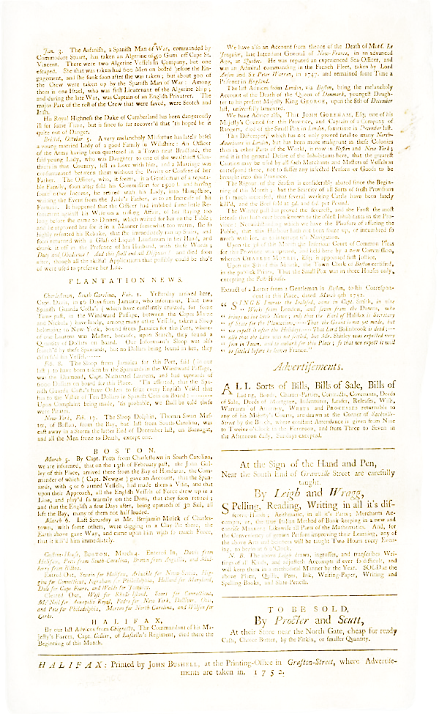
Foundation of Newspapers in Canada
French settlers were largely illiterate – communication mainly oral
In 1759, British overpower French in their stronghold terrorises
1752 – Halifax Gazette – John Bushell
1785 – Christopher Sower became King’s Printer for New Brunswick
Late 1800s – British North America established a limited number of gazettes in a variety communities including Montreal, Halifax and Quebec.
1800 - 1810 – Independent press began
Irish Vindicator (1828)
Colonial Advocate (1824)
Funding began coming from subscriptions and advertising
Most owners were writers and printers

Slide 9
Nineteenth Century Political Culture and Media
Loyalists vs reformers
Reformers include:
William Lyon Mackenzie
Bartimus Ferguson
Joseph Howe – Charged with libel and acquitted
Amor de Cosmos
About ¼ of the participants at the Charlottetown Conference were journalists, editors and publishers
1843 – Defendants can defend libel by demonstrating the truth

Slide 10
Technology & Media in the 1800s
1800- 1867: Small scale competition among a plethora of small operators
Means of producing media were expensive, therefore owned by wealthy individuals
Advances in technology lead to advances in media production in Canada:
1750 Printing press – printing plates
1840 – 1850s - Telegraph & Trans Atlantic cable 1840 – 1850s
1868 – Typewriter (slugs) – stereos (stereotyping)
Late 1800s – Media companies depended upon innovation, advertisers and readers
Newspaper owners become more concentrated
1880 – 1920s – Universal suffrage

Slide 11
Beginnings of a Mass Media
1900 – Increase size and circulation of news print media 1900-1910 – Radio becomes established 1913 – 138 daily newspapers each with their own publisher 1902-1914 – Development of movie theatres 1918 – First popular radio broadcast: WXA broadcast of a public lecture given to the Royal Society of Canada 1920s – Advertising revenue becomes important to decrease cost of subscriptions – Writing improved (fact checking) – Writing became more neutral because media companies competed for market share
1931 – 1/3 of Canadians had a radio 1940 – ¾ Canadians have radios 1950 – Radios universal – 3600 Canadians had televisions 1960 – ¾ people had television sets 1970 – 116 Daily papers but far fewer publishers 1980s – Canadians begin to connect to the internet Today – Media Ownership Chart

Slide 12
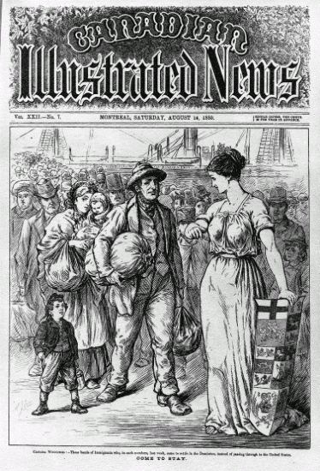
Media and Nation Building in Canada
First wave – Print and telegraph allowed people to communication across distances, to other communities. Print also was used to advertise Canada.
Second wave – Between east and west in 1930 & 40s.
Four distinct factors contributed to each wave of nation building:
Canada was becoming more independent from Brittan
Each Canadian public policy action was in part a reaction to American presence
Influence of the state in building communication infrastructure
Canada was growing internally and establishing its own roots

Slide 13
Emergence of Broadcast Regulations
Public vs Private
1929 – John Aird Commission on the future control, organizations and financing of broadcasting
Canadians want Canadian programming
Should be controlled by the public and not private interests
Series of 50 000-watt public transmitting stations should be set up across the country
Public broadcasting company; revenues from licence fees, indirect advertisements & government subsidies
Opposed by the Canadian Association of Broadcasters (CAB)
1930 – Canadian Radio League
Promote Canadian broadcasting (CRL)
1932 – First Broadcasting Act - Canadian Radio Broadcasting Commission (CRBC)
Became the Canadian Broadcasting Corporation (CBC)
Bilingual

Slide 14
Emergence of Broadcast Regulations
Prime Minister Bennett vs Mackenzie King & Mr. Sage Advertisements
In 1936 – CRBC to CBC
Political broadcasts were banned
CBC was given the mandate of:
Producing radio broadcasts
Regulating private radio stations
Because of funding cuts in 1953, the CBC became a government/semi-independent hybrid in 1958
Société du Radio Canada (SRC) was founded in 1941
Broadcasting acts from 1932 – 1965 promoted national unity and cultural exchange between linguistic groups
Fowler Committee Report 1965 – CBC does not represent French Canada properly – private stations provide external content
1991 Progressive Conservatives removed national unity mandate
Maintaining it artificially and violation to freedom of expression
Provisions for rights of aboriginal peoples to broadcast in aboriginal language
Television North Canada (1999) Aboriginal Peoples Television Network
Beginning of deregulating the media in Canada
Government can overrule CRTC decisions
2003 Standing Committee on Canadian heritage – Two nations approach

Slide 15
Development of the CRTC
The CBC was under scrutiny for being a regulator and competitor to private broadcasting companies
1949 – Massey Commission determined that broadcasting should be directed and controlled by the public through a body that answers to parliament.
Advent of television was too much for Canada to regulate
1958 – Diefenbaker's Progressive Conservatives passed 1958 Broadcasting Act and created the Board of Broadcast Governors (BBG) to arbitrate between CBC and competitors. CBC funds were also restricted
1968 – Canada Radio and Television Commission (CRTC)

Slide 16
CRTC Mandate
1968 – The CRTC was set up to:
Make regulations governing broadcasting
Issue broadcasting licences
Administer policy
Five substantive facets that allowed the CRTC to pursue its mandate:
Nurture and develop Canadian programming (values, ideas, visions)
Promote the culture, social and economic fabric of Canada
Be reflective of Canadas basic political culture (linguistic, multicultural, gender, and aboriginal)
Promote use of Canadian talent
Balance information, entertainment
CRTC was bullied and swayed by private interests
1998 – CRTC requires 50% Canadian contend television shows between 6PM and midnight and 35% Canadian radio content

Slide 17
Canadian Film Industry
1939 – National Film Board
1967 – Canadian Film Development Corporation
1983 – Telefilm Canada

Slide 18
Globalization and Canadian Media
Media corporations are global multinational companies
Funding to Canadian public broadcasting is being continuously reduced
Media corporations in Canada have changed ownership frequently over the last 15 years
A few powerful corporations control most of the media in Canada

Slide 19
Discussion
Are you in favour of a more public , private or hybrid media system?
Why, or why not?

Slide 20
Media Producers
Who are the producers of media in Canada?

Slide 21
Thanks!
Questions or concerns?

