Slide 1
Media, Technology and Politics
Media effects
Erik Chevrier
July 31, 2017

Slide 2
Media Effects
Media effects research usually describes the reception/reading of codes/forms/texts
Receivers are also affected by (and have an effect on)
Media organizations and technology
Political and socio-economic environment
Media Organizations and technologies are affected by (and have an effect on)
Political and socio-economic environment
Receivers (audiences)
McLuhan – The Medium is the message
Machines are an extension of our human experience and bodily sensations

Slide 3
How are you Affected by Media General Examples
Very basic examples of how I can affect your emotional state via video
Example 1
Example 2
Example 3
Small variations in media texts produce different interpretations
Example
People are fallible
Example
What do people learn from media?
Example

Slide 4
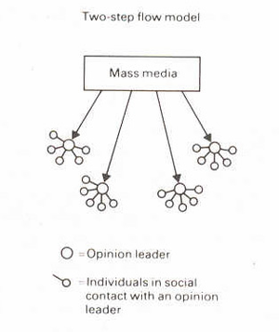
Looking at Nesbitt-Larking
Moral panic
Magic bullet/hypodermic
War of the Worlds
War of Worlds follow up
Manufacturing Consent
Colin Powell Speech about Weapons of Mass Destruction
Leni Riefenstahl’s Triumph of Will – Nazi Propaganda Video
Donald Trump Pledge
Richard Spenser – Hail Trump Video
Limited effects/uses and gratifications
Two-step communication flow/discursive elaboration
Selective attention/cognitive beliefs/selective recall
Critical perspective
Freedom within determining conditions
Personality
Polysemic
Gendered reading formations
Ontological
Engagement with Media

Slide 5
Media Fantasy Becomes Reality
Jean Baudrillard
The media – especially when the content is fictional and fantastic – are more real than the world they proport to represent.
The symbolic structure of the media is so powerful that the meaning is dissolved as mere content is relegated to the demands of form.
Verisimilitude - They appear to be real.
Mark Poster
Mediation is becoming so intense and worked over that ‘reality’ is consistently in question
Nesbitt-Larking
Forms that blend reality:
Infotainment
Docudrama
‘Faction’ – blending fact from fiction
Reality television
News/entertainment spoof

Slide 6
How to Propagate Effectively
The next section is an overview of leading theories regarding factors that help influence people.
If you will be involved in political campaigning or devising media strategy, you should utilize some of the following methods.
The power of words in regards to memory

Slide 7
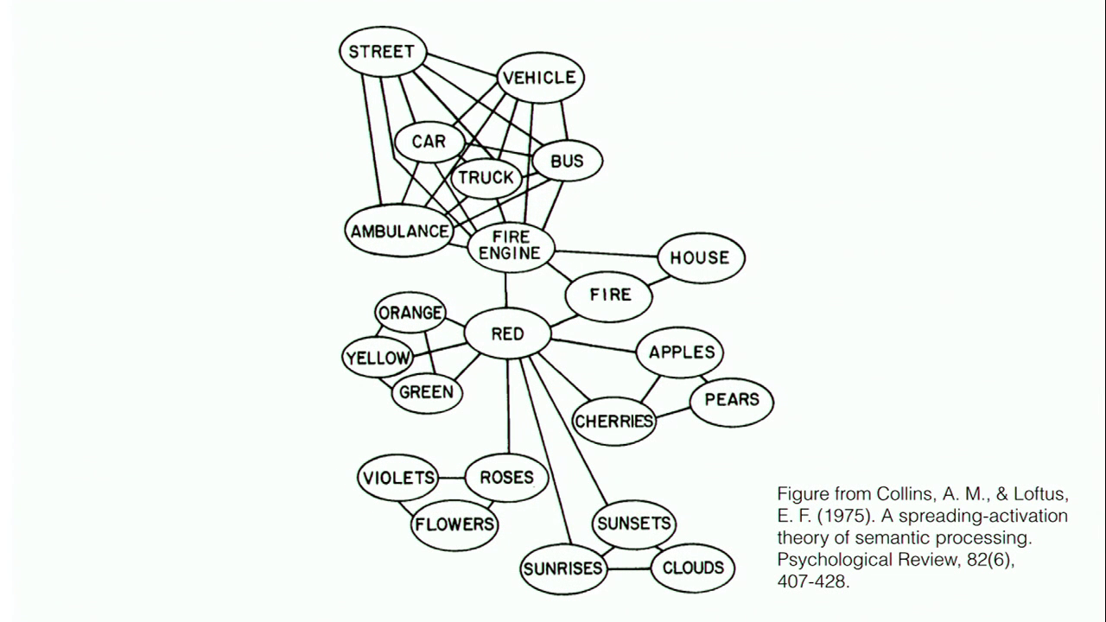
Priming/Framing/Schema
Cognitive Model
Semantic Processing – Spreading Activation

Slide 8
The Power of Suggestion
An Inquiry Into How People Are Affected by Profuse Amounts of Publicity: A Multidisciplinary Approach
Advertising as a suggestion – Page 26
Suggestions can bypass critical thought because there is no direct request to refuse

Slide 9
The Psychology of Influence
Robert Cialdini
Six weapons of influence
1 – Reciprocation
2 – Commitment and consistency
3 – Social proof
4 – Liking
5 – Authority
6 – Scarcity

Slide 10
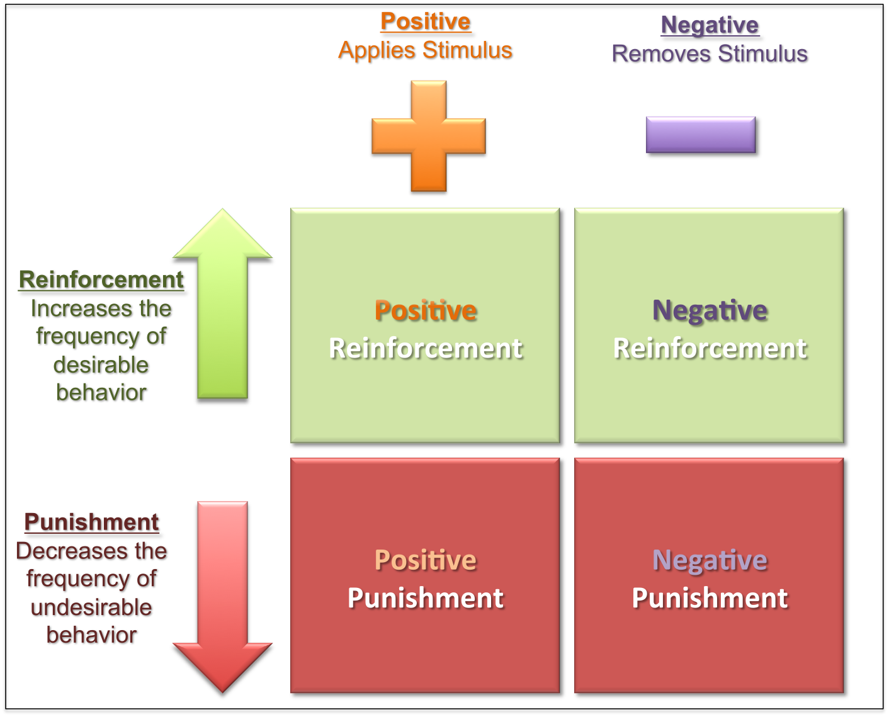
Learning Theories
Social modeling
Operant conditioning
Classical conditioning
Internal vs external motivation

Slide 11
Changing Values and Attitudes
Values:
Desirable, trans-situational goals, varying in importance, that serve as a guiding principles in people’s lives
Attitudes:
An internal state that, given the occurrence of certain stimulus events, will ultimately result in some sort of response or behaviour.
Cognitive dissonance:
Cognitive dissonance is a state of psychological tension occurring when thoughts, beliefs, attitudes, and/or behaviours are in conflict with each other.
Key Factors:
Ratio of dissonance Importance of factors in dissonance
Avoiding dissonance
1 – Modify 2 – Change importance 3 – Rationalize 4 – Add new consonant beliefs to bolster

Slide 12
Compliance Techniques
Foot in the door: An individual who agrees to carry out a small request is subsequently more likely to agree to carry out a larger request
Door in the face/reciprocal concessions: When the person making the larger request reduces it to a smaller one, the other person feels obliged to make a matching concession
Low-ball/bait and switch: When an agreement is made, the offer reduces in value
Improving the deal: When a product is offered at a high price, then after a brief pause, another product is offered to the deal or the price is reduced
Guilt: People comply to reduce feelings of guilt

Slide 13
Factors that Help Influence
Groupthink
In group vs out group
Conformity to group
Social Roles – Stanford prison experiment
Physical Factors
Appearance/attractiveness
Likability
Similarities
Non-verbal communication
Emotional Appeal
Fear
Sadness
Embarrassment
Confidence
Savvy Media Consumer Appeal:
Honest about media influence
Contagion:
When large crowds form, people may behave in ways that is extreme and unlike their normal behaviour

Slide 14
Me-Media
Problems with studying media effects
Media changes rapidly and suddenly
Scholars are continuously trying to keep up with the rapidly changing media landscape
Turns scholars into ‘storm chasers’

Slide 15
Media Effects – Me-Media
Democracy vs illusion of involvement
Democracy
Todd Gitlin (1999) – “Because of technology, relentless horizontal momentum is irreversible. The vertical cannot hold…Roll over authorities – the culture of the next millennium is not going your way.”
Francis Fukuyama – “hierarchies of all sorts, political and corporate, have come under pressure and begun to crumble”
Esther Dyson – “the great virtue of the Internet is that it erodes power. It sucks power out of the center and takes it to the periphery: it erodes the power of institutions over people while giving to the individuals the power to run their own lives”.
Manuel Castells – “ ‘network’ society had become so expansive, powerful, global, and instant that it had the capacity to overwhelm and sideline the nation state”
Manuel Castells – Later admits that media conglomerates dominate many areas of these networks and nation states have a stubborn staying power, levers of control over the organization of daily life, and an emotional bond with their citizens that make them difficult to circumvent.
Cognitive surplus

Slide 16
Media Effects - Me-Media
Democracy vs illusion of involvement
Illusion of involvement
Malcolm Gladwell – Social media “are effective at increasing participation – but lessening the level of motivation that participation requires”. “Little can be achieved without strong leaders, hard core political action and specific policy solutions”.
Manuel Castells – It is the looseness and diversity of these movements that allow these movements to create their own cyber-environment, a signature of their success.
Clay Shirky – The very virtues that can make online political engagement so effective – such as the ability to reach millions and stretch across the globe – can also be impediments to action.
Christopher Waddell on the 2011 Canadian Election – Social media did NOT figure predominantly into the Canadian election campaign or it’s outcome because: Limited number of people on social media, narrow range of issues highlighted, lack of impact on issues, not many uses for social media.
2012 USA presidential elections had 9% less voter turnout than the previous election
VOTE TOGETHER CAMPAIGN

Slide 17
Media Effects - Me-Media
Efficiency vs inefficiency
Efficiency
Digital natives learn to multi-task, orient to networks and monitor their environments in ways that the pre-digital world is unable to match
Inefficiency
People are less able to think deeply about a problem
We are being rewired into shallow thinkers
We do not fully engage with the communities we get involved with online
Digital ADD

Slide 18
Media Effects - Me-Media
Identity
Identity ghettos
Self-confirming bias (confirmation bias)
Selective exposure
Search bias (algorithm based on previous searches)
Echo chamber
Greater number of choices leads to political polarization
Self-performance and management of impressions
Social capital ‘online friends’
Feelings of missing out
Sunstein – narrowing information happens in two ways:
Loss of by-product learning
Information ghettos expose people to limited information pool
Markus Proir – People who are interested in politics tend to migrate from news program to news program regardless whether they are liberal or conservative.

Slide 19
Media Effects - Me-Media
Absence in presence – attention is elsewhere
Presence in absence – you can be there even if you are not physically present (telepresence)
Erosion of time and space
Inequalities persist – Access problem, subscriptions, etc.
Dangers – Privacy, data, cyber-bullying, extreme content

Slide 20
Media Effects – Cable Explosion
Narrowcasting and fragmentation
Subscriptions (advertising and subscription costs)
Audience niche
Cable revolution weakened structures of Canadian television:
Syphoning away money from advertisers
Competition, reluctance to invest in high-quality productions
Altered boundaries towards more sensational programming
Offloading of politics to the back alleys of TV
Canadian content cannot compete

Slide 21
Media Effects – Blogs
Journalism vs blogging
Blogging not seen as a credible form of journalism
Bloggers may be able to respond to a story more quickly
Some journalists get information from blogs to begin a story
Blogging may provide missing perspectives not covered by mainstream media
Blogging is like journalism without a salary and organization to back you up with legal troubles
Four categories of blogs
Cyber-Celebrities
Aggregator - centralizes a number of news and blog sites
Celebrities themselves
Ordinary people

Slide 22
Media Effects - YouTube
Largest online video archive
Greatest teaching tools
Attracting more and more advertising
National television are a large part of YouTube content
News moments
Amateur production
Mobilizing citizens – contagion effect
Double edge sword – spying on activists

Slide 23
Questions?
Please read this chapter carefully and understand the divergence of opinions in regards to the ‘effects of the Internet’
If you have any questions or concerns, please make an appointment with me.

