Slide 1
Media, Technology and Politics
Media ownership and concentration in canada
Erik Chevrier
July 5th, 2017

Slide 2
In the Media!
Donald Trump
Ongoing Battle Between Trump and CNN
How does Trump deal with questions from the press, especially from media sources he doesn’t like?
How does Trump deal with questions from the press, especially from media sources he doesn’t like? # 2
Justin Trudeau
Unsettling 150 Video
Anti-Colonial Demonstrations
Anti-Colonial Demonstrations #2
How did Justin Trudeau address protestors
How did Justin Trudeau address protestors #2
Arrests were made

Slide 3
RECAP – History of the Mass Media in Canada
Aboriginal communication until colonization
Colonizers replace traditional aboriginal communication
Feudalism is changing to capitalism
Media technology is developing rapidly (industrialization of the means of production & supporting infrastructure)
United States colonies declare independence from Brittan (1776)
Loyalists clash with reformers in Canada
Canada is concerned about American media intrusion & formation of national identity
English and French clash over status of Quebec and language
Development of public broadcasting corporations and regulators
Neo-liberalism: shifting away from publicly funded broadcasting
Private media concentration
Rapidly developing communication technology

Slide 4
Why does it matter who owns the media?
  The media industry plays a central role in shaping social, cultural and political life (Noam, 2016, p. 1180)
  Noam Chomsky – Manufacturing Consent – (Short)
  Noam Chomsky – Manufacturing Consent – (Long)

Slide 5
Why does it matter who owns the media?
  The media industry plays a central role in shaping social, cultural and political life (Noam, 2016, p. 1180)
  Noam Chomsky – Manufacturing Consent – (Short)
  Noam Chomsky – Manufacturing Consent – (Long)
  Propaganda Model
  - Selection of topics - Determine
  - Distribution of concerns - Select
  - Emphasis - Shape
  - Framing of issues - Control
  - Filtering of information - Restrict
  - Bounding of debate - Serve the interest of a select elite group

Slide 6
Who owns the media?
It is important to understand…
  There are various types of ownership
    Non-commercial arrangements (governments, semi-independent public corporations, charities)
    Private ownership (individuals, families, partnerships, shareholders, institutional investors, private equity funds, venture capitalists, coops and non-profits)
    Depending on the type of ownership, the proprietor may not control managerial decisions (owners vs managers)
  Media owners provide platforms (means of production, methods of distribution)
  Media owners provide messages (content – propaganda model)

Slide 7
Canadian Media Concentration Research Project
Canadian Media Concentration Research Project Website
An updated report on Media Ownership and Concentration in Canada by Dwayne Winseck is available via this link

Slide 8
CRTC Regulations
CRTC Businesses and Licensing
Diversity of Voices Polity
  2 out of 3 – Newspaper, Television, Radio Station in same market
  Ownership caps – 35% - 45% potentially threatening, over 45% rejected
  Incumbent telephone and cable companies cannot consolidate to ‘control the internet’
  Vertical integration of programming – ¾ have to be produced from outside sources, 25% Canadian programming from independent producers
  Examples of CRTC rulings regarding these regulations are contained in this report

Slide 9
Media Ownership in Canada Trends
Source

Slide 10
Source

Slide 11
Media Ownership in Canada Trends
Source

Slide 12
Source

Slide 13
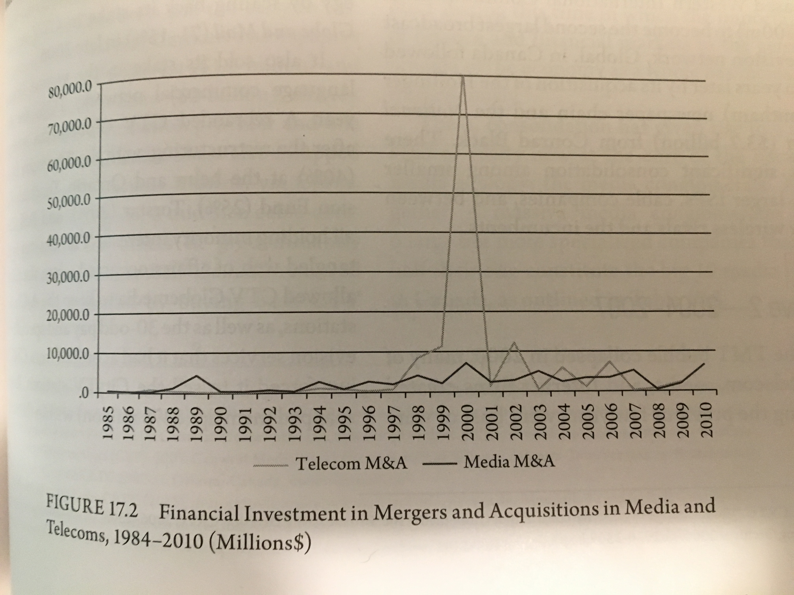
Waves of Media Consolidation

Slide 14
Wave One – 1994 - 2000
1994
Rogers took Maclean-Hunter
Conrad Black (Hollinger) took Southam
1998 - 2001
BCE took CTV and the Globe and Mail
Quebecor took Videotron, TVA and the Sun
Canwest took Western International Communications (Global Television)
Canwest took Hollinger, (Southam, National Post)
TELUS took Clearnet
A more detailed account of these acquisitions are available here.

Slide 15
Wave Two – 2004 - 2007
Rogers took Microcell (Fido)
Canwest had financial troubles sold small dailies to Transcontinental and Osprey
Craig Media created Toronto One channel
Quebecor took Toronto One after Craig Media went bankrupt
CHUM sold to Bell Globemedia
Bell Globemedia scaled back holdings in CTV and Globe and Mail
Rogers took City TV from CTV Globemedia
Astral Media took Standard Broadcasting
Quebecor took Osprey
Canwest and Goldman Sachs Alliance Atlantis (13 specialty pay channels)
A more detailed account of these acquisitions are available here.

Slide 16
Wave 3 – 2010 - 2015
Postmedia took Canwest newspapers
Shaw took Canwest TV stations
Bell Canada took back CTV
Bell took Astral Media
TELUS took Public Mobile
Rogers took Mobilicity
Postmedia took Quebecor’s English papers
A more detailed account of these acquisitions are available here.

Slide 17
Trends from Wave Analysis
Acquisitions and mergers happen periodically rather than being a constant process towards greater consolidation or competition
No media company is immune to consolidation
Consolidation gives rise to the media conglomerate
Internet ownership is not ‘solving’ the media concentration problem; mobile wireless is the most concentrated media sector

Slide 18
2015 Report on Media Concentration in Canada
Highlights:
  Google and Facebook account for more than 2/3 internet advertising revenue
  Mobile wireless is the most concentrated sector Rogers, Bell, TELUS account for over 90% revenue
  Bell, Shaw, Quebecor, CBC, Rogers own 217 TV channels and 86% of the market
  Bell and Shaw account for more than 50% of the TV market
  A more detailed account of these acquisitions are available here.

Slide 19
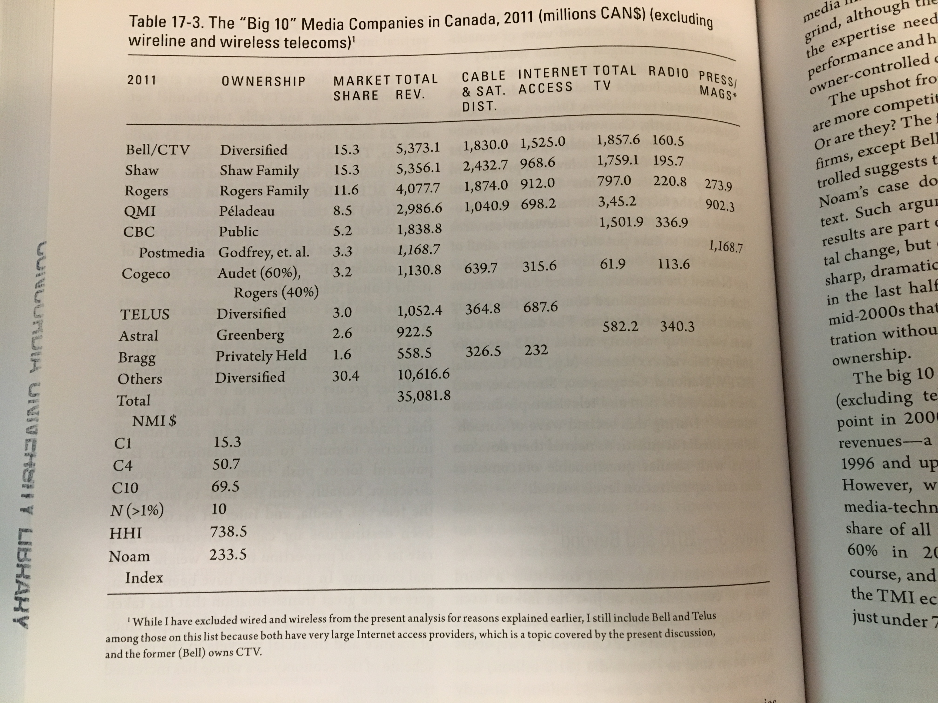
From the Assigned Readings – Up to 2011

Slide 20
Source

Slide 21
Source
Source

Slide 22
Comparison of Canada vs USA
Source

Slide 23
2015 Report on Media Concentration in Canada
Source

Slide 24
Vertical Integration: Content vs Connectivity
Source

Slide 25
Who Owns the World Media
(Noam, E. M. (2016) Who Owns the World’s Media? Media Concentration and Ownership around the World, Oxford Press, p. 1172)
Top 10 Media Companies by Revenue | Revenue 2011 in Millions
Government of China | $201 366
AT&T (USA) | $124 611
Verizon (USA) | $104 767
NTT (Japan – 33% public) | $89 716
Telefonica (Spain) | $85 895
Comcast (USA) | $75 954
Deutsche Telekom (Germany – 38% public) | $69 558
Vodafone (UK) | $62 366
Softbank (Japan) | $55 707
Grupo Carso (Mexico) | $55 559

Slide 26
Who Owns the World Media
(Noam, E. M. (2016) Who Owns the World’s Media? Media Concentration and Ownership around the World, Oxford Press, p. 1177)
Top 10 Media Content Companies | Revenue 2013 in Millions
Murdoch Group (USA) | $32 516
Government of China | $27 936
Google (USA) | $26 747
Comcast (USA) | $26 307
Redstone Group (USA) | $18 041
Disney (USA) | $16 481
Bertelsmann (Germany) | $13 650
Time Warner (USA) | $12 554
BBC (UK – public) | $12 301
DirecTV (USA) | $10 571

Slide 27
Guest Speaker!
Steve Faguy, a freelance journalist and founder of Fagstein Blog

