Slide 1
Media, Technology and Politics
Media, Technology and Privacy
Erik Chevrier
August 2nd, 2017

Slide 2
Privacy Legislation in Canada
Office of the Privacy Commissioner of Canada
Privacy Act – Government
Personal Information Protection and Electronic Documents Act - Business
Office of the Privacy Commissioner of Canada

Slide 3
Privacy Act
The purpose of this Act is to extend the present laws of Canada that protect the privacy of individuals with respect to personal information about themselves held by a government institution and that provide individuals with a right of access to that information.
The Canadian Government shall:
Inform you that they are collecting information about you (exceptions exist 8.2)
Inform you about the reason they are collecting information about you – unless it makes the information inaccurate or will defeat the purpose/provide prejudice to the information being collected
Make sure the information is accurate and up-to-date, and complete
Dispose of information when the procedure is finished
They cannot share the information with other sectors of the government or use it for anything other than the purpose it was collected (exceptions exist 8.2)
Exception (8.2)
(m) for any purpose where, in the opinion of the head of the institution,
(i) the public interest in disclosure clearly outweighs any invasion of privacy that could result from the disclosure, or
(ii) disclosure would clearly benefit the individual to whom the information relates

Slide 4
Anti-Terrorism Act
Security of Information
The concept of "harm to Canadian interests" (also known as a purpose "prejudicial to the safety or interests of the State") was defined to address a wide array of potential harms, including terrorist activity, interference with critical infrastructure, and the development of weapons of mass destruction in contravention of international law.
Surveillance and Identification
Terrorism offences are included in the Criminal Code electronic surveillance scheme. The changes removed the last-resort requirement for the use of electronic surveillance in the investigation of terrorism offences, and extended the duration of a wiretap authorization (from 60 days to a maximum of one year) and permitted delays of up to three years as a requirement to notify a target after a surveillance has been completed in relation to a terrorism offence. The DNA warrant scheme and Data Bank were extended to include terrorism offences to the list of "primary designated offences", thus permitting the use of forensic DNA technology in the investigation and prosecution of these offences. Also, it is possible for courts to issue DNA warrants and to order the inclusion of DNA profiles of persons convicted of these offences in the National DNA Data Bank.

Slide 5
Personal Information Protection and Electronic Documents Act (PIPEDA)
The purpose of this Part is to establish, in an era in which technology increasingly facilitates the circulation and exchange of information, rules to govern the collection, use and disclosure of personal information in a manner that recognizes the right of privacy of individuals with respect to their personal information and the need of organizations to collect, use or disclose personal information for purposes that a reasonable person would consider appropriate in the circumstances..
Limit
This Part does not apply to
(a) any government institution to which the Privacy Act applies;
(b) any individual in respect of personal information that the individual collects, uses or discloses for personal or domestic purposes and does not collect, use or disclose for any other purpose; or
(c) any organization in respect of personal information that the organization collects, uses or discloses for journalistic, artistic or literary purposes and does not collect, use or disclose for any other purpose personal information for purposes that a reasonable person would consider appropriate in the circumstances.

Slide 6
Data Governance
Governments and corporations monitor, track, store, and use personal data for various purposes
Governments – Spy on citizens to various degrees depending on the government in question
Stingray technology IMSI catcher
Canadian police use IMSI catchers
Vault 7 – WikiLeaks
Companies – Manage, sell, store data
Some apps track and store data – apple watch
Companies sell data to advertisers – especially points cards that track purchases
Companies are contracted to manage and store data – cloud server companies
Social media apps display personal information which could be tracked by third parties with ease

Slide 7
Leaks & Hacktivism
WikiLeaks – Collateral Murder
Edward Snowden PRISM
GCHQ in UK collects metadata
Documentaries on Hacktivism and Digital Spying
We are Legion
Citizenfour – Edward Snowden
Hacker Wars
The Internet’s Own Boy: The Story of Aaron Swartz
We Steal Secrets

Slide 8
Metadata Collection
Metadata refers to data that describes data.
Location
Date
Time stamped information
IP addresses
Metadata falls into two categories:
Information that allows communication to occur
Information about the parties to the communication

Slide 9
Data Farming & Cloud Computing
Clouds are becoming more common for data storage
Google
Facebook
Microsoft (underwater data center)

Slide 10
Consequences of Cloud Technology
Data theft – breach problems
Government monitoring
Corporate monitoring
Protection of youth – time, date location stamps
Leaks of personal information – celebrity nude picture leak
Monitoring dissent
Market research and niche targeting
Customized searches – echo chamber
Stealing intellectual property

Slide 11
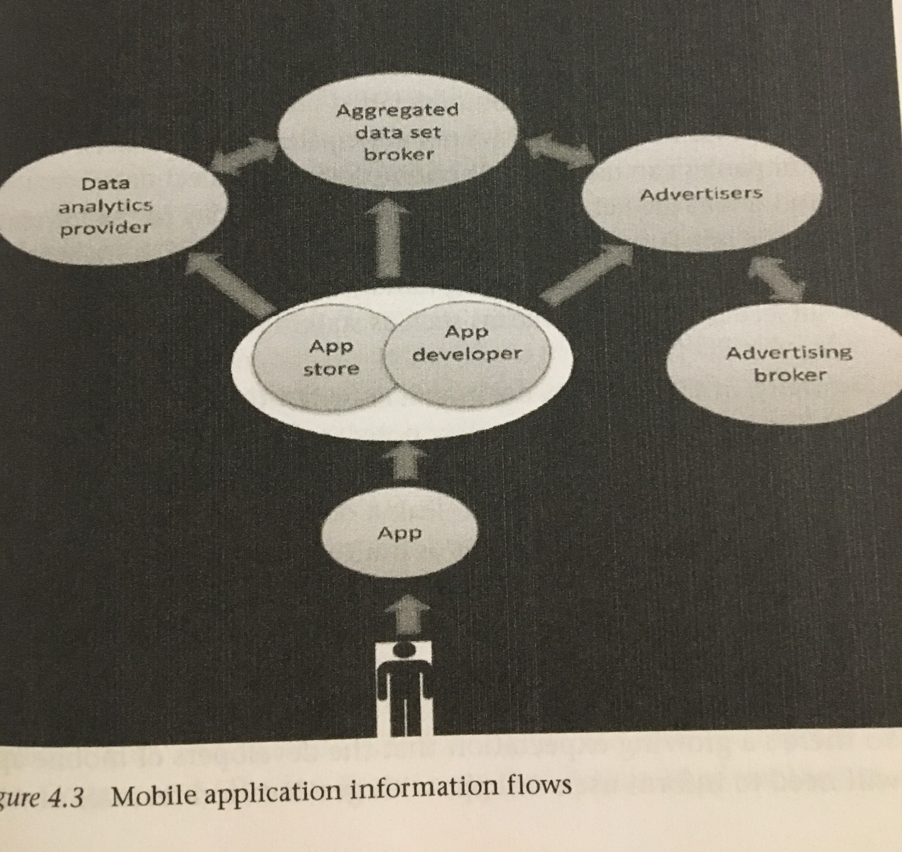
Example of Application Information Flows
Source:
Dwyer, T., (2016), Convergent Media and Privacy, Palgrave MacMillan.

Slide 12
Technology and Media
Definitions of technology (Goggin)
Greek – Systematic treatment (particularly applied to grammar)
17th century – German & French (technologie) – Branch of knowledge dealing with the mechanical arts and applied science
19th century – Technology – The application of such knowledge for practical purposes
20th century
The product of such application (of knowledge);
technological knowledge or knowhow;
a technological process, method, or technique;
machinery, equipment, etc. developed from the practical application of scientific and technological knowledge

Slide 13
Technology
Is shaped by social, political, cultural and economic circumstances
New media technology is mainly shaped by users
Digitization vs analogue
Internet and networks of data packets
Science and technology are not ‘neutral’ processes (Law. J, (1996) Laboratories and Tests)
Actors-networks
Recourses
Journals
Funding
Statistics

Slide 14
Terms
TCP/IP – Transmission control protocol/Internet protocol
P2P – Peer-to-peer
HTTP – Hypertext Transfer Protocol
E-mail – Electronic mail
MMS – Multimedia messaging
SMS – Short message service
Social Media – A new group of technologies, which rely upon – indeed are constituted by – the productive interactions of media consumers and users.
Pro-am – Distinctive new ways professionals and workers and armature media consumer-cum-producers produce media.
Three forms of broadcasting:
Terrestrial via transmitter
Satellite
Cable

Slide 15
Media Technologies, Politics and the Economy
Free market proponents were thrilled about the possibilities of the internet in breaking down government regulations. Their celebration was short lived because they asked government to ‘regulate’ their property.
Breakdown of leisure and work
Sharing economies flourish online – the internet is based on sharing (reciprocity)
Polanyi – Reciprocity, redistribution and markets.
Marketing segments – long tail, i.e. niche marketing
Gate-keepers are now gate-watchers
Commodities are now virtual but still have value – ‘video game commodities’

Slide 16
What is the future of technology?
Blow your Mind Technology
Top 9 Future Gadgets
Next Future Technology will Blow Your Mind
10 Future Technologies Right Around the Corner

Slide 17
Questions? Concerns?
Remember – Monday is the oral presentations
You all must show up or you will lose 2 points on your final paper
You must submit your presentation
You must submit a summary of your paper/presentation
You must come up with and define 3 – 5 key terms that pertain to your topic
You must include all the group member’s names on these documents

