Slide 1
Food and Culture
Erik Chevrier
September 14th, 2017

Slide 2
Discussion From Last Class
What kind of food etiquette did your family follow at the diner table?
Did you eat together?
Did you have family conversations?
Did you eat in front of the TV?
What were the divisions of labour (i.e. cooking, cleaning dishes, preparation, etc.)?
What kind of rules were set at the table?
Language, preventing bodily functions, etc.…
What other kind of food rituals can you remember partaking in as a child (parties, barbecues, corn roasts, gatherings, etc.)?

Slide 3
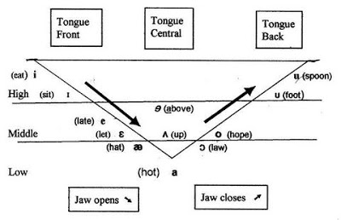
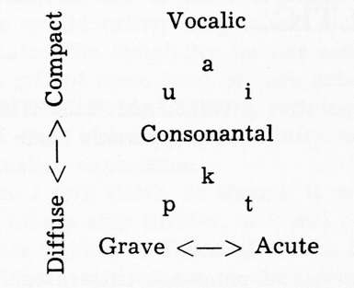
Foundations of Food and Culture
Claude Levi-Strauss – The Culinary Triangle * Published in 1966
Uses linguistic principles of the ‘vowel triangle’ and ‘consonant triangle’ to relate to cooking

Slide 4
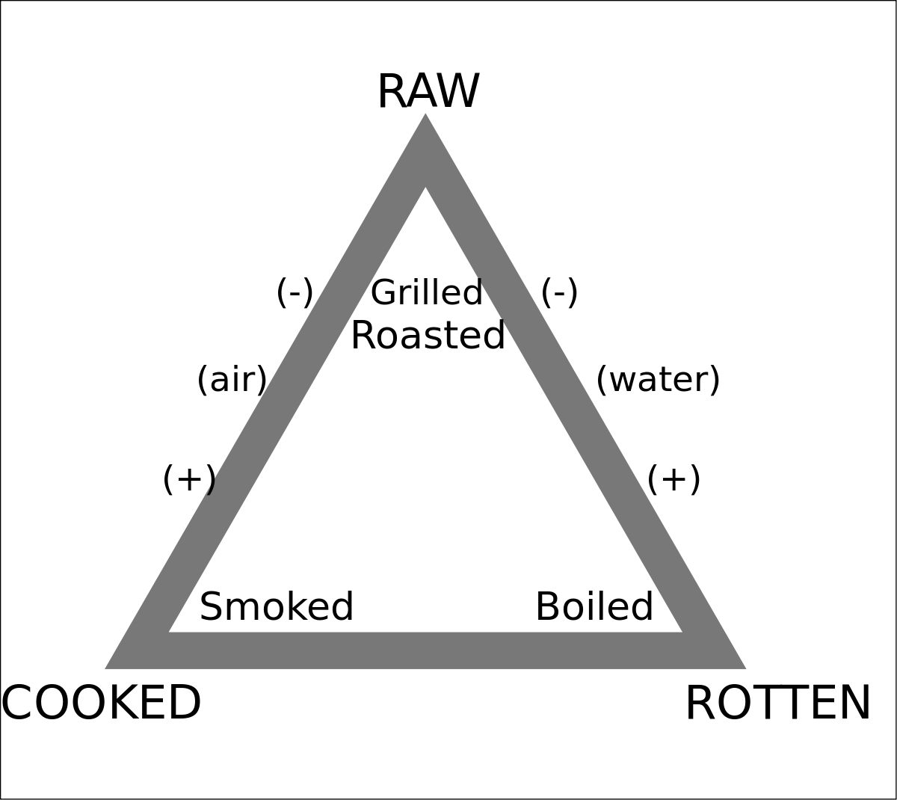
Foundations of Food and Culture
Claude Levi-Strauss – The Culinary Triangle * Published in 1966

Slide 5
Foundations of Food and Culture
Mary Douglas – The Abominations of Leviticus * Published in 1966
Marvin Harris – The Abominable Pig *Published in 1985
Both texts look at biblical dietary rules
Get into groups and answer the following questions:
What animals are permitted and forbidden to be eaten according to the Old Testament?
What are the reasons given in the biblical texts as for why certain animals are forbidden to be eaten?
What explanations do the authors give as justifications for these rules?
What similarities and differences exist between Harris & Douglas’s explanations?
According to Harris, what are the reasons why the Old Testament and the Koran forbid people from eating pigs?

Slide 6
Guest Lecture
Sebastian Di Poi
Concordia Food Coalition

Slide 7
The Concordia Greenhouse
Before next class, please check out!
The Concordia Greenhouse

