Slide 1
Food and Culture
Political Economy of food and culture
Erik Chevrier
September 21th, 2017

Slide 2
Who is Vandana Shiva?
Hero’s Sanctuary
Vandana Shiva on Food Sovereignty at Concordia

Slide 3
Living Economies – Vandana Shiva
Earth democracy refers to every being having equal access to the earth’s resources that make life possible; this access is assured by recognizing the importance of the other two economies: nature’s economy and the sustenance economy.
Economy and ecology derive from oikos – household Economy derives from the Latin word oeconomia meaning household management
Three types of economies: markets – nature – sustenance
What are features of the three types of economies suggested by Vandana Shiva?

Slide 4
Living Economies – Vandana Shiva
Market economy (globalized free market economy, capitalism, corporate globalization):
Based on scarcity
Private property – closing commons
Capital exchange
Measured by GDP/NDP – total productive output
Externalizes social, economic burden, and destroys natural economy for profits and capital accumulation
Places of exchange
Social relations have become a relationship between things (reification)
Two forms of markets – concrete and ‘the market’
Two main reasons why ecological disasters and the number of displaced, destitute, and disposable people increase in direct proportion to economic growth
1 – Reduction of visible economy to the market and activities controlled by capital
2 – The legal rights of corporations have increased at the cost of the rights of real people

Slide 5
Living Economies – Vandana Shiva
Nature economy
The first and most important economy – without it, no other economies can exist
Not recognized by traditional econometrics
It is being destroyed by practices of market economies
The production and reproduction of nature by nature

Slide 6
Living Economies – Vandana Shiva
Sustenance economy
People work to directly provide the conditions necessary to maintain their lives
Human production and reproduction is possible
Balance with natural economy
Reproduce society through partnerships, mutuality and reciprocity
More important than market economy – market economy cannot exist without the sustenance economy

Slide 7
Discussion
According to Vandana Shiva…
what are some myths about markets?
what does it mean to enclose the commons?
what is terra matter and terra nullius?

Slide 8
Living Economies – Vandana Shiva
Closing of commons:
1 – The exclusion of people from access to resources that had been their common property of held in common
2 – The creation of ‘surplus’ or ‘disposable’ people by denying rights of access to the commons that sustained them
3 – The creation of private property by the enclosure of common property
4 – The replacement of diversity that provides for multiple needs and performs multiple functions with monocultures that provide raw material 5 – The enclosure of minds and imagination, with the result that enclosures are defined and perceived as universal human progress, not as growth of privilege and exclusive rights for a few and dispossession and impoverished for the many
Terra matter – Mother earth
Terra nullius – Empty land
Myths about markets:
Market economies are more efficient – industrial agriculture uses more energy than it produces
Free trade allows food to be delivered efficiently
Globalization creates a knowledge society
Important topics to understand about privatization
In 1995 Trade-Related Intellectual Property Rights (TRIPs): Article 27.3(b) intellectual agreement of the WTO

Slide 9
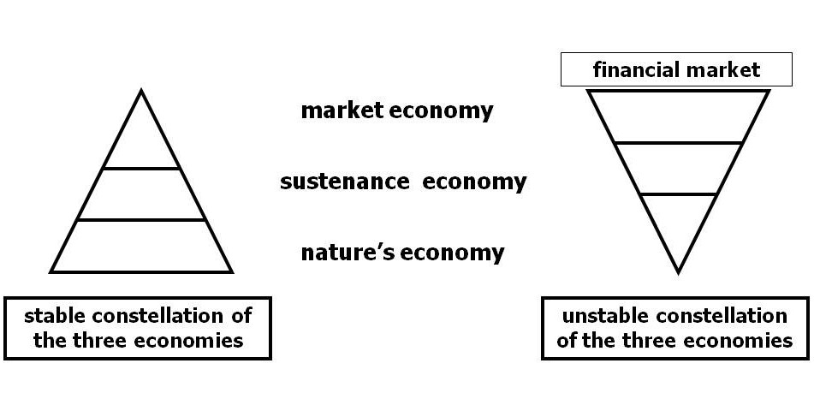
Living Economies – Vandana Shiva

Slide 10
Discussion
What other types of economies and/or economic practices can you think of?

Slide 11
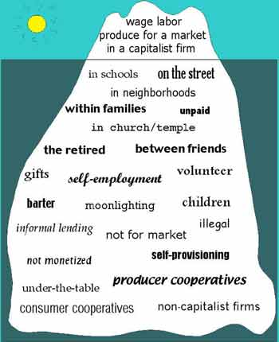
Gibson Graham – Take back the Economy Gibson-Graham, J.K., Cameron, J., Healy, S. (2013) Take Back the Economy: An Ethical Guide for Transforming Communities, University of Minnesota Press
Katherine Gibson Interview Playlist

Slide 12
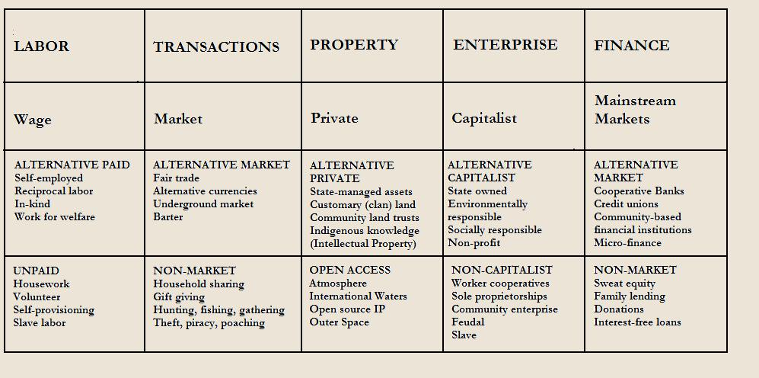
Gibson Graham – Take back the Economy Gibson-Graham, J.K., Cameron, J., Healy, S. (2013) Take Back the Economy: An Ethical Guide for Transforming Communities, University of Minnesota Press

Slide 13
Take Back the Economy – Commons Toolkit Gibson-Graham, J.K., Cameron, J., Healy, S. (2013) Take Back the Economy: An Ethical Guide for Transforming Communities, University of Minnesota Press
Types of commons:
Biophysical
Cultural
Social
Knowledge
Ways to assess commons:
Access
Use
Benefit
Care
Responsibility
Property

Slide 14
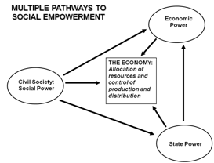
Envisioning Real Utopias – Erik Olin Wright Olin Wright, E. (2010) Envisioning Real Utopias, Verso

Slide 15
Three Systems of an Economy – John Pierce Pearce, J. (2009) Social Economy: Engaging as a Third System, In Amin, A. The Social Economy; International Perspectives on Economic Solidarity, p. 26.
See next slide

Slide 16
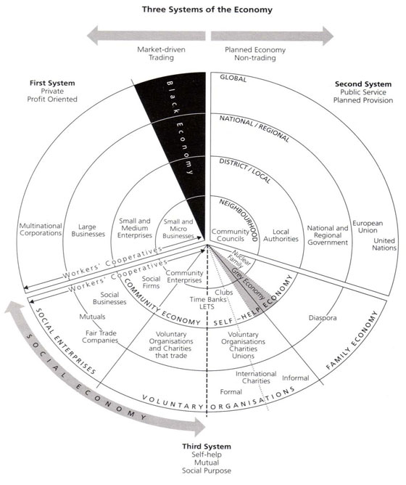

Slide 17
Karl Polanyi
Types of economic practices:
Markets (exchange)
Household economy
Redistribution
Reciprocity

Slide 18
Thanks!
Questions or concerns?

