Slide 1
Food and Culture
Political Economy of food and culture
Erik Chevrier
September 26th, 2017

Slide 2
Living Economies – Recap

Slide 3
Aristotle Aristotle. Aristotle in 23 Volumes, Vol. 21, translated by H. Rackham. Cambridge, MA, Harvard University Press; London, William Heinemann Ltd. 1944.
Chrematistics – art of acquisition – limitless accumulation unnatural and problematic
Oikonomia – management of the household – true form of an economy

Slide 4
Karl MarxMarx, K. Capital Volume 1, Penguin Classics.
C – C – Basic barter C – M – C – The way classical economists viewed basic barter with money M – C – M’ – What really happens when barter systems incorporate money – Limitless accumulation M – M’ – Usury capital system – Limitless accumulation

Slide 5
Karl PolanyiPolanyi, K. (2001) The Great Transformation; The Political and Economic Origins of Our Time, Beacon Press
Types of economic practices:
Markets (exchange)
Household economy
Redistribution
Reciprocity

Slide 6
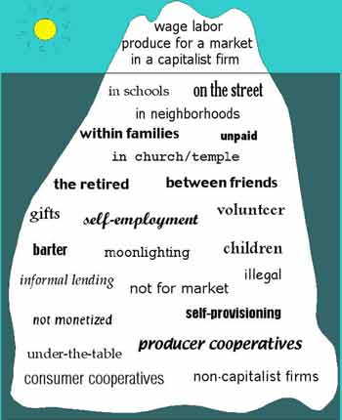
Gibson Graham – Take back the Economy Gibson-Graham, J.K., Cameron, J., Healy, S. (2013) Take Back the Economy: An Ethical Guide for Transforming Communities, University of Minnesota Press
Katherine Gibson Interview Playlist

Slide 7
Gibson Graham – Take back the Economy Gibson-Graham, J.K., Cameron, J., Healy, S. (2013) Take Back the Economy: An Ethical Guide for Transforming Communities, University of Minnesota Press

Slide 8
Gibson-Graham – Take back the Economy Gibson-Graham, J.K., Cameron, J., Healy, S. (2013) Take Back the Economy: An Ethical Guide for Transforming Communities, University of Minnesota Press
Please use Gibson-Graham’s diagram from Take Back the Economy and identify types of food organizations and practices in regards to the five categories:
Enterprise
Labour
Transactions
Property
Finance

Slide 9
Take Back the Economy – Commons Toolkit Gibson-Graham, J.K., Cameron, J., Healy, S. (2013) Take Back the Economy: An Ethical Guide for Transforming Communities, University of Minnesota Press
Types of commons:
Biophysical –Exist naturally – i.e. rocks, soil, air, etc.
Cultural – Things shared by members of the same culture – i.e. language, musical heritage, symbols
Social – Things shared between members of a social system – i.e. education, health, political systems
Knowledge – Things people know – i.e. Indigenous ecological knowledge, scientific achievements
Ways to assess commons. To be a commons:
Access – Must be shared widely
Use – Must be negotiated by a community
Benefit – Must be distributed to the community and possibly beyond
Care – Must be performed by community members
Responsibility - Must be assumed by the community
Property – Must be collectively owned private property, state owned property and/or open access property

Slide 10
Envisioning Real Utopias – Erik Olin Wright Olin Wright, E. (2010) Envisioning Real Utopias, Verso

Slide 11
Three Systems of an Economy – John Pierce Pearce, J. (2009) Social Economy: Engaging as a Third System, In Amin, A. The Social Economy; International Perspectives on Economic Solidarity, p. 26.
See next slide

Slide 12
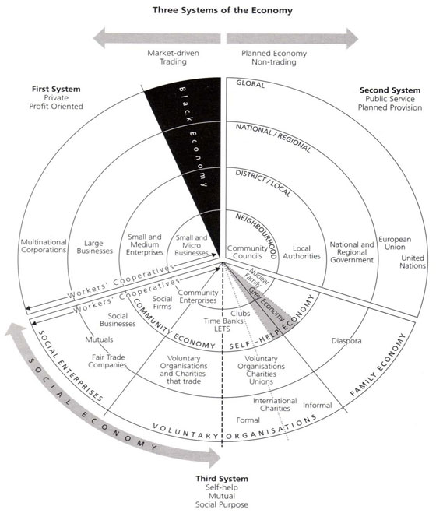

Slide 13
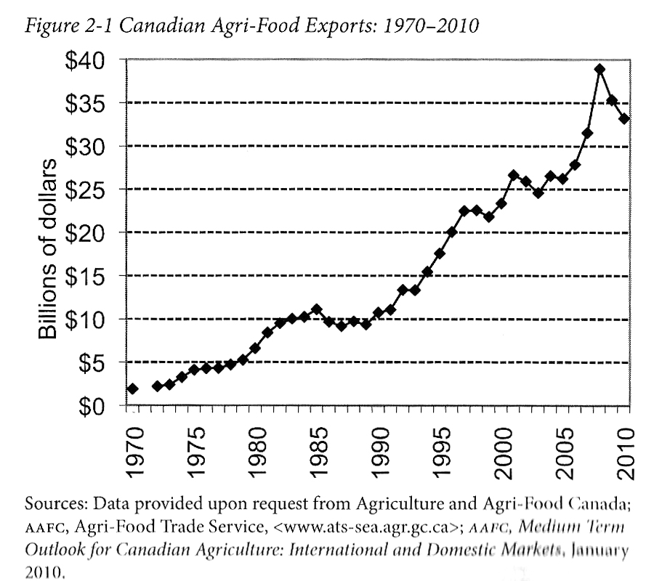
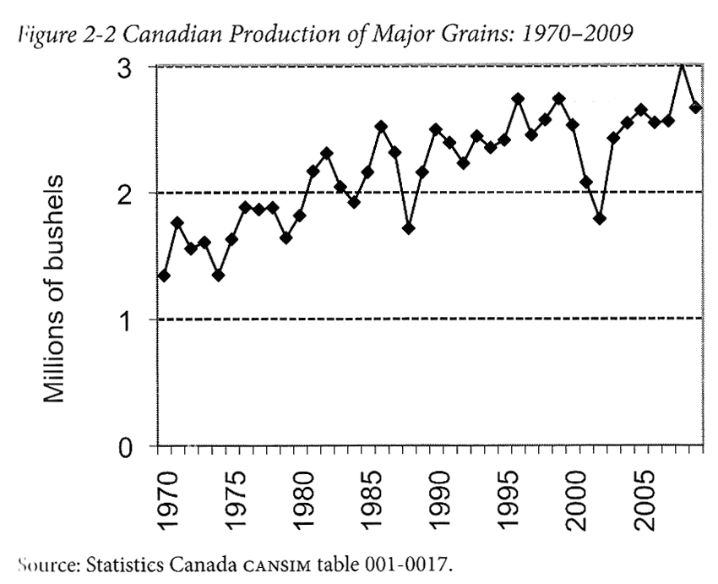
Advancing Agriculture by Destroying Farms? The State of Agriculture in Canada Qualman, D. (2011) Advancing Agriculture by Destroying Farms? The State of Agriculture in Canada, pp. 20 – 42. In, Wittman, H., Desmarais, A. A., & Wiebe, N. (2011) Food Sovereignty in Canada: Creating Just and Sustainable Food Systems, Fernwood Publishing

Slide 14
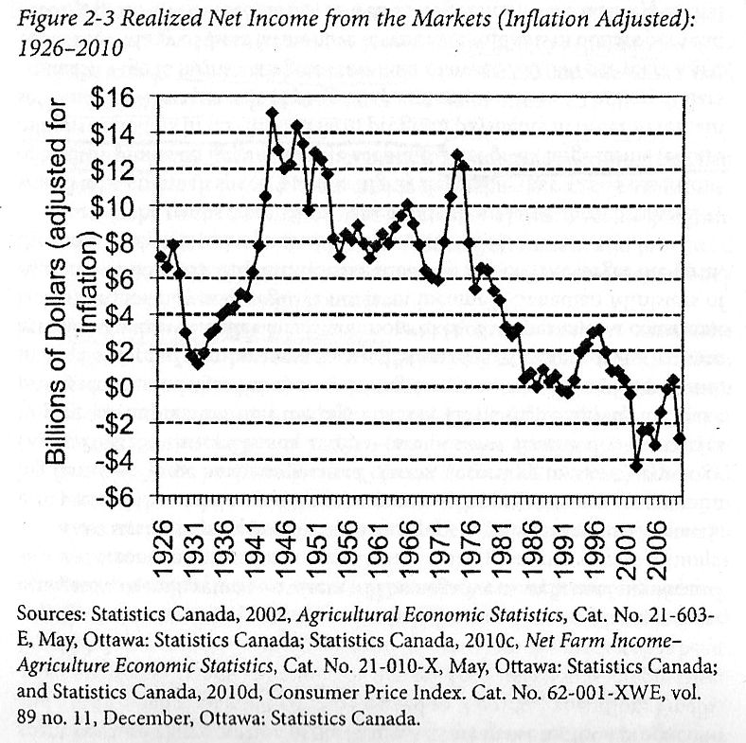
Advancing Agriculture by Destroying Farms? The State of Agriculture in Canada Qualman, D. (2011) Advancing Agriculture by Destroying Farms? The State of Agriculture in Canada, pp. 20 – 42. In, Wittman, H., Desmarais, A. A., & Wiebe, N. (2011) Food Sovereignty in Canada: Creating Just and Sustainable Food Systems, Fernwood Publishing

Slide 15
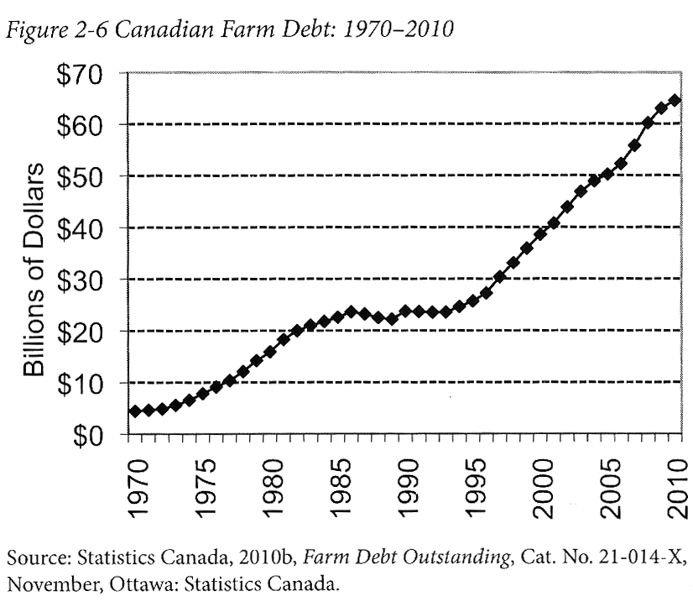
Advancing Agriculture by Destroying Farms? The State of Agriculture in Canada Qualman, D. (2011) Advancing Agriculture by Destroying Farms? The State of Agriculture in Canada, pp. 20 – 42. In, Wittman, H., Desmarais, A. A., & Wiebe, N. (2011) Food Sovereignty in Canada: Creating Just and Sustainable Food Systems, Fernwood Publishing

Slide 16
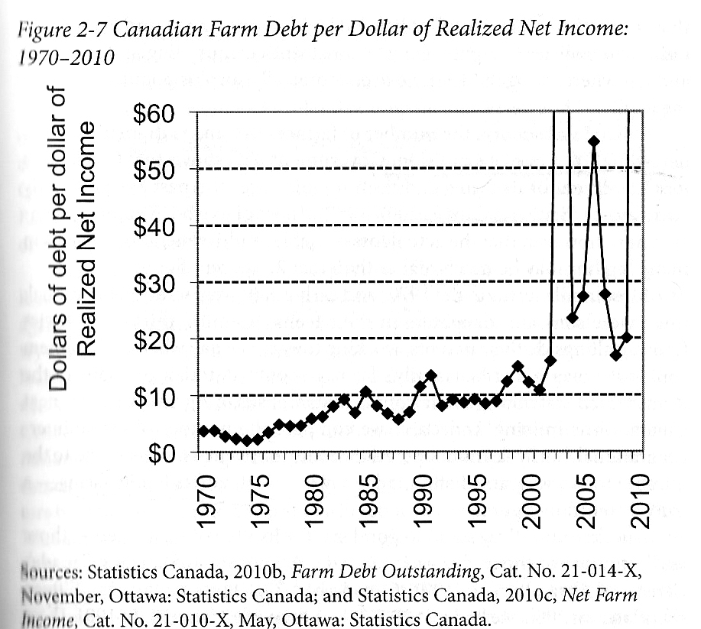
Advancing Agriculture by Destroying Farms? The State of Agriculture in Canada Qualman, D. (2011) Advancing Agriculture by Destroying Farms? The State of Agriculture in Canada, pp. 20 – 42. In, Wittman, H., Desmarais, A. A., & Wiebe, N. (2011) Food Sovereignty in Canada: Creating Just and Sustainable Food Systems, Fernwood Publishing

Slide 17
Advancing Agriculture by Destroying Farms? The State of Agriculture in Canada Qualman, D. (2011) Advancing Agriculture by Destroying Farms? The State of Agriculture in Canada, pp. 20 – 42. In, Wittman, H., Desmarais, A. A., & Wiebe, N. (2011) Food Sovereignty in Canada: Creating Just and Sustainable Food Systems, Fernwood Publishing
Drain on taxpayers:
Canadian taxpayers have provided 3 – 4 billion dollars per year, $67 billion (about 8000$ per household) to agri-business transnationals
Government programs for agriculture sector:
Crop insurance – Insurance for crops for potential damage i.e. insects, weather, plant disease
Margin-based support programs – insurance for crops for potential damage i.e. insects, weather, plant disease
Agriculture Income Disaster Assistance Program
Canadian Farm Income Program
Savings account programs – Savings programs that are matched by government to withdraw when net incomes fall
Net income stabilization account
Ad-hoc payments – Made to farmers to offset large losses
Quebec’s ASRA –L’assurance stabilization des revenues agricoles –To stabilize Quebec farm incomes in relation to production costs

Slide 18
ACTIVITY: Three Systems of an Economy – John Pierce Pearce, J. (2009) Social Economy: Engaging as a Third System, In Amin, A. The Social Economy; International Perspectives on Economic Solidarity, p. 26.
Please use John Pearce’s diagram to identify where the following organizations would be located
Food bank
The Hive Solidarity Cooperative
Monsanto
A local farm
A local for profit café
A government owned regional food delivery program
A family producing their own food

Slide 19
Thanks!
Questions or concerns?

