Slide 1
Food and Culture
Food sovereignty and culture
Erik Chevrier
September 28th, 2017

Slide 2
Three Systems of an Economy – John Pierce Pearce, J. (2009) Social Economy: Engaging as a Third System, In Amin, A. The Social Economy; International Perspectives on Economic Solidarity, p. 26.
See next slide

Slide 3
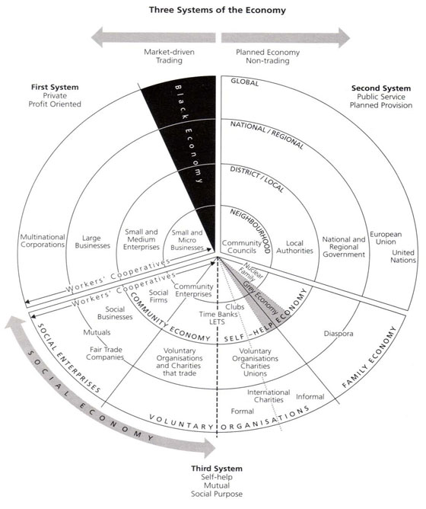

Slide 4
ACTIVITY: Three Systems of an Economy – John Pierce Pearce, J. (2009) Social Economy: Engaging as a Third System, In Amin, A. The Social Economy; International Perspectives on Economic Solidarity, p. 26.
Please use John Pearce’s diagram to identify where the following organizations would be located
Food bank
The Hive Solidarity Cooperative
Monsanto
A local farm
A local for profit café
A government owned regional food delivery program
A family producing their own food
Someone who left their country but sends money to their family to buy food

Slide 5
Introduction to Food Sovereignty
La Via Campesina
Nyéléni Newsletter
People’s Coalition for Food Sovereignty
International Planning Committee for Food Sovereignty

Slide 6
Introduction to Food Sovereignty
Darrin Qualman Advancing Agriculture by Destroying Farms? The State of Agriculture in Canada
Food Sovereignty is NOT:
A set of policies simplistically aimed at maximizing production and exports
A disregard for the destruction of family farms and rural communities
A push towards high-input, high-cost, high-energy-use model for food production that generates chronic negative returns for the farm families who work the soil
A concentration of land ownership into the hands of fewer and fewer owners, many of them non-farmers
A corporate takeover of a growing number of agricultural sectors (e.g. hog production and cattle finishing)
A push towards massive production units that concentrate potential pollutants
A transfer of key food processing facilities to foreign companies, even to foreign lands
Economic policies that make foreign-based transnationals the primary beneficiaries of the wealth created by farm families working our land
A system that makes citizens ever more dependent on food supplied further and further from their homes

Slide 7
Food Sovereignty
Hannah Arendt – First right above all else is the right to have rights
Raj Patel – Food sovereignty is the right to have rights over food
Food Security – Food and Agriculture Organization of the UN (FAO):
The availability at all times of adequate world food supplies of basic foodstuffs to sustain a steady expansion of food consumption and to offset the fluctuations in production and prices (1975)
Food security, at the individual level, household, national, regional and global level [is achieved] when all people, at all times, have physical and economic access to sufficient, safe and nutritious foods to meet their dietary needs and food preferences for an active and healthy life (1996)
Food security [is] a situation that exists when all people, at all times, have physical, social and economic access to sufficient, safe and nutritious food that meets their dietary needs and food preferences for an active and healthy life (2001)

Slide 8
Food Sovereignty
Via Campesina (1996)
Long-term food security depends on those who produce food and care for the natural environment. As stewards of food producing resources we hold the following principles as the necessary condition for achieving food security…Food is a basic human right. This can only be realized in a system where food sovereignty is guaranteed. Food sovereignty is the right of each nation to maintain and develop its own capacity to produce its basic foods respecting cultural and productive diversity. We have the right to produce our own food in our own territory. Food sovereignty is a precondition to genuine food security.
People’s Food Sovereignty Network (2002)
Food sovereignty is the right of peoples to define their own food and agriculture; to protect and regulate domestic agricultural production and trade in order to achieve sustainable development objectives; to determine the extent to which they want to be self reliant; to restrict the dumping of products in their markets; and to provide local fisheries-based communities the priority in managing the use of and the rights to aquatic resources. Food sovereignty does not negate trade, but rather, it promotes the safe formulation of trade policies and practices that serve the rights of peoples to safe, healthy and ecologically sustainable production.

Slide 9
Food Sovereignty
Read the 2007 Nyéléni Declaration on Food Sovereignty
What does the declaration state?
Who formulated the declaration?
What are they fighting for?
What are they fighting against?
What can and will they do about it?
Can we apply a food sovereignty approach to university food services? If so, how?
Concordia Food Groups Discussion About Campus Food Sovereignty

Slide 10
Thanks!
Questions or concerns?

