Slide 1
Food and Culture
Global Food Culture – International Trade Regulations
Erik Chevrier
October 10th, 2017

Slide 2
Preparation for Midterm Exam
Format
Combination of multiple choice and short answers
Material
PowerPoint Slides and classroom discussions
All assigned readings except
- Chapter 8 – Mintz, S. W. (1979) Time, Sugar and Sweetness, pp. 91 – 103
- Chapter 36 – Clapp, J. (2005) The Political Economy of Food Aid in an Era of Agricultural Biotechnology, pp. 531 – 545
- Wittman, H. (2011) Food Sovereignty: A New Rights Framework for Food and Nature? Environment and Society: Advances in Research 2, pp. 87 – 105.
- Read the reports from the Canadian Biotechnology Action Network https://cban.ca/publications/reports/ - Koc, M., Sumner, J., Winson, A. (2012) Critical Perspectives in Food Studies, Oxford. Chapter 9 – Constructing Healthy Eating/Constructing Self, pp. 136 – 151. - Anderson, C. R., Brady, J., & Levoke, C. (2016) Conversations in Food Studies, University of Manitoba Press. Chapter 7 – Martin, W., Mundel, E., and Rideout, K., (2016) Finding Balance: Food Safety, Food Security, and Public Health, pp. 170 – 192.

Slide 3
Discussion About Group Projects
Go Around about Group Projects
What topic did you choose?
What is your project about?
How will you accomplish your project?
What outcomes do you expect?

Slide 4
Discussion
Last class, I asked if people wanted to visit City Farm School
We will go to City Farm School on Thursday, October 12th
Those that have class downtown right after can leave early if need be
We will cover Food, Health, and Culture next week at City Farm School once the tour is over

Slide 5
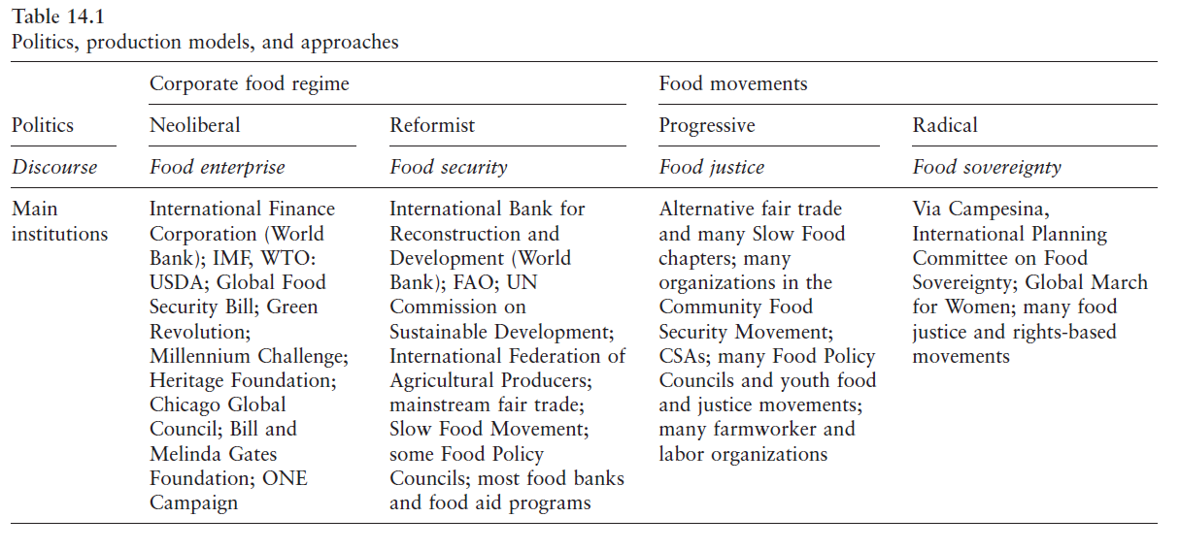

Slide 6
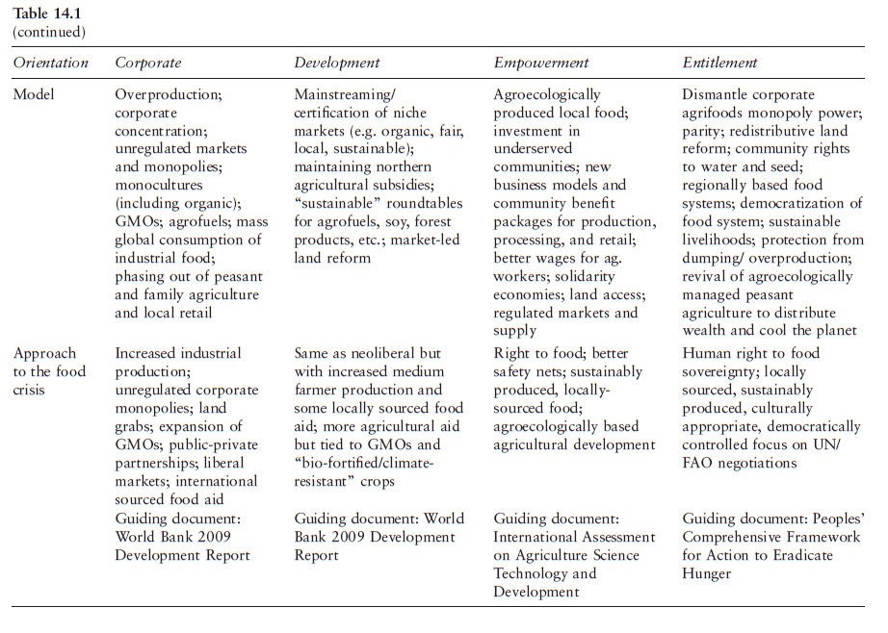

Slide 7
World Trade Organization
GATT – General Agreement on Tariffs and Trade – 1947 - 1994
World Trade Organization – 1995
Trade negotiations - The WTO agreements cover goods, services and intellectual property. They spell out the principles of liberalization, and the permitted exceptions. They include individual countries’ commitments to lower customs tariffs and other trade barriers, and to open and keep open services markets. They set procedures for settling disputes. These agreements are not static; they are renegotiated from time to time and new agreements can be added to the package. Many are now being negotiated under the Doha Development Agenda, launched by WTO trade ministers in Doha, Qatar, in November 2001.
Implementation and monitoring - WTO agreements require governments to make their trade policies transparent by notifying the WTO about laws in force and measures adopted. Various WTO councils and committees seek to ensure that these requirements are being followed and that WTO agreements are being properly implemented. All WTO members must undergo periodic scrutiny of their trade policies and practices, each review containing reports by the country concerned and the WTO Secretariat.
Dispute settlement - The WTO’s procedure for resolving trade quarrels under the Dispute Settlement Understanding is vital for enforcing the rules and therefore for ensuring that trade flows smoothly. Countries bring disputes to the WTO if they think their rights under the agreements are being infringed. Judgements by specially appointed independent experts are based on interpretations of the agreements and individual countries’ commitments.
Building trade capacity - WTO agreements contain special provision for developing countries, including longer time periods to implement agreements and commitments, measures to increase their trading opportunities, and support to help them build their trade capacity, to handle disputes and to implement technical standards. The WTO organizes hundreds of technical cooperation missions to developing countries annually. It also holds numerous courses each year in Geneva for government officials. Aid for Trade aims to help developing countries develop the skills and infrastructure needed to expand their trade.
Outreach - The WTO maintains regular dialogue with non-governmental organizations, parliamentarians, other international organizations, the media and the general public on various aspects of the WTO and the ongoing Doha negotiations, with the aim of enhancing cooperation and increasing awareness of WTO activities

Slide 8
World Trade Organization
Sanitary and Phytosanitary Measures (SPS)
Value Chain Development Approach
Cocoa: Value Chain
Technical Barriers to Trade (TBT)
On 9 November 2016 the TBT Committee held a thematic session on regulatory cooperation between Members in the area of food labelling

Slide 9
Codex Alimentarius
Codex Alimentarius

Slide 10
Food Labelling in Canada
Canada Food Labelling
Canada vs USA COOL labelling

Slide 11
Thanks!
Questions or concerns?

