Slide 1
Food and Culture
Global Food Culture – International Trade Regulations & GMOs
Erik Chevrier
October 17th, 2017

Slide 2
Midterm Exam
Exam Format
15 = Multiple Choice (3 points each)
4 = Short Answer Questions (10 points each)
Short Answer – Points (0 – 10)
0 = You wrote nothing
1 – 2 = You wrote something but it is not right at all
3 – 5 = You wrote something that is partially true but mainly wrong
6 = You are correct but extremely vague
7 = You are correct but slightly vague
8 – 9 = You are correct and are clear. You provide examples to back up your claim(s).
10 = You are spot on. You provide a range of examples to back up your claim(s). Your answer is full. You don’t leave anything out. Each part of your answer is completely correct.

Slide 3
Midterm Exam
There will be a range of questions some requiring more detail and some requiring less detail
The goal is to provide a balanced exam
If you expect to get an A or A+ you should study the material in more detail
You should study the material from the book as well as the PowerPoint slides
Study both – use the book to complement the material from what we went over in class
Last class, I provided you a list of readings to exclude from your studying
This is to minimize the amount of information you need to learn for the exam
Depending on how much we cover, I may exclude the readings from the class before the exam
I will let you know on Thursday the 19th

Slide 4
World Trade Organization
GATT – General Agreement on Tariffs and Trade – 1947 - 1994
World Trade Organization – 1995
Trade negotiations - The WTO agreements cover goods, services and intellectual property. They spell out the principles of liberalization, and the permitted exceptions. They include individual countries’ commitments to lower customs tariffs and other trade barriers, and to open and keep open services markets. They set procedures for settling disputes. These agreements are not static; they are renegotiated from time to time and new agreements can be added to the package. Many are now being negotiated under the Doha Development Agenda, launched by WTO trade ministers in Doha, Qatar, in November 2001.
Implementation and monitoring - WTO agreements require governments to make their trade policies transparent by notifying the WTO about laws in force and measures adopted. Various WTO councils and committees seek to ensure that these requirements are being followed and that WTO agreements are being properly implemented. All WTO members must undergo periodic scrutiny of their trade policies and practices, each review containing reports by the country concerned and the WTO Secretariat.
Dispute settlement - The WTO’s procedure for resolving trade quarrels under the Dispute Settlement Understanding is vital for enforcing the rules and therefore for ensuring that trade flows smoothly. Countries bring disputes to the WTO if they think their rights under the agreements are being infringed. Judgements by specially appointed independent experts are based on interpretations of the agreements and individual countries’ commitments.
Building trade capacity - WTO agreements contain special provision for developing countries, including longer time periods to implement agreements and commitments, measures to increase their trading opportunities, and support to help them build their trade capacity, to handle disputes and to implement technical standards. The WTO organizes hundreds of technical cooperation missions to developing countries annually. It also holds numerous courses each year in Geneva for government officials. Aid for Trade aims to help developing countries develop the skills and infrastructure needed to expand their trade.
Outreach - The WTO maintains regular dialogue with non-governmental organizations, parliamentarians, other international organizations, the media and the general public on various aspects of the WTO and the ongoing Doha negotiations, with the aim of enhancing cooperation and increasing awareness of WTO activities

Slide 5
World Trade Organization
Sanitary and Phytosanitary Measures (SPS)
The SPS Agreement sets out rules for food safety and requirements for animal and plant health. It recognizes the right of governments to adopt and enforce measures necessary to protect human, animal or plant life or health. While the need to constrain trade may arise, any measures taken to do so should not be applied in an arbitrary or discriminatory manner or act as a disguised restriction on international trade.
Technical Barriers to Trade (TBT)
Under the TBT Agreement, members are free to choose how to regulate products to achieve those objectives but must do so in a way that does not discriminate between trading partners or that does not unnecessarily restrict trade in these products. The TBT Agreement covers trade in all goods – agricultural and industrial alike – and applies to three categories of measures: technical regulations, standards and conformity assessment procedures.
On 9 November 2016 the TBT Committee held a thematic session on regulatory cooperation between Members in the area of food labelling

Slide 6
World Trade Organization
Sanitary and Phytosanitary Measures (SPS)
The SPS Agreement explicitly recognizes three international standard-setting bodies, covering the three main areas in which SPS measures are applied:
• the FAO/WHO Codex Alimentarius Commission, for food safety standards;
• the World Organization for Animal Health (OIE), for animal health standards and diseases that can be transmitted from animals to humans (zoonoses); and
• the International Plant Protection Convention (IPPC), for plant-health standards.

Slide 7
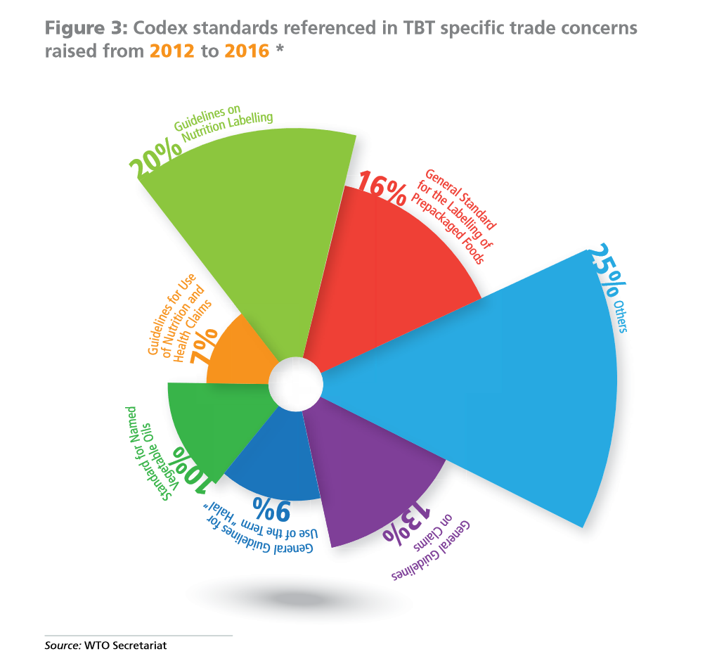

Slide 8
Codex Alimentarius
Codex Alimentarius
The Codex Alimentarius Commission was established by FAO and the WHO in 1963 as part of the Joint FAO/WHO International Food Standards Programme. It is the single most important international reference point for food standards.
Codex Alimentarius is a compilation of harmonized international food standards, guidelines and codes of practice.
Codex standards, guidelines and codes of practice are advisory in nature: to become legally enforceable, countries must voluntarily translate them into national legislation or regulations.
The annual meeting of the Codex Alimentarius Commission brings together an average of more than 130 member states and nearly 50 international observers, including representatives from the private sector, academia, civil society and other stakeholder groups.
Besides the annual plenary session of the Commission, Codex has 17 committees, six regional coordinating committees and further ad hoc task forces In any given year, there can be as many as 100 working groups in Codex operating electronically between sessions on work assigned by a committee.
Trade and Food Standards Document 2017

Slide 9
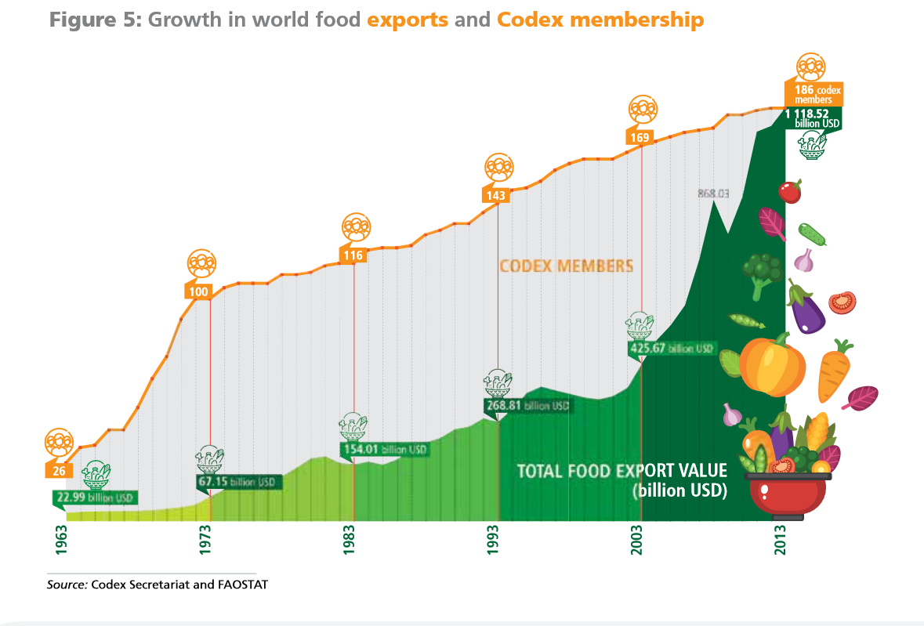
Codex Alimentarius

Slide 10
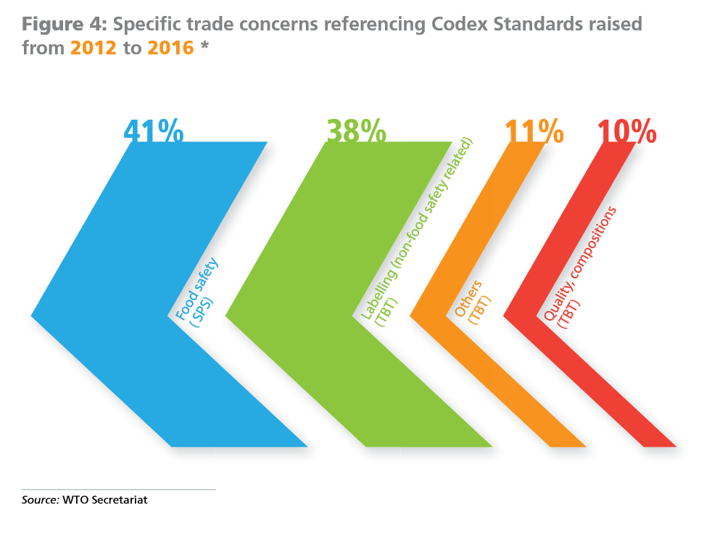

Slide 11
Food Labelling in Canada
Canada Food Labelling
Country of Origin Labelling in Canada
In Canada, there are mandatory requirements for certain food products to indicate the country of origin on their labels. Companies may also make origin claims to highlight the origins of a product or ingredient in a product.
Country of origin labelling does not provide information on the safety of a food product. All food products sold in Canada, whether produced in Canada or abroad, must meet the same food safety standards.
Mandatory labelling
All prepackaged food products sold in Canada are required to be labelled with the identity and principal place of business of the company responsible for the product, such as the importer or manufacturer.
When a food product is wholly manufactured outside of Canada, the label must show that the product is imported. This information can be provided in one of three ways:
the identity and principal place of business of the foreign manufacturer, or
the statement "imported for" or "imported by" followed by the identity and principal place of business of the Canadian company;
the identity and principal place of business of the Canadian company with the country of origin of the product.
Canada vs USA COOL labelling

Slide 12
World Trade Organization
Agreement on Trade-Related Aspects of Intellectual Property Rights (TRIPS)
International Union for the Protection of New Varieties of Plants (UPOV)

Slide 13
Seed Sovereignty Food Security
Vandana Shiva
Industrial monoculture agriculture has pushed more than 75% of our agro-biodiversity to extinction
75% of the bees have been killed because of toxic pesticides.
75% of the water on the planet is being depleted and polluted for chemical-intensive industrial agriculture.
75% of the land and soil degradation is caused by chemical farming
40% of all greenhouse gas emissions responsible for climate change comes from fossil fuel, chemical-intensive industrial globalized systems of agriculture.

Slide 14
GMO Myths According to Vandana Shiva
What are the myths and realities of GMOs according to Vandana Shiva?

Slide 15
GMO Myths According to Vandana Shiva
Myth 1 – GMOs are an ‘invention of corporations’ and therefore can be patented and owned
Myth 2 – Genetic engineering is more accurate and precise than conventional breeding
Myth 3 – GMOs are just like naturally occurring organisms, and therefore they are safe
Myth 4 – GMOs are based on cutting edge science; GMO critics are ‘anti-science’
Myth 5 – GMOs increase yields and are the answer to world hunger
Myth 6 – GMOs reduce chemical use and are therefore environmentally beneficial
Myth 7 – GMOs promote free choice

Slide 16
Dangers of GMOs According to Mae-Wan Ho
What are the dangers of GMOs according to Mae-Wan Ho?

Slide 17
Thanks!
Questions or concerns?

