Slide 1
Food and Culture
GMOs, loss of Biodiversity and the Privatizing of Genetics
Erik Chevrier
October 17th, 2017

Slide 2
GMO Myths According to Vandana Shiva
Myth 1 – GMOs are an ‘invention of corporations’ and therefore can be patented and owned
Myth 2 – Genetic engineering is more accurate and precise than conventional breeding
Myth 3 – GMOs are just like naturally occurring organisms, and therefore they are safe
Myth 4 – GMOs are based on cutting edge science; GMO critics are ‘anti-science’
Myth 5 – GMOs increase yields and are the answer to world hunger
Myth 6 – GMOs reduce chemical use and are therefore environmentally beneficial
Myth 7 – GMOs promote free choice

Slide 3
What is a GMO?
Genetic Engineering
Mae-Wan Ho
GMO is an organism with synthetic genetic material inserted into its gnome. It is made in a laboratory.
Epigenetics
Epigenetics – More Technical Mechanics

Slide 4
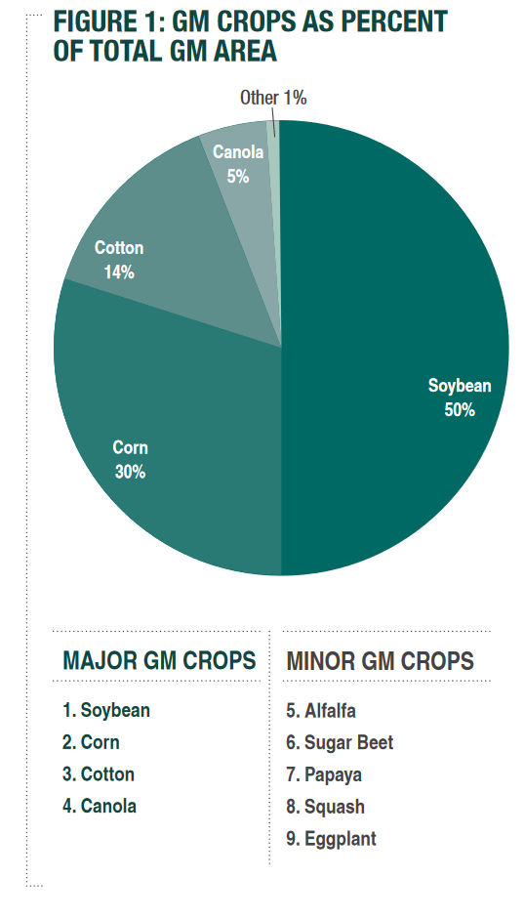
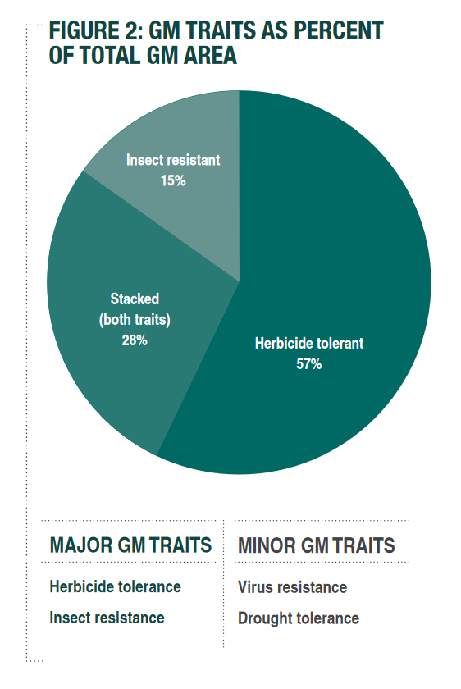
Source

Slide 5
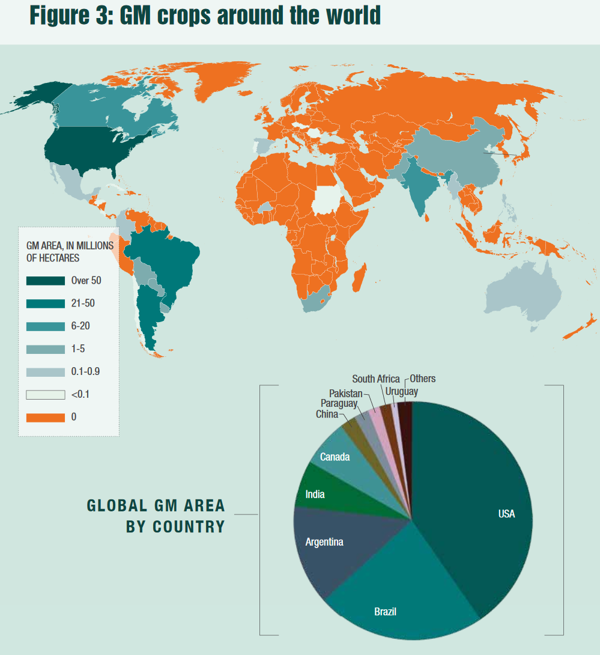
Source

Slide 6
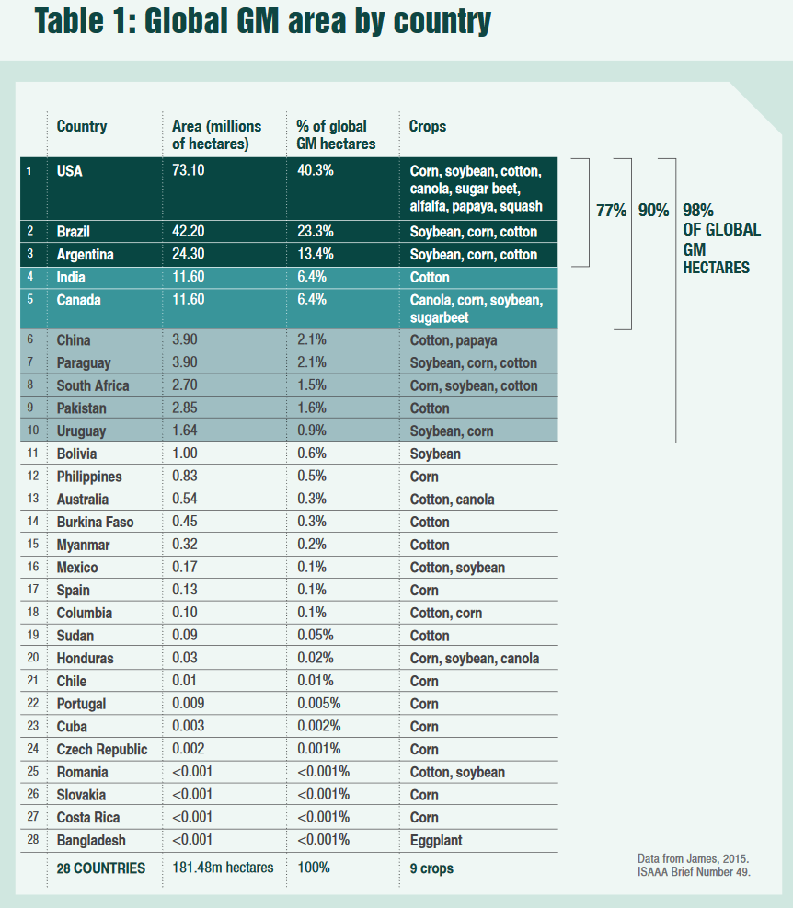
Source

Slide 7
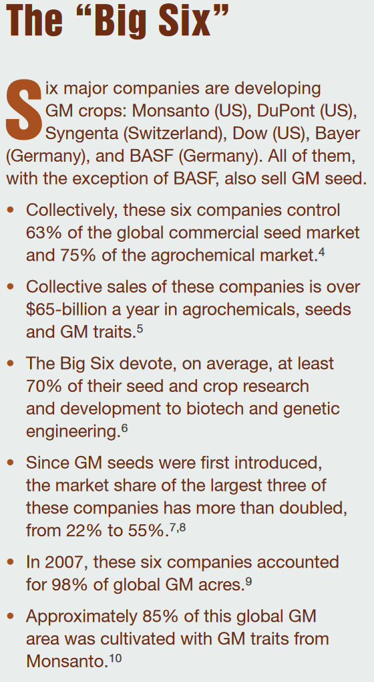
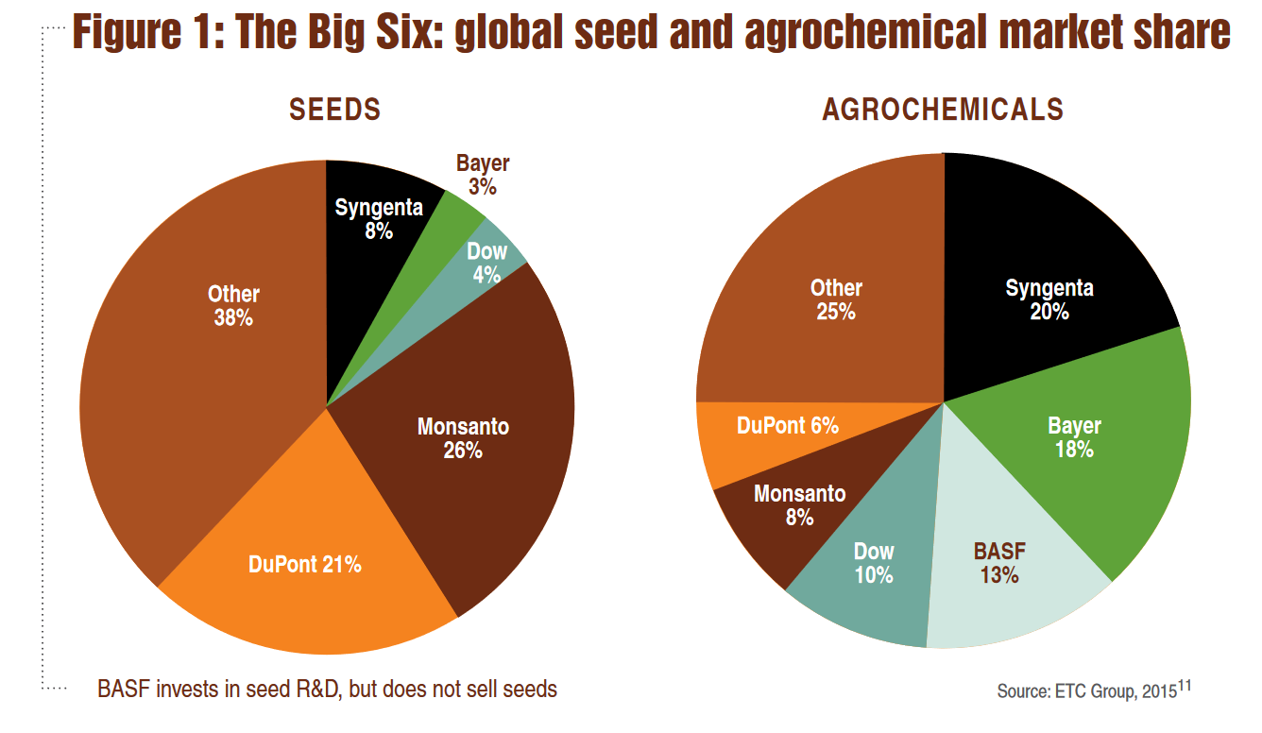
Source

Slide 8
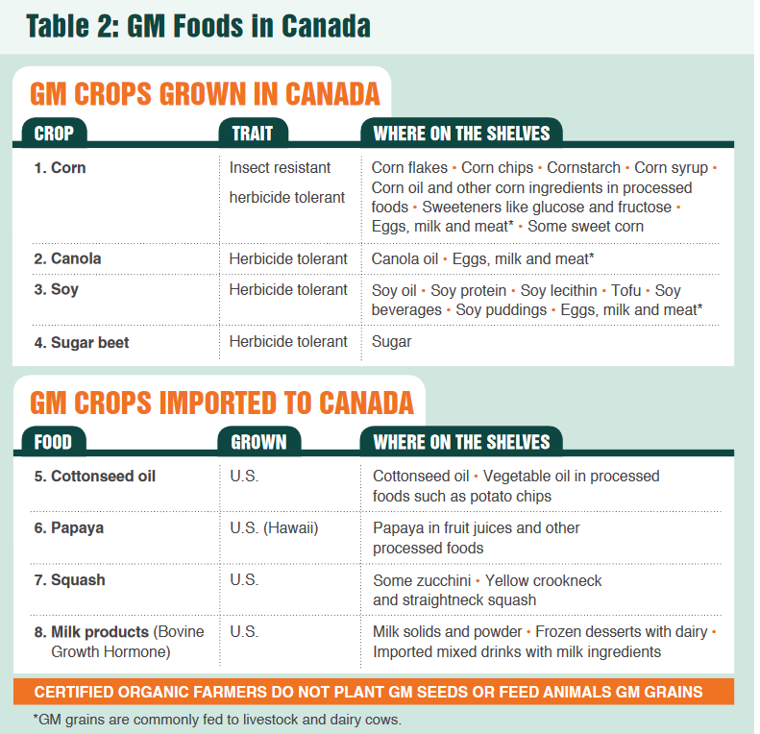
Source

Slide 9
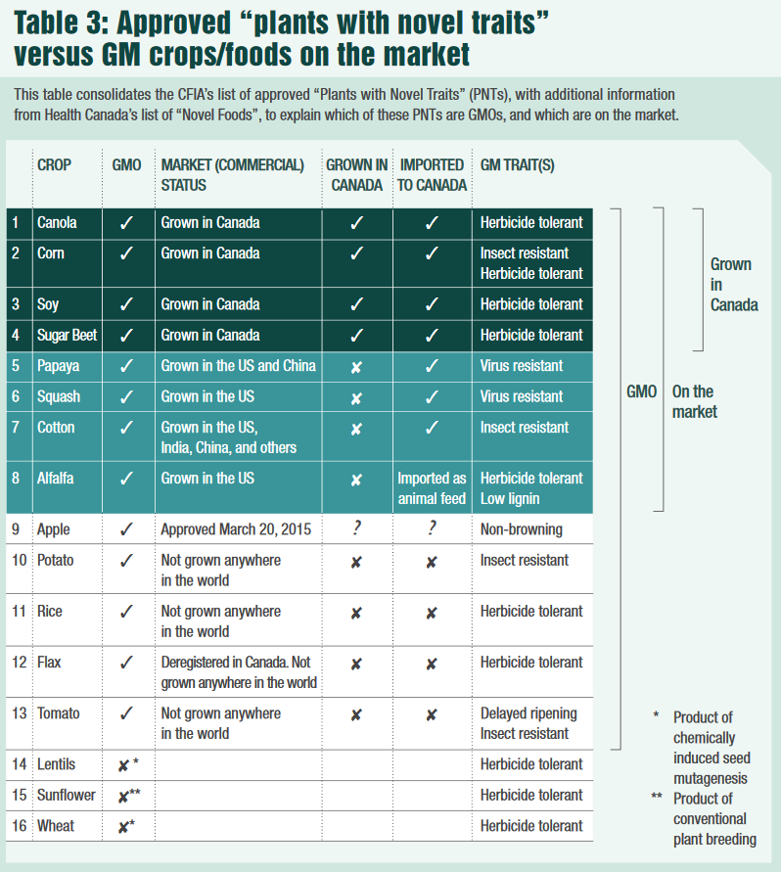
Source

Slide 10
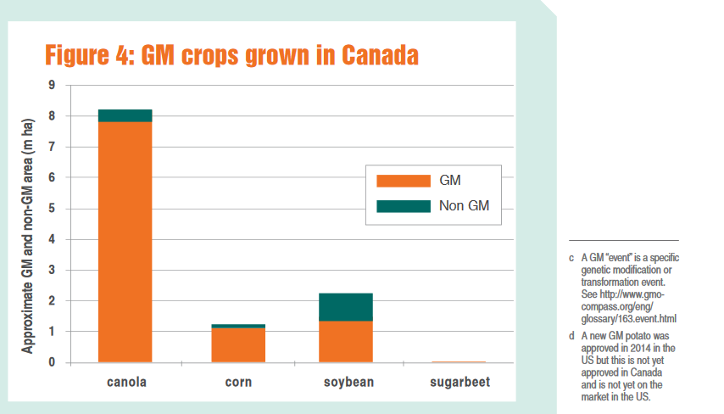
Source

Slide 11
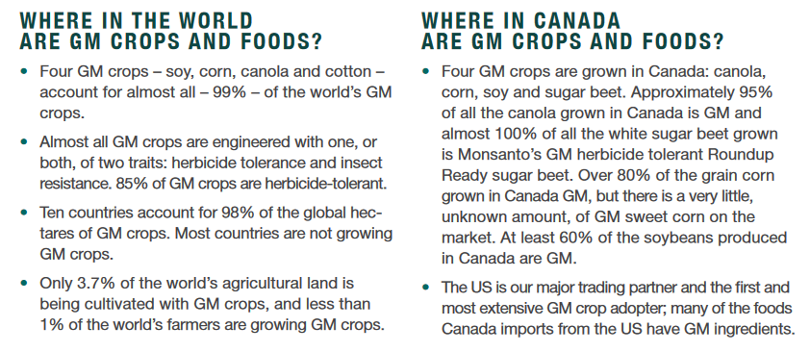
Source

Slide 12
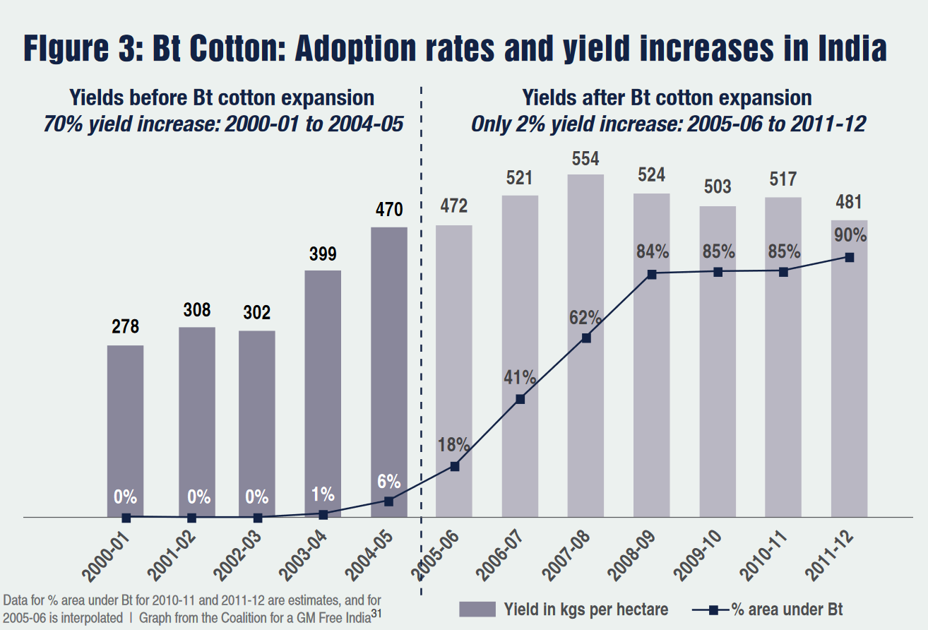
Source

Slide 13
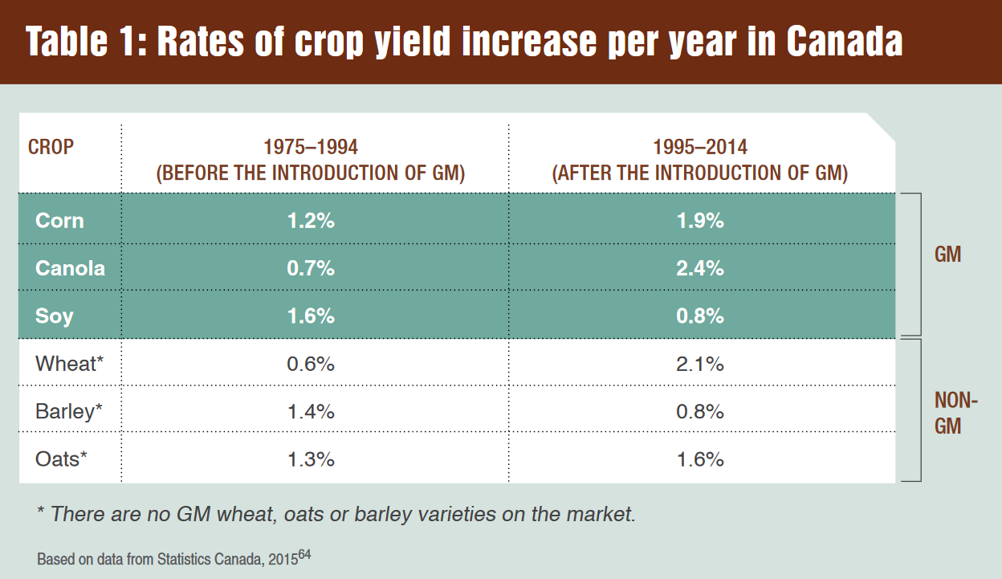
Source

Slide 14
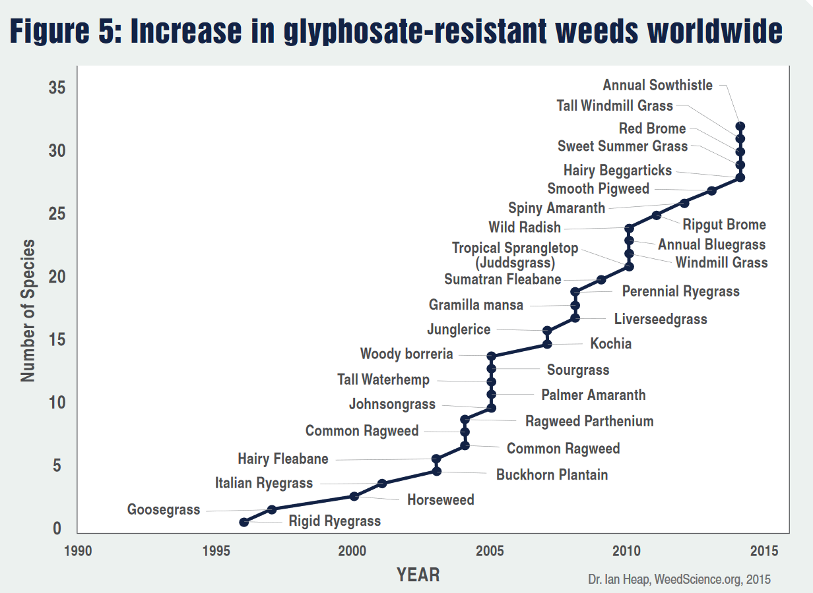
Source

Slide 15
GMOs in Canada Presently
GMO products that are presently on the market in Canada Alfalfa Canola Corn Cotton Papaya Salmon Soy Squash Sugar beet
GMO products that are not presently on the market in Canada Apple Flax Potato Rice Wheat
Source

Slide 16
Negative Consequences of GMOs
Health concerns with GMOs(Mae-Wan Ho) Health concerns with herbicide and pesticides Loss of Biodiversity Privatization of genetic material (restricted access) Rising cost of seed and chemicals Research funding being directed to GMOs instead of traditional breeding methods Financial burden to farms Pest resistance to Bt crops and glyphosate Reduction of pollinators Reduction of butterflies We still have not been able to feed the world!

Slide 17
Health Hazards of GMOs
Mae-Wan Ho
Uncontrollable, unpredictable impact on safety due to the genetic modification process
Scrambling of host gene, widespread mutations, inactive genes, activating genes, creating new transcripts, creating new proteins, etc.
Toxicity of transgene protein(s) introduced
Transgene protein toxic, transgene protein allergenic or immunogenic, Protein created by sequence insert may be toxic, etc.
Effects due to the GM insert and its stability
Genetic rearrangement with further unpredictable effects, horizontal gene transfer and recombination, spreading antibiotic drug resistance, creating new viruses and bacteria that cause disease, etc.
Toxicity of herbicides used with herbicide-tolerant GM crops

Slide 18
Thanks!
Questions or concerns?
Study Hard!
I can meet you Monday for any last questions.
Please e-mail me if you want to meet.

