Slide 1
Media, Technology and Politics
Political Economy of the media in canada
Erik Chevrier
October 4th, 2017

Slide 2
The Birth of Consumerism
You are a commodity to be sold to advertisers!
We Deliver Young People
YUL-LAB
Advertising and the End of the World

Slide 3
What is Capitalism?
Private ownership of the means of production
Labourers work for capitalists
Capital is virtual and physical
An exchange based system (money)
A system that permits the endless accumulation of wealth
Profit motive
Workers do not own the products of their labour
Alienation/exploitation/monopoly
Can manifest in many ways
  Corporatism
  No state intervention

Slide 4
Early Capitalism
(1600 - 1900)
Changing from feudalism & monarchism to capitalism
Little to no leisure time for working class
Rampant poverty
Mostly subsistence wages – people separated from self-reproduction
Work mainly done by hand or with assistance from basic machines and animals
Billboard and print advertising – then beginning of newspapers, magazines, railways, sea exploration, telegraph
People mainly consumed what they needed to survive

Slide 5
Middle Capitalism
(Late 1800 - 1950)
Development of more advanced machinery
Fordism & the introduction of more efficient assembly line practices
Workers are better paid
Work hours were reduced (more leisure time)
Radio, motion picture and beginning of TV
Introduction of psychology into advertising
Workers are able to consume luxury items over and above what they need to survive

Slide 6
Later Capitalism
(1950 - today)
Rapid advancement of science and technology
Planned obsolescence
Global expansion of industrialized capitalism
Expansion of products and services
Consumption is a central part of the market
Neo-liberalism – free trade agreements & deregulation
Advanced advertising techniques
Workers must be able to continuously consume in order for the capitalist market to function

Slide 7
Rise of Modern Advertising
Begin at about late 1600 in France billboard
1700 – Newspaper & magazine & advertising agencies as brokers
1900 – Sears & Cosmopolitan Magazine
1920 – Psychology & Ed Bernays & Radio
1950 – Television & motion picture
1980 – Internet & data mining
2000 – Product integration & interactive advertising
Today – Multiple profuse convergent network (clutter)

Slide 8
How is this Relevant to Media?
Media can be produced by governments, companies, groups, and individuals.
In a capitalist system:
  Media companies are capitalist firms in a global market
  Media messages (adverting) facilitate consumerism
  Media produces and reflects the ideology of capitalism
  Media products are sold on the capitalist market
  Media sell space and time to advertisers
  Consumers are commodities to advertisers

Slide 9
Why does it matter who owns the media?
  The media industry plays a central role in shaping social, cultural and political life (Noam, 2016, p. 1180)
  Noam Chomsky – Manufacturing Consent – (Short)
  Noam Chomsky – Manufacturing Consent – (Long)

Slide 10
Why does it matter who owns the media?
  The media industry plays a central role in shaping social, cultural and political life (Noam, 2016, p. 1180)
  Noam Chomsky – Manufacturing Consent – (Short)
  Noam Chomsky – Manufacturing Consent – (Long)
  Propaganda Model
  - Selection of topics - Determine
  - Distribution of concerns - Select
  - Emphasis - Shape
  - Framing of issues - Control
  - Filtering of information - Restrict
  - Bounding of debate - Serve the interest of a select elite group

Slide 11
Who owns the media?
It is important to understand…
  There are various types of ownership
    Non-commercial arrangements (governments, semi-independent public corporations, charities)
    Private ownership (individuals, families, partnerships, shareholders, institutional investors, private equity funds, venture capitalists, coops and non-profits)
    Depending on the type of ownership, the proprietor may not control managerial decisions (owners vs managers)
  Media owners provide platforms (means of production, methods of distribution)
  Media owners provide messages (content – propaganda model)

Slide 12
Canadian Media Concentration Research Project
Canadian Media Concentration Research Project Website
An updated report on Media Ownership and Concentration in Canada by Dwayne Winseck is available via this link

Slide 13
CRTC Regulations
CRTC Businesses and Licensing
Diversity of Voices Polity
  2 out of 3 – Newspaper, Television, Radio Station in same market
  Ownership caps – 35% - 45% potentially threatening, over 45% rejected
  Incumbent telephone and cable companies cannot consolidate to ‘control the internet’
  Vertical integration of programming – ¾ have to be produced from outside sources, 25% Canadian programming from independent producers
  Examples of CRTC rulings regarding these regulations are contained in this report

Slide 14
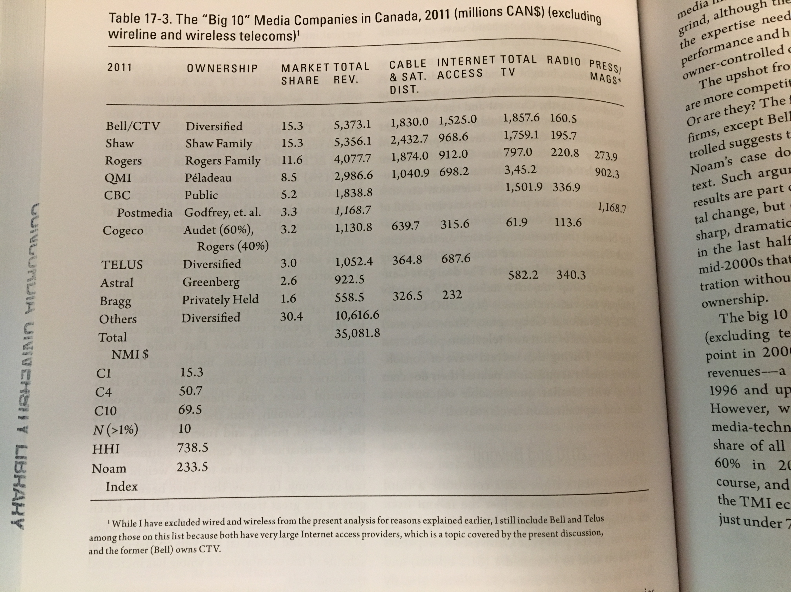
From the Assigned Readings – Up to 2011

Slide 15
Source

Slide 16
Source
Source

Slide 17
Comparison of Canada vs USA
Source

Slide 18
2015 Report on Media Concentration in Canada
Source

Slide 19
Vertical Integration: Content vs Connectivity
Source

Slide 20
Media Ownership in Canada Trends
Source

Slide 21
Source

Slide 22
Source

Slide 23
Media Ownership in Canada Trends
Source

Slide 24
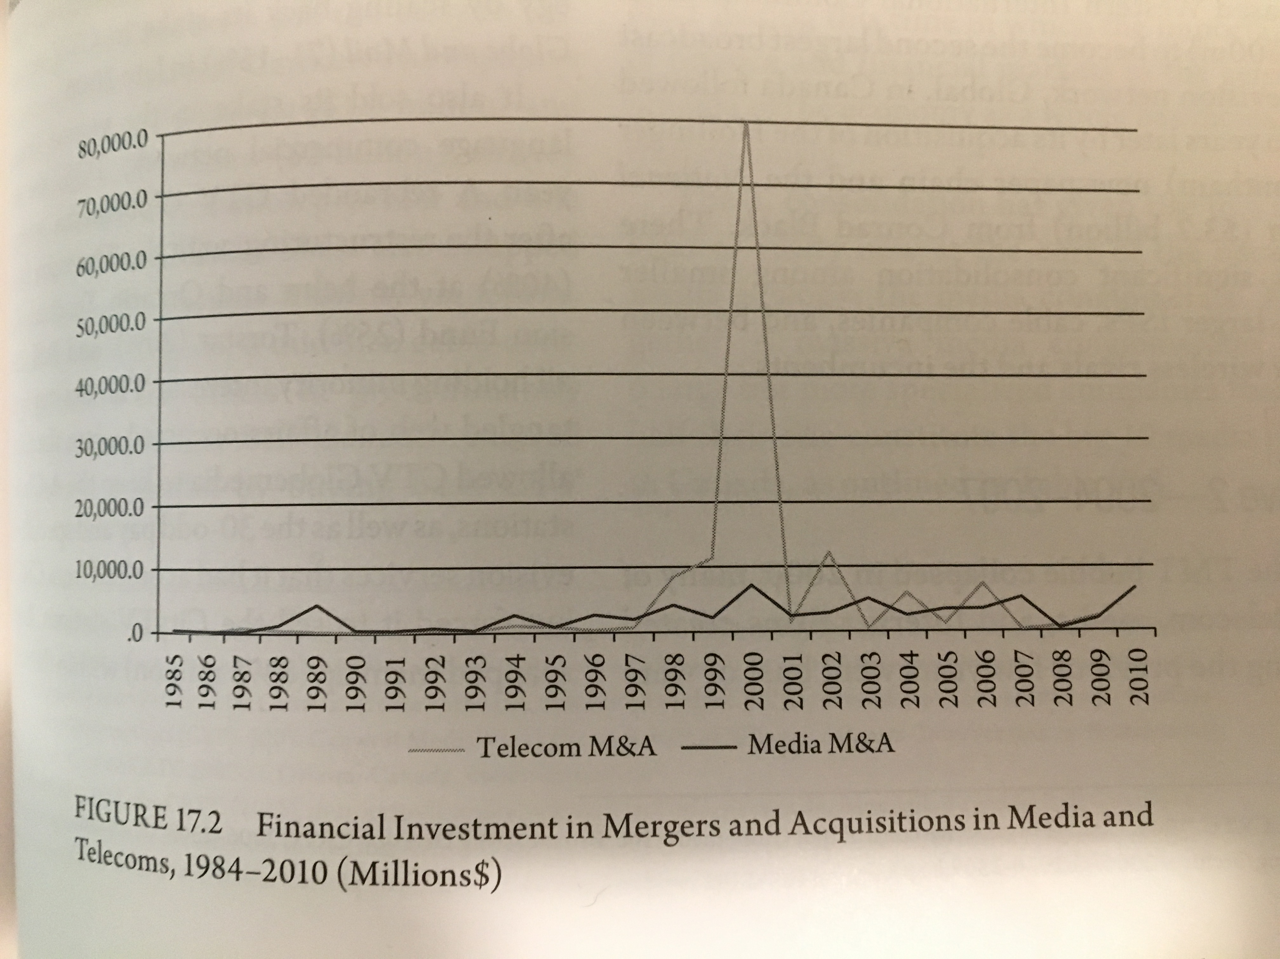
Waves of Media Consolidation

Slide 25
Wave One – 1994 - 2000
1994
Rogers took Maclean-Hunter
Conrad Black (Hollinger) took Southam
1998 - 2001
BCE took CTV and the Globe and Mail
Quebecor took Videotron, TVA and the Sun
Canwest took Western International Communications (Global Television)
Canwest took Hollinger, (Southam, National Post)
TELUS took Clearnet
A more detailed account of these acquisitions are available here.

Slide 26
Wave Two – 2004 - 2007
Rogers took Microcell (Fido)
Canwest had financial troubles sold small dailies to Transcontinental and Osprey
Craig Media created Toronto One channel
Quebecor took Toronto One after Craig Media went bankrupt
CHUM sold to Bell Globemedia
Bell Globemedia scaled back holdings in CTV and Globe and Mail
Rogers took City TV from CTV Globemedia
Astral Media took Standard Broadcasting
Quebecor took Osprey
Canwest and Goldman Sachs Alliance Atlantis (13 specialty pay channels)
A more detailed account of these acquisitions are available here.

Slide 27
Wave 3 – 2010 - 2015
Postmedia took Canwest newspapers
Shaw took Canwest TV stations
Bell Canada took back CTV
Bell took Astral Media
TELUS took Public Mobile
Rogers took Mobilicity
Postmedia took Quebecor’s English papers
A more detailed account of these acquisitions are available here.

Slide 28
Trends from Wave Analysis
Acquisitions and mergers happen periodically rather than being a constant process towards greater consolidation or competition
No media company is immune to consolidation
Consolidation gives rise to the media conglomerate
Internet ownership is not ‘solving’ the media concentration problem; mobile wireless is the most concentrated media sector

Slide 29
2015 Report on Media Concentration in Canada
Highlights:
  Google and Facebook account for more than 2/3 internet advertising revenue
  Mobile wireless is the most concentrated sector Rogers, Bell, TELUS account for over 90% revenue
  Bell, Shaw, Quebecor, CBC, Rogers own 217 TV channels and 86% of the market
  Bell and Shaw account for more than 50% of the TV market
  A more detailed account of these acquisitions are available here.

Slide 30
Who Owns the World Media
(Noam, E. M. (2016) Who Owns the World’s Media? Media Concentration and Ownership around the World, Oxford Press, p. 1172)
Top 10 Media Companies by Revenue | Revenue 2011 in Millions
Government of China | $201 366
AT&T (USA) | $124 611
Verizon (USA) | $104 767
NTT (Japan – 33% public) | $89 716
Telefonica (Spain) | $85 895
Comcast (USA) | $75 954
Deutsche Telekom (Germany – 38% public) | $69 558
Vodafone (UK) | $62 366
Softbank (Japan) | $55 707
Grupo Carso (Mexico) | $55 559

Slide 31
Who Owns the World Media
(Noam, E. M. (2016) Who Owns the World’s Media? Media Concentration and Ownership around the World, Oxford Press, p. 1177)
Top 10 Media Content Companies | Revenue 2013 in Millions
Murdoch Group (USA) | $32 516
Government of China | $27 936
Google (USA) | $26 747
Comcast (USA) | $26 307
Redstone Group (USA) | $18 041
Disney (USA) | $16 481
Bertelsmann (Germany) | $13 650
Time Warner (USA) | $12 554
BBC (UK – public) | $12 301
DirecTV (USA) | $10 571

Slide 32
Fagstein Blog
Fagstein Blog

Slide 33
Precursor for Next Class?
Should self-expression (aka. free speech) be regulated?
  If so, how?
  If not, why not?

Slide 34
Questions?
Questions or concerns?

