Slide 1
Food and Culture
Who Really feeds the world – Agroecology & Living Soils
Erik Chevrier
November 2nd, 2017

Slide 2
Discussion From Previous Course
How do we build an environmentally sustainable food system?
What are practices that should be promoted?
What are practices that should be avoided?
What are potential barriers to change?
How can we overcome the existing barriers?
How do we facilitate social change?

Slide 3
Discussion About Readings
November 7 – Race, Class, Food and Culture
Shiva, V. (2016) Who Really Feeds the World, North Atlantic Books Chapter 3 – Bees and Butterflies Feeds the World, Not Poisons and Pesticides, pp. 27 – 40 Chapter 4 – Biodiversity Feeds the World, Not Toxic Monocultures, pp. 41 – 54

Slide 4
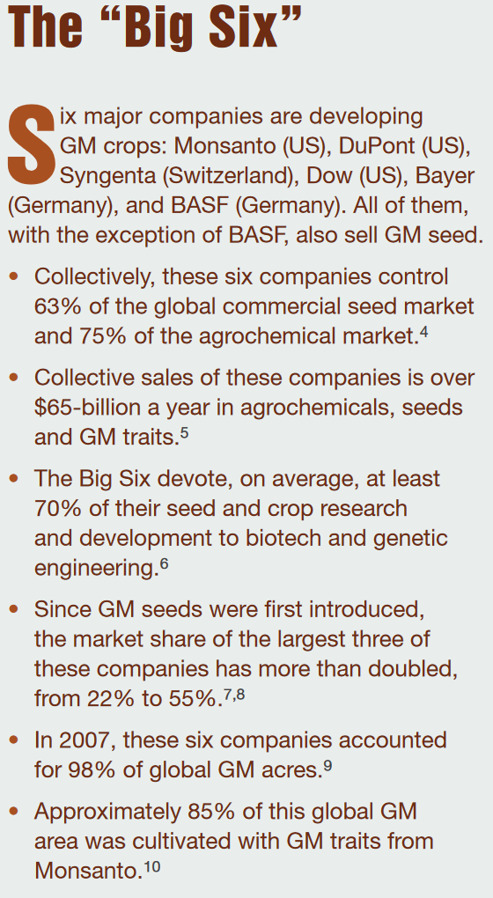
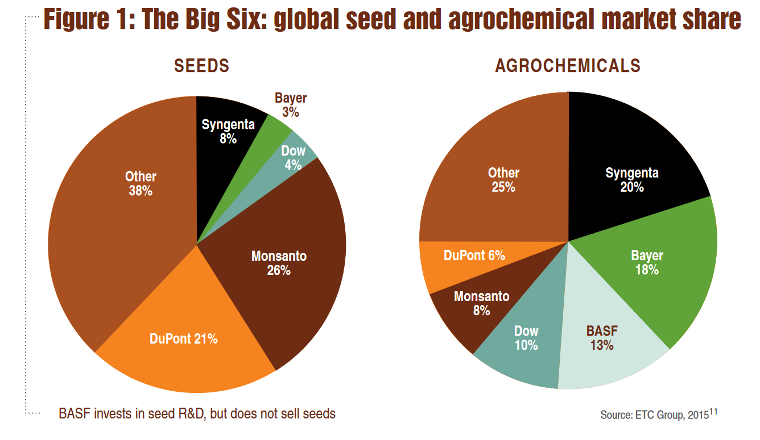
Source

Slide 5
Seed & Fertilizer Companies Merge Since the CBAN Report
Dow Chemical and DuPont have merged companies and are now called DowDuPont
ChemChina bought Syngenta
Bayer bought Monsanto but the deal has not gone through yet the deal is expected to be complete by 2018
BASF acquires seed and non-selective herbicide companies from Bayer to help reduce concerns of anti-trust violations

Slide 6
War Companies Now Food Companies
These are a few examples:
Monsanto produced Agent Orange and now is using it as a fertilizer
Bayer and BASF formed IG Farben a company who worked with the Nazis and tested chemicals and drugs on people

Slide 7
What is Agroecology?
In the agroecological paradigm of knowledge, and in organic farming, food is the web of life. Humans are part of this web, as cocreators and coproduces, as well as eaters. When we save seed and replant it, we become part of the cycle of life. When we return organic matter to the soil, we are feeding the soil’s organisms. Working according to nature’s law is participating in nature’s processes of creation and production. This is the basis of sustainable food and agricultural systems. An agroecological knowledge system feeds the world, not a violent, reductionist paradigm.

Slide 8
What is Agroecology?
The paradigm of agroecological knowledge reshapes the ways which we understand issues surrounding food.
It recognizes interconnections in nature and is based on the application of ecological science to food and agricultural systems, instead of a reductionist, mechanistic, and militarized approach
It promotes the health of the soil, plants, animals, and human beings
It enhances the ecological integrity of food production through the Law of Return
It conserves biodiversity and intensifies biodiversity services such as pollinators, rendering agrochemical inputs such as pesticides redundant
It maximizes “health per acre” and “nutrition per acre” instead of “yield per acre”
Is based on seed freedom, where the control of seeds lies with farmers, instead of a system that views seeds as corporate intellectual property
It creates the socioeconomic, political, and cultural context for the exercise of food freedom and food sovereignty
It is centered on woman’s knowledge of biodiversity, ecosystems, health, and nutrition instead of corporate controlled and manipulated knowledge based on monocultures
It is based on a sense of place and gives priority to the local, instead of the unfair privilege given to global corporations

Slide 9
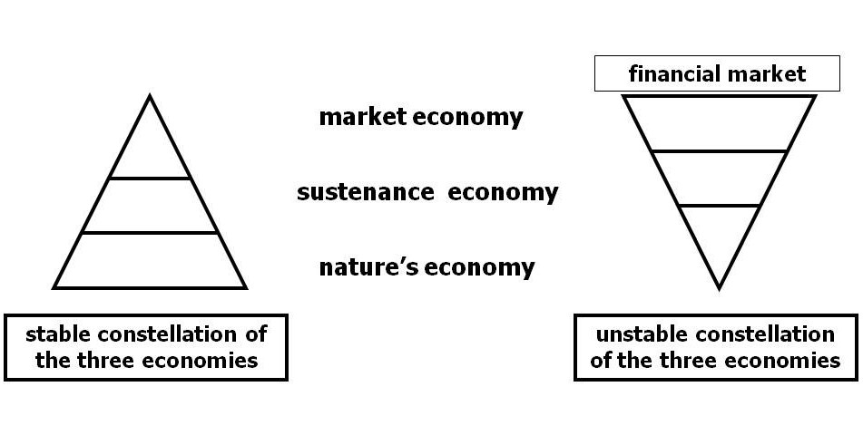
Living Economies Recap

Slide 10
Vandana Shiva Introduction
The Law of Return — All living beings give and take mutually
The Law of Exploitation – Taking without giving back
The Law of Domination – Humans exploiting nature

Slide 11
Commons Recap
Closing of commons:
1 – The exclusion of people from access to resources that had been their common property of held in common
2 – The creation of ‘surplus’ or ‘disposable’ people by denying rights of access to the commons that sustained them
3 – The creation of private property by the enclosure of common property
4 – The replacement of diversity that provides for multiple needs and performs multiple functions with monocultures that provide raw material 5 – The enclosure of minds and imagination, with the result that enclosures are defined and perceived as universal human progress, not as growth of privilege and exclusive rights for a few and dispossession and impoverished for the many
Terra matter – Mother earth
Terra nullius – Empty land

Slide 12
Commons Toolkit - Recap Gibson-Graham, J.K., Cameron, J., Healy, S. (2013) Take Back the Economy: An Ethical Guide for Transforming Communities, University of Minnesota Press
Types of commons:
Biophysical
Cultural
Social
Knowledge
Ways to assess commons:
Access
Use
Benefit
Care
Responsibility
Property

Slide 13
Living Soil Not Chemical Fertilizers
FAO Video About Soil
The Soil Story

Slide 14
Discussion about Paper
Get into groups of two
Step 1 – Each member will, in turn, provide a 2 minutes summary of your second paper related to food.
One person talks about their paper for 2 minutes, the other person listen and does not interrupt.
Step 2 – The member who was listening will provide feedback for 2 minutes
The one who presented their idea does not talk
Step 3 – Repeat step 1 but switch roles
You may address the following questions
What is your food item?
What you intend to write about?
What topics/subtopics you will?
What kind of sources you will search for?

Slide 15
Cooking Project Part 2 – November 9th
What are the positive and negative consequences surrounding the production, transformation, transportation, distribution, consumption and waste management processes of your food item?
First, identify your ingredients – then find out how your food item is produced, transformed, transported, distributed, consumed, and how much waste it produces.
You may include the following topics as discussion points –– labour, gender, class, privilege, colonial imposition, racial issues, health, economy, community, environmental footprint, etc.
You may go in depth about one of these topics if you think it warrants more attention, or you can provide a more general overview of a couple of these topics. You will not have enough space to cover all of these topics; therefore make sure you include what is most important to your food item.

Slide 16
Thanks!
Questions or concerns?

