Slide 1
Food and Culture
Who Really feeds the world – Bees, Butterflies & Biodiversity
Erik Chevrier
November 7nd, 2017

Slide 2
Discussion about Paper
Get into groups of two
Step 1 – Each member will, in turn, provide a 2 minutes summary of your second paper related to food.
One person talks about their paper for 2 minutes, the other person listen and does not interrupt.
Step 2 – The member who was listening will provide feedback for 2 minutes
The one who presented their idea does not talk
Step 3 – Repeat step 1 but switch roles
You may address the following questions
What is your food item?
What you intend to write about?
What topics/subtopics?
What kind of sources you will search for?

Slide 3
Cooking Project Part 2 – November 9th
What are the positive and negative consequences surrounding the production, transformation, transportation, distribution, consumption and waste management processes of your food item?
First, identify your ingredients – then find out how your food item is produced, transformed, transported, distributed, consumed, and how much waste it produces.
You may include the following topics as discussion points –– labour, gender, class, privilege, colonial imposition, racial issues, health, economy, community, environmental footprint, etc.
You may go in depth about one of these topics if you think it warrants more attention, or you can provide a more general overview of a couple of these topics. You will not have enough space to cover all of these topics; therefore make sure you include what is most important to your food item.

Slide 4
Discussion About Readings
November 9 – Seed Sovereignty and Small-Scale Farmers
Shiva, V. (2016) Who Really Feeds the World, North Atlantic Books Chapter 5 – Small-Scale Farmers Feed the World, Not Large-Scale Industrial Farms, pp. 55 – 66. Chapter 6 – Seed Freedom Feeds the World, Not Seed Dictatorship, pp. 67 – 84.

Slide 5
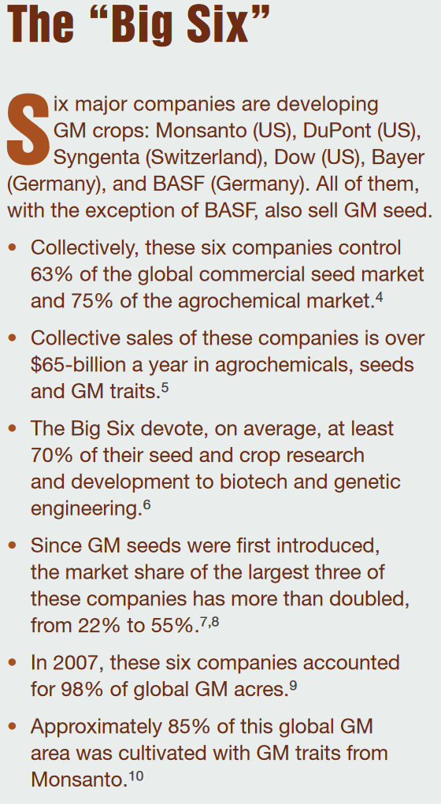
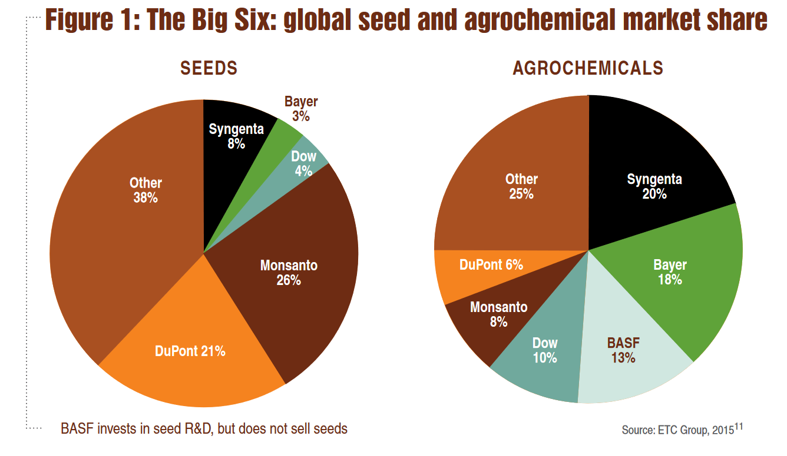
Source

Slide 6
Seed & Fertilizer Companies Merge Since the CBAN Report
Dow Chemical and DuPont have merged companies and are now called DowDuPont
ChemChina bought Syngenta
Bayer bought Monsanto but the deal has not gone through yet the deal is expected to be complete by 2018
BASF acquires seed and non-selective herbicide companies from Bayer to help reduce concerns of anti-trust violations

Slide 7
War Companies Now Food Companies
These are a few examples:
Dow Chemical Invented Agent Orange
Monsanto produced Agent Orange and now is using it as a fertilizer
Bayer and BASF formed IG Farben a company who worked with the Nazis and tested chemicals and drugs on people including Zyklon B
The Bhopal disaster: Toxic legacy
One Night in Bhopal
The Bhopal Disaster

Slide 8
Living Soil Not Chemical Fertilizers
FAO Video About Soil
The Soil Story

Slide 9
Documentary to Watch
Seed: The Untold Story (Trailer)

Slide 10
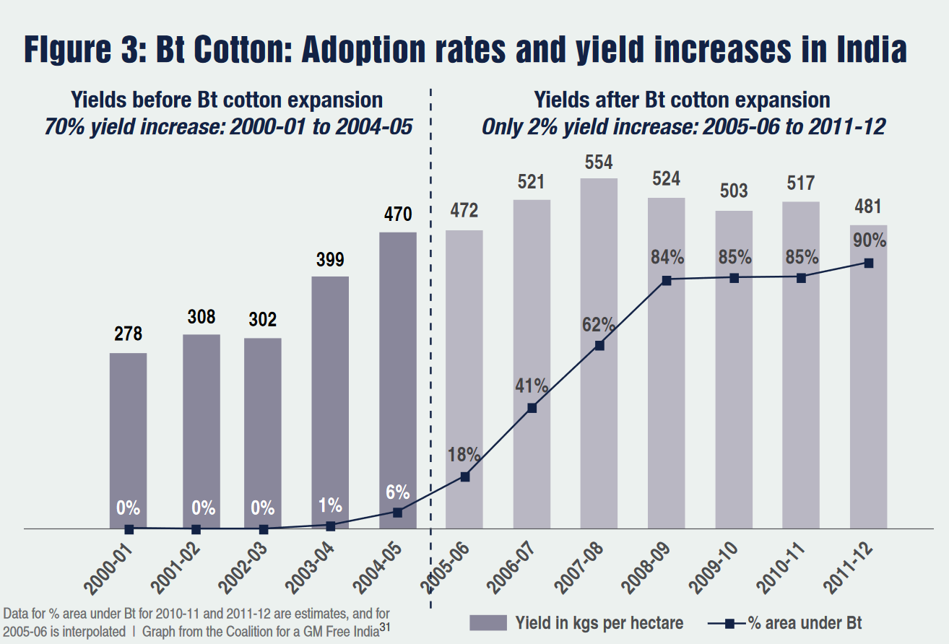
Source

Slide 11
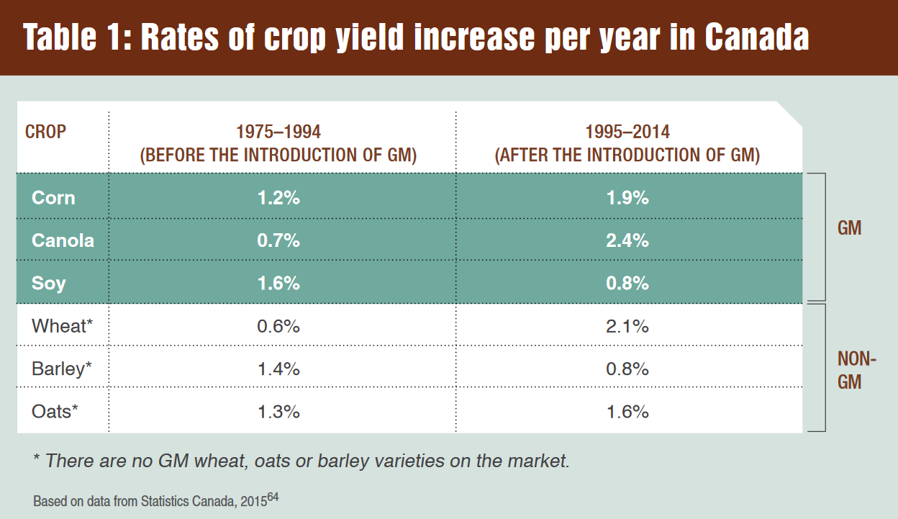
Source

Slide 12
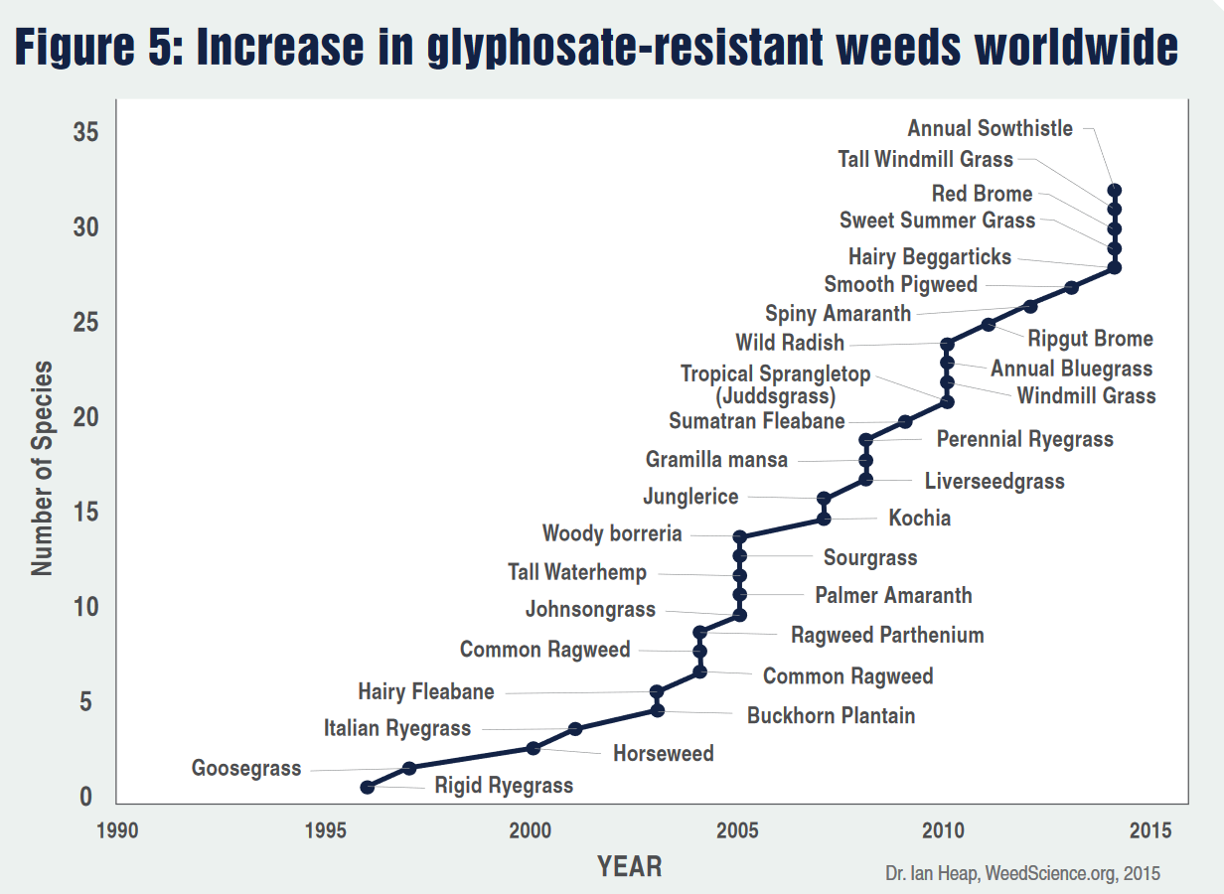
Source

Slide 13
War Against Pests (Vandana Shiva)
Pests are controlled when there is an ecological balance among diverse components in a farming system, and biodiversity is our best friend in dealing with pest problems. This works on two levels.
1 – Ecological balance through biodiversity is the best pest control mechanism, and friendly insects such as lady bugs, beetles, solider beetles, spiders, wasps, and the praying mantis all contribute to this process.
Push and pull system
2 – If there is a pest outbreak, biodiversity offers ecological alternatives in the form of botanical pest control agents, such as neem.
FAO Area Wide Pest Management

Slide 14
Fighting Back Against Pesticide & Fertilizer Companies (Vandana Shiva)
France banned Gaucho – a broad-spectrum insecticide, due to its toxicity to bees and other forms of life, including humans.
On April 29, 2013, the European Union banned the use of nicotinoids to protect bees. This decision was blocked by Bayer.
On May 6, 2014, the Chinese Government announced that GMO grain, food, and oil would no longer be supplied to its military.

Slide 15
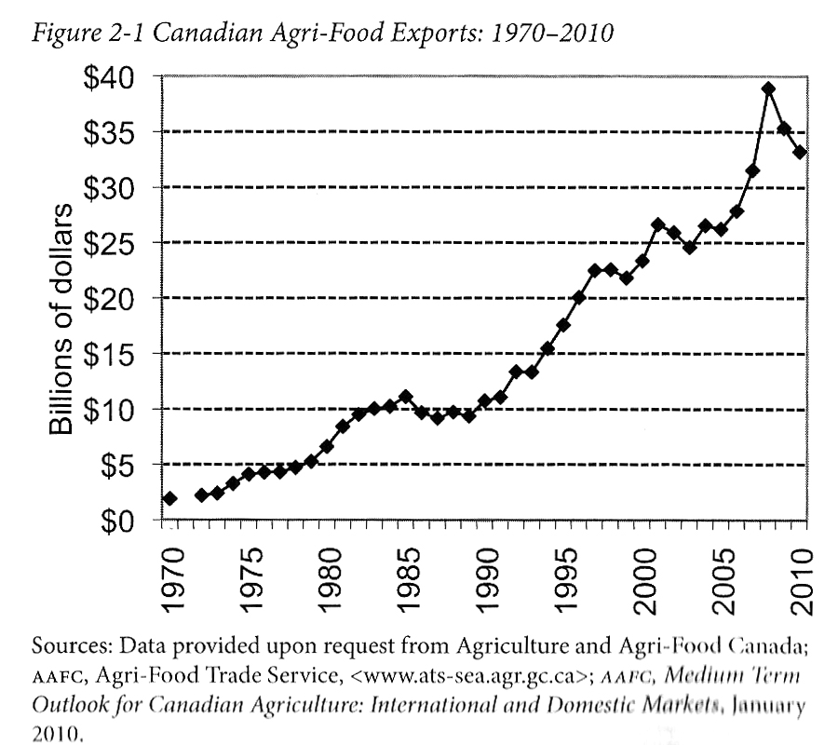
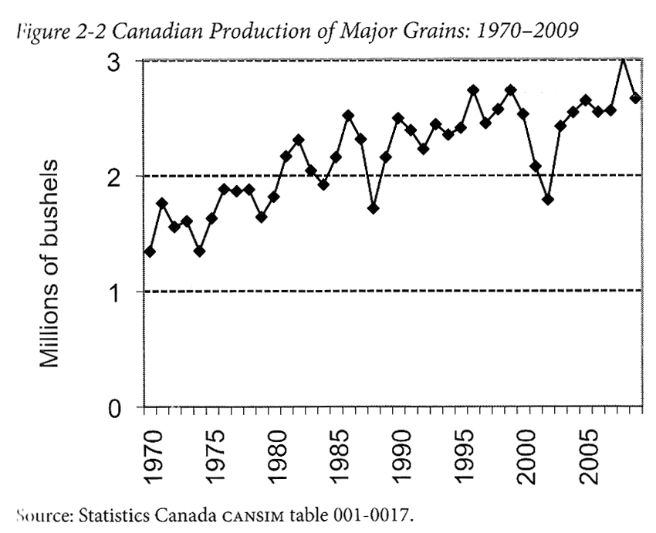
Advancing Agriculture by Destroying Farms? The State of Agriculture in Canada Qualman, D. (2011) Advancing Agriculture by Destroying Farms? The State of Agriculture in Canada, pp. 20 – 42. In, Wittman, H., Desmarais, A. A., & Wiebe, N. (2011) Food Sovereignty in Canada: Creating Just and Sustainable Food Systems, Fernwood Publishing

Slide 16
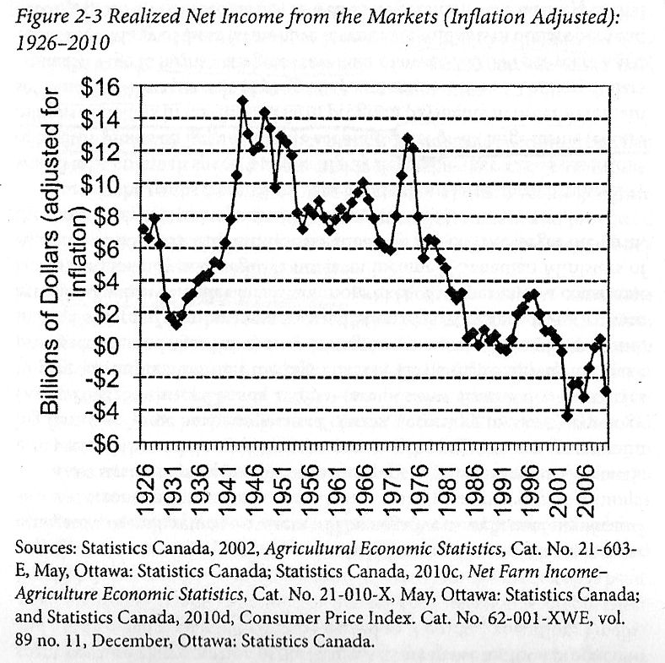
Advancing Agriculture by Destroying Farms? The State of Agriculture in Canada Qualman, D. (2011) Advancing Agriculture by Destroying Farms? The State of Agriculture in Canada, pp. 20 – 42. In, Wittman, H., Desmarais, A. A., & Wiebe, N. (2011) Food Sovereignty in Canada: Creating Just and Sustainable Food Systems, Fernwood Publishing

Slide 17
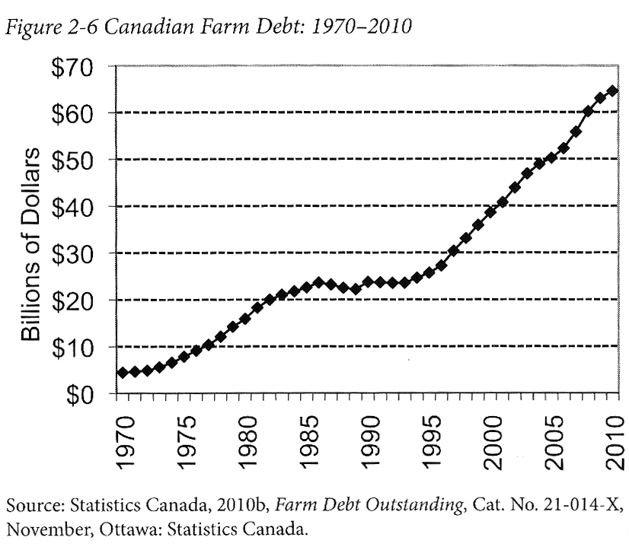
Advancing Agriculture by Destroying Farms? The State of Agriculture in Canada Qualman, D. (2011) Advancing Agriculture by Destroying Farms? The State of Agriculture in Canada, pp. 20 – 42. In, Wittman, H., Desmarais, A. A., & Wiebe, N. (2011) Food Sovereignty in Canada: Creating Just and Sustainable Food Systems, Fernwood Publishing

Slide 18
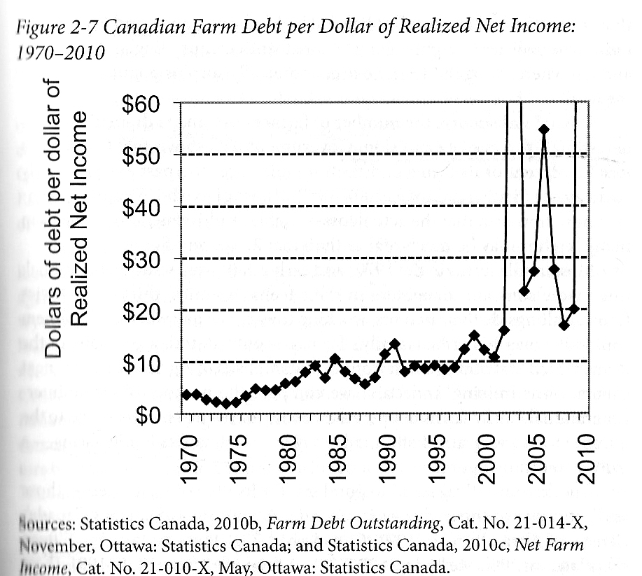
Advancing Agriculture by Destroying Farms? The State of Agriculture in Canada Qualman, D. (2011) Advancing Agriculture by Destroying Farms? The State of Agriculture in Canada, pp. 20 – 42. In, Wittman, H., Desmarais, A. A., & Wiebe, N. (2011) Food Sovereignty in Canada: Creating Just and Sustainable Food Systems, Fernwood Publishing

Slide 19
Biodiversity
Seed Saving Movement Navdanya
System to monitor ecological changes (Navdanya):
Provides documentation of the biodiversity status of a farm, including crop, tree and animal biodiversity
Indicates the contribution of biodiversity to provisioning of internal inputs and to the building and maintenance of nature’s economy through the conservation of the soil, water, and biodiversity
Indicates the contribution of biodiversity to the self-provisioning of food needs by agricultural families and communities, and to the building and maintenance of people’s economy
Reflects the market economy of the farm in terms of incomes from the sale of agricultural produce, as well as the additional costs for extremal inputs and retail food when biodiversity is lost
Baranaja: Twelve Seeds of Sustainability

Slide 20
Thanks!
Questions or concerns?

