Slide 1
Media, Technology and Politics
Encoding and decoding messages & Media effects
Erik Chevrier
November 8th, 2017

Slide 2
Encoding vs Decoding
To decode, we must make inferences about the encoding process:
Most of the time, we do not know:
The intensions of the encoders
The reason behind using certain ‘codes’ over others
The market/demographic research used to make the ‘codes’
The thought process of those who produced the ‘codes’
To understand the encoding/decoding process, we should take into account:
Intended and unintended effects
Positive and negative effects

Slide 3
Content Analysis
The scientific exploration of texts in order to test inferences about the content of that text (mainly descriptive but can be paired with other inferential methods)
Provides an ‘accurate’ statement of what is in the text
Does not reveal the true intentions of the ‘producer’ nor explain how it will affect every individual
Evaluates denotative meanings or manifest content (as opposed to latent content)
While designing a content analysis experiment, you should:
Devise a testable hypothesis
Operationalize and code your variables
Chose a method of analysis
Topics that may be investigated with content analysis:
Processes, groups, issues, events
Some things to keep in mind:
Internal validity
External validity
Reliability
Replicability
Sampling
Systematic

Slide 4
Content Analysis
Advantages of content analysis (Riffe, Lacy, Fico):
Nonobtrusive, nonreactive measurement technique
Longitudinal study potential
Reduction to numbers summarizing large amounts of information
Unlimited applicability
Useful or necessary when (Riffe, Lacy, Fico):
Data accessibility is a problem, limited to using documentary evidence
Communicators language use and structure is critical
The volume of material exceeds capacity to investigate it

Slide 5
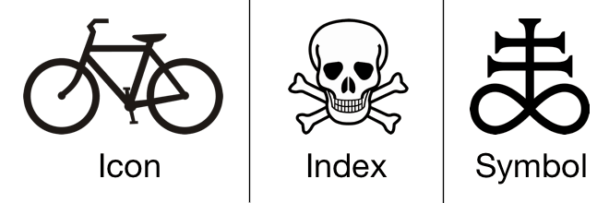
Discourse Analysis
An analysis of a text that goes beyond its overt elements
Semiotic analysis (we will explore this in more detail next lecture)
Nesbitt-Larking
Semiotic analysis of discourse is centred on the deconstruction of those codes that are invoked in the communication of meaning
Codes are signs that have been culturally and ideologically organized in order to attach them to certain referents
Signs come in 3 forms
Icons – Resemble objects to which they refer
Indexes – Signs that are immediately implied in their referent
Symbols – Bear no obvious resemblance to their referents but come to be associated to them

Slide 6
Recap - Political Culture, Ideology, and Media
Signs – A combination of signifier and signified
Signifier – The physical existence of what carries meaning
Signified – The mental representation that is the meaning
Denotative meaning – Common sense, obvious meaning
Connotative - Interaction of denotative meaning and one’s subjective feelings
Factors that influence the extent to which people are impacted by cultural symbols (Schudson)
Retrievable in memory (priming)
Rhetorical force (ability to move us)
Resonance (ability to tie to other cultural symbols)
Institutional retention (linking to existing structures of power and influence)
Resolution (ability to motivates, convinces, structures understanding)

Slide 7
Deciphering Advertisements (Jib Fowles, (1996) Deciphering Advertisements)
Context for the ad
Product category?
Which medium does it appear?
Who is the intended audience?
Implications for the ad
What is the ad implying about relationships between people?
What is this ad saying about identity and gender relations?
What does the ad convey about social status?
What kind of cultural beliefs are displayed in the ad?
How does the ad attempt to commodify human experience?
Looking at the ad
What are the aesthetic properties of the ad?
Photograph or drawing (retouching?)
What is in the foreground?
What is the commodity?
Subtract the commodity and look at the ad’s symbolic appeal
List various elements pictured in the symbolic appeal
What are the meanings of these symbols in relation to the intended audience?
What are the inferred states of mind of humans in the ads?
Where is the space in which the ad is situated?
What is the timeframe in which the ad is situated?
Consider the ad as a narrative, can we tell the story?
What is missing?
Does the symbolic appeal idealize anything?
Imagine someone looking at the ad, what state of mind would they be in? What does the ad supplement to their state?
Is there intertextual referents from something earlier?
What is in frame, what is framed out?

Slide 8
Levi's – Go Forth - Video

Slide 9
Media Effects
Media effects research usually describes the reception/reading of codes/forms/texts
Receivers are also affected by (and have an effect on)
Media organizations and technology
Political and socio-economic environment
Media Organizations and technologies are affected by (and have an effect on)
Political and socio-economic environment
Receivers (audiences)
McLuhan – The Medium is the message
Machines are an extension of our human experience and bodily sensations

Slide 10
How are you Affected by Media General Examples
Very basic examples of how I can affect your emotional state via video
Example 1
Example 2
Example 3
Small variations in media texts produce different interpretations
Example
People are fallible
Example
What do people learn from media?
Example

Slide 11
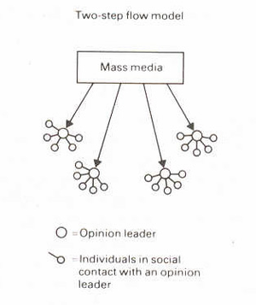
Looking at Nesbitt-Larking
Moral panic
Magic bullet/hypodermic
War of the Worlds
War of Worlds follow up
Manufacturing Consent
Colin Powell Speech about Weapons of Mass Destruction
Leni Riefenstahl’s Triumph of Will – Nazi Propaganda Video
Donald Trump Pledge
Richard Spenser – Hail Trump Video
Limited effects/uses and gratifications
Two-step communication flow/discursive elaboration
Selective attention/cognitive beliefs/selective recall
Critical perspective
Freedom within determining conditions
Personality
Polysemic
Gendered reading formations
Ontological
Engagement with Media

Slide 12
Media Fantasy Becomes Reality
Jean Baudrillard
The media – especially when the content is fictional and fantastic – are more real than the world they proport to represent.
The symbolic structure of the media is so powerful that the meaning is dissolved as mere content is relegated to the demands of form.
Verisimilitude - They appear to be real.
Mark Poster
Mediation is becoming so intense and worked over that ‘reality’ is consistently in question
Nesbitt-Larking
Forms that blend reality:
Infotainment
Docudrama
‘Faction’ – blending fact from fiction
Reality television
News/entertainment spoof

Slide 13
How to Propagate Effectively
The next section is an overview of leading theories regarding factors that help influence people.
If you will be involved in political campaigning or devising media strategy, you should utilize some of the following methods.
The power of words in regards to memory

Slide 14
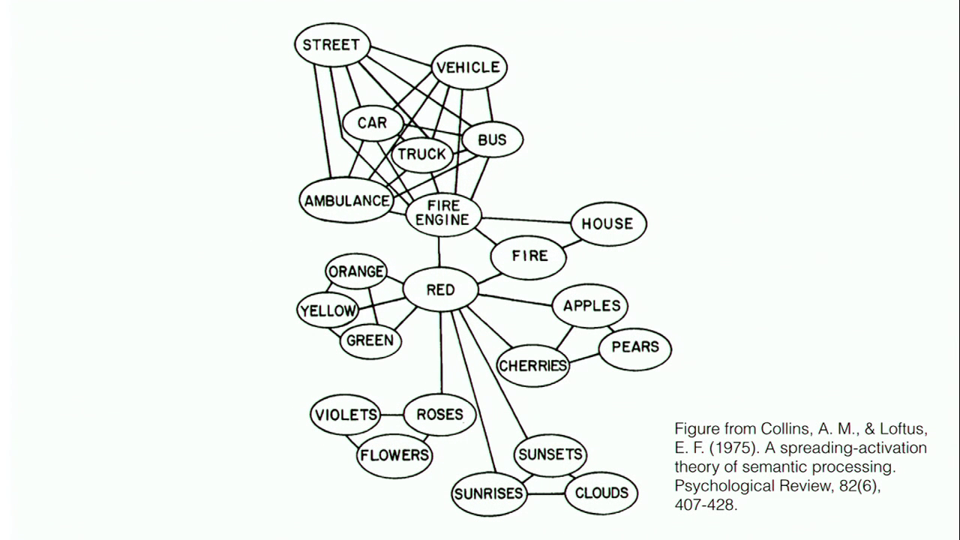
Priming/Framing/Schema
Cognitive Model
Semantic Processing – Spreading Activation

Slide 15
The Power of Suggestion
An Inquiry Into How People Are Affected by Profuse Amounts of Publicity: A Multidisciplinary Approach
Advertising as a suggestion – Page 26
Suggestions can bypass critical thought because there is no direct request to refuse

Slide 16
The Psychology of Influence
Robert Cialdini
Six weapons of influence
1 – Reciprocation
2 – Commitment and consistency
3 – Social proof
4 – Liking
5 – Authority
6 – Scarcity

Slide 17
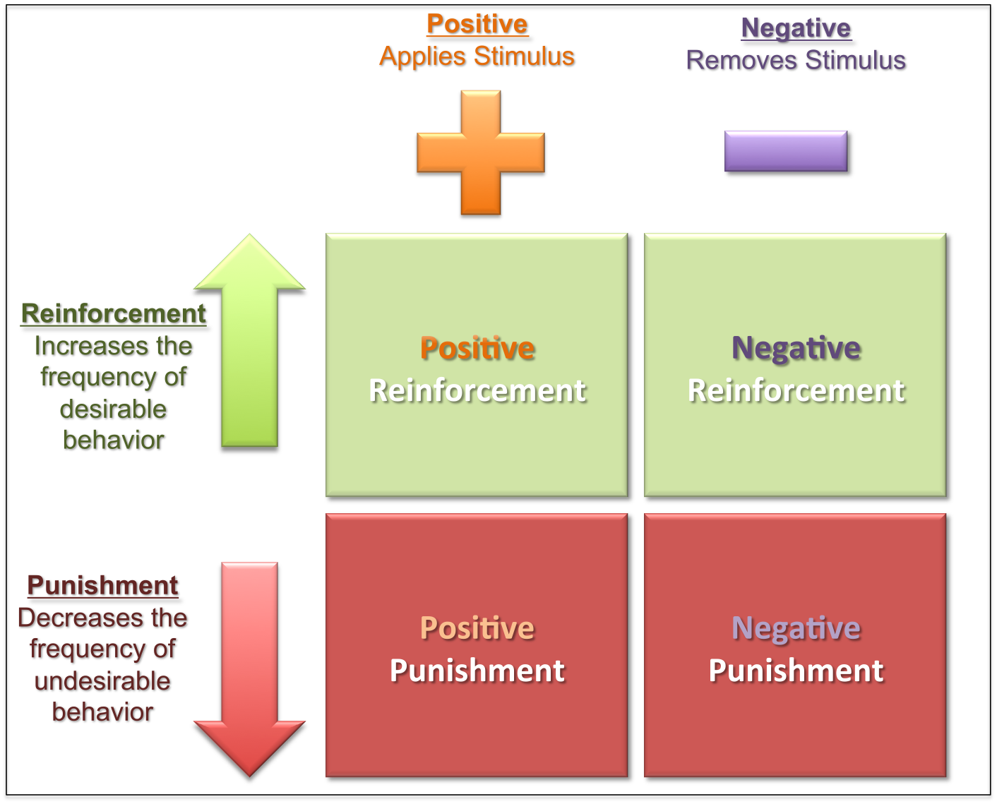
Learning Theories
Social modeling
Operant conditioning
Classical conditioning
Internal vs external motivation

Slide 18
Changing Values and Attitudes
Values:
Desirable, trans-situational goals, varying in importance, that serve as a guiding principles in people’s lives
Attitudes:
An internal state that, given the occurrence of certain stimulus events, will ultimately result in some sort of response or behaviour.
Cognitive dissonance:
Cognitive dissonance is a state of psychological tension occurring when thoughts, beliefs, attitudes, and/or behaviours are in conflict with each other.
Key Factors:
Ratio of dissonance Importance of factors in dissonance
Avoiding dissonance
1 – Modify 2 – Change importance 3 – Rationalize 4 – Add new consonant beliefs to bolster

Slide 19
Compliance Techniques
Foot in the door: An individual who agrees to carry out a small request is subsequently more likely to agree to carry out a larger request
Door in the face/reciprocal concessions: When the person making the larger request reduces it to a smaller one, the other person feels obliged to make a matching concession
Low-ball/bait and switch: When an agreement is made, the offer reduces in value
Improving the deal: When a product is offered at a high price, then after a brief pause, another product is offered to the deal or the price is reduced
Guilt: People comply to reduce feelings of guilt

Slide 20
Factors that Help Influence
Groupthink
In group vs out group
Conformity to group
Social Roles – Stanford prison experiment
Physical Factors
Appearance/attractiveness
Likability
Similarities
Non-verbal communication
Emotional Appeal
Fear
Sadness
Embarrassment
Confidence
Savvy Media Consumer Appeal:
Honest about media influence
Contagion:
When large crowds form, people may behave in ways that is extreme and unlike their normal behaviour

Slide 21
To Be Continued Next Class…
Questions or concerns?

