Slide 1
Fundamentals of Social Psychology
The Self in a social context
July 18th, 2018
Erik Chevrier

Slide 2
Activity
Get into groups of about 4 people.
Everyone take turns answering the following question…
Who are you?

Slide 3
Video
Increase your self-awareness –Tasha Eurich

Slide 4
Origins of the Self
In humans, the self-recognition develops between 18 – 24 months.
There is evidence that other animals have rudimentary self-concepts
Chimpanzees
Orangutans
Dolphins
Elephants
Magpies

Slide 5
Self-Concept Clarity Scale
1. My beliefs about myself often conflict with one another.
2. On one day I might have one opinion of myself and on another day I might have a different opinion.
3. I spend a lot of time wondering about what kind of person I really am.
4. Sometimes I feel that I am not really the person that I appear to be.
5. When I think about the kind of person I have been in the past, I'm not sure what I was really like.
6. I seldom experience conflict between the different aspects of my personality.
7. Sometimes I think I know other people better than I know myself.
8. My beliefs about myself seem to change very frequently.
9. If I were asked to describe my personality, my description might end up being different from one day to another day.
10. Even if I wanted to, I don't think I could tell someone what I'm really like.
11. In general, I have a clear sense of who I am and what I am.
12. It is often hard for me to make up my mind about things because I don't really know what I want.

Slide 6
Self-Concept Clarity Scale
1. My beliefs about myself often conflict with one another.*
2. On one day I might have one opinion of myself and on another day I might have a different opinion.*
3. I spend a lot of time wondering about what kind of person I really am.*
4. Sometimes I feel that I am not really the person that I appear to be.*
5. When I think about the kind of person I have been in the past, I'm not sure what I was really like.*
6. I seldom experience conflict between the different aspects of my personality.
7. Sometimes I think I know other people better than I know myself. *
8. My beliefs about myself seem to change very frequently.*
9. If I were asked to describe my personality, my description might end up being different from one day to another day.*
10. Even if I wanted to, I don't think I could tell someone what I'm really like.*
11. In general, I have a clear sense of who I am and what I am.
12. It is often hard for me to make up my mind about things because I don't really know what I want.*
* Indicates reverse-keyed item.

Slide 7
Self-Schemas
Self-Schemas
An organized body of knowledge about the self that influence what people notice, think, and remember about themselves
They affect and are affected by memory
Affected by a desire to see ourselves in a positive light
According to Reeve, J. (2015) Understanding Motivation and Emotion, 6th ed. John Wiley and Sons
Self-concepts are:
An individual’s mental representation of themselves
Constructed from experiences and reflections from those experiences
People get feedback about their personal attributes, characteristics, and preferences
People translate their multitude of specific experiences into a general representation of the self
A collection of domain specific schemas
The self-schemas that are involved in the definition of the self-concept are those that are most important to the person

Slide 8
Self-Concept
Self-concept clarity – The extent to which knowledge about the self is stable; and clearly and consistently defined.
People with low self-concepts:
experience low self-esteem, are more prone to depression, are more prone to neuroticism, are less awareness of their internal states, engage in chronic self-evaluation, partake in rumination, self-handicap more, and are less likely to engage in positive forms of self-focus
People with a clear sense of self-concept:
experience higher self-esteem, self-satisfaction and well-being, and have more self-compassion

Slide 9
Self-Concept
Cultural differences
Independent view of self – Defining oneself in terms of one’s own internal thoughts, feelings, and actions, and not in terms of the thoughts, feelings, and actions of other people.
Usually from ‘individualist’ cultures
Interdependent view of the self – Defining oneself in terms of one’s relationship to other people; recognizing that one’s behaviour is often determined by the thoughts, feelings and actions of others
Usually from ‘collectivist’ cultures
Concept clarity does not affect self-esteem as much in collectivist cultures
Gender Differences?
Relational interdependence – Defining yourself through close relationships
Women from individualist cultures
Collective interdependence – Defining yourself in terms of social groups
Men from individualist cultures
In collectivist cultures, women and men are equally likely to hold a relational vide of themselves

Slide 10
Knowing Ourselves Through Introspection
Introspection – The process whereby people look inward and examine their own feelings, thoughts, and motives
People do not often rely on introspection
People are not always aware of the reasons for their feelings, thoughts, and motives
How well do you really know yourself? Do you know the ‘real’ reasons for your feelings, thoughts and motives
On a scale of 1 – 10, how would you rate your accuracy in introspection?

Slide 11
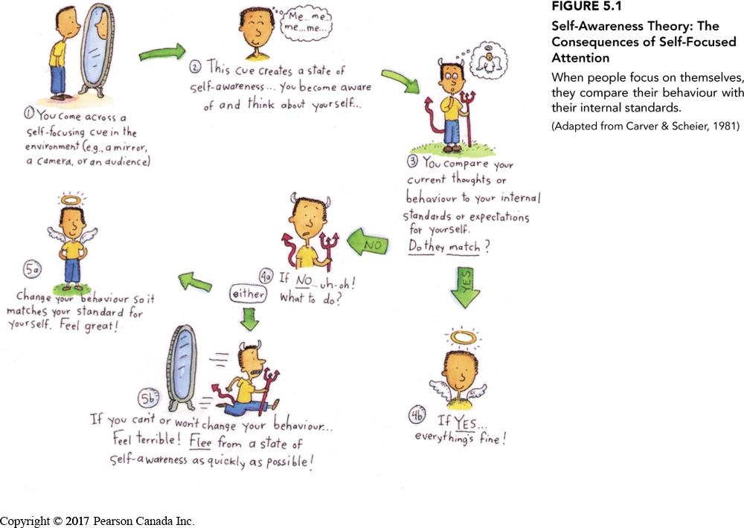
Self-Awareness Theory
Self-awareness theory – The ideas that when people focus their attention on themselves, they evaluate and compare their behaviour with their internal standards and values.

Slide 12
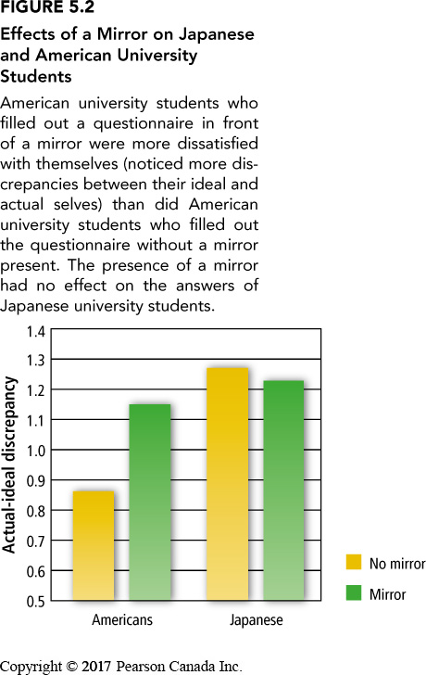
Cultural Differences in Self-Awareness
Outsider perspective of the self – viewing themselves through the eyes of other people
More likely in collectivist cultures
Insider perspective of the self – focus on private experiences without considering how other people see them
More likely in individualist cultures

Slide 13
Judging Why We Feel The Way We Do : Telling More Than We Know
Telling more than we know phenomenon – People’s explanations of their feelings often go beyond what they can reasonably know. (Nisbitt & Wilson)
People often misattribute mood explanations
Blue Mondays
Fun Fridays & weekend
Causal theories – Theories about the causes of one’s own feelings and behaviours; typically, we learn such theories from our culture

Slide 14
Knowing Ourselves by Observing Our Own Behaviour
Self-perception theory – When our attitudes and feelings are uncertain or ambiguous, we infer these states by observing our behaviour and the situation in which it occurs
We infer our inner feelings from our behaviour only when we are not sure how we feel.
People evaluate whether their behaviour really reflects how they feel or whether the situation they are in made them act that way.
Intrinsic motivation – The desire to engage in an activity because we enjoy it or find it interesting, not because of external rewards or pressure
Extrinsic motivation – The desire to engage in an activity because of external rewards or pressures, not because we enjoy the task or find it interesting

Slide 15
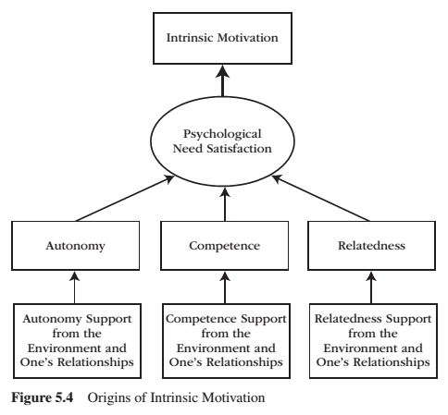
Intrinsic Motivation
Intrinsic motivation is the inherent propensity to seek out novelty and challenge, to extend and exercise one’s capacities, to explore, and to learn.
It is a natural inclination towards exploration, spontaneous interest, and environmental mastery that emerges from innate strivings for personal growth and from experiences of psychological needs satisfaction.
According to Reeve, J. (2015) Understanding Motivation and Emotion, 6th ed. John Wiley and Sons

Slide 16
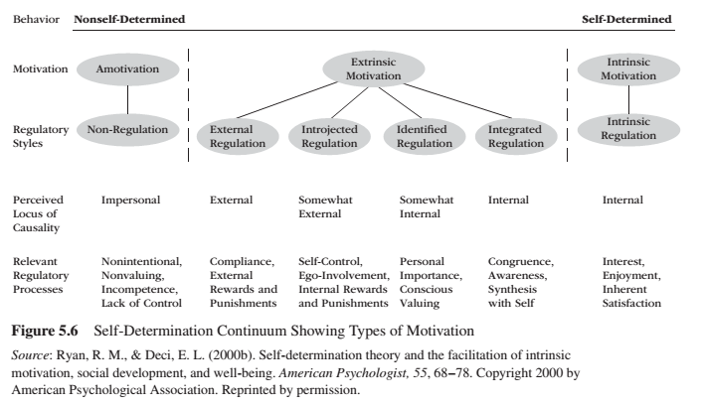
Types of Extrinsic Motivation According to Reeve, J. (2015) Understanding Motivation and Emotion, 6th ed. John Wiley and Sons

Slide 17
Knowing Ourselves by Observing Our Own Behaviour
Overjustification effect – The case whereby people view their behaviour as caused by compelling extrinsic reasons, making them underestimate the extent to which their behaviour were caused by intrinsic reasons
Preserving intrinsic interest
Task contingent rewards – Reward for a task regardless of how well the task is done.
Performance-contingent rewards – Rewards that are based on how well we perform a task
Rewards can undermine intrinsic motivation (unless rewards are not tangible or expected)

Slide 18
Knowing Ourselves…
Through Social Interaction
Looking-glass self – The idea that we see ourselves through the eyes of other people and incorporate their views into our self-concept.
Who we are is determined in part by the internal audience we have in mind.
By Comparing Ourselves to Others
Social comparison theory – The idea that we learn about our own abilities and attitudes by comparing ourselves with others
When there is no objective standard for us to measure ourselves against and when we experience some uncertainty about ourselves in a particular area
With who we compare depends on our goals

Slide 19
Self-Control According to Reeve, J. (2015) Understanding Motivation and Emotion, 6th ed. John Wiley and Sons
Self control is:
The capacity to suppress, restrain, and even override an impulsive desire, urge, behaviour, thought or tendency so to pursue a long-term goal.
Willpower
Self-Regulatory resource model
Energy reserve that exists in a limited amount
Once depleted, people lose some of their capacity for future self control
Is enhanced through practice
Is limited in strength – Limited Strength Model of Self-Control
Amount or strength of willpower is critical to the success of self-control
The exertion of self-control depletes some of this resource, and hence…
Subsequent attempts at self-control are increasingly likely to fail
Long term goal pursuit is difficult because people are more attracted to the immediate gratification of short-term rewards than they are to delay the gratification necessary for longer-term rewards.

Slide 20
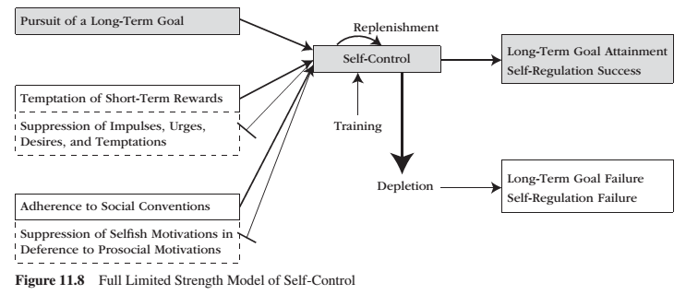
Limited Strength Model According to Reeve, J. (2015) Understanding Motivation and Emotion, 6th ed. John Wiley and Sons

Slide 21
Esteem: How We Evaluate Ourselves
Downward social comparison – The process whereby we compare ourselves with people who are worse than we are in a particular trait or ability
Much better for our self-esteem but does not inevitably result in increased self-esteem
Compare performance to past performance
Is harmful to self-esteem if we feel vulnerable to have the same negative outcomes
More common in ‘individualistic’ cultures
Upward social comparison – The process whereby we compare ourselves with people who are better than we are in a particular trait or ability
More threatening to our self-esteem
When we focus on our ‘actual self’ we can benefit from being exposed to a ‘superstar’ for inspiration
Can help motivate us to pursue our goals and dreams
In romantic relationships, couples feel better after engaging in upward social comparison with each other
More common in ‘collectivist’ cultures

Slide 22
Social Acceptance and Self-Esteem: Sociometer Theory
Sociometer Theory – The theory that self-esteem is a gauge that monitors the extent to which we are accepted or rejected by others.
Self-esteem is stable (trait) and changes (state)
High self-esteem people are willing to join groups more than people with low self-esteem
People with low self-esteem feel comfortable once they know that they are accepted and will respond better to social rewards than social costs
Self-fulfilling prophecy

Slide 23
Questions for the Class
Rate your abilities/attributes on a scale of 1 – 10 where 5 is the national average….
Conveying your emotions effectively
Creativity
Problem solving
Communicating
Relating to others
Warmth
Loving
Caring

Slide 24
Self-Evaluation: Biased or Accurate
Self-enhancement – Unrealistically positive view about oneself.
Everyone is better than average (unless you know you are really not good at something)
More common in ‘individualist’ cultures
Self-effacement – Unrealistically negative view about oneself.
More common in ‘collectivist’ cultures
Self-verification theory – People need to seek confirmation of their self-concept, whether the self-concept is positive or negative; this tendency can conflict with desire to uphold a favourable view of oneself
It is unsettling and confusing to change our self-concept all the time
It can be uncomfortable to interact with someone who view us differently than how we view ourselves
Depends on what is being evaluated, how important that is to our self-concept and the nature of the relationship with the other person
Keep in mind:
People hold negative beliefs only when they are certain of those beliefs
When the consequences of being improperly evaluated aren’t that great, people with negative views prefer positive feedback
When people can’t change, they prefer positive feedback

Slide 25
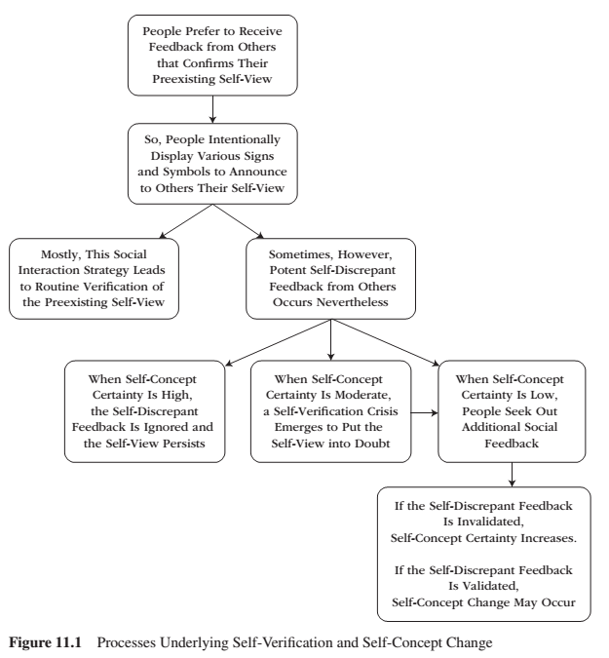
Self-Verification and Self-Concept Change According to Reeve, J. (2015) Understanding Motivation and Emotion, 6th ed. John Wiley and Sons

Slide 26
Identity According to Reeve, J. (2015) Understanding Motivation and Emotion, 6th ed. John Wiley and Sons
Identity:
The means by which the self relates to society, as it captures the essence of ‘who’ within a cultural context
Once a person inhabits a role, that identity prescribes the person to display some behaviours (identity-confirming) while avoiding others (identity-disconfirming)
Roles:
Consist of cultural expectations for behaviour from persons who hold a particular social position
We all hold different social positions and the role we inhabit at any given time depends on the situation we are in and the people with whom we are interacting
People change how they act depending on the role they are assuming

Slide 27
Identity According to Reeve, J. (2015) Understanding Motivation and Emotion, 6th ed. John Wiley and Sons
Identity-establishing behaviour:
Individuals have many identifies, and they present to others the particular identity that is most appropriate for the situation.
Identity-confirming behaviours:
Humans possess a wide range of potential behaviours, but only a subset are appropriate and expected in any one particular setting.
Behaviours and emotions that are appropriate are determined by the identity of the person, situation and culture.
Identities direct behaviour, and behaviour feedback to maintain and confirm identity.
Identity-restoring behaviours:
If a person behaves in an inconsistent way, they can restore their original identity through restorative behaviours or restorative emotions.
The motivation and emotional implications are that, once the individual finds their place in society, society expects them to behave and emote in a way that is consistent with that identity.

Slide 28
Critique (Gough, McFadden, McDonald, 2013)
Personality questionnaires are restrictive – loss of ‘subjectivity’
We must reincorporate subjectivity in trying to understand the self
Aspects of people’s personalities don’t necessarily fit together into neat, consistent packages
Situational factors account for behaviour more than people think – fundamental attribution error
Focusing on personality over situational factors has legal and social consequences
Cultural practices have a great deal of influence on how we see ‘the self’
We must take into account cultural norms and practices
People create and re-create the ‘social self ‘by ‘acting’ out social roles
The ‘self’ is a process
To study personality, you must look at the self-in-society
People are increasingly multicultural
Cultures are more nuanced than being individualistic or collectivistic
Personality psychology has contributed to oppression

Slide 29
Learning Check
What is a self-schema, self-concept, social roles and identity? How do they defer from each other?
What are ways that we compare ourselves to others? How does this differ cross culturally?
What are ways we establish, maintain and restore identities?
What is intrinsic motivation? What factors foster intrinsic motivation?
What is extrinsic motivation? What types of extrinsic motivation exist? How do they defer?
How do people self-verify? What would lead them to change their self-concept?
What is self-enhancement and self-effacement? How and why do they manifest?
What is the sociometer theory?
How do people exert self-control?
What is the difference between upward and downward social comparison? Why do people do this?
What is social awareness theory?
What is an independent and interdependent view of the self?
What is collective and relational interdependence?
What is introspection?
What is the insider and outsider view of the self?
What do Gough, McFadden, McDonald, 2013 provide as a critique to ‘personality psychology’?

Slide 30
Questions or Concerns?
Have a great day!

