Slide 1
Fundamentals of Social Psychology
Attitudes and attitude change
July 23th, 2018
Erik Chevrier

Slide 2
Activity
Please describe your stance on the following issues:
Climate change
Social equality
Income tax and government spending
Welfare
Carbon tax
Liberal government buying Kinder Morgan Trans Mountain Pipeline for $4.5 billion dollars

Slide 3
For Wednesday – Watch the Push
The Push – Darren Brown
Trailer
Identify persuasion tactics used by Darren Brown

Slide 4
Attitude
Attitudes are evaluations of people, objects or ideas.
Affectively Based Attitudes – An attitude based primarily on people’s emotions and feelings about the attitude object.
Stem from people’s values, sensory reaction, and/or aesthetic reaction
Have 3 things in common
1 – They do not result from rational examination of the issue
2 – They are not governed by logic
3 – They are often linked to people’s values, so that trying to change them challenges those values
Cognitively Based Attitude – An attitude based primarily on a person’s beliefs about the properties of an object.
Behaviorally Based Attitude – An attitude based primarily on observations of how one behaves toward an attitude object.
Self-perception theory – when our attitudes and feelings are uncertain or ambiguous, we infer these states by observing our behaviour and the situation in which it occurs.

Slide 5
Explicit vs Implicit Attitudes
Explicit attitudes are ones that we can consciously endorse and easily report
Implicit attitudes are ones that are involuntary, uncontrollable, and at times ‘unconscious’
Implicit association test - https://implicit.harvard.edu/implicit/
Studies cited
Implicit and explicit attitudes are positively correlated when people reflect on their feelings about an attitude object but not when they are asked about their cognitions of the object (Gawronski and LeBel, 2008)
Implicit attitudes are rooted more in people’s childhood experiences, explicit attitudes are more rooted in their recent experiences (Rudman, Phelan, Heppen, 2007)

Slide 6
Theory of Planned Behaviour

Slide 7
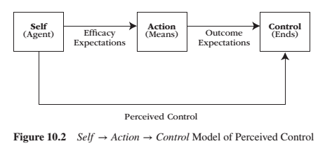
Perceived Behavioural Control Reeve, J. (2015) Understanding Motivation and Emotion, 6th ed. John Wiley and Sons

Slide 8
Example of Theory of Planned Behaviour
Implications for Safer Sex – p. 144 – 146.
Summary:
Even the most positive of attitudes towards condom use do not guarantee that people will practice safer sex. The theory of planned behaviour suggests that other factors must be taken into account as well, including subjective norms, perceived behavioural control and behavioural intentions.
mood, self-esteem, intoxication

Slide 9
Activity
How would you use the theory of planned behaviour to assess whether people would agree to reduce their plastic consumption?

Slide 10
How do Attitudes Change?
Persuasive Communication advocates a particular side of an issue
Persuade - to move by argument, entreaty, or expostulation to a belief, position, or course of action
Yale Attitude Change Approach

Slide 11
Central and Peripheral Routes to Persuasion

Slide 12
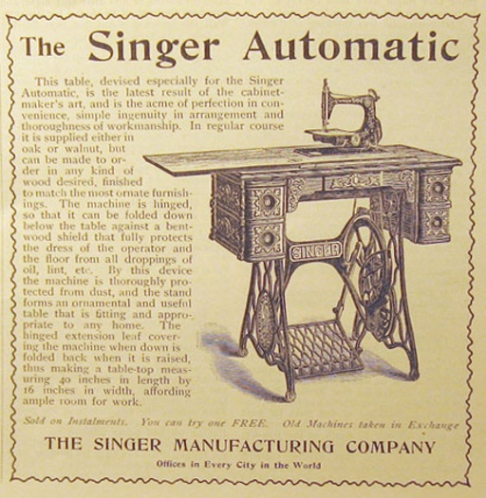
Central and Peripheral Routes to Persuasion
McDonalds Commercial

Slide 13
Fear and Attitude Change
Fear-Arousing Communication – A persuasive message that attempts to change people’s attitudes by arousing their fears
Fear get’s attention → listening to messages about how to reduce fear motivates people to analyze the message carefully and change their attitudes via central route
If fear is too overwhelming or there is no way to affectively remove the threat, the message will not work
Humour can work well in defusing fearful situations
Fear based ads – Texting and Driving
Fear based ads – Texting and Driving
If you see something, say something

Slide 14
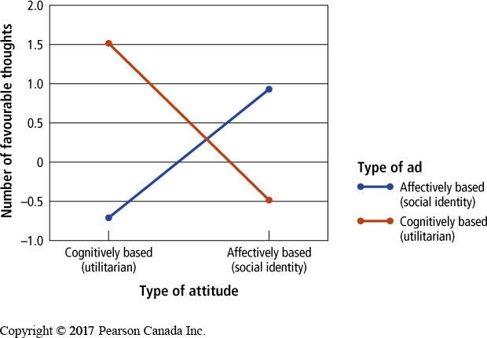
Implementation of Attitude Change – Advertising
Change cognitively based attitudes with rational arguments
Utilitarian products
Change affectively based attitudes using emotion
Intangible products – social identity products
People reacted more favourable to ads that matched their attitudes
People react more favourably to attitudes that match their cultural preference for individualism (independent) vs collectivism (interdependent)
Product placement
Advertising today
Data mining, specific targeting, attitudes and preferences are known by data companies, fMRI usage in devising ads, etc.

Slide 15
Resisting Persuasive Messages
Attitude Inoculation – The process of making people immune to attempts to change their attitudes by exposing them to small doses of arguments against their position
Peer pressure
Smoking prevention
Attacks on attitude – making them more robust

Slide 16
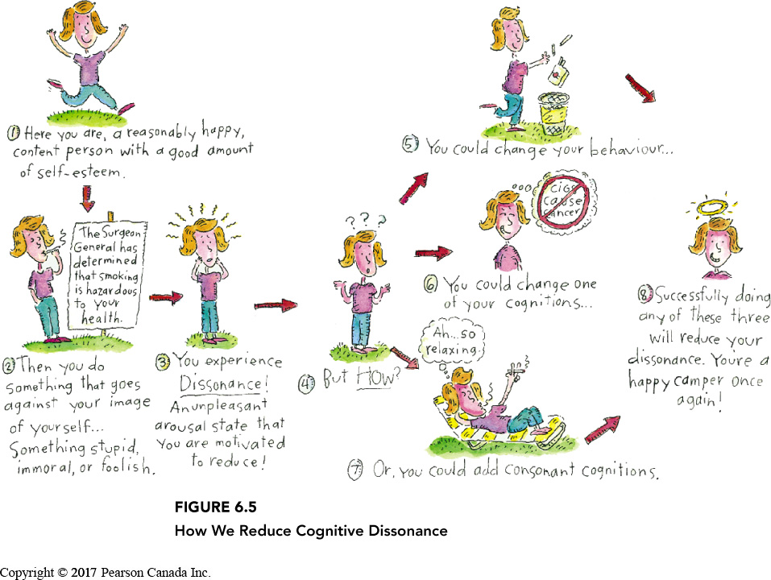
Cognitive Dissonance
A feeling of discomfort caused by the realization that one’s behaviour is inconsistent with one’s attitudes or that one holds two conflicting attitudes
Cognitive dissonance is a state of psychological tension occurring when thoughts, beliefs, attitudes, and/or behaviours are in conflict with each other.
Alleviating Dissonance
1 – Justify behaviour by changing one of the dissonant cognitions 2 – Changing behaviour to bring it in line with the dissonant cognition 3 – Justify behaviour by adding new cognitions

Slide 17
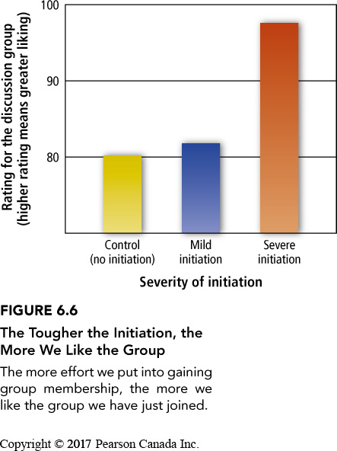
Post-Decision Dissonance
Post-Decision Dissonance that is inevitably aroused after a person makes a decision; such dissonance is typically reduced by enhancing the attractiveness of the chosen alternative and devaluing the rejected alternative
Effects can be implicit
Permanence – the more permeant and less revocable the decision, the greater the need to reduce dissonance.
Dissonance reduction following a difficult moral decision can cause people to behave either more or less ethically in the future.
Effort Justification – The tendency for individuals to increase their liking for something they have worked hard to attain
What are examples of choices you made recently? What are your justifications for that choice?

Slide 18
External vs Internal Justification
External Justification – A person’s reason or explanation for the dissonant behaviour resides outside the individual
Internal Justification – A person’s reason or explanation for the dissonant behaviour resides inside the individual
Counter-Attitudinal Advocacy – A process that occurs when a person states an opinion or attitude that runs counter to his or her private belief or attitude
Create dissonance by introducing hypocrisy (especially effective with people with high self-esteem)
When we do this with little external justification, we start to believe our own lies
Used to deal with social problems like racism, safe sex practices
Insufficient Punishment – Dissonance aroused when individuals lack sufficient external justification for having resisted a desired activity or object, usually resulting in an individuals devaluing the forbidden activity or object
Uses internal justification to reduce dissonance – longer lasting.
Removing or reducing autonomy also removes or reduces intrinsic motivation

Slide 19
Avoid the Rationalization Trap
Rationalization Trap – The potential for dissonance reduction to produce a succession of self-justifications that ultimately result in a chain of stupid immoral acts
Self-Affirmation theory suggests that people will reduce the impact of a dissonance arousing threat to their self-concept by focusing on and affirming their competence on some dimension unrelated to the threat

Slide 20
The Psychology of Influence
Robert Cialdini
Six weapons of influence
1 – Reciprocation
2 – Commitment and consistency
3 – Social proof
4 – Liking
5 – Authority
6 – Scarcity

Slide 21
Activity
Why do people still support politicians who go against what they promised?
A Few Examples!
Recently, Trump was accused of ‘throwing Americans under the bus’ in regards to his position with Russia and election rigging. Despite this, Trump still has a strong support base. Why is that?
Trudeau has taken a strong stance to be more environmentally and fiscally responsible; however recently he purchased Kinder Morgan’s Trans Mountain Pipeline for $4.5 billion dollars. Despite some criticism, Trudeau still has a strong support base. Why is that?
When George Bush senior was campaigning, he uttered the words, Read My Lips, No New Taxes. Then two years after winning, he increased taxes in order to reduce the deficit. Why did people continue to support him after he raised taxes?

Slide 22
Learning Check
- What is an attitude? What are components of an attitude? - What is an implicit vs explicit attitude? - When do attitudes predict behaviour? - What is the theory of planned behaviour? How does it apply to an example, like encouraging safe sex? - How do attitudes change? - What is the Yale Attitude Change Approach? - What are central and peripheral routes to persuasion? Which works best? - What is fear-arousing communication? How does it work? - What is the difference between utilitarian and social identity products and how does that relate to advertising? What is the best route to persuasion to take in advertising? - What is attitude inoculation? How does it work? - What is cognitive dissonance theory? - What is post decision dissonance? How is affected by permanence? How does it affect our moral values? - What is justification of effort? - What is internal and external justification? How do they help maintain or change behaviour and/or attitudes? - What is counter-attitudinal advocacy? How can it be used to tackle social problems? - What is insufficient punishment? How does it work? - How do we avoid the rationalization trap? - What is the self-affirmation theory?

Slide 23
Questions or Concerns?
Have a great day!

