Slide 1
Fundamentals of Social Psychology
Introduction
July 4th, 2018
Erik Chevrier

Slide 2
Ice Breaker
The object of the game is to be the first group to sit together and come up with a name that best represents your group.
When you get into a group of five, you have to pick an original name that has some significance to the group.
You will be scored on name originality and time of completion.

Slide 3
Ice Breaker
The object of the game is to be the first group to sit together and come up with a name that best represents your group.
When you get into a group of five, you have to pick an original name that has some significance to the group.
You will be scored on name originality and time of completion.
Find five people who were born in the same month as you (or)
Find five people who have the same letter of their first name as you (or)
Find five people who have the same letter of their last name as you

Slide 4
Ice Breaker
Reflect on the situation, what did you do? How did you notice others behave? What influence did your behaviour have over others and how were you influenced by other people’s behaviour?
Form a construal – how individuals perceive, comprehend, and interpret the social world.

Slide 5
Ice Breaker #2
Form a line (box) around the perimeter of the classroom. The box must be formed in a fashion where everyone is arranged from oldest to youngest.
You must complete the activity in under 5 minutes.
You cannot talk throughout the activity.

Slide 6
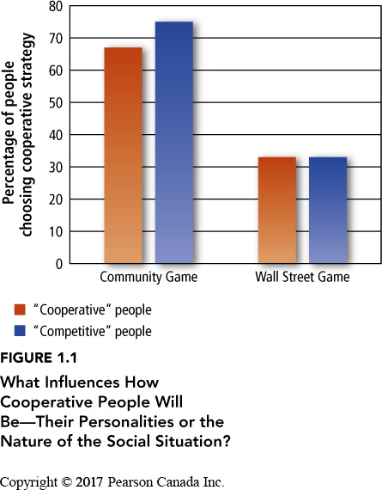
Cooperation vs Competition
Liberman, Samuels and Ross (2004)

Slide 7
Where We Finished Last Class - Discussion Questions?
Racism and fascism is on the rise in the USA, in Canada and even worldwide. What is causing the rise of racism and fascism?
Charlottesville: Race and Terror
Social media has become ubiquitous. What effects does social media have on behaviour?
Socialization?
Interaction?
Information processing?
Information gathering?
World beliefs?

Slide 8
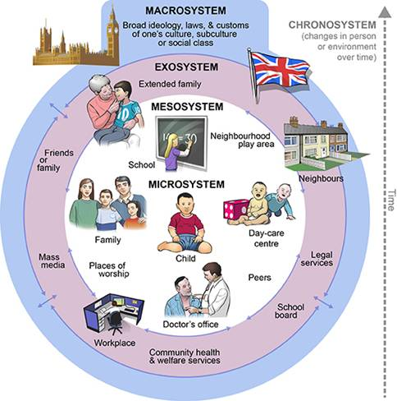
RECAP – Ecological Systems Theory of Development

Slide 9
Please Watch Before Next Class
The Century of Self – Part 1

Slide 10
RECAP – Some Considerations
Objectivity vs subjectivity
Parts vs whole
Representation vs reality
Process vs structure
Epistemology vs ontology

Slide 11
RECAP – What is Social Psychology?
Social psychology is the scientific study of the way which people’s thoughts, feelings, and behaviours are influenced by the real or imagined presence of other people. (Aronson, E. Wilson, T. D., Fehr, B, Akert, R. M., 2017)
Critical social psychology challenges social institutions, practices and power relations – including the discipline of psychology – that contribute to forms of inequality and oppression. (Gough, B., McFadden, M., McDonald, M., 2013)
Methodologies and assumptions:
Traditional social psychology – Empiricism, experiments, hypothesis testing, belief in objective reality, focus on the individual and individual difference, tries to explain human nature through social relations
Critical social psychology – Action-based research, discourse analysis, adopts particular positions instead of embracing objectivity, reflexivity, individual embedded in social relations

Slide 12
RECAP – What is Social Psychology?
Psychological social psychology (PSP) – The individual is at the center of the analysis
Sociological social psychology (SSP) – The social dimensions are at the center of the analysis

Slide 13
What is Social Psychology?
Aronson, Wilson, Fehr, Akert (2017)
The goal of social psychology is to identify universal properties of human nature that make everyone susceptible to social influence, regardless of social class or culture.
Social psychology – Level of analysis is the individual in the context of society.
Sociology – Is more concerned with broad societal factors that influence events in a society.
Personality psychologists – Focus on individual differences.
Behaviourism – A school of psychology maintaining that to understand human behaviour, you need to consider the reinforcing properties of the environment.
Gestalt psychology – A school of psychology stressing the importance of studying the subjective way in which an object appears in people’s minds, rather than the objective physical attributes of the object
Social cognition – How people think about themselves and the social world, more specifically, how people select, interpret, remember, and use social information. Cognitive approach to social psychology.
Gough, McFadden, McDonald (2013)
In striving to measure particular concrete aspects of social situations and individual responses to these, social psychological research manufacture and promote a de-socialized conception of the individual.
Culture is taken as accidental and local, while psychological processes are depicted as fixed and universal.

Slide 14
Discussion – Thinking Critically about Scientific Psychology
Since its inception, social psychology has attempted to emulate the philosophy and methods of natural science – however not all human activities can be captured sufficiently by scientific methods (experiments, questionnaires). Give examples of human behaviours which can and cannot be measured, predicted and controlled. (How) (C)an we understand social phenomenon that cannot be captured by the scientific method?
What are the positive and negative consequences of focusing on the ‘individual in society’ rather than focusing on both the individual and society equally?

Slide 15
The Power of Social Interpretation
How do we understand social situations?

Slide 16
The Power of Social Interpretation
How would you interpret these social situations?
You sit down at a brunch restaurant, you have been there for 15 minutes without anyone coming over. Although the restaurant is busy, the waitress for your table seems to be taking time to talk with people from another table. You finally get her attention and ask for a coffee. She scowls at you before going to get your coffee. How do you interpret her behaviour?
You are sitting in the classroom and everyone gets up to leave before the class is over. The professor is still conducting their lecture and there doesn’t seem to be an immediate emergency. How would you interpret the situation and orient your behaviour?
In the mid-1980s residents in Quebec were introduced to the Order of the Solar Temple cult. The cult leaders convinced people that the only way to receive redemption was to die by fire. In total, 74 members killed themselves worldwide. Why did they kill themselves?

Slide 17
The Power of Social Interpretation
How do we understand social situations?
Construal – the way people perceive, comprehend, and interpret the social world.
Naïve Realism – the conviction that all of us perceive things ‘as they really are’.
Everyone can easily misperceive a situation
How can we determine what ‘folk-wisdom’ or ‘common sense’ explanations vs valid explanations of social behaviour?
Power of the situation
Oversimplification
Behaviourism cannot fully explain social behaviour because it is important to look at the situation from the viewpoint of the people in it, to see how they construe the world around them.
Gestalt approaches had a positive influence on social psychology.
The whole is different from the sum of parts.
Focus on the phenomenology of the perceiver.
Kurt Lewin, Kurt Kofka, Wolfgang Kohler, Max Wertheimer

Slide 18
The Power of the Situation
Fundamental attribution error – the tendency to explain people’s behaviour in terms of personality traits and to underestimate the power of the situation.
Example of fundamental attribution error = victim blaming
Gough, McFadden, McDonald (2013)
Social problems cannot only be explained by individual factors. Social and cultural factors must be taken into account.
Somewhat ironically for research on sexism, it is women who are held responsible for inequitable and seemingly unchangeable working practices.
According to a study by Jackson et al (1992):
Women anticipate taking more time off work than men
They recognized the ‘reality’ of unequal pay and conditions more then men do
They perceive relatively low levels of pay as more fair than do men
They compare themselves more with other women than men

Slide 19
Where do Construals Come From
Two motives are important for the formation of construals:
The need to feel good about ourselves
The need to be accurate
Self esteem approach: we need to feel good about ourselves
Most people need to maintain reasonably high self-esteem (people’s evaluations of their own self worth)
Given the choice of distorting the world in order to feel good about themselves and representing the world accurately, people often take the first option.
Justifying past behaviour
Suffering and self-justification
Think of a time where you protected your self-esteem and maintained a ‘wrong’ position in order to feel good about yourself.

Slide 20
Where do Construals Come From
Two motives are important for the formation of construals:
The need to be right about ourselves
The need to be accurate
Social cognition approach: need to be accurate
Social cognition researchers begin with the assumption that people try to view the world as accurately as possible.
Self-fulfilling prophesies sometimes hinder our construal of a social situation
Think of a time you were ‘accurate’ but it affected your or someone else’s self-esteem.

Slide 21
Social Psychology and the Social Problem
Aronson, Wilson, Fehr, Akert (2017)
Most psychologists have another reason [not just understanding social influence] for studying causes of social behaviour, to contribute to the solution of the social problem.
Social psychologists have been interested in such social problems as the reduction of hostility, prejudice and increase in altruism generosity.
Gough, McFadden, McDonald (2013)
The critical spotlight cast on the institutional and disciplinary role of social psychology as bolstering existing inequalities of power by leaving them unexamined.
The social psychologist performs the role of social engineer helping to maintain the status quo by concentrating the gaze on individuals and not society.
Obsessive emphasis on quantified detail without context, on progressively finer and finer measurements of smaller and smaller problems, leaving us knowing more and more about less and less.

Slide 22
Discussion
Psychologists tend to focus on mental illness as an individual problem, how can society (i.e. social institutions, customs, cultural practices) contribute to mental health issues?

Slide 23
Learning Check
What is a construal? What two motives guide construals?
What are variations of social psychology? What are related disciplines? Compare and contrast them.
What is the fundamental attribution error? How does it apply to social situations?
Compare and contrast the views of social psychology and critical social psychology in response to addressing social issues.

Slide 24
Questions or Concerns?
Have a great day!

