Slide 1
Fundamentals of Social Psychology
Doing Critical Social Psychology
August 13th, 2018
Erik Chevrier

Slide 2
Critique
Conventional Quantitative Methods have been criticized for (Gough, McFadden, McDonald, 2013):
Reducing complex human phenomena to measurable variables and simplistic categories
Presenting ‘subjects’ as naïve stimulus-response machines and ‘society’ as an invisible constant
Providing ‘knowledge’ which is technical, mystifying and uncritical
Helping to perpetuate social relations of inequality
Obscuring significant personal and contextual features of the research
Facilitating the myth of social psychology as a science that will, one day, uncover the set of universal laws governing social behaviour

Slide 3
Critical Social Psychology Sets Out To (Gough, McFadden, McDonald, 2013)
‘Denaturalize’ taken-for-granted thinking in psychology; emphasize the variation, complexity, and often contradictory qualities in human experience and social behaviour
Situate individual/research participants within wider social and (inter)personal contexts
Offer knowledge which is partial, incomplete and critical
Challenge aspects of existing inequalities in society
Make visible pertinent personal and contextual elements within the research
Deconstruct the myth of (social)psychology as a natural science, and challenge its key assumptions which underpin its authority and relevance to contemporary social behaviour

Slide 4
Ways to Practice Critical Social Psychology Research (Gough, McFadden, McDonald, 2013)
Embrace performative qualities of research
Action research – Working towards desirable change
Participatory research – A democratic research process is favoured where participants have an equal say in decisions concerning data collection and analysis – the term ‘co-researchers’ is often used in this context.
Prevalence and needs assessment – Instead of being defined in advance by researchers, participants needs and issues are identified during the initial stages of the research through open discussions
Evaluation research – To assess the effectiveness of actions instituted within the research process and decide between competing strategies for further use
Demystification – Refers to knowledge gained during action research as promoting change – the greater the awareness of the situation, the greater capacity for action.

Slide 5
Four Key Action Strategies For Promoting Positive Social Change (Gough, McFadden, McDonald, 2013)
Create a critical consciousness
Create new social relations and/or settings
Develop alliances and counter-systems
Accompaniment, advocacy, and analysis of policy

Slide 6
NOT ON EXAM – Activist Methods Smith, G. (1990) Political Activist as Ethnographer, Social Problems, 37(4), 629 – 648.
1 – Start with the actual lives of people and undertake an analysis of a world known reflexively
2 – Stake out an ontological commitment to a social order constituted in the practices and activities of people
3 – Take their analytic, the notion of “social relations”
4 – Are based on the use of meetings with government officials and professional cadres as ethnographic data
5 – Analyze texts such as media reports of government departments, in developing a description of how the ruling regime works
6 – Illustrate the necessity of the bracketing ordinary political explanations – the technique of the materialist epoch, in order to provide a scientific account of the social organization of a ruling regime.

Slide 7
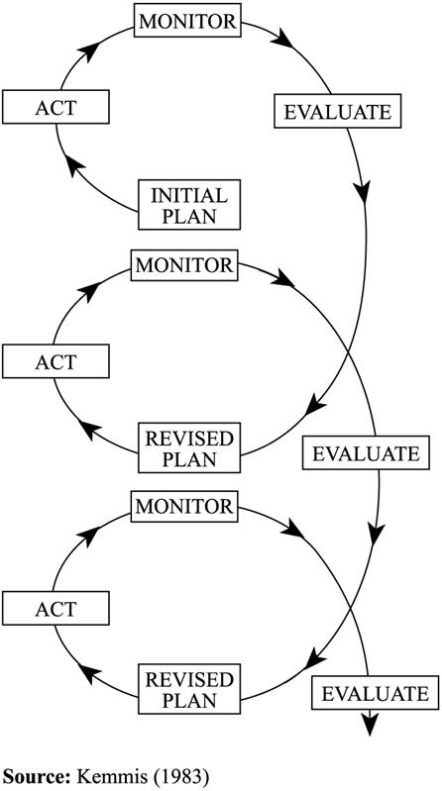
NOT ON EXAM – Action Research
1 – Action research integrates research and action. 2 – Action research is conducted by a collaborative partnership of participants and researchers. 3 – Action research involves the development of knowledge and understanding of a unique kind. 4 – Action research starts from a vision of social transformation and aspirations for greater social justice. 5 – Action research involves a high level of reflexivity and sensitivity to the role of the self in mediating the whole research process. 6 – Action research involves explanatory engagement with a wide range of existing knowledge drawn from psychology, sociology, and other fields of science, in order to test its explanatory power and practical usefulness. 7 – Action research engenders powerful learning for participants through combining research with reflection on practice. 8 – Action research locates the inquiry in an understanding of broader historical, political and ideological contexts that shape and constrain human activity at even the local level, including economic factors and international forces such as the structuring power of globalization.
Somekh, B. (2006) Action Research: A Methodology for Change and Development, Open University Press, pp. 6 – 8.

Slide 8
NOT ON EXAM - Forms of Action Research
Participatory action research involves participants as co-researchers .
Critical participatory action research involves participants as co-researchers and addresses what is unsustainable, unjust, and irrational.
There are many other types of action research.

Slide 9
NOT ON EXAM – Erik Olin Wright
1 – Desirable
2 – Viable
3 – Achievable

Slide 10
NOT ON EXAM – Example of Critical Participatory Action Research
Concordia Student-Run Food Groups Research Project
Imagine Together Sustainable Food Services

Slide 11
OBVIOUSLY NOT ON EXAM – Questions or Concerns?
Have a great day!
Thanks for the wonderful semester!
Don’t forget to study hard!

