Slide 1
Fundamentals of Social Psychology
Prosocial Behaviour
August 13th, 2018
Erik Chevrier

Slide 2
Why Do People Help
Prosocial behaviour – any act performed with the goal of benefiting another person.
Altruism – The desire to help others, even if it involves a cost to the helper.
Other definition…Helping others purely out of self-concern for their well-being (Heinzen & Goodfriend, 2019)
What is the most altruistic thing you have ever done? Was it truly altruistic?

Slide 3
Discussion
An alien ship is about to attack the planet! You are given two seats on a spaceship that will get you and __________ safely to a habitable planet nearby. Who would you take? What if you were given four seats (you and three more)?

Slide 4
Evolutionary Theories of Prosocial Behaviour
Charles Darwin (1859) & Evolutionary Psychologists
Natural selection can explain prosocial behaviour
Kin Selection – The idea that behaviour that helps a genetic relative is favoured by natural selection.
People who are more likely to follow the ‘biological importance’ rule are considered more likely to survive
Closeness is a better predictor of willingness to help (Korchomaros & Kenny, 2006)
Reciprocity Norm – The expectation that helping others will increase the likelihood that they will help us in the future.
May be genetically based
Reciprocity in infancy
Learning social norms – link between reciprocity and evolution – adaptive to learn social norms
RECAP – Cialdini six weapons of social influence & door in the face technique

Slide 5
Social Exchange: The Costs and Rewards of Helping (CHAPTER 9)
Social exchange theory – How people feel about a relationship depends on their perceptions of the rewards and costs of the relationship, the kind of relationship they desire, and the probability that they could have a better relationship with someone else.
Cost-reward ratio – The notion that there is a balance between the rewards that come from a relationship and the personal cost of maintaining the relationship; if the ratio is not favourable, the result is dissatisfaction.
Comparison level – People’s expectations about the levels of rewards and costs that they deserve in a relationship.
Comparison level for alternatives – People’s expectations about the level of rewards and costs they would receive in an alternative relationship.
Investment model – People’s commitment to a relationship depends on their satisfaction with the relationship in terms of rewards, costs, and comparison level; their comparison level for alternatives; and how much they have invested in the relationship that would be lost by leaving.

Slide 6
Social Exchange: The Costs and Rewards of Helping (CHAPTER 9)

Slide 7
Social Exchange Theory
Social exchange theory looks at costs and rewards of helping
More costly = Less likely to help
More reward = More likely to help
True altruism does not exist because people are merely trying to boost self worth - reward
Does not fully explain prosocial behaviour
Can how you feel about someone affect your willingness to help them?

Slide 8
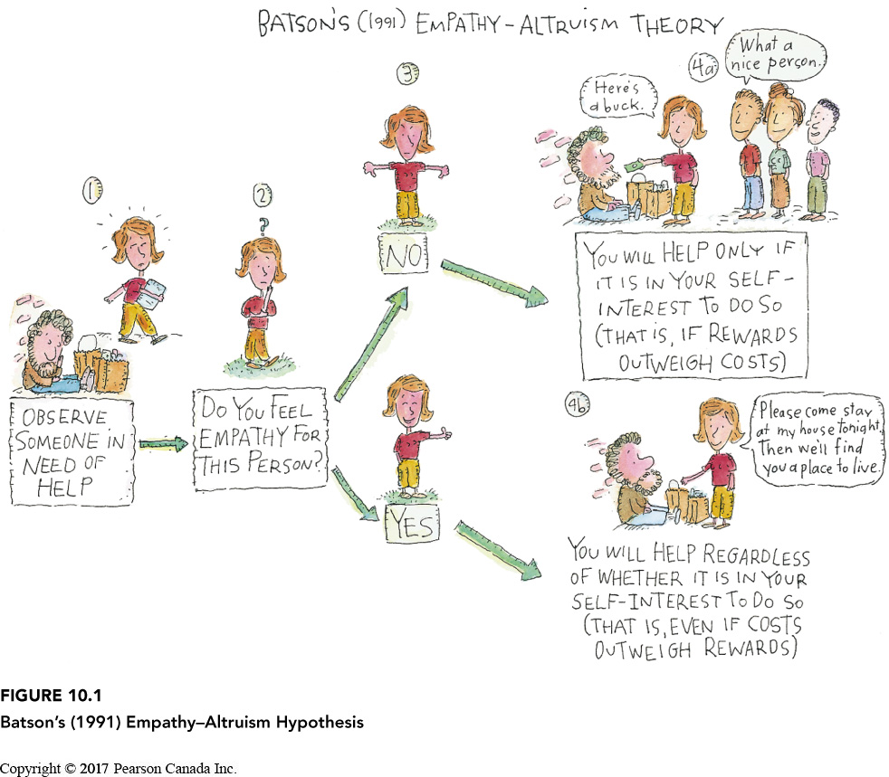
Empathy and Altruism
Daniel Batson (1991) – People help purely out of the goodness of their hearts.
Pure altruism comes from empathy – the ability to experience events and emotions the way another person experiences them.
Empathy-Altruism-Hypothesis – The idea that when we feel empathy for a person, we will attempt to help them purely for altruistic reasons, regardless of what we have to gain.
If we don’t share the person’s distress, social exchange comes into play.

Slide 9
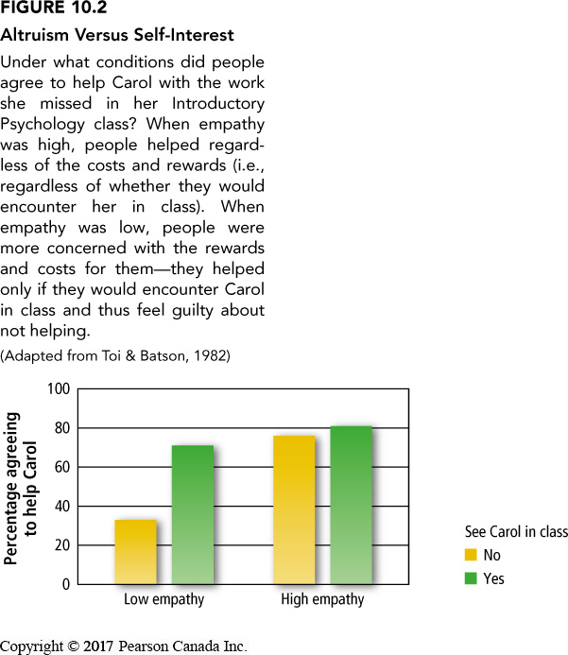
Empathy and Altruism
Daniel Batson (1991) – People help purely out of the goodness of their hearts.
Pure altruism comes from empathy – the ability to experience events and emotions the way another person experiences them.
Empathy-Altruism-Hypothesis – The idea that when we feel empathy for a person, we will attempt to help them purely for altruistic reasons, regardless of what we have to gain.
If we don’t share the person’s distress, social exchange comes into play.

Slide 10
Personal Determinants of Prosocial Behaviour
Altruistic personality – Aspects of a person’s makeup that cause them to help others in a wide variety of situations.
People who score high on altruistic personality scales are not much more likely to help than others – situation and context are important.
Gender differences – women labeled as more nurturing/caring, men as more chivalrous/heroic
Socioeconomic status – Lower economic status people are more prosocial
People are more prosocial with in-groups than out-groups
Interdependent cultures are more prosocial with in-group members than independent cultures
Interdependent cultures are less likely to help out-group members than independent cultures
Interdependent cultures take less credit for altruism than independent cultures
Religion and prosocial behaviour
Religious people are more prosocial than nonreligious people, especially if the help is known publicly
Effects of Mood
Feel good, do good – Three reasons (1) look at bright side, (2) prolongs good mood, (3) increases self awareness & makes us more likely to behave according to our values and ideals
Negative state-relief hypothesis – People help in order to alleviate their own sadness and distress.

Slide 11
Situational Determinants of Prosocial Behaviour
Rural environments foster more prosocial behaviour than urban environments
Urban overload hypothesis – The theory that because people living in cities are constantly being bombarded with stimulation, they keep to themselves to avoid being overloaded.
Residential mobility – People who reside in the same location for a long time are more likely to feel attachment to the community and help more. Prosocial behaviour is much more likely when people feel part of a group or community.
Bystander effect – The finding that the greater number of bystanders who witness an emergency, the less likely it is that any one of them will help. (See Next Slide)
Pluralistic ignorance – The phenomenon whereby bystanders assume that nothing is wrong in an emergency because no one else looks concerned.
Diffusion of responsibility – Each bystander’s sense of responsibility to help decrease as the number of witnesses to an emergency or crisis increases.

Slide 12
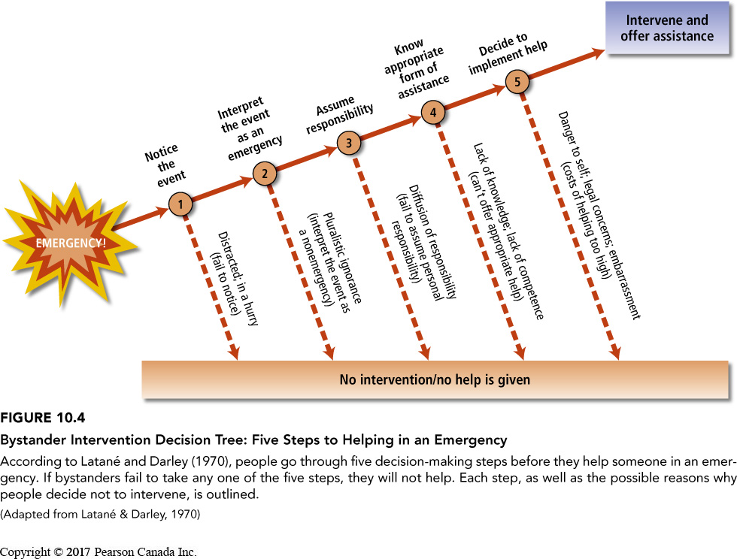
Bystander Effect

Slide 13
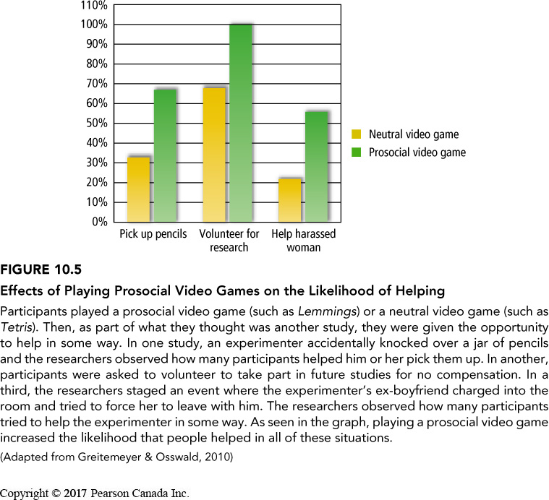
Increasing Helping
Remember – people don’t always want to be helped, it’s best to ask first!
Being aware of the barriers can help people be more prosocial
Reward prosocial behaviour with positive affirmations (reinforce that the child/person is a good person)
Don’t fell victim to over-justification effect
Act prosocially – others learn from you!
Prosocial behaviour can be primed (videogames, songs, etc.)

Slide 14
Learning Check!
What is prosocial behaviour? What is altruism? What is the debate regarding true altruism – can true altruism be achieved?
What are evolutionary theories of prosocial behaviour? What factors seem to contradict the kin selection theory?
What is the social exchange theory for relationships? How does the theory apply to prosocial behaviour?
How does empathy relate to prosocial behaviour?
What are personal determinants of prosocial behaviour?
What are situational determinants of prosocial behaviour?
What is the bystander effect? Please describe the bystander intervention decision tree.
What is pluralistic ignorance? What is diffusion of responsibility?
How can we increase prosocial behaviour?

Slide 15
Questions or Concerns?
Have a great day!
Thanks for the wonderful semester!
Don’t forget to study hard!

