Slide 1
Advertising and the Consumer Culture
History of Advertising and Consumer Culture
Erik Chevrier
September 27th, 2018

Slide 2
Early Capitalism (1600 - 1800)
Little to no leisure time for working class
Feudal and monarchial systems being replaced by capitalism
Expropriation of peasants from agricultural communities to cities and towns
Rampant poverty
Mostly subsistence wages
Work mainly done by hand or with assistance from basic machines and animals
People mainly consumed what they needed to survive

Slide 3
Middle Capitalism (Late 1800 - 1950)
Development of more advanced machinery
Fordism & the introduction of more efficient assembly line practices
Workers are better paid
Work hours were reduced (more leisure time)
Introduction of psychology into advertising (1920s)
Workers are able to consume luxury items over and above what they need to survive

Slide 4
Later Capitalism (1950 - today)
Rapid advancement of science and technology
Built obsolescence
Global expansion of industrialized capitalism
Expansion of products and services
Consumption is a central part of the market
Advanced advertising techniques
Workers must be able to continuously consume in order for the capitalist market to function

Slide 5
History of Advertising
Rise of modern advertising
Begin at about late 1600 in France billboard 1700 – Newspaper & magazine & Advertising agencies as brokers 1900 – Sears & Cosmopolitan Magazine 1920 – Psychology & Ed Bernays & Radio 1950 – Television & motion picture 1980 – Internet & data mining 2000 – Product integration & interactive advertising Today – Multiple profuse convergent network (clutter)

Slide 6
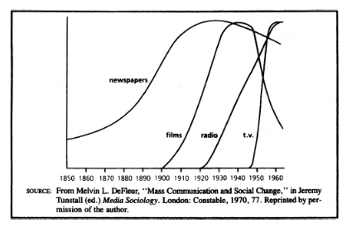
History of Media

Slide 7
History of Advertising Advertising and Consumer Society (Holm, 2017)
Four Moments in advertising history
First Moment: Origins of industrial development
Pre capitalist societies had art forms but these cannot be considered advertising
Factors that led to the development of advertising
Urbanization (expropriation from agricultural communities to cities)
Rationalization (reformation of time and space)
Mass production and distribution (development of industrialization and capitalism)
Mass media (development and proliferation of mass media)
Beginning of consumer society
New division of labour
New way of understanding products
Increases in production needed to be matched by increases in consumption
People start defining themselves by their consumption
Purchase way to a better life
Promote general use of advertising
Advertising agencies were space brokers

Slide 8
History of Advertising Advertising and Consumer Society (Holm, 2017)
Four Moments in advertising history
Second Moment: Professionalism, consolidation and redemption
Consolidation of advertising agencies
Lack of professionalism, accountability and organization
False claims in patent medicine
Fear of advertising
Development of ‘full service’ agencies
Market research, creative art, space brokers – 1920s
More respected profession
N.W. Ayer and Sons
Factual copy
Research – demographics and brand preference
John. E. Powers
Plain speech & fine writing is offensive
John E. Kennedy
Reason why advertising

Slide 9
History of Advertising Advertising and Consumer Society (Holm, 2017)
Four Moments in advertising history
Third Moment: Manipulation, creativity, and globalization
Booming consumer culture of 1950s
Industry seen as repetitive, monotonous, and dull
Fear of advertising
Vince Packard – The Hidden Persuaders
James Vicary – Subliminal Advertising Fiasco
Creative Revolution
Television ads
Emotional ads

Slide 10
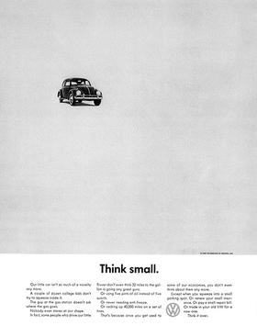
Think Small Ad Volkswagen
Bill Bernbach (BBD)

Slide 11
History of Advertising Advertising and Consumer Society (Holm, 2017)
Four Moments in advertising history
Fourth Moment: Digital advertising, algorithms, and data-surveillance\
Move towards globalization
Mergers between companies and advertising agencies (mega agencies)
Online advertising
Search engine optimization – SEO
Google – AdWords (algorithms)
Old ad format integrated into ‘new’ media
Seeking new methods
Social media and viral ads
Facebook & Spotify, etc.
Data mining
People share content

Slide 12
Have a Great Night
Questions or concerns?
Readings for next week:
Chapter 9 – Late-Modern Consumer Society, Leiss, W., Kline, S., Jhally, S., Botterill, J., Asquith, K. (2018) Social Communication in Advertising, 4th Edition, Routledge, pp. 214 – 237.
Watch ‘The Corporation’
Proposals are due! Please bring a hard copy to submit to me in class.

