Slide 1
Food and Culture
Erik Chevrier
September 5th, 2018

Slide 2
About Me
Erik Chevrier Website: www.erikchevrier.ca Office hours: By request (Wednesday 6 – 8:30 PM) Office location: H-1125.12 E-Mail: professor@erikchevrier.ca Research Project: Concordia Food Groups Research Project Facebook Group: Concordia Food Groups Facebook Group for the Class: https://www.facebook.com/groups/foodandculture/
Another project I started: Co-op Collective Vision

Slide 3
Food and Culture Write-Up
Food is an important part of cultural studies. It is central to many cultural rituals, like feasts and festivals; it has been a catalyst for global resistance to capitalism, like in the food sovereignty movement; it is embedded with a variety of beliefs and customs, like religious diets (i.e. Kosher and Halal); it is a uniting force for the development of a social economy, like in the development of food cooperatives; it has also been a central theme in countless cultural texts, films and literature; most importantly, it is what keeps people alive.
In this course, we explore themes related to food and culture. We focus on the political economy of food by examining how food is produced, transformed, distributed, consumed, and how food waste is managed in different areas of the world. We take a critical perspective to analyze multinational food corporations, like Bayer, by looking at the consequences of large scale industrialized farming, monoculture, and the privatization of genetics. These consequences include, the use of GMOs and the loss of biodiversity; reliance on fossil fuels and its contribution to climate change; use of glyphosate and the accompanying health effects; seed patents and loss of food sovereignty; use of natural resources and the depletion of water and food supplies; among others.
We also explore what certain cultures are doing to prevent these negative consequences. We look at the slow food movement coming out of Italy and Ireland as a way of re-localizing food production, processing and consumption – aka. the farm to plate movement; we examine the food sovereignty movement coming out of Mexico at La Via Campesina assembly in 1996 – which is now being popularized globally; we learn about the Detroit Black Community Food Security Network and their initiative to reclaim food sovereignty, food justice and eliminate food insecurity; we also look at sustainable production, like seed saving, indigenous practices, permaculture, rooftop gardening, and organic farming. Moreover, we read about and discuss a variety of beliefs and customs regarding food by addressing the differences in cultural symbolism of plants and animals in different parts of the world.
In this course, we partake in the ‘practice’ of food. Students cook a meal related to their cultural heritage to share with the class. They write about and discuss the cultural significance, meaning and symbolism of the food that they prepared for the class. They also perform research about the supply chain of the ingredients and environmental footprint, as well as the labour, gender, class, and racial relations that went into preparing the food. Students also take turns preparing food items for the class so we all have a snack while we learn. Student partake in other forms of food production – they will grow a plant from seed and must care for it until the class is complete.
An important focus of this course is community engagement. Students participate with local food projects in and around Concordia University. Students perform an action-based research project by creating a new food organization, participating with and enhancing a current food project, and/or conducting research about university food systems. Students can even create content for the Concordia Student-Run Food Group Research project:
www.concordiafoodgroups.ca

Slide 4
Class Rules
Course Materials and Text:
Students are expected to complete ALL the designated readings and watch ALL of the assigned videos BEFORE EACH CLASS. Students are also expected to attend ALL classes, and participate in class discussions.
The required readings for this course is contained in a course-pack available at the library bookstore.
The power-point lecture notes will be posted on the course site on a weekly basis before each class.
Recommended readings: URLs and other electronic sources may be posted on the course website from time to time. Please visit the course website to get this material. These are only for interest and are not required.

Slide 5
Course Evaluation
Exam 1 30%
Exam 2 30%
Conference/Workshop Report 10%
Cultural Significance of Food Report 10%
Report - Action Research Project 10%
Participation in Classroom Activities & Cooking 10%
Total 100%

Slide 6
Assignments
Exams – Exams will consist of a combination of multiple choice, short answer and essay questions.
Conference Report – Students will attend a food related conference or event and create a blog post about the event. Blogs that are done well will be posted on the Concordia Food Groups Facebook page.
Cooking/Participation – Students will be asked to prepare food for their fellow classmates from time to time. The goal is to have food available each class – we will all take turns preparing small items to offer to fellow classmates. This portion of the project will count towards a portion of the participation marks. No paper will be required for this assignment.
In Class Assignments/Participation – Students will be given assignments, discussion topics and other interactive activities in class. These will also count for participation grades.
Cultural Significance of Food Report – In one project, students will chose a food recipe related to your cultural heritage and prepare it for the class. For this project, they will also submit a short paper about your food item. On November 21st, students will participate in potluck and get to taste food prepared by their fellow classmates.
Research Report – Students will form research clusters and produce a short research report in collaboration with their group. Each individual will submit their own part and will be graded individually.

Slide 7
Readings
Course-pack Available at the Concordia Bookstore.
Other Recommended Reading:
Di Giovine, M. A., Brulotte, R. L (2014), Edible Identities: Food as Cultural Heritage, Ashgate
This book is available at Concordia Community Solidarity Co-op Bookstore: www.co-opbookstore.ca/
The following slide is a TENTATIVE schedule and is subject to change. Be sure to consult the course website regularly to be aware of any changes.

Slide 8
Course Format
This course consists of a variety of pedagogical styles including lectures, discussions, guest speakers, and community service learning. Students are expected to read the required text and/or watch the assigned movie before coming to class. In class, students engage with each other through interactive activities, discussions and by talking with people who work with food – production, transformation, distribution, and waste management. At times, the class participates in fieldtrips on and off campus. Students will be notified in advance by e-mail and in class prior to these events.
Students also take turns preparing food items for the class so that we have snacks as we learn. Students work out a schedule in the first weeks of the course. This counts towards your participation grade along with other activities discussed below.

Slide 9
Tentative Schedule and Readings
September 5 – Introduction
September 12 – Food and Culture
Koc, M., Sumner, J., Winson, A. (2012) Critical Perspectives in Food Studies, Oxford.
Chapter 4 – Johnson, J., Cappeliez, You Are What You Eat: Enjoying (and Transforming) Food Culture, pp. 49 – 64.
Levkoe, C., Brady, J., and Anderson, C. (2016) Towards and Interdisciplinary Food Studies: Working the Boundaries. In Conversations in Food Studies, Anderson, C. R., Brady, J., Levkoe, C. eds, University of Manitoba Press.
September 19 – Foundations of Food and Culture
Couninham, C., Van Estrik, P. (2013) Food and Culture; A Reader, Routledge.
Chapter 1 – Mead. M. (1971) Why do we overeat? Pp. 19 – 22
Chapter 2 – Barthes, R. (1961) Towards a Psychosociology of Contemporary Food Consumption, pp. 23 – 30
Chapter 3 - Bordeau, P. (1979) Distinction: A Social Critique of the Judgement of Taste, pp. 31 – 40
Chapter 4 – Levi-Strauss, C. (1966) The Culinary Triangle, pp. 40 – 47
September 26 – Foundations of Food and Culture
Couninham, C., Van Estrik, P. (2013) Food and Culture; A Reader, Routledge.
Chapter 5 – Douglas, M. (1966) The Abominations of Leviticus, pp. 48 – 58
Chapter 6 – Harris, M. (1985) The Abominable Pig, pp. 59 – 71
Chapter 7 – Goody, J. (1982) Industrial Food: Towards the Development of a World Cuisine, pp. 72 – 90
Chapter 8 – Mintz, S. W. (1979) Time, Sugar and Sweetness, pp. 91 – 103

Slide 10
Tentative Schedule and Readings
October 3 – Political Economy of Food and Culture
Shiva, V. (2015) Earth Democracy: Justice, Sustainability and Peace, North Atlantic Books.
Chapter 1 – Living Economies, pp. 11 – 64.
Wittman, H., Desmarais, A. A., & Wiebe, N. (2011) Food Sovereignty in Canada: Creating Just and Sustainable Food
Systems, Fernwood Publishing.
Chapter 2 – Qualman, D. (2011) Advancing Agriculture by Destroying Farms? The State of Agriculture in Canada, pp. 20 – 42.
October 10 – Food Sovereignty
Cultural Significance of Food Report DUE
Patel, R. (2009) Food Sovereignty, Journal of Peasant Studies, 36, 3, pp. 663 – 706.
Wittman, H. (2011) Food Sovereignty: A New Rights Framework for Food and Nature? Environment and Society: Advances
in Research 2, pp. 87 – 105.
Alkon, A. H., & Agyeman, J. (2011) Cultivating Food Justice: Race, Class and Sustainability, MIT Press.
Chapter 14 – Holt-Giminez, E. (2011) Food Security, Food Sovereignty or Food Justice: Crises, Food Movements and Regime Change, pp. 309 – 330.
October 17 – Exam 1

Slide 11
Tentative Schedule and Readings
October 24 – GMOs, Biodiversity, Privatization of Genetics
Shiva, V. (2016) Seed Sovereignty, Food Security, North Atlantic Books.
Introduction – Shiva, V. (2011) Seed Sovereignty, Food Security, pp. vii – xxi
Chapter 5 – Ho., Mae-Wan, The New Genetics and Dangers of GMOs, pp. 105 – 128.
Read the reports from the Canadian Biotechnology Action Network
https://cban.ca/publications/reports/
October 31 – A Global Food Culture: International Trade Regulations
Smythe, E. (2014) Globalization and Food Sovereignty: Global and Local Change in the New Politics of Food, University of Toronto Press.
Chapter 2 – The Territory of Self-Determination: Social Reproduction, Agro-Ecology, and the Role of the State, pp. 289 – 318.
Chapter 10 – Food Sovereignty, Trade Rules, and the Struggle to Know the Origins of Food, pp. 289 – 318.
November 7 – Race, Class, Feminism, Food and Culture
White, M. M., (2011) D-Town Farm: An African American Resistance to Food Insecurity and the Transformation of Detroit, Environmental Practice, 13, 4
Koc, M., Sumner, J., Winson, A. (2017) Critical Perspectives in Food Studies, Oxford.
Chapter 6 – Brady, J., Power, E., Szabo, M., Gingras, J. pp. 81 – 94.

Slide 12
Tentative Schedule and Readings
November 14 – Food and Indigenous Cultures
Shiva, V. (2016) Seed Sovereignty, Food Security, North Atlantic Books.
Chapter 13 – Foote, S. (2016) Reviving Native Sioux Agricultural Systems, pp. 209 – 214.
Chapter 14 – LaDuke, W. (2016) In Praise of the Leadership of Indigenous Women, pp. 215 – 235.
Wittman, H., Desmarais, A. A., & Wiebe, N. (2011) Food Sovereignty in Canada: Creating Just and Sustainable Food Systems, Fernwood Publishing.
Chapter 6 – Morrison, D. (2011) Indigenous Food Sovereignty: A Model for Social Learning, pp. 97 – 113.
November 21 – Food and Cultural Identity
Readings – One chapter from:
Di Giovine, M. A., Brulotte, R. L (2014), Edible Identities: Food as Cultural Heritage,
Ashgate
November 28 – Food, Health, and Culture
Report – Action Research Project Report DUE
***Watch Cooked, Michael Pollan
Koc, M., Sumner, J., Winson, A. (2012) Critical Perspectives in Food Studies, Oxford.
Chapter 9 – Constructing Healthy Eating/Constructing Self, pp. 136 – 151.
Anderson, C. R., Brady, J., & Levoke, C. (2016) Conversations in Food Studies, University of Manitoba Press.
Chapter 7 – Martin, W., Mundel, E., and Rideout, K., (2016) Finding Balance: Food Safety, Food Security, and Public Health, pp. 170 – 192.
Final Exam at End of Semester – This will be set by the exams office.

Slide 13
Introduction – Let’s Talk About Food
What is your name?
What is your cultural heritage?
What’s your favorite food? Why?
What kind of food do you NOT like? Why not?
Do you have any food allergies?
Do you have any dietary needs (vegan, vegetarian etc.)?
Do you have experience producing food (gardening, farming, etc.)?
Do you have experience transforming/processing food (cooking)?
Do you have experience storing food (canning, fermenting, etc.)?
What do you know about food waste management?

Slide 14
What is Food Culture?
Food culture refers to the practices, attitudes, and beliefs as well as the networks and institutions surrounding the production, distribution, and consumption of food.
It encompasses the concepts of foodways, cuisine, and food system and includes the fundamental understandings a group has about food, historical and current conditions shaping that group’s relationship to food, and the ways in which the group uses food to express identity, community, values, status, power, artistry and creativity. It also includes a groups’ definitions of what items can be food, what is tasty, healthy, and socially appropriate for specific subgroups or individuals and when, how, why, and with whom those items can or should be consumed.
Source Dr. Long

Slide 15
Key Points to Consider
Objectivity vs subjectivity
Parts vs whole
Representation vs reality
Process vs structure
Epistemology vs ontology
Discussion
What is true? What is objective?

Slide 16
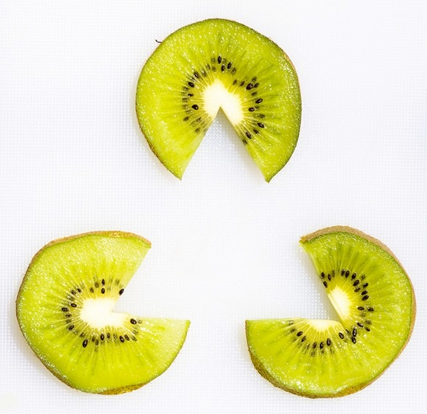
Perception is Subjective

Slide 17
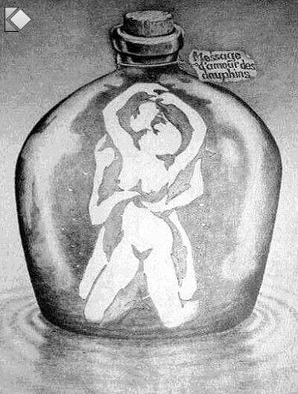
Perception is Deceptive

Slide 18
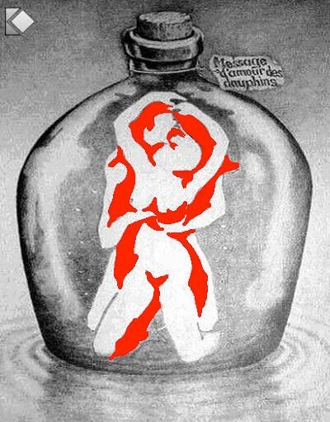
Perception is Deceptive

Slide 19
Sometimes we cannot even notice what’s right in front of us!

Slide 20
Importance of Action Based Research
Why are action based projects important?
It is important to challenge the problematic dominant epistemological understandings of food.
Instead we should produce ontological formations of the world we want by co-creating and co-recreating social relations that produce positive outcomes on people and the planet.
Action based learning theories incorporate students and facilitators as co-learners and co-collaborators. Together, they learn by doing. They also connect with the community.
Epistemology – A term meaning “theory of knowledge,” which gets at the how we know about the social world that lies behind all theoretical approaches. (Frampton, Kinsman, Thompson, Tileczek, (2006))
Ontology – Assumptions relating to how the social comes into being that inform all theories and ways of writing the social. (Frampton, Kinsman, Thompson, Tileczek, (2006))

Slide 21
The Dominant Epistemological View of Food?
The world has or will soon have the agricultural technology available to feed the 8.3 billion people anticipated in the next quarter of a century. The more pertinent question today is whether farmers and ranchers will be permitted to use that technology. Extremists in the environmental movement, largely from rich nations and/or the privileged strata of society in poor nations, seem to be doing everything they can to stop scientific progress in its tracks. It is sad that some scientists, many of whom should or do know better, have also jumped on the extremist environmental bandwagon in search of research funds. When scientists align themselves with antiscience political movements or lend their name to unscientific propositions, what are we to think? Is it any wonder that science is losing its constituency? We must be on guard against politically opportunistic, pseudo-scientists…
Borlaug, N., E. (2000) Ending World Hunger. The Promise of Biotechnology and the Threat of Antiscience Zealotry, Plant Physiology, 124(2) pp. 488.

Slide 22
Critique of Dominant Epistemological View of Food
When poisons are introduced into agriculture to control pests, or when GMOs are introduced under the argument of “feeding the world,” the justification given is always “science”. But “science” does not have a singular entity, and it did not come into existence within a vacuum. Today, what we generally refer to as “science” is in fact Western, mechanistic, reductionist modern science, which became the dominant practice of understanding the world during the Industrial Revolution and has continued as the dominant paradigm….To shape the industrial system in the form of new, violent technologies, and to shape the capitalist system in the form of new, profit-driven economics, a certain type of science was promoted and privileged as the only scientific knowledge system. Two scientific theories came to dominate this new, industrial paradigm, and they continue to shape practices of food, agriculture, health, and nutrition even today. The first is a Newtonian-Cartesian idea of separation: a fragmented world made of fixed, immutable atoms…The second significant theory that has framed the knowledge paradigm for industrial agriculture is Darwin’s theory of competition as the basis for evolution…The Newtonian-Cartesian theory of fragmentation and separation and the Darwinian paradigm of competition, have led to a nonrenewable use of Earth’s resources, a nonsustainable model for food and agriculture, and an unhealthy model of health and nutrition. An emphasis on the legitimacy of these arguments as the sole “scientific” approach has created a knowledge apartheid by discounting the knowledge of Mother Earth.
Shiva, V. (Shiva, V. (2016) Who Really Feeds the World, North Atlantic Books, pp. 4 – 7.

Slide 23
Activity Planting a Seed
Like a seed grows into a plant, we will all grow intellectually together as a class.
Take care of your plant and we’ll take care of each other’s intellectual and social needs during this course.
Your plant will need water, room to grow, light and nutrients (if it grows big).
The goal is to grow a kale plant to eat at the end of the course.

Slide 24
Discussion about the Food Project
We will all take turns cooking and bringing food for our fellow classmates.
We will cook about 3 times each
We need to manage waste (no excessive garbage and we need to clean up the room)
We should respect people’s dietary needs (I suggest we do vegetarian or vegan items)
You shouldn’t spend much money
We will discuss who will prepare food for the next class every week
If there are issues why you cannot participate, please come see me (financial, or other)

Slide 25
Videos
Hero’s Sanctuary
What’s wrong with Industrial Food?
The World According to Monsanto
Monsanto Lobbyist

Slide 26
What do you know about industrial food?
What is your current level of knowledge about industrial producing, processing, distribution and waste management?
What are positive and negative consequences of industrial food practices? Please provide sources for evidence of claims if any are made.
What are your current food practices regarding industrial food?
Do you eat at restaurants a lot?
Do you regularly buy already processed food items at the grocery store instead of untransformed ingredients?
Do you buy factory farmed meat (if you consume meat)?
Do you buy GMO and mass produced monoculture farmed vegetables?
Do you buy foods with pesticides or organic produce?
How important are the above questions to you?

Slide 27
Questions or Concerns?
Thanks!
Have a great day!
Homework – Go Check Out The Concordia Greenhouse!
Food for next week:
Salsa (and or dip) crackers (chips or toasted tortillas).
It cannot be bought processed!

