Slide 1
Advertising and the Consumer Culture
Erik Chevrier
September 6th, 2018
Introduction to course – advertising and consumer society

Slide 2
About Me
Erik Chevrier Website
Projects:
  Coop Collective Vision
  Concordia Food Groups Research Project
  Research for the CSU on Concordia’s Investment Practices
  Masters Thesis:
  How Individuals are Affected by Profuse Amounts of Publicity: A multidimensional approach
  Office hours: By request – Wednesday 6-8:30 PM
  Office location: H-1125.12 – we can meet at Loyola after class
  E-Mail: professor@erikchevrier.ca
  Facebook Group for the Class: https://www.facebook.com/groups/advertisingandtheconsumerculture/

Slide 3
Who are you?
What is your name?
What is your program major and minor?
What is your level of knowledge about advertising and consumer culture?
Why are you interested in this course?
What do you want to get out of this course?
What kind of media platforms do you use?
How much time do you spend with different media platforms?
How do you participate in consumer culture? What do you do for work? What are your consumer/shopping habits? What is your ecological footprint? Do you do social justice or volunteer work?

Slide 4
What is Advertising?
You are a commodity to be sold to advertisers!
We Deliver Young People
YUL-LAB
Advertising and the End of the World

Slide 5
What is Advertising?
Advertising is a product whose purpose is to sell other products/and or ideas.
Advertising provides a source of revenue to media companies and is a form of media itself.
Advertising is a creation of artistic expression, but one controlled by commercial/political interests.
Advertising reflects and creates culture simultaneously – it is designed to reflect social interactions but, in the process, it influences social behaviour.
Advertising is loved and hated by people.
Advertisers are always trying to find new ways to capture the attention of their audience and at the same time, people also watch ads for pleasure.
Many people don’t believe that they are personally affected by advertising, yet, they insist that it affects everyone else.
Advertising is pervasive in industrialized nations and consists of a plethora of commercial signs and symbols that communicate ideas and meaning – mainly to sell products and services and/or political ideas.
Attention is what advertisers seek but oversaturating the adverting environment causes people to pay less attention to advertising.
What is advertising to you?

Slide 6
Advertising and the Consumer Culture Write-Up
The goal of this course is to provide students with a critical examination of advertising and consumer culture in contemporary society. To accomplish this, we take a multidimensional approach by looking at advertising agencies, producers, and technologies; codes, texts, and forms; audiences and readings; and political socio-economic environments.
Students learn about advertising and consumer culture by looking at the changing structure of advertisements over the course of history. For example, we explore six advertising strategies and their historical context: utility-based ads in the 1800 - 1920s, product symbol based ads from the 1920s - 1950s, personification ads from the 1950s - 1970s, lifestyle ads from the 1970s - 1990s, demassifying ads from the 1990s - 2000s, and the mise-en-scène ads in the 2000s until now.
Furthermore, we juxtapose these strategies, within their historical contexts, with political and economic trends that helped pave the way for modern-day consumerism. For example, we look at the history of capitalism, industrialization, Fordism, liberalism, neoliberalism, financialization, and globalization, among other topics. We also explore what an economy is by looking at how commodities are produced, processed, distributed, and how current economic practices are affecting the biosphere.
In the course, students critically analyze their own economic practices to encourage them to become engaged, socially and environmentally responsible, ethical citizens of the world.
Topics covered in this course include but are not limited to: semiology, ideology, mythology, culture, consumerism, political economy, commodity fetishism, advertising agencies, structure of advertisements, culture jamming, materialism, resistance movements, modernism, post-modernism, digital advertising, social media, privacy, priming, feminism, racism, Marxism, among others.

Slide 7
Learning Objectives
To develop a critical understanding of advertising and consumer culture:
  By exploring the interrelation between cultural codes, forms, and texts; reception and readings of audiences; political and socio-economic environments; and productive organizations and technologies.
  By examining the history of advertising, advertising agencies, commodities, and new industrialized production methods.
  By investigating new media forms and their impact on consumerism, privacy, political systems and social systems.
To develop a critical understanding of political economy:
  By exploring power dynamics of those who produce, transform, distribute, and consume products – especially advertising agencies and audiences.
  By analyzing different types of political and economic arrangements focusing on the interaction between three main actors: states, corporations, and civil society.
  By understanding the history of capitalism, market economies, industrialization, mass production, consumerism and advertising.
  By evaluating other types of ‘post-capitalist’ political arrangements.
  By reviewing Marx’s theory of commodity fetishism (the perception of social relations being about a relationship between commodities instead of a relationship between people) and Lukács's theory of reification (the act of transforming human properties, relations and actions into properties, relations and actions of human‑produced things which have become independent from their creators).
To learn how to ‘read’ advertisements:
  By analyzing the influence of media forms, contexts, and meanings.
  By introducing semiotics, mythology and ideology.
  By examining social media forms, like Facebook, Youtube, and Twitter, etc.

Slide 8
Learning Objectives
To learn how advertisers encode meaning:
  By exploring the various technologies used to create advertisements.
  By evaluating advertising as a product of art and research.
  By understanding social influence and conformity tactics.
To identify oppressive power relations in advertising and consumer culture:
  By exploring perspectives from feminists, Marxists, the LGTBQ community, Indigenous peoples, and from people of colour.
  By evaluating criticisms of advertising from a multidisciplinary approach, i.e. psychologists against advertising to children, women’s rights groups advocating against unrealistic representations in advertising, etc.
  By understanding the extent of data collection and surveillance technologies in modern society.
To learn about cultural resistance movements:
  By exploring art forms of cultural resistance, like culture jamming, and ‘detournement’ from the French situationists.
  By encouraging communications students to be critical of their own consumption habits and participate in creating a more just society.

Slide 9
Course Evaluation

Slide 10
Assignment 1: What is Your Role in Consumer Culture
The goal of the first assignment is for students to reflect on their participation in consumer culture. Students are asked to provide a critical, introspective account of the way they participate in consumerism. Topics can include, labour practices, consumption habits, ecological footprint, social justice work, or any other related topic approved by me. Students can choose to do an in-depth report about one of the practices listed above or can choose to write more broadly about their participation in consumer culture. The paper should be no more than three pages long. If a student requests to submit the assignment in another form, we will discuss the parameters of the assignment together once I approve the project.

Slide 11
Assignment 2:
Critical Analysis of Advertising
The goal of the second assignment is to allow students to explore critical topics related to advertising that weren’t addressed in the assigned and recommended readings. These topics can include: advertising and desire; advertising and body image; feminist perspectives in advertising; Indigenous perspectives in advertising; race and advertising; new media and advertising; political advertising; data mining; future of advertising; technology and advertising; product placement; and mise-en-scène advertising. Students can propose other topics, but these must be approved by me. The paper should be no more than three pages long. If a student requests to submit the assignment in another form, we will discuss the parameters of the assignment together once I approve the project.

Slide 12
Proposals
The proposals are clear and concise descriptions of the projects and includes the specific topic chosen, a summary of the project, the purpose of the project, the structure and format of the final report, sources cited and/or methodology used to gather research, and other relevant information about the project. The proposals should be no more than a page and a half long.

Slide 13
Readings
Students are expected to complete ALL the designated readings and watch ALL of the assigned videos BEFORE EACH CLASS. Students are also expected to attend ALL classes, and participate in class discussions.
Required Books:
Holm, N. (2017) Advertising and Consumer Society: A Critical Introduction, Palgrave Macmillan.
Leiss, W., Kline, S., Jhally, S., Botterill, J., Asquith, K. (2018) Social Communication in Advertising
4th Edition, Routledge.
The recommended readings are not provided, students are encouraged to seek them out on their own.
The power-point lecture notes will be posted on the course site on a weekly basis before each class.
Recommended readings: URLs and other electronic sources may be posted on the course website and/or Facebook group from time to time. Please visit the course website and Facebook group to get this material. These are only for interest and are not required.
These books are available at Concordia Community Solidarity Co-op Bookstore

Slide 14
Course Format
This course consists of a variety of pedagogical styles including lectures, discussions, guest speakers, and/or community service learning (if requested as part of a project). Students are expected to read the required text and/or watch the assigned movie before coming to class. In class, students participate in interactive activities, discussions and have occasional visits from people who work: in advertising, culture jamming, with alternative economic practices and/or other related domains. At times, the class participates in fieldtrips on and off campus. Students are notified in advance by e-mail and in class prior to these events.

Slide 15
Tentative Schedule and Readings
The following slide is a TENTATIVE schedule and is subject to change. Be sure to consult the course website regularly to be aware of any changes.
September 6 – Introduction to the Course
September 13 – Introduction to Advertising and Consumer Culture
Required Readings:
Chapter 1 – Introduction: Why study advertising? Holm, N. (2017) Advertising and Consumer Society: A Critical Introduction, Palgrave Macmillan, pp. 1 – 12.
Chapter 1 – Introduction, Leiss, W., Kline, S., Jhally, S., Botterill, J., Asquith, K. (2018) Social Communication in Advertising, 4th Edition, Routledge, pp. 1 – 25.
Documentary to Watch:
The Century of Self: Part 1
https://www.youtube.com/watch?v=eJ3RzGoQC4s
September 20 – Analyzing Advertisements
Required Reading:
Chapter 3 – Analyzing Advertisements: Form, Semiotics, and Ideology, Holm, N. (2017) Advertising and Consumer Society: A Critical Introduction, Palgrave Macmillan, pp. 35 – 61.
Documentary to Watch:
The Century of Self: Part 2
https://www.youtube.com/watch?v=eJ3RzGoQC4s

Slide 16
Tentative Schedule and Readings
September 27 – History of Advertising and Consumer Society
Required Readings:
Chapter 2 – The History of Advertising: Contexts, Transformations and Continuity, Holm, N. (2017) Advertising and Consumer Society: A Critical Introduction, Palgrave Macmillan, pp. 14 – 32.
Chapter 4 – Advertising, Capitalism, and Ideology. Holm, N. (2017) Advertising and Consumer Society: A Critical Introduction, Palgrave Macmillan, pp. 63 – 92.
October 4 – Advertising and the Economy
Proposal for Project 1 Due
Required Reading:
Chapter 9 – Late-Modern Consumer Society, Leiss, W., Kline, S., Jhally, S., Botterill, J., Asquith, K. (2018) Social Communication in Advertising, 4th Edition, Routledge, pp. 214 – 237.
Documentary to Watch:
The Corporation
https://www.youtube.com/watch?v=Y888wVY5hzw
October 11 – Exam 1

Slide 17
Tentative Schedule and Readings
October 18 – Advertising and Commodities
Required Readings:
Chapter 5 – Advertising, Commodities and Commodity Fetishism, Holm, N. (2017) Advertising and Consumer Society: A Critical Introduction, Palgrave Macmillan, pp. 93 – 114.
Chapter 6 – Audiences for Sale: Quantification, Segmentation, and Personalization, Holm, N. (2017) Advertising and Consumer Society: A Critical Introduction, Palgrave Macmillan, pp. 117 – 137.
October 25 – Advertising Agencies
Project 1 Report Due
Required Reading:
Chapter 7 – Advertising Agencies: Organization, Agency and Internal Conflict, Holm, N. (2017) Advertising and Consumer Society: A Critical Introduction, Palgrave Macmillan, pp. 142 – 160.
Documentary to Watch:
The Persuaders by Douglas Rushkoff
https://www.pbs.org/wgbh/frontline/film/showspersuaders/
November 1 – Advertising, the Internet, Social and Mobile Mediated Marketplaces
Required Reading:
Chapter 12 – The Internet, Social and Mobile Mediated Marketplace, Leiss, W., Kline, S., Jhally, S., Botterill, J., Asquith, K. (2018) Social Communication in Advertising, 4th Edition, Routledge, pp. 313 – 344.

Slide 18
Tentative Schedule and Readings
November 8 – Twenty-First-Century Promotional and Consumer Culture
Proposal for Project 2 Due
Required Reading:
Chapter 13 – Twenty-First-Century Promotional and Consumer Culture, Leiss, W., Kline, S., Jhally, S., Botterill, J., Asquith, K. (2018) Social Communication in Advertising, 4th Edition, Routledge, pp. 345 – 372.
November 15 – Advertising as Art
Required Reading:
Chapter 8 – Advertising as Art: From Creativity to Critique. Holm, N. (2017) Advertising and Consumer Society: A Critical Introduction, Palgrave Macmillan, pp. 162 – 180.
Documentary to Watch:
Art & Copy: Inside Advertising's Creative Revolution by Doug Pray
November 22 – Culture Jamming and Resistance Culture
Required Readings:
Chapter 9 – Empowering Consumers: Engagement, Interpretation, Interpretation and Resistance. Holm, N. (2017) Advertising and Consumer Society: A Critical Introduction, Palgrave Macmillan, pp. 181 – 199.
Chapter 10 – The Politics of Advertising: Capitalism, Resistance, and Liberalism. Holm, N. (2017) Advertising and Consumer Society: A Critical Introduction, Palgrave Macmillan, pp. 201 – 209.
November 29 – Presentations
Project 2 Due
Final Exam During Exam Period

Slide 19
Key Points to Consider
Objectivity vs subjectivity
Parts vs whole
Representation vs reality
Process vs structure
Epistemology vs ontology

Slide 20


Perception is Subjective

Slide 21
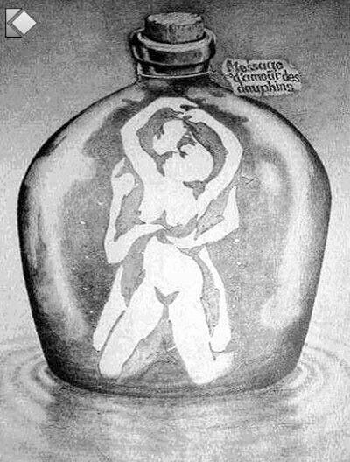
Perception is Deceptive

Slide 22

Perception is Deceptive

Slide 23
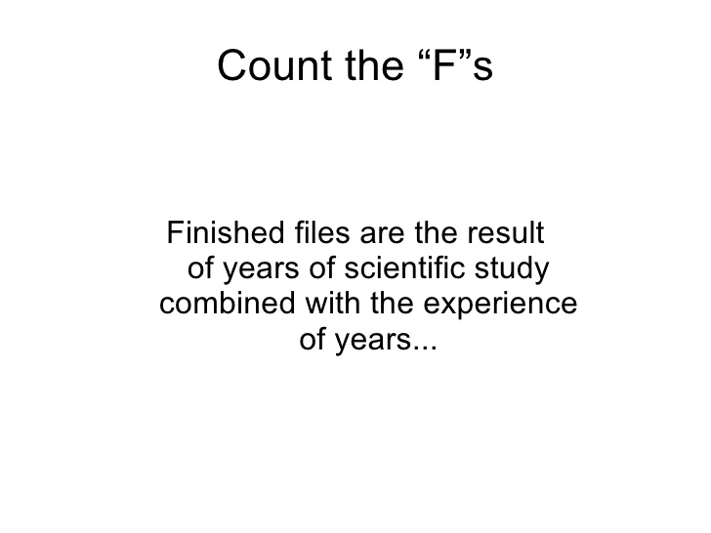
Sometimes we cannot even notice what’s right in front of us!

Slide 24
Recap – Key Points to Consider
Objectivity vs subjectivity
Parts vs whole
Representation vs reality
Process vs structure
Epistemology vs ontology

Slide 25
How Does this Apply to Advertising?
Advertising is NOT good or bad. It has intended and unintended, positive and negative consequences that are created with helpful and/or harmful intentions.
To understand advertising and consumer culture, a critical, multidimensional approach is best.

Slide 26
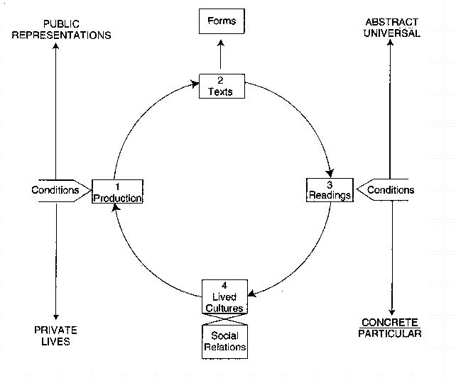
Critical Multidimensional Model
Richard Johnson
What is Cultural Studies Anyways, Social Text, (1986-87)

Slide 27
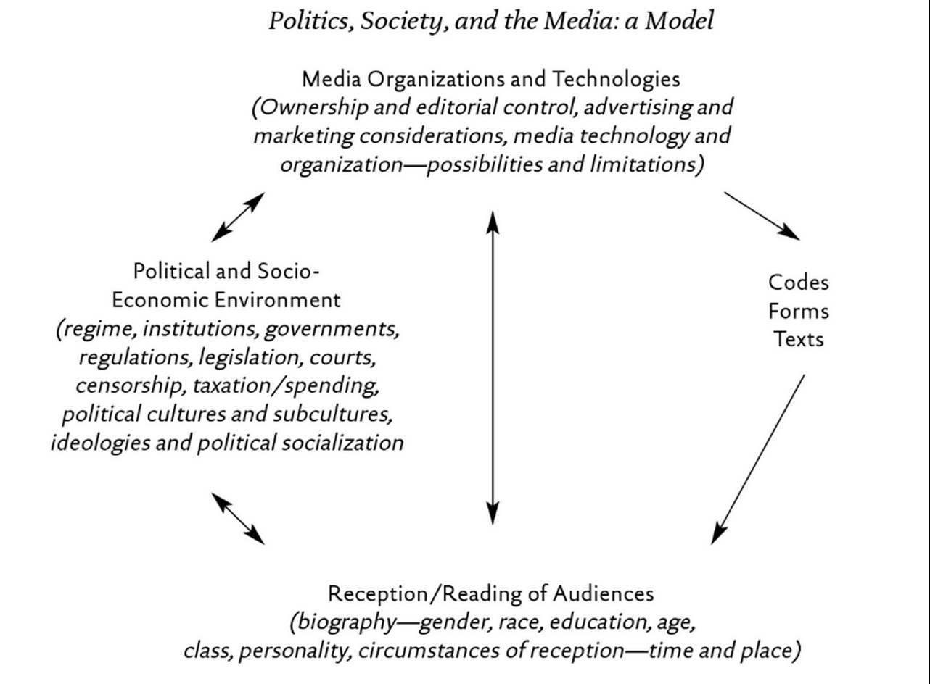
Critical Multidimensional Model
Paul Nesbitt-Larking. Politics, Society and the Media (2nd Edition). Broadview Press. 2009.

Slide 28
Critical Multidimensional Models

Slide 29
Let’s Analyze the New Nike Ad
Colin Kaepernick Nike Commercial

Slide 30
Compare and contrast ad campaigns!
Dove
Dove Evolution Video
Dove Onslaught Video
Axe
Axe Music Video
Axe Television Ad Diner Party
Axe Television Ad Dentist

Slide 31
Possible Field Trip
The Sign Makers of Montreal – Film Screening and Discussion
September 13th
5:30 PM
CJ. 1.114
Do we want to go? Who can make it at 5:30?

Slide 32
Questions or Concerns?
See you all next week.
Prioritize the following reading.
Chapter 1 – Introduction, Leiss, W., Kline, S., Jhally, S., Botterill, J., Asquith, K. (2018) Social Communication in Advertising, 4th Edition, Routledge, pp. 1 – 25.
Reflect on your consumption habits over the next week in order to prepare for the discussion next week.

