Slide 1
Food and Culture
Political Economy of food and culture
Erik Chevrier
October 3rd and 10th, 2018

Slide 2
Midterm Exam
Exam Format
15 – 20 = Multiple Choice (1 point each)
1 or 2 (of 2 or 3) = Short Answer Questions (10 points each)
Short Answer – Points (0 – 10)
0 = You wrote nothing
1 – 2 = You wrote something but it is not right at all
3 – 5 = You wrote something that is partially true but mainly wrong
6 = You are correct but extremely vague
7 = You are correct but slightly vague
8 – 9 = You are correct and are clear. You provide examples to back up your claim(s).
10 = You are spot on. You provide a range of examples to back up your claim(s). Your answer is full. You don’t leave anything out. Each part of your answer is completely correct. This is given to exceptional answers only.

Slide 3
Midterm Exam
There will be a range of questions some requiring more detail and some requiring less detail
The goal is to provide a balanced exam
If you expect to get an A or A+ you should study the material in more detail
You should study the material from the book as well as the PowerPoint slides
Study both – use the book to complement the material from what we went over in class
Koc, M., Sumner, J., Winson, A. (2012) Critical Perspectives in Food Studies, Oxford. Chapter 4 – Johnson, J., Cappeliez, You Are What You Eat: Enjoying (and Transforming) Food Culture, pp. 49 – 64. Levkoe, C., Brady, J., and Anderson, C. (2016) Towards and Interdisciplinary Food Studies: Working the Boundaries. In Conversations in Food Studies, Anderson, C. R., Brady, J., Levkoe, C. eds, University of Manitoba Press. Couninham, C., Van Estrik, P. (2013) Food and Culture; A Reader, Routledge. Chapter 1 – Mead. M. (1971) Why do we overeat? Pp. 19 – 22 Chapter 2 – Barthes, R. (1961) Towards a Psychosociology of Contemporary Food Consumption, pp. 23 – 30 Chapter 3 - Bordeau, P. (1979) Distinction: A Social Critique of the Judgement of Taste, pp. 31 – 40 Chapter 4 – Levi-Strauss, C. (1966) The Culinary Triangle, pp. 40 - 47 Chapter 5 – Douglas, M. (1966) The Abominations of Leviticus, pp. 48 – 58 Chapter 6 – Harris, M. (1985) The Abominable Pig, pp. 59 – 71 Chapter 7 – Goody, J. (1982) Industrial Food: Towards the Development of a World Cuisine, pp. 72 – 90 Chapter 8 – Mintz, S. W. (1979) Time, Sugar and Sweetness, pp. 91 - 103 Shiva, V. (2015) Earth Democracy: Justice, Sustainability and Peace, North Atlantic Books. Chapter 1 – Living Economies, pp. 11 – 64. Wittman, H., Desmarais, A. A., & Wiebe, N. (2011) Food Sovereignty in Canada: Creating Just and Sustainable Food Systems, Fernwood Publishing. Chapter 2 – Qualman, D. (2011) Advancing Agriculture by Destroying Farms? The State of Agriculture in Canada, pp. 20 – 42.

Slide 4
Who is Vandana Shiva?
Hero’s Sanctuary
Vandana Shiva on Food Sovereignty at Concordia

Slide 5
Discussion
What is the main findings of Vanada Shiva’s article Living Economies?
Compare and contrast the three types of economies mentioned by Shiva. What features do they have?
What are some myths about markets?
What does it mean to enclose the commons?
What is terra matter and terra nullius? Why are these terms important?
What are ways to close the commons?
What is the TRIPS agreement? Why is it important?
Why should be concerned about turning commons into commodities?

Slide 6
Living Economies – Vandana Shiva
Earth democracy refers to every being having equal access to the earth’s resources that make life possible; this access is assured by recognizing the importance of the other two economies: nature’s economy and the sustenance economy.
Economy and ecology derive from oikos – household Economy derives from the Latin word oeconomia meaning household management
Three types of economies: markets – nature – sustenance
What are features of the three types of economies suggested by Vandana Shiva?

Slide 7
Living Economies – Vandana Shiva

Slide 8
Living Economies – Vandana Shiva
Market economy (globalized free market economy, capitalism, corporate globalization):
Based on scarcity
Private property – closing commons
Capital exchange
Measured by GDP/NDP – total productive output
Externalizes social, economic burden, and destroys natural economy for profits and capital accumulation
Places of exchange
Social relations have become a relationship between things (reification)
Two forms of markets – concrete and ‘the market’
Two main reasons why ecological disasters and the number of displaced, destitute, and disposable people increase in direct proportion to economic growth
1 – Reduction of visible economy to the market and activities controlled by capital
2 – The legal rights of corporations have increased at the cost of the rights of real people

Slide 9
Living Economies – Vandana Shiva
Nature economy
The first and most important economy – without it, no other economies can exist
Not recognized by traditional econometrics
It is being destroyed by practices of market economies
The production and reproduction of nature by nature

Slide 10
Living Economies – Vandana Shiva
Sustenance economy
People work to directly provide the conditions necessary to maintain their lives
Human production and reproduction is possible
Balance with natural economy
Reproduce society through partnerships, mutuality and reciprocity
More important than market economy – market economy cannot exist without the sustenance economy

Slide 11
Living Economies – Vandana Shiva
Closing of commons:
1 – The exclusion of people from access to resources that had been their common property of held in common
2 – The creation of ‘surplus’ or ‘disposable’ people by denying rights of access to the commons that sustained them
3 – The creation of private property by the enclosure of common property
4 – The replacement of diversity that provides for multiple needs and performs multiple functions with monocultures that provide raw material 5 – The enclosure of minds and imagination, with the result that enclosures are defined and perceived as universal human progress, not as growth of privilege and exclusive rights for a few and dispossession and impoverished for the many
Terra matter – Mother earth
Terra nullius – Empty land (denied land to original inhabitants and obscured regenerative capacity of the earth)
Myths about markets:
Market economies are more efficient – industrial agriculture uses more energy than it produces
Free trade allows food to be delivered efficiently
Globalization creates a knowledge society
Important topics to understand about privatization
In 1995 Trade-Related Intellectual Property Rights (TRIPs): Article 27.3(b) intellectual agreement of the WTO

Slide 12
Living Economies – Vandana Shiva
Market economies have produced a shift in how resources are perceived. Transformation of commons into commodities has two implications:
It deprives politically weaker groups of their right to survive
It robs nature of the ability to self-renew and sustain
The entire foundation of the ‘ownership society’ is based on new enclosures. The contrived law to justify contemporary enclosures according to Epstein (in Shiva) is based on three falsifications:
The erasure of the history of colonization as a taking and the denial of the experience of occupied inhabitants and their prior rights and prior claims.
The defining of the behaviour of states acting on public trust doctrines eminent domain.
The reduction of the public to the individual.

Slide 13
Foundations of Food and Culture
Jack Goody – Towards the Development of a World Cuisine *Published in 1982
What is the main message in Goody’s article?
What are important factors in the development of a ‘World Cuisine’?
What is the history of:
1 – Preserving
2 – Mechanization
3 – Retailing
4 – Transport
Is adulteration of food a new concern? Why or why not?
How does global food trade function today?
What is the role of advertising in creating a global food cuisine?

Slide 14
Foundations of Food and Culture
Jack Goody – Towards the Development of a World Cuisine *Published in 1982
The development of mass cuisine developed because of advances in four main areas:
1 – Preserving
2 – Mechanization
3 – Retailing
4 – Transport

Slide 15
Foundations of Food and Culture
Towards the Development of a World Cuisine
Preserving methods
Salting meat and fish were salted as of the 15th century to be shipped by sea
Pickling was an early industrial activity
Sugar was used to preserve fruit and meat
Brief history of canning
In 1681 – Invention of the ‘digester’ Canning ‘or bottling’ by Denis Papin in 1681
End of 17th century – glass containers for medicine and wine at end of 17th century
1804 – Appert opened bottling factory at Massy, near Paris – developed new improved methods
1814 – Donkin, Hall, Gamble set up canning factories in Bermondsey – food rations purchased by Navy
1821 – William Underwood began trading internationally in Boston – jellies, jams, pickles, ketchup, sauces
1825 – Kensett & Doggett set up cannery in New York
1870 – Rapid expansion of industrial canned goods, especially in France and Brittan
1847 & 1855 – Grimwade took a patent for condensed milk and powdered milk

Slide 16
Foundations of Food and Culture
Towards the Development of a World Cuisine
Brief History of Artificial Freezing
Early 1800s – Ice houses in Scotland, Russians conserve chickens in snow, natural ice was packed into refrigerators
1806 – Frederic Tudor began worldwide ice shipping company from Boston
1851 – Refrigerated rail cars in USA
1850 – James Harrison developed first practical ice making machine
Development in branding and advertising – mass production & mass consumption
1823 – Mr. Lea & Mr. Perrins Worcestershire Sauce
1860 – Dr. Kellogg produced granola based foods
1890s – Charles Post produced Post Toasties – marketed as health food
Flaking, toasting, puffing, extrusion

Slide 17
Foundations of Food and Culture
Towards the Development of a World Cuisine
Mechanization and Transportation
Mechanization of food production, preparation and canning.
1849 – Mechanism for pressing out can tops
1876 – Howe machine increased canning production
Middle to late 1800s – Development of Railways
Retailing
1500 – 1600 Shift from open markets to closed shops
Company of Grocers
Late 1800s early 1900s – rapid expansion of retail outlets – advertising becomes significant
Significant factors:
- Separation of people from producing food, separation of people from arable land = people become dependent on food markets.
- Adulteration of food is not a new concern
- Time and space are major obstacles that were overcome to develop a world food system
- Industrialization of means of production

Slide 18
Foundations of Food and Culture
Time, Sugar, Sweetness – Sidney W. Mintz (1979)
Anthropologists have traditionally focused on unusual aspects of food rater than the everyday eating rituals
Chewing and spitting to encourage fermentation, eating larvae, cannibalism, prohibitions and taboos, etc.
New research is refocusing on the everyday experience of people with food
Concerns of resources, energy, prices, women, labour, etc.
Mintz focuses on the anthropology and history of production and consumption (focus on sweetness)
Sugar was first a luxury edible but began to be commonplace in the Western World in the 17th century
Sugar began in medicines, became a preservative agent and flavour enhancer, it is now ubiquitous in modern processed foods
Sugar cannot be studied in isolation because it is supplement.
Sugar was produced in the 8th century A.D. in the Mediterranean Island and Spain (was more medicine than food)
13th century English monarchs were using sugar – King Henry III ordered 300 pounds
14th century England got a cargo full of sugar from Venice
15th century Thomas Austin’s cookbooks contained recipes that included sugar
17th century sugar consumption increased fourfold
From 1663-1775 sugar consumption increased about 20 times
This trend continued in the 19th and 20th centuries
Rise in industrialization incorporated sugar into ‘new ‘ processed foods
Meaning of sugar changed as capitalism developed – space and time were transformed
Sugar has endured over time to be part of modern diets

Slide 19
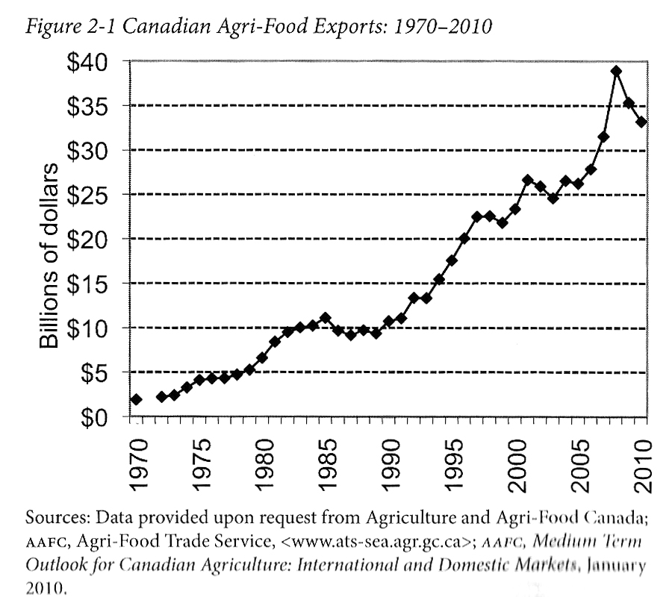
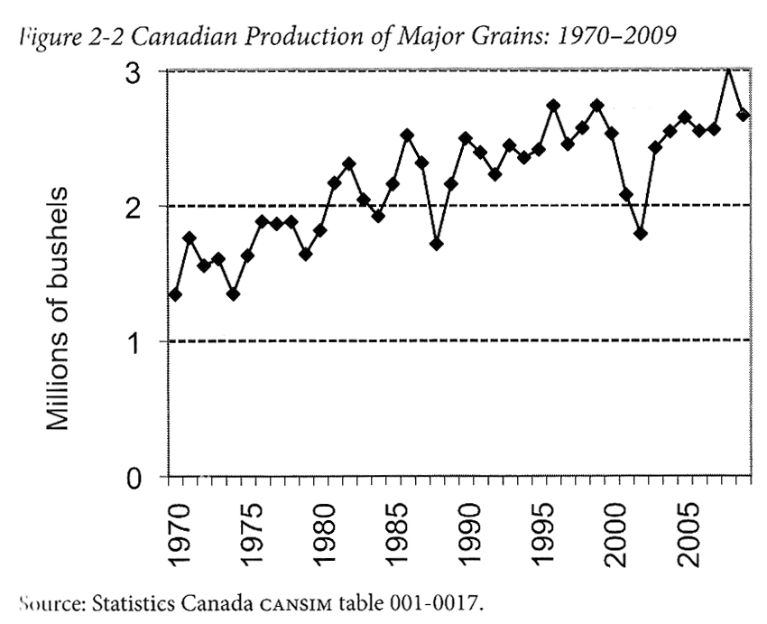
Advancing Agriculture by Destroying Farms? The State of Agriculture in Canada Qualman, D. (2011) Advancing Agriculture by Destroying Farms? The State of Agriculture in Canada, pp. 20 – 42. In, Wittman, H., Desmarais, A. A., & Wiebe, N. (2011) Food Sovereignty in Canada: Creating Just and Sustainable Food Systems, Fernwood Publishing

Slide 20
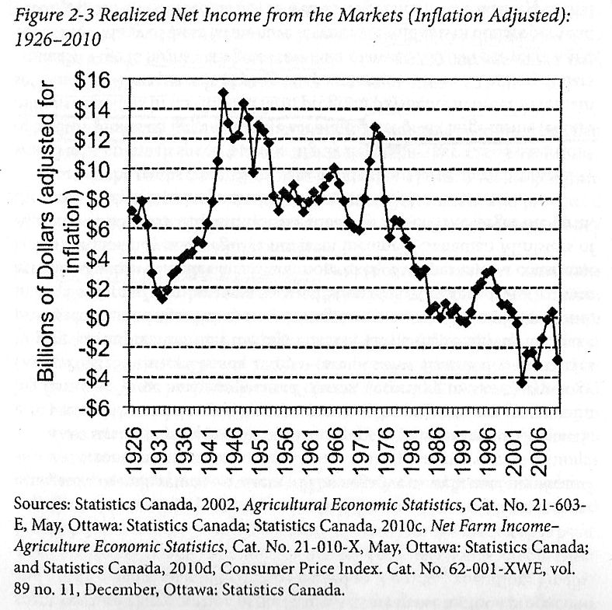
Advancing Agriculture by Destroying Farms? The State of Agriculture in Canada Qualman, D. (2011) Advancing Agriculture by Destroying Farms? The State of Agriculture in Canada, pp. 20 – 42. In, Wittman, H., Desmarais, A. A., & Wiebe, N. (2011) Food Sovereignty in Canada: Creating Just and Sustainable Food Systems, Fernwood Publishing

Slide 21
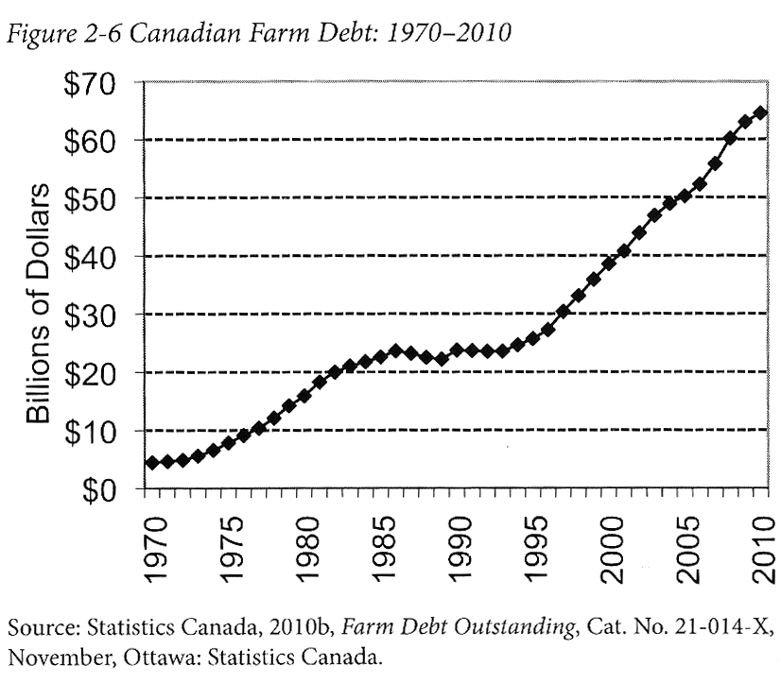
Advancing Agriculture by Destroying Farms? The State of Agriculture in Canada Qualman, D. (2011) Advancing Agriculture by Destroying Farms? The State of Agriculture in Canada, pp. 20 – 42. In, Wittman, H., Desmarais, A. A., & Wiebe, N. (2011) Food Sovereignty in Canada: Creating Just and Sustainable Food Systems, Fernwood Publishing

Slide 22
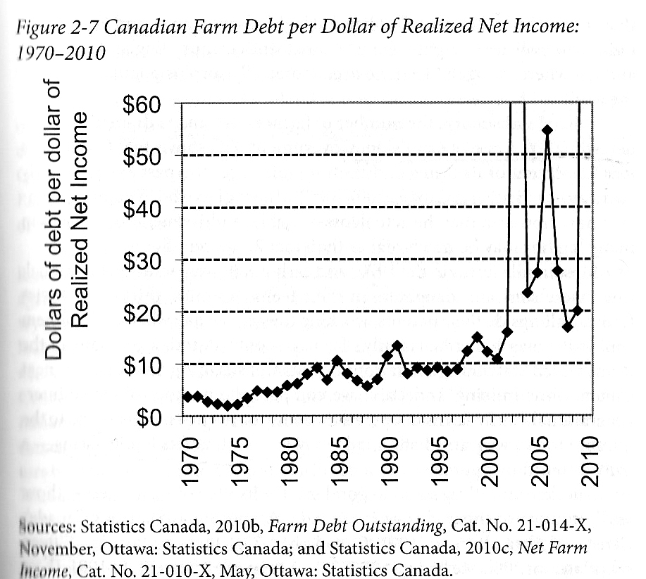
Advancing Agriculture by Destroying Farms? The State of Agriculture in Canada Qualman, D. (2011) Advancing Agriculture by Destroying Farms? The State of Agriculture in Canada, pp. 20 – 42. In, Wittman, H., Desmarais, A. A., & Wiebe, N. (2011) Food Sovereignty in Canada: Creating Just and Sustainable Food Systems, Fernwood Publishing

Slide 23
Advancing Agriculture by Destroying Farms? The State of Agriculture in Canada Qualman, D. (2011) Advancing Agriculture by Destroying Farms? The State of Agriculture in Canada, pp. 20 – 42. In, Wittman, H., Desmarais, A. A., & Wiebe, N. (2011) Food Sovereignty in Canada: Creating Just and Sustainable Food Systems, Fernwood Publishing
Drain on taxpayers:
Canadian taxpayers have provided 3 – 4 billion dollars per year, $67 billion (about 8000$ per household) to agri-business transnationals
Government programs for agriculture sector:
Crop insurance – Insurance for crops for potential damage i.e. insects, weather, plant disease
Margin-based support programs – insurance for crops for potential damage i.e. insects, weather, plant disease
Agriculture Income Disaster Assistance Program
Canadian Farm Income Program
Savings account programs – Savings programs that are matched by government to withdraw when net incomes fall
Net income stabilization account
Ad-hoc payments – Made to farmers to offset large losses
Quebec’s ASRA –L’assurance stabilization des revenues agricoles –To stabilize Quebec farm incomes in relation to production costs

Slide 24
Living Economies – Recap

Slide 25
Aristotle Aristotle. Aristotle in 23 Volumes, Vol. 21, translated by H. Rackham. Cambridge, MA, Harvard University Press; London, William Heinemann Ltd. 1944.
Chrematistics – art of acquisition – limitless accumulation unnatural and problematic
Oikonomia – management of the household – true form of an economy

Slide 26
Karl MarxMarx, K. Capital Volume 1, Penguin Classics.
C – C – Basic barter C – M – C – The way classical economists viewed basic barter with money M – C – M’ – What really happens when barter systems incorporate money – Limitless accumulation M – M’ – Usury capital system – Limitless accumulation

Slide 27
Karl PolanyiPolanyi, K. (2001) The Great Transformation; The Political and Economic Origins of Our Time, Beacon Press
Types of economic practices:
Markets (exchange)
Household economy
Redistribution
Reciprocity

Slide 28
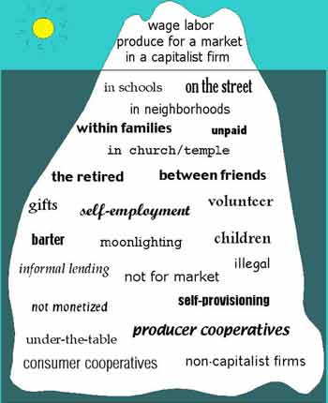
Gibson Graham – Take back the Economy Gibson-Graham, J.K., Cameron, J., Healy, S. (2013) Take Back the Economy: An Ethical Guide for Transforming Communities, University of Minnesota Press
Katherine Gibson Interview Playlist

Slide 29
Gibson Graham – Take back the Economy Gibson-Graham, J.K., Cameron, J., Healy, S. (2013) Take Back the Economy: An Ethical Guide for Transforming Communities, University of Minnesota Press

Slide 30
Gibson-Graham – Take back the Economy Gibson-Graham, J.K., Cameron, J., Healy, S. (2013) Take Back the Economy: An Ethical Guide for Transforming Communities, University of Minnesota Press
Please use Gibson-Graham’s diagram from Take Back the Economy and identify types of food organizations and practices in regards to the five categories:
Enterprise
Labour
Transactions
Property
Finance

Slide 31
Take Back the Economy – Commons Toolkit Gibson-Graham, J.K., Cameron, J., Healy, S. (2013) Take Back the Economy: An Ethical Guide for Transforming Communities, University of Minnesota Press
Types of commons:
Biophysical –Exist naturally – i.e. rocks, soil, air, etc.
Cultural – Things shared by members of the same culture – i.e. language, musical heritage, symbols
Social – Things shared between members of a social system – i.e. education, health, political systems
Knowledge – Things people know – i.e. Indigenous ecological knowledge, scientific achievements
Ways to assess commons. To be a commons:
Access – Must be shared widely
Use – Must be negotiated by a community
Benefit – Must be distributed to the community and possibly beyond
Care – Must be performed by community members
Responsibility - Must be assumed by the community
Property – Must be collectively owned private property, state owned property and/or open access property

Slide 32
Envisioning Real Utopias – Erik Olin Wright Olin Wright, E. (2010) Envisioning Real Utopias, Verso

Slide 33
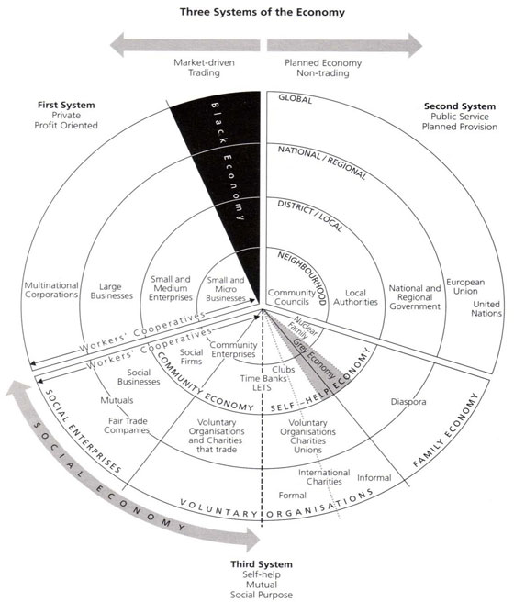
Three Systems of an Economy – John Pierce Pearce, J. (2009) Social Economy: Engaging as a Third System, In Amin, A. The Social Economy; International Perspectives on Economic Solidarity, p. 26.

Slide 34
Introduction to Food Sovereignty
Darrin Qualman Advancing Agriculture by Destroying Farms? The State of Agriculture in Canada
Food Sovereignty is NOT:
A set of policies simplistically aimed at maximizing production and exports
A disregard for the destruction of family farms and rural communities
A push towards high-input, high-cost, high-energy-use model for food production that generates chronic negative returns for the farm families who work the soil
A concentration of land ownership into the hands of fewer and fewer owners, many of them non-farmers
A corporate takeover of a growing number of agricultural sectors (e.g. hog production and cattle finishing)
A push towards massive production units that concentrate potential pollutants
A transfer of key food processing facilities to foreign companies, even to foreign lands
Economic policies that make foreign-based transnationals the primary beneficiaries of the wealth created by farm families working our land
A system that makes citizens ever more dependent on food supplied further and further from their homes

Slide 35
ACTIVITY: Three Systems of an Economy – John Pierce Pearce, J. (2009) Social Economy: Engaging as a Third System, In Amin, A. The Social Economy; International Perspectives on Economic Solidarity, p. 26.
Please use John Pearce’s diagram to identify where the following organizations would be located
Food bank
The Hive Solidarity Cooperative
Monsanto
A local farm
A local for profit café
A government owned regional food delivery program
A family producing their own food

Slide 36
Thanks!
Questions or concerns?
Go Eat at the People’s Potato!
Exam next week! Study Hard!

