Slide 1
Advertising and the Consumer Culture
Advertising and the economy
Erik Chevrier
October 4th, 2018

Slide 2
Activity
After three examples, you must write down the first word that comes to your head after I give you a CATEGORY prompt.
The goal of the activity is to write down a word in that CATEGORY the fastest!
Ready, I’m going to catch you off guard.
You will be given three examples to make sure you understand the activity. Don’t let me catch you napping! You’ll need to act FAST!

Slide 3
CATEGORY = THINGS YOU DISLIKE

Slide 4
CATEGORY = THINGS YOU DISLIKE
LITTER

Slide 5
CATEGORY = THINGS YOU DISLIKE
LITTER
CHEATERS

Slide 6
CATEGORY = THINGS YOU DISLIKE
LITTER
CHEATERS
LIARS

Slide 7
CATEGORY = FOOD ITEMS

Slide 8
CATEGORY = FOOD ITEMS
KETCHUP

Slide 9
CATEGORY = TYPES OF SCANS

Slide 10
CATEGORY = TYPES OF SCANS
PET SCAN – Positron emission tomography

Slide 11
CATEGORY = TYPE OF ANIMAL

Slide 12
Automatic Thinking – Low Effort Thinking
Automatic thinking – Is thought that is generally unconscious, unintentional, involuntary, and effortless.
Schemas – Mental structures people use to organize their knowledge about the social world themselves and that influence the information people notice, think about, and remember.
We tend to fill in the blanks with SCHEMA-CONSISTENT INFORMATION.
How People are Affected By Profuse Amounts of Publicity? – Advertising and Priming
Activity – Automatic Thinking!

Slide 13
SAY THIS WORD OUTLOUD 10 TIMES
ROAST

Slide 14
SAY THIS WORD OUTLOUD 10 TIMES

Slide 15
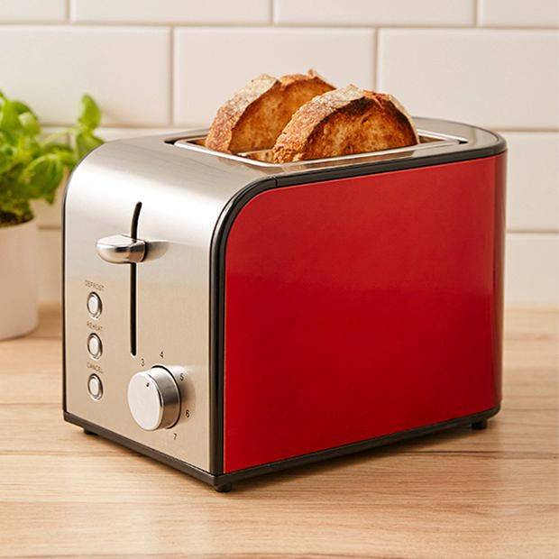
Answer the following question?
What do you put in a toaster?

Slide 16
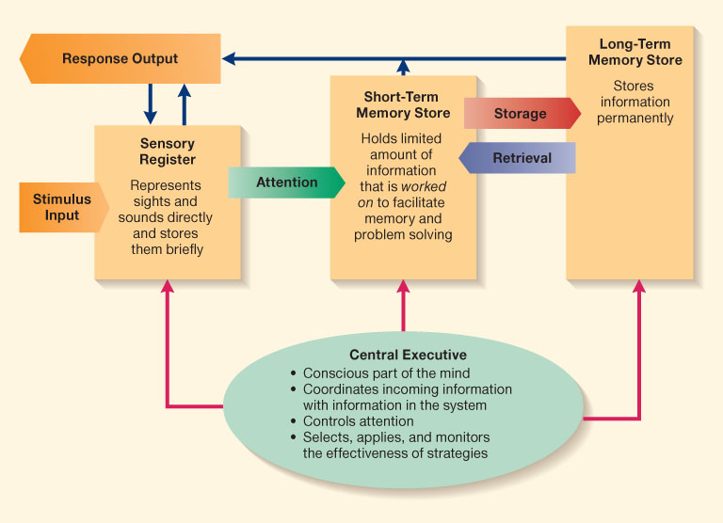
Information Processing Model

Slide 17
Accessibility and Priming
Accessibility – The extent to which schemas and concepts are at the forefront of people’s minds and are, therefore, likely to be used when making judgments about the social world.
Schemas can be accessible for three reasons:
1 – Some schemas are chronically accessible because of past experience – these schemas are constantly active and ready to use to interpret ambiguous situations.
2 – Schemas can be accessible because they are related to a current goal.
3 – Schemas can become temporary accessible because of our recent experiences.
Priming – The process by which recent experiences increase the accessibility of a schema, trait, or concept.
Words have to be accessible and applicable to act as a prime.
Schemas may be quite resistant to change
Schemas are influenced by culture
Perception Without Awareness (PWA) – Daren Brown – How to Control a Nation – Toy Story
How to Control a Nation Full Video
The Art of Misdirection
Advertising makes consumption schemas continuously accessible. Advertising primes our consumer drives.

Slide 18
The Power of Words
The power of words in regards to memory

Slide 19
The Power of Suggestion
An Inquiry Into How People Are Affected by Profuse Amounts of Publicity: A Multidisciplinary Approach
Advertising as a suggestion – Page 26
Suggestions can bypass critical thought because there is no direct request to refuse

Slide 20
Other Persuasion Techniques
Priming
Persuasion
Central Routes
Peripheral Routes
Internal and External Justification (justification spiral)
Conditioning

Slide 21
Exam Format
You will answer five short answer questions.
Short Answer – Points (0 – 10)
0 = You wrote nothing
1 – 2 = You wrote something but it is not right at all
3 – 5 = You wrote something that is partially true but mainly wrong
6 = You are correct but extremely vague
7 = You are correct but slightly vague
8 – 9 = You are correct and are clear. You provide examples to back up your claim(s).
9 – 10 = You are spot on. You provide a range of examples to back up your claim(s). Your answer is full. You don’t leave anything out. Each part of your answer is completely correct. This grade is only given for exceptional answers.
There will be a range of questions some requiring more detail and some requiring less detail
The goal is to provide a balanced exam
If you expect to get an A or A+ you should study the material in detail
You should study the material from the books, the PowerPoint slides, and documentaries
Use the book to complement the material from what we went over in class
I will not ask a specific question about the documentaries but they will serve as resources for you to provide examples while answering the exam questions.

Slide 22
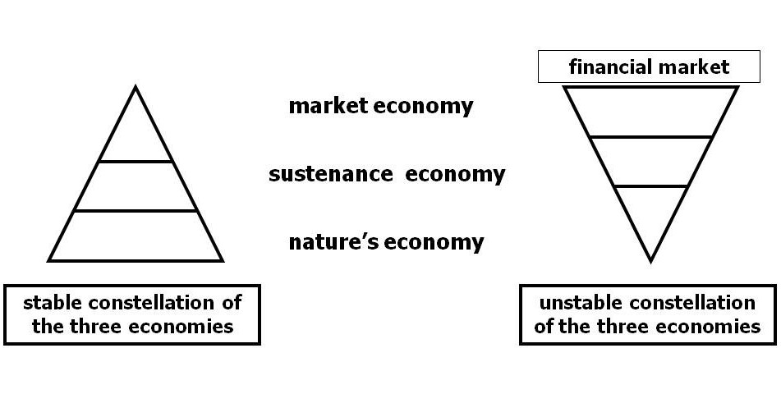
Living Economies – Vandana Shiva

Slide 23
Aristotle Aristotle. Aristotle in 23 Volumes, Vol. 21, translated by H. Rackham. Cambridge, MA, Harvard University Press; London, William Heinemann Ltd. 1944.
Chrematistics – art of acquisition – limitless accumulation unnatural and problematic
Oikonomia – management of the household – true form of an economy

Slide 24
Karl MarxMarx, K. Capital Volume 1, Penguin Classics.
C – C – Basic barter C – M – C – The way classical economists viewed basic barter with money M – C – M’ – What really happens when barter systems incorporate money – Limitless accumulation M – M’ – Usury capital system – Limitless accumulation

Slide 25
Karl PolanyiPolanyi, K. (2001) The Great Transformation; The Political and Economic Origins of Our Time, Beacon Press
Types of economic practices:
Markets (exchange)
Household economy
Redistribution
Reciprocity

Slide 26
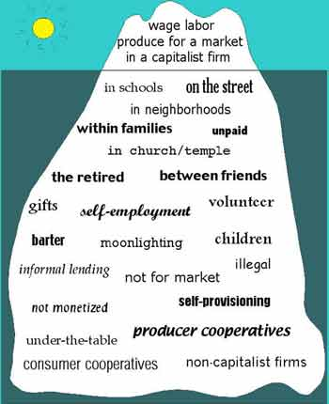
Gibson Graham – Take back the Economy Gibson-Graham, J.K., Cameron, J., Healy, S. (2013) Take Back the Economy: An Ethical Guide for Transforming Communities, University of Minnesota Press
Katherine Gibson Interview Playlist

Slide 27
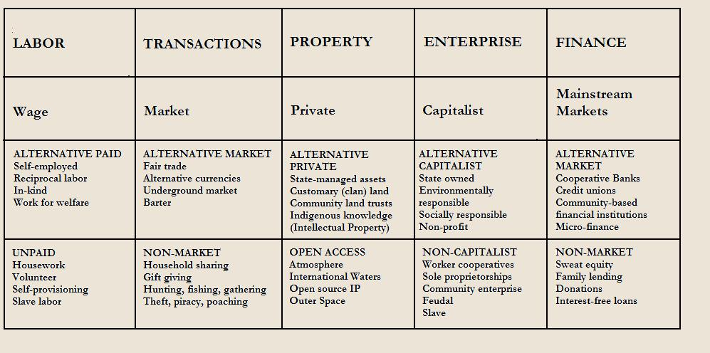
Gibson Graham – Take back the Economy Gibson-Graham, J.K., Cameron, J., Healy, S. (2013) Take Back the Economy: An Ethical Guide for Transforming Communities, University of Minnesota Press

Slide 28
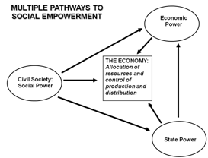
Envisioning Real Utopias – Erik Olin Wright Olin Wright, E. (2010) Envisioning Real Utopias, Verso

Slide 29
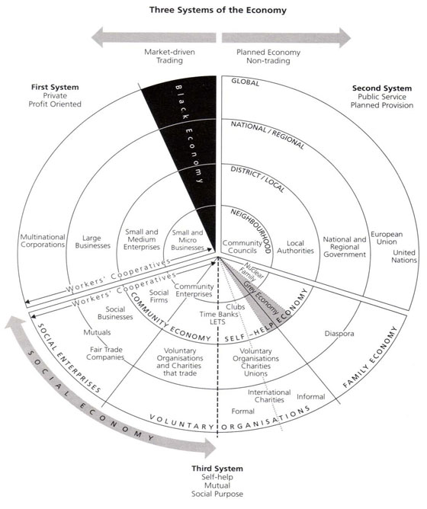
Three Systems of an Economy – John Pierce Pearce, J. (2009) Social Economy: Engaging as a Third System, In Amin, A. The Social Economy; International Perspectives on Economic Solidarity, p. 26.

Slide 30
What is Capitalism? Holm (2017) Advertising, Capitalism and Ideology
Weber’s Six Characteristics of Modern Capitalism
Private ownership of property
Free trade in markets
Rational accounting practices
Predictable and consistent legal systems
Free (non-slave) labour
A formal system for partial ownership of business and property
Other mentions: Profit, trade, exchange.
Milton Friedman – Capitalism is the organization of the bulk of economic activity through private enterprise operating in a free market.
James Fulcher – Capitalism is essentially the investment of money in the expectation of making a profit. Capitalism requires the circulation of capital. It also is a system that produces profits.

Slide 31
What is Political Economy? Holm (2017) Advertising, Capitalism and Ideology
Political economy:
The study of how economic relations inform and are informed by other aspects of society and culture.
Economics influences not just the buying and selling of goods but also the wider and seemingly unrelated aspects of our society.
One central methodology in media studies, whereby scholars seek to understand the textual forms, social influence, and political role of the media through the study of the economics of the media.
Political economy looks at society as a totality – not different units like economics, culture, religion, sports, science, etc.

Slide 32
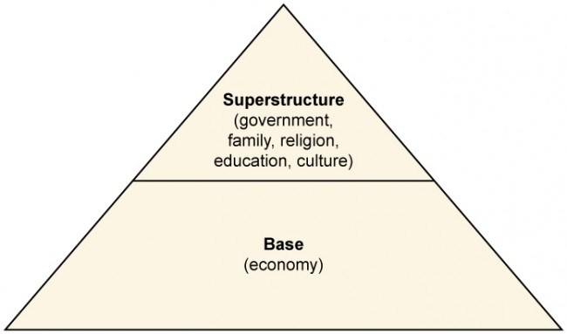
What is Ideology? Holm (2017) Advertising, Capitalism and Ideology

Slide 33
Advertising, Capitalism and Ideology Holm (2017) Advertising, Capitalism and Ideology
Marxism and Capitalism
Naturalizing Capitalism
Advertising and Ideology
Raymond Williams – Official art of modern capitalism
Advertising as Ideological State Apparatus
Louis Althusser – Reproduction of relations of production – Ideological state apparatus vs repressive state apparatus
Ideology in Practice
Consumption becomes how people gain control over their everyday practices and master the world around them
Example with Visa
Fantasy and pleasure
Focus on relation to consumption instead of production
Self-realization through consumption
Separate relations between consumption and production
Consumer Society and the Magic System
Raymond Williams – Not materialist enough
Materialism – Utility vs ‘magic system’
Magic system and society of the spectacle
Selling Capitalism
Capitalist realism vs socialist realism

Slide 34
Late-Modern Consumer Society Less, Klein, Jhally, Botterill, Asquith (2017) Social Communication in Advertising
Questions:
What is the main message in the chapter Late-Modern Consumer Society? What is Jean Baudrillard’s view about consumer culture and the role of symbolic processes in socialization and political economy?
What do the authors mean by the triumph of culture? How does Bordieu view the economic and cultural spheres? What does Featherstone say about the ‘new middle class’? How are lifestyles integrated into our understanding of advertising and culture? What is important of ‘post-traditional societies’ in creating identities?
What do the authors mean by lifestyle diversity and reflexive identity? What is unique about consuming for pleasure? What is the difference between pleasure and satisfaction and how does that relate to post-modern consumer habits?
How has business become more ‘hip’? How does social opposition relate to consumerism? How have advertisers embraced ‘cool’? Brands shifted from ‘cultural blueprints’ to ‘cultural resources’ – what does this mean and what does Holt suggested that advertisers achieved these goals (3 ways)? What does Malcolm Gladwell suggest about rules to ‘cool?
What do Less, Klein, Jhally, Botterill, Asquith mean by commodities becoming unstable satisfiers?
Please describe how (post)modern consumer society led to a loss in social consumption and/or celebration of materialism?
What are some criticisms and defenses of advertising in the post-modern era? What are cultural Critiques of Advertising?

Slide 35
Have a Great Night
Questions or concerns?
You have an exam next week. Study hard!
I can meet next week on Tuesday or Wednesday downtown. If you want to meet to discuss the material, please e-mail me before Sunday because my schedule fills up very quickly.

