Slide 1
Advertising and the Consumer Culture
Advertising Agencies
Erik Chevrier
November 1st, 2018

Slide 2
Discussion
Who wants to work in advertising?
What is an advertiser?
Tasks
Jobs
Types of employment
Knowledge or skillset needed
Salary

Slide 3
Social Communication in Advertising Table 1.1 Cultural Frames That Summarize The Development of Media, Marketing and Advertising

Slide 4
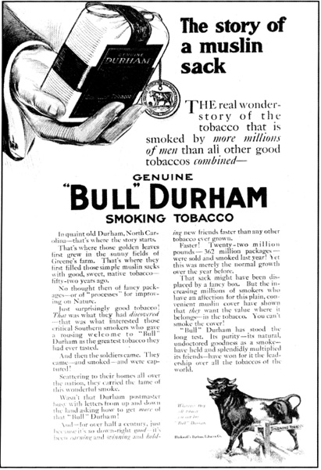
Social Communication in Advertising Table 1.1 Cultural Frames That Summarize The Development of Media, Marketing and Advertising

Slide 5
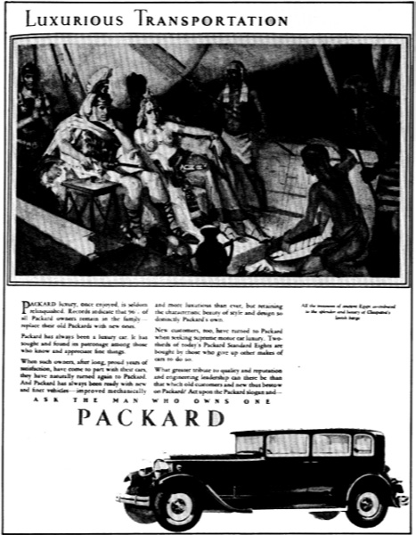
Social Communication in Advertising Table 1.1 Cultural Frames That Summarize The Development of Media, Marketing and Advertising

Slide 6
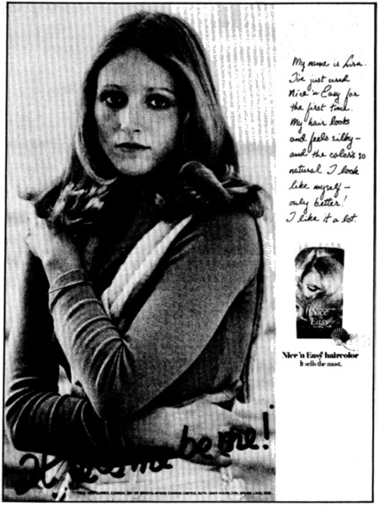
Social Communication in Advertising Table 1.1 Cultural Frames That Summarize The Development of Media, Marketing and Advertising

Slide 7
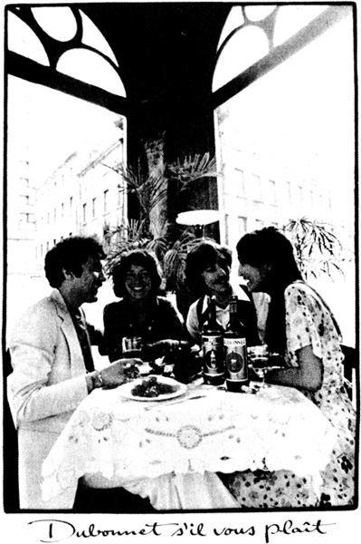
Social Communication in Advertising Table 1.1 Cultural Frames That Summarize The Development of Media, Marketing and Advertising

Slide 8
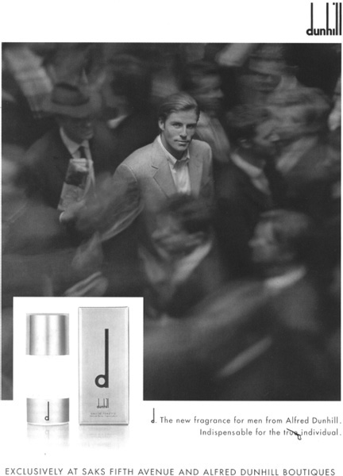
Social Communication in Advertising Table 1.1 Cultural Frames That Summarize The Development of Media, Marketing and Advertising

Slide 9
History of Advertising Advertising and Consumer Society (Holm, 2017)
Four Moments in advertising history
First Moment: Origins of industrial development
Pre capitalist societies had art forms but these cannot be considered advertising
Factors that led to the development of advertising
Urbanization (expropriation from agricultural communities to cities)
Rationalization (reformation of time and space)
Mass production and distribution (development of industrialization and capitalism)
Mass media (development and proliferation of mass media)
Beginning of consumer society
New division of labour
New way of understanding products
Increases in production needed to be matched by increases in consumption
People start defining themselves by their consumption
Purchase way to a better life
Promote general use of advertising
Advertising agencies were space brokers

Slide 10
History of Advertising Advertising and Consumer Society (Holm, 2017)
Four Moments in advertising history
Second Moment: Professionalism, consolidation and redemption
Consolidation of advertising agencies
Lack of professionalism, accountability and organization
False claims in patent medicine
Fear of advertising
Development of ‘full service’ agencies
Market research, creative art, space brokers – 1920s
More respected profession
N.W. Ayer and Sons
Factual copy
Research – demographics and brand preference
John. E. Powers
Plain speech & fine writing is offensive
John E. Kennedy
Reason why advertising

Slide 11
History of Advertising Advertising and Consumer Society (Holm, 2017)
Four Moments in advertising history
Third Moment: Manipulation, creativity, and globalization
Booming consumer culture of 1950s
Industry seen as repetitive, monotonous, and dull
Fear of advertising
Vince Packard – The Hidden Persuaders
James Vicary – Subliminal Advertising Fiasco
Creative Revolution
Television ads
Emotional ads

Slide 12
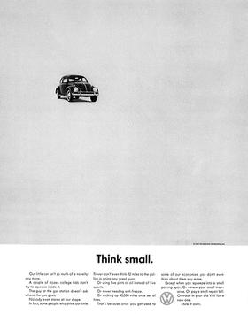
Think Small Ad Volkswagen
Bill Bernbach (BBD)

Slide 13
History of Advertising Advertising and Consumer Society (Holm, 2017)
Four Moments in advertising history
Fourth Moment: Digital advertising, algorithms, and data-surveillance\
Move towards globalization
Mergers between companies and advertising agencies (mega agencies)
Online advertising
Search engine optimization – SEO
Google – AdWords (algorithms)
Old ad format integrated into ‘new’ media
Seeking new methods
Social media and viral ads
Facebook & Spotify, etc.
Data mining
People share content

Slide 14
Limits to Abstraction
Please describe the labour theory of value described last class. What is the value of a commodity?
What is reification? What is commodity fetishism? How do these concepts relate to advertising?
What are limits to abstraction as pointed out by Holt in chapter 7, Advertising agencies: Organizations, agency and internal conflict?
What does Holm mean by the human touch?
What is the dual meaning of agency?
Why does Holm consider structures and agencies part of a chicken-or-the-egg argument?

Slide 15
The Limits to Abstraction
Limits to abstraction include:
Theories tend to offer a monolithic account
i.e. profit motive
Can present the world as determined by oppressive forces
i.e. it cannot be resisted and cannot change
Theories tend to offer a monolithic account
i.e. profit motive
Ads are made by real people
Who have values, morals, political beliefs, and motivations
Cronin (2004)
Advertising is not an infallible commercial machine, inexorably generating and disseminating consistently persuasive promotional tools. Instead, advertising is much more complicated and piecemeal practice where the people involved are constantly working to justify themselves and their products in response to wider cultural changes.

Slide 16
Structure and Agency
Agency refers to:
Business involved in the creation, planning, and placement of advertisements
A central sociological term meaning that finds its complement and opposition in the idea of a structure
The ability (or belief in the ability) of either humans ort collective groups of humans to act in a conscious and reflexive manner to enact change in the world.
Complementary term is structure – sets of rules that shape human behaviour in particular ways
Circular Reasoning – Structures are the products of the actions of human agents; while on the other hand, the behaviour of agents is determined and shaped by structures.
Structuralist thinkers place more emphasis on ‘institutions’ than on individual agency
Main concern of structuralists in their view of advertising is capitalism
We can also focus on the agency of people
We need to account for both structure and agency

Slide 17
Ecological Systems Theory of Development

Slide 18
Advertising Agencies Today
Advertising agencies are central corporate entities involved in the planning, production and placement of advertising.
Different shapes and sizes – small firms to mega agencies
List of the largest mega agencies
WPP
Omnicom Group
Publicis Groupe
Interpublic Group
Dentsu
Association of Creative Communications Agencies
Get into groups and research these mega-agencies
What brands (smaller agencies) do they have?
What is their revenues?
What is their history?
What type of cooptation are they?
Who owns these companies?

Slide 19
The Different Parts of An Agency
Full Service Agency
Media (buying and planning)
Account management
Creative (ad conception designers)
Production (productive labourers)
Account Planning (research)

Slide 20
Changing Agencies
Space Brokers
Full Service Agency
Consolidation of full service agencies to global mega corporations
Specialized agencies (unbundling = separation of media buying and creative-production)
Boutique agencies (media specialists)

Slide 21
Advertisers in their Voices
David Ogilvy (2004) – Confessions of an Advertising Man
How to guide/memoir
Wild west and gentleman's club
A set of rules for principled success that extol the reader to live a life that is brave and principled
Prepared to be risky
Personal integrity, praise of virtues (positive outlook), faith in the individual over the committee, pragmatism over flair, generosity towards rivals, etc.
Jerry Della Femina (2010) – From Those Wonderful Folks Who Brought You Pearl Harbor
Never-ending debaucherously party
Freak fest
Profanity, screaming, drinking, yelling
Luke Sullivan (2012) – Hey Whipple, Squeeze This!
Guide to create successful advertisements
Personal thrill of crafting responsible, engaging, successful advertisements
Documentary: Art and Copy

Slide 22
Advertisers as a Demographic
Creative departments are typically made up of:
Young, well resourced, well-educated, fashionable, urban elite who have high levels of cultural and aesthetic knowledge.
Homogenous (white and from similar backgrounds)
Slightly more females (but males hold the better paying, prestigious positions)
Testosterone-dominated competitive environments

Slide 23
Conflict and Compromise in the Agency
What does Holm suggest about conflict and compromise in agencies?

Slide 24
Interesting Links
Newspaper Press Directory (1846)
Ad Forum
Advertising Archives USA
Advertising Archives UK

Slide 25
Have a Great Night
Questions or concerns?

