Slide 1
Food and Culture
GMOs, Biodiversity, Privatization of Genetics
Erik Chevrier
November 7th, 2018

Slide 2
Discussion
What is the difference between private and public space?
What is the commons? What is a commodity?
What is property? What is a possession?

Slide 3
Issues with GMOs
Safety concerns with genetic modification – Bt plants, epigenetics, proper transfer
Safety concerns with use of herbicides – Glyphosate and others
Issues with privatization
Issues with cost on farmers
Issues with biodiversity
Issues with unwanted genetics spreading onto non GMO farms
Issues with seed saving
Issues with loss of Indigenous farming methods
Issues with soil arability
Issues with killing pollinators
Issues with water ‘dead zones’
Issues with corporate concentration of agribusinesses
We still cannot feed the world – the problem is not about production, it is about access! The problem is rooted in the capitalist food system!

Slide 4
Commodification of Food
Commodity:
Cambridge English Dictionary
A substance or product that can be traded, bought, or sold.
A valuable quality
Oxford Dictionary
A raw material or primary agricultural product that can be bought and sold, such as copper or coffee.
A useful or valuable thing.
Myriam-Webster Dictionary
An economic good: such as
A product of agriculture
An article of commerce especially when delivered for shipment
A mass-produced unspecialized product commodity chemicals
Something useful or valued
Convenience, advantage
A good or service whose wide availability typically leads to smaller profit margins and diminishes the importance of factors (such as brand name) other than price
One that is subject to ready exchange or exploitation within a market

Slide 5
Commodification of Food
Marx circulation of commodities and money
C – C
C – M – C
M – C – M’
M – M’
See Diagram on Board Regarding Marx’s Labour Theory of Value
Polanyi – Fictitious Commodity
Land
Labour
Money

Slide 6
De-commodifying = Creating Commons
Closing of commons = commodifying food:
1 – The exclusion of people from access to resources that had been their common property of held in common
2 – The creation of ‘surplus’ or ‘disposable’ people by denying rights of access to the commons that sustained them
3 – The creation of private property by the enclosure of common property
4 – The replacement of diversity that provides for multiple needs and performs multiple functions with monocultures that provide raw material 5 – The enclosure of minds and imagination, with the result that enclosures are defined and perceived as universal human progress, not as growth of privilege and exclusive rights for a few and dispossession and impoverished for the many
Terra matter – Mother earth
Terra nullius – Empty land
Bio nullius – Life as empty intelligence

Slide 7
Commons Toolkit - Recap Gibson-Graham, J.K., Cameron, J., Healy, S. (2013) Take Back the Economy: An Ethical Guide for Transforming Communities, University of Minnesota Press
Types of commons:
Biophysical
Cultural
Social
Knowledge
Ways to assess commons:
Access
Use
Benefit
Care
Responsibility
Property

Slide 8
Land Grab Vandana Shiva (2015) Who Really Feeds the World? The Failures of Agribusiness and the Promise of Agroecology
European Union
1% control 20% of EU Farmland
3% control 50% of EU Farmland
80% of farms (small-scale) control 14.5% of EU Farmland
Between 2007 and 2010, small-scale farmers lost 17% of EU Farmland
Farmer suicide is linked o debt-induced landgrabs

Slide 9
Seed Sovereignty Vandana Shiva (2015) Who Really Feeds the World? The Failures of Agribusiness and the Promise of Agroecology
Farmer varieties of seeds are being replaced by:
High yielding varieties
Hybrid seeds – combined from crossing two genetically dissimilar parent species – cannot be replanted because next generations will give lower yields
GMOs

Slide 10
Violence Against Farmers Vandana Shiva (2015) Who Really Feeds the World? The Failures of Agribusiness and the Promise of Agroecology
Farmers are being criminalized for seed breeding, seed saving and seed sharing
Contribution to seed breeding is being erased – farmers have coevolved with nature
Patents lead to royalty collection
Contamination leads to lawsuits

Slide 11
TRIPS Agreement
Article 27.3(b)
Parties may exclude from patentability plants and animals other than micro-organisms, and essentially biological processes for the production of plants or animals other than non-biological and micro-biological processes. However, parties shall provide for the protection of plant varieties either by patents of by effective sui generis system of by any combination thereof.
Vernon Hugh Bowman
Percy Schmeiser
Percy Schmeiser on Democracy Now
Monsanto vs Farmers
The World According to Monsanto

Slide 12
Corporation
Definition of Corporation in Quebec
A business corporation (also called "corporation" or "legal person") is a separate legal entity and, accordingly, has its own specific rights and obligations.
The purpose of a business corporation is to operate an enterprise in order to generate profits that will be distributed, if applicable, among its shareholders.
A business corporation:
has an existence separate from that of its shareholders;
owns property in its own name;
acquires rights and assumes obligations and liabilities;
signs contracts through its directors;
may sue or be sued in the same way as a natural person
The Corporation – What is a Corporation?
The Corporation – Full Movie - 2h 11min 33sec

Slide 13
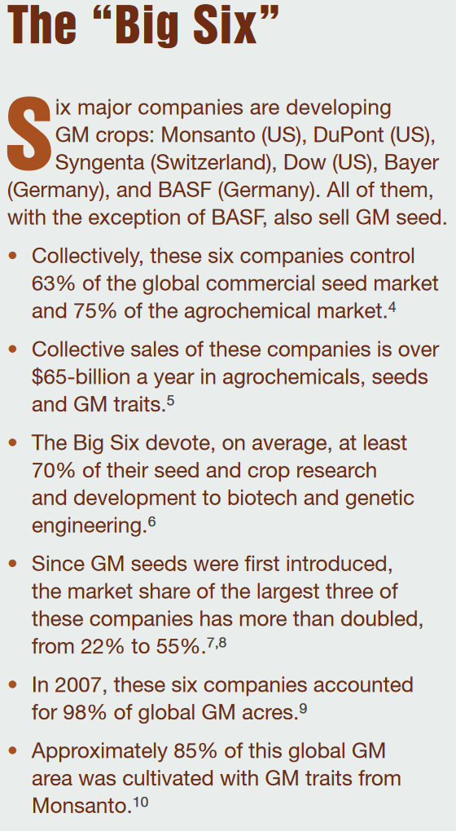
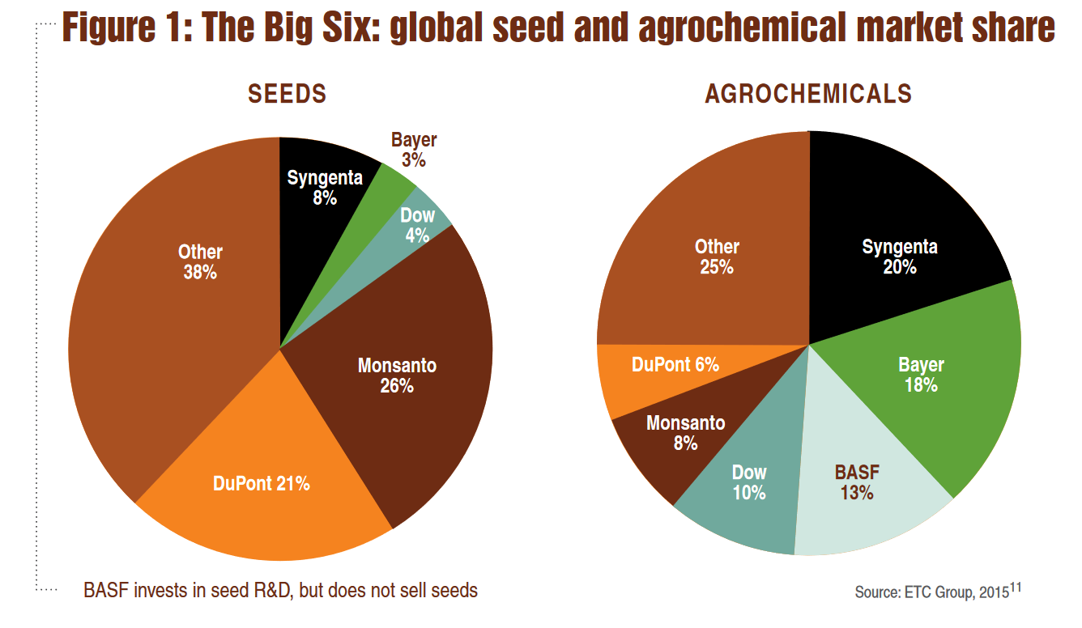
Source

Slide 14
Seed & Fertilizer Companies Merge Since the CBAN Report
With the Bayer-Monsanto merger, four companies will control about two thirds of the global seed market and more than 70% of global pesticides:
Dow Chemical and DuPont merged and are now called DowDuPont
Corteva Agriscience is the agriculture division of DowDuPont
ChemChina bought Syngenta and is expected to merge with Sinochem
Bayer bought Monsanto
BASF acquires seed and non-selective herbicide companies from Bayer to help reduce concerns of anti-trust violations

Slide 15
Companies of War, Destruction and Death
These are a few examples:
Dow Chemical Invented Agent Orange
Monsanto produced Agent Orange and now is using it as a fertilizer
Bayer and BASF formed IG Farben a company who worked with the Nazis and tested chemicals and drugs on people including Zyklon B
The Bhopal disaster: Toxic legacy
One Night in Bhopal
The Bhopal Disaster

Slide 16
Living Soil Not Chemical Fertilizers
FAO Video About Soil
The Soil Story

Slide 17
GMO Myths According to Vandana Shiva
Myth 1 – GMOs are an ‘invention of corporations’ and therefore can be patented and owned
Myth 2 – Genetic engineering is more accurate and precise than conventional breeding
Myth 3 – GMOs are just like naturally occurring organisms, and therefore they are safe
Myth 4 – GMOs are based on cutting edge science; GMO critics are ‘anti-science’
Myth 5 – GMOs increase yields and are the answer to world hunger
Myth 6 – GMOs reduce chemical use and are therefore environmentally beneficial
Myth 7 – GMOs promote free choice

Slide 18
What is a GMO?
Genetic Engineering
Mae-Wan Ho
GMO is an organism with synthetic genetic material inserted into its gnome. It is made in a laboratory.
Epigenetics
Epigenetics – More Technical Mechanics

Slide 19
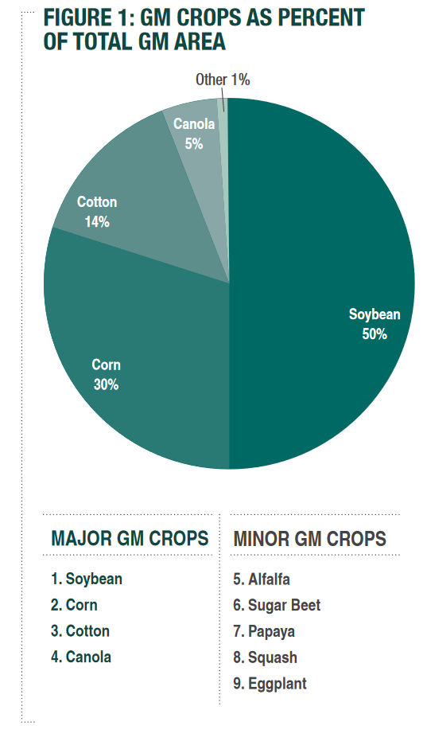
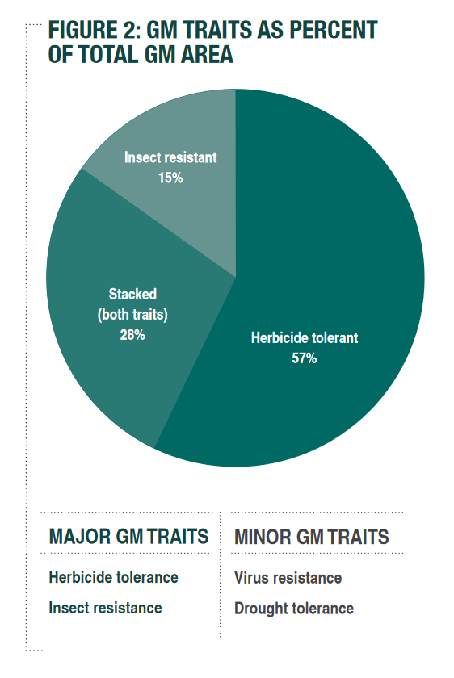
Source

Slide 20
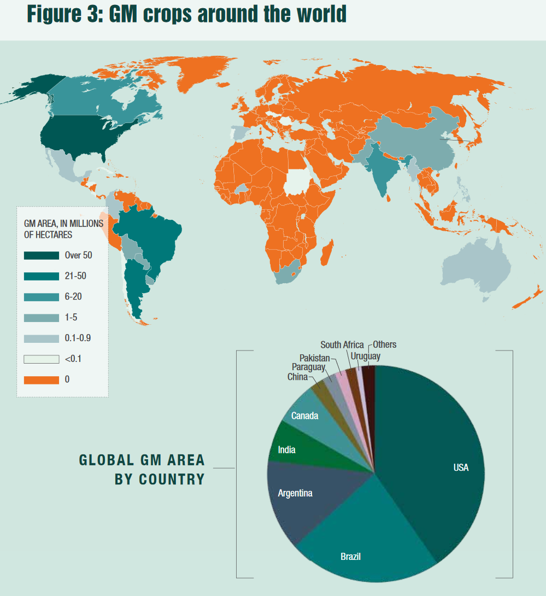
Source

Slide 21
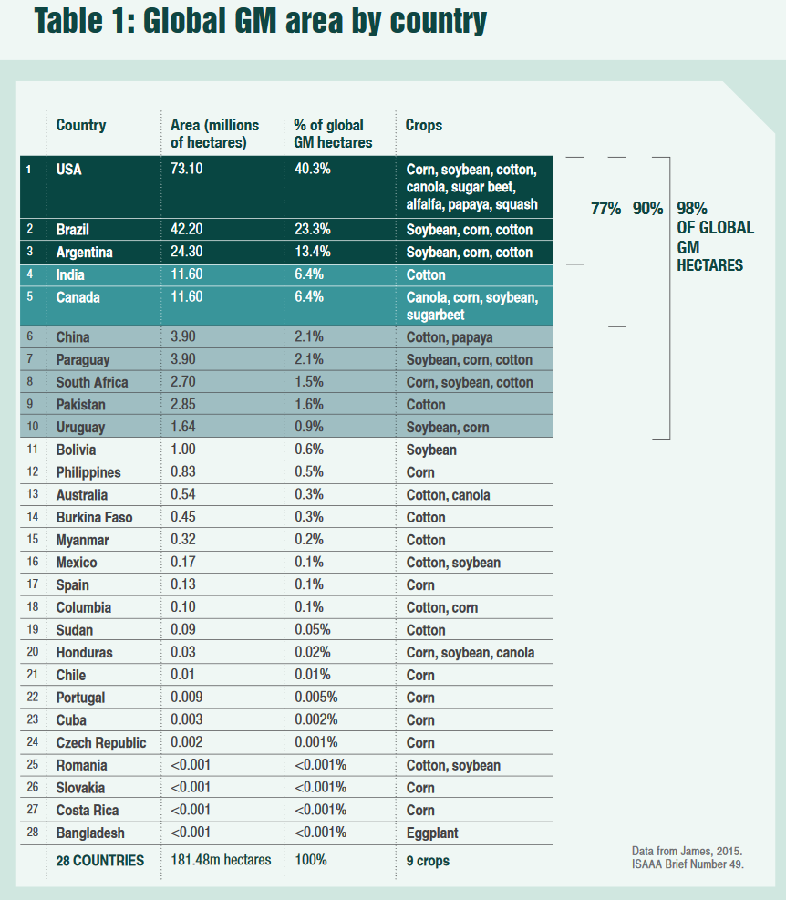
Source

Slide 22
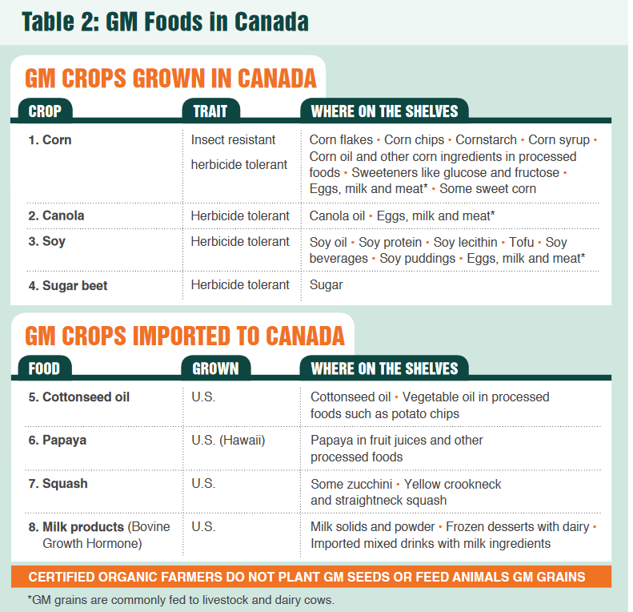
Source

Slide 23
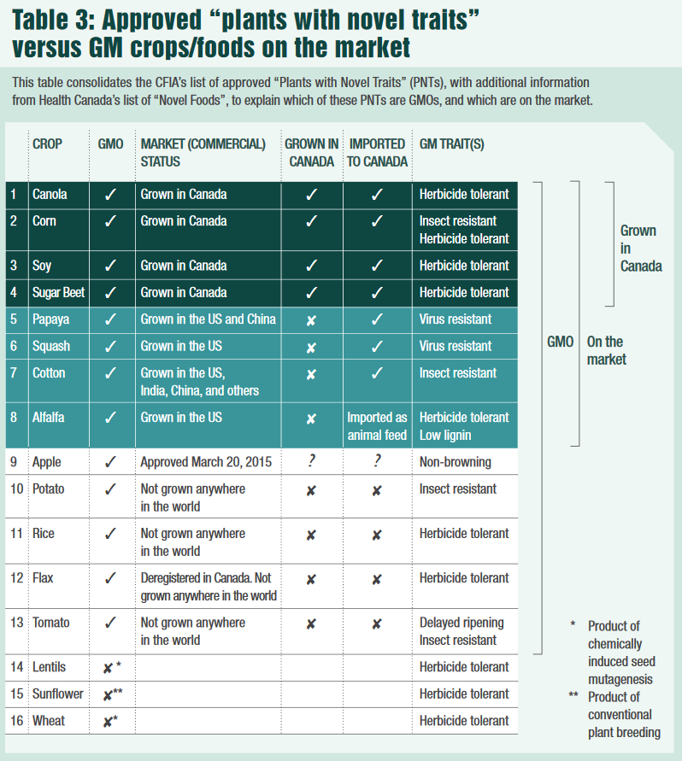
Source

Slide 24
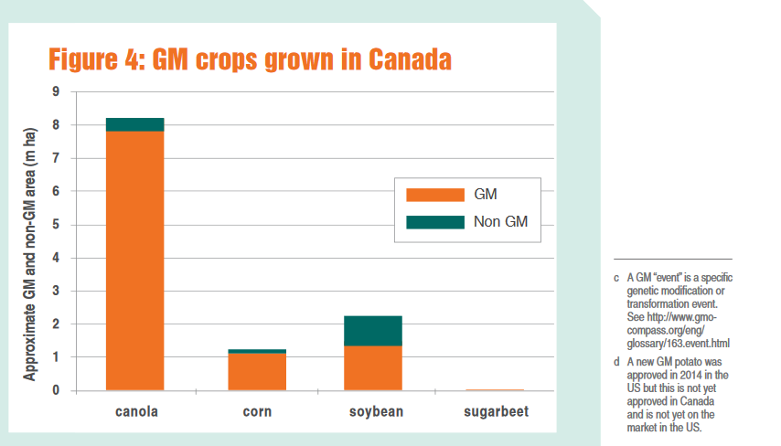
Source

Slide 25
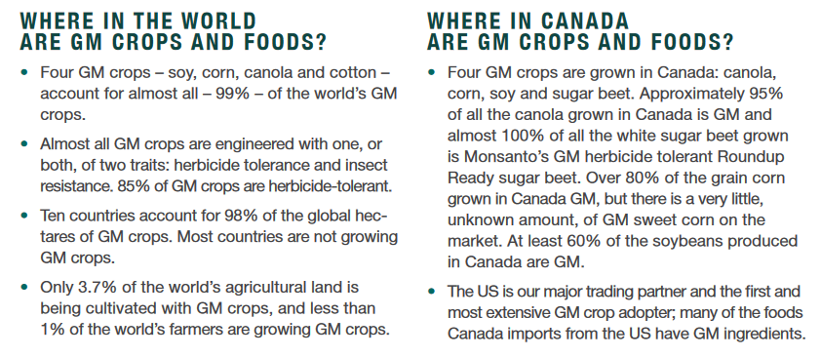
Source

Slide 26
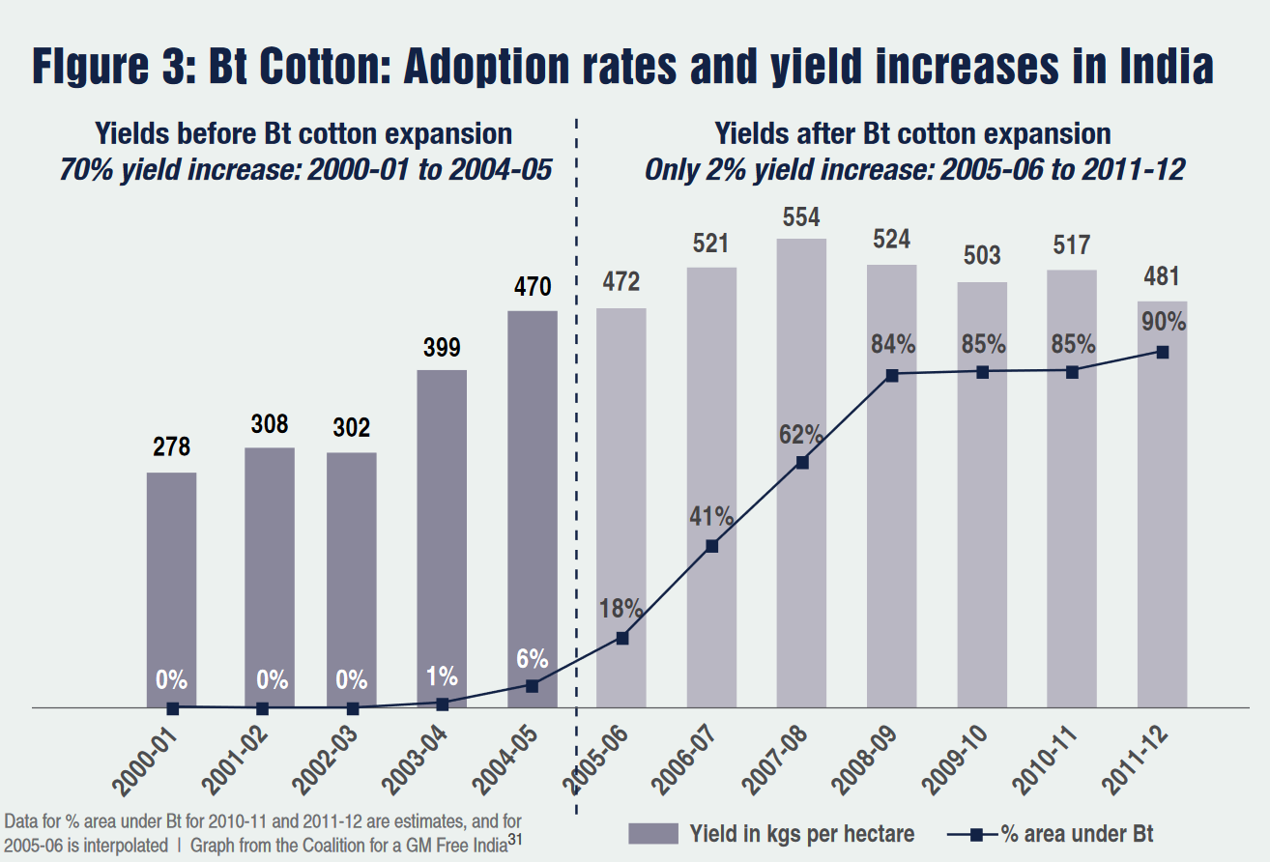
Source

Slide 27
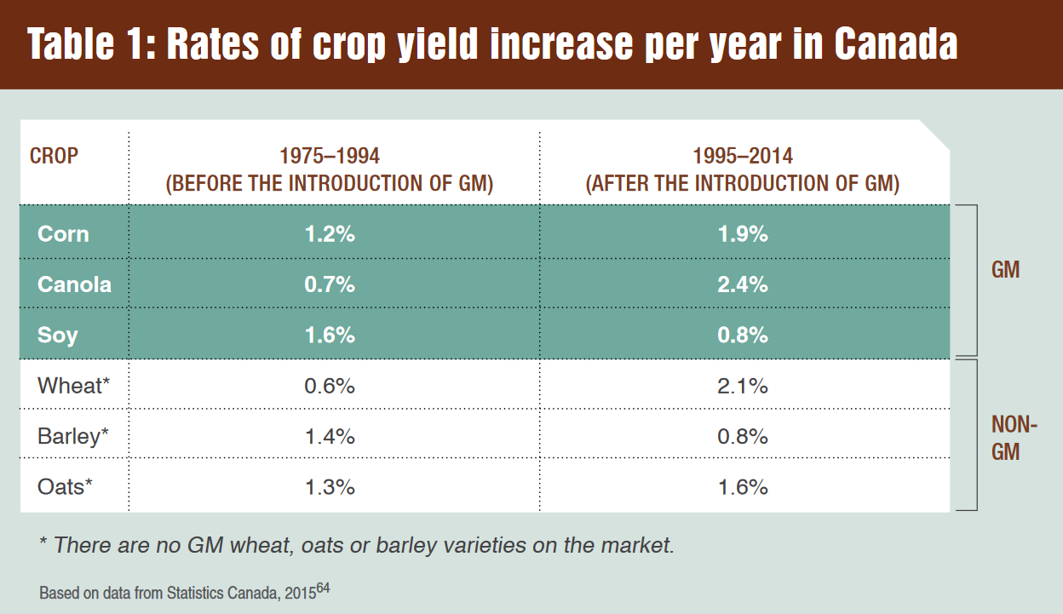
Source

Slide 28
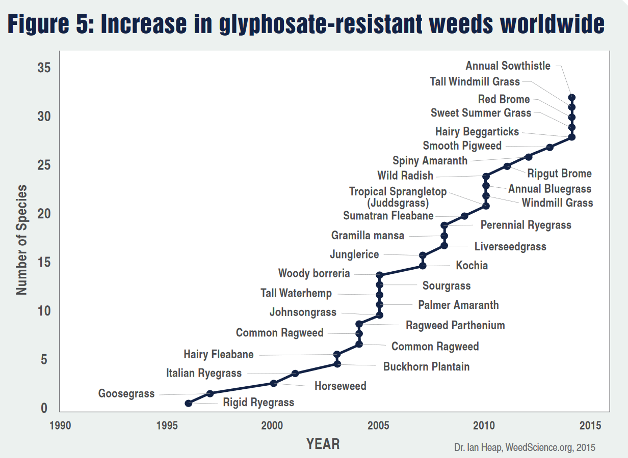
Source

Slide 29
GMOs in Canada Presently
GMO products that are presently on the market in Canada Alfalfa Canola Corn Cotton Papaya Salmon Soy Squash Sugar beet
GMO products that are not presently on the market in Canada Apple Flax Potato Rice Wheat
Source

Slide 30
Negative Consequences of GMOs
Health concerns with GMOs(Mae-Wan Ho) Health concerns with herbicide and pesticides Loss of Biodiversity Privatization of genetic material (restricted access) Rising cost of seed and chemicals Research funding being directed to GMOs instead of traditional breeding methods Financial burden to farms Pest resistance to Bt crops and glyphosate Reduction of pollinators Reduction of butterflies We still have not been able to feed the world!

Slide 31
Health Hazards of GMOs
Mae-Wan Ho
Uncontrollable, unpredictable impact on safety due to the genetic modification process
Scrambling of host gene, widespread mutations, inactive genes, activating genes, creating new transcripts, creating new proteins, etc.
Toxicity of transgene protein(s) introduced
Transgene protein toxic, transgene protein allergenic or immunogenic, Protein created by sequence insert may be toxic, etc.
Effects due to the GM insert and its stability
Genetic rearrangement with further unpredictable effects, horizontal gene transfer and recombination, spreading antibiotic drug resistance, creating new viruses and bacteria that cause disease, etc.
Toxicity of herbicides used with herbicide-tolerant GM crops

Slide 32
Documentary to Watch
Seed: The Untold Story (Trailer)

Slide 33
Biodiversity Vandana Shiva (2015) Who Really Feeds the World? The Failures of Agribusiness and the Promise of Agroecology
Seed Saving Movement Navdanya
System to monitor ecological changes (Navdanya):
Provides documentation of the biodiversity status of a farm, including crop, tree and animal biodiversity
Indicates the contribution of biodiversity to provisioning of internal inputs and to the building and maintenance of nature’s economy through the conservation of the soil, water, and biodiversity
Indicates the contribution of biodiversity to the self-provisioning of food needs by agricultural families and communities, and to the building and maintenance of people’s economy
Reflects the market economy of the farm in terms of incomes from the sale of agricultural produce, as well as the additional costs for extremal inputs and retail food when biodiversity is lost
Baranaja: Twelve Seeds of Sustainability

Slide 34
Discussion About Group Projects
How are your projects coming along?

Slide 35
Thanks!
Questions or concerns?
Try to go vegetarian for the weekend.
Who is bringing food next week?

