Slide 1
Advertising and the Consumer Culture
Advertising, the Internet, Social and Mobile Mediated Marketplaces
Erik Chevrier
November 8st, 2018

Slide 2
Video
The Hire – Ambush

Slide 3
Internet Advertising
2017 – advertisers spent more money on internet advertising ($69.2 billion) than that of television advertising ($68.4).
2014 – in Canada advertisers spent more on internet advertising than television advertising.
2016 internet advertising = $5.48 billion; television advertising = $3.19 billion.
Internet advertising is neither a simple nor a singular advertisement category.
Internet is a ‘key moment’ in advertising history.
Continuation (acceleration) of double mediation.
Daily lives are increasingly mediated through technological devices
The communications and cultural environment is the result of a mediation between a variety of semi-autonomous institutions. These institutions simultaneously work together and struggle against one another.

Slide 4
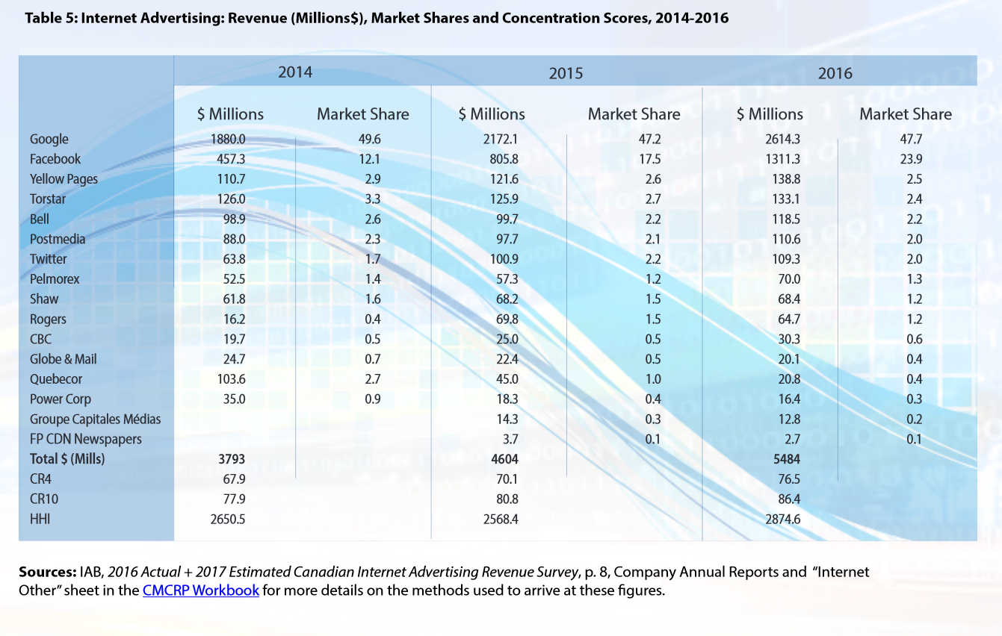
The Google and Facebook ‘Duopoly’
Source

Slide 5
Google
Larry Page and Sergey Brin founded the company as PhD students in 1998.
Was originally a research project in 1996.
Developed the PageRank algorithm.
In 2000s expanded rapidly – Gmail, Google Maps, Google Docs, Android, Chrome, Youtube (2006), Motorola (2011), Nest (2014).
Google is now Alphabet
Google was born out of a distain for advertising – they created a search engine that cared more about efficiency and relevance of search results.
In 2000, Google started to offer advertising – meant to be as unobtrusive as possible.
In 2002, Google developed AdWords
Advertisers paid based on the number of users who clicked on an ad – click through rate.
Google developed an auction system where advertisers bid on the keywords corresponding to their ads
Carefully designed AdWords to ensure that a high bid is still not the only quality that determines whether an ad will appear
2008 – Google acquired DoubleClick to make deals with webpages for banner ads.

Slide 6
Facebook
Invented by Mark Zukerberg in 2004
In 2005 – 2006 it was mainly used by college/university students but in 2006 it became available for anyone to open a Facebook account.
At the beginning, Facebook turned away advertisers, but now they allow business profiles and banner ads.
Advertisers can target specific demographics via Facebook ads.
In 2017 Facebook created Facebook Creative Shop to assist people in building Facebook ads.
Facebook now gives Facebook advertising awards.

Slide 7
Programmatic & Addressable Advertising
Programmatic advertising:
refers to digital advertising on computer and mobile platforms, bought and sold through some automated process, usually algorithms to optimize media buying.
represents advertisers’ ability to purchase media without having to talk to a human.
real-time bidding
advertisers can ‘buy’ a person instead of space
is immediately connected to behavioural data, microtargeting, and data-mining
began with banner ads but now incorporates video ads and has moved across platforms like Facebook and Twitter.
eliminates (or reduces) ad waste
Addressable advertising:
television now has ‘addressable’ ads, like programmatic advertising but catered to television user profiles.
Canoe Ventures
OpenAP
makes up 6% of television advertising

Slide 8
Controversy With Programmatic and Addressable Advertising
Individualizes people and removes them from their collective experience.
Ads might run with/beside controversial ads.
Snapchat with nude pictures
Macy’s article beside Breitbart articles.
Solutions? Omnicom ‘inclusion’ vs ‘exclusion’
Measurement problems
Viewability
Clickfraud

Slide 9
Audience is a Commodity
Free media = advertising = labour of being a consumer = attention
Cookie & persistent identifier = digital fingerprint
Log-into multiple devices = convenience = data-mining & surveillance
Data brokers
Axciom
Clusters
BlueKai/Oracle
Data Directory
eXelate/Nielsen
PRISM – Customer Data
Cambridge Analytica harvested data off Facebook and sold it to political clients.

Slide 10
Audience Segmentation

Slide 11
Intensifying Economy of Attention
Ad length progression
60-second ad 30-second ad 15-second ad Less than 15 seconds
Things that prevent ads from being attended to:
Zapping Banner blindness Ad blocker Ad avoidance
McDonalds Mindy Kaling ad

Slide 12
Branded Content
Content marketing
Works more on audience pull than push
Product placement requires negotiation to get a brand into someone else’s media content, branded media content on its own.
Cause related advertising and larger corporate social responsibility
The Scarecrow Chipotle
Other Branded Content Videos:
H&M Come Together
PRADA Castello Cavalcanti
Full Service Agency
Red Bull Media House
Space Jump

Slide 13
Native Advertising
Native Advertising:
Refers to the relationship within the flows of other surrounding non-sponsored content.
A form of paid advertising offered by a digital publisher or platform.
Reflects a desire to fit into, rater than interrupt, surrounding digital media content.
Sparked debate in journalism community
Examples, AdWords, promoted tweets, Facebook ads in news feed, video games with corporate content, fake news articles for companies, Buzzfeed (clickbait), etc.
To create native advertising, publishers employ one of three models:
Underwriting model – publisher produces content.
Platform model – gives space to advertiser to publish media mascaraing as content.
Middle ground – a combination of both models presented above.

Slide 14
Influencer Marketing
Influencer marketing:
Embeds promotional messages within the flows of internet media content.
Relies upon content provided by individuals, bloggers, vloggers, YouTubers, Instagrammers.
Has created a new type of celebrity ‘micro-celebrity’
Uses same type of influence as ‘word-of-mouth’
Seems more authentic
Uses opinion leaders
Conscripting
Influencer relationships can take several forms:
Ship free products
Paid relationship
Commission on sales
BzzAgent
#Paid

Slide 15
Guerilla Marketing
Street marketing
Use of theatre, actors, etc.
Graffadi, Brandalism
Taps into ‘cool’
Campaigns:
Old Spice – Your man could smell like
Companies:
Diabolical
ALT TERRAIN
Culture Jams Against Guerilla Marketing
Coppertone Jam – Culture Jam
Global Invisible Theatre

Slide 16
Discussion About Final Project
The goal of the second assignment is to allow students to explore critical topics related to advertising that weren’t addressed in the assigned and recommended readings. These topics can include: advertising and desire; advertising and body image; feminist perspectives in advertising; Indigenous perspectives in advertising; race and advertising; new media and advertising; political advertising; data mining; future of advertising; technology and advertising; product placement; and mise-en-scène advertising. Students can propose other topics, but these must be approved by me. The paper should be no more than three pages long. If a student requests to submit the assignment in another form, we will discuss the parameters of the assignment together once I approve the project.

Slide 17
Have a Great Night
Questions or concerns?

