Slide 1
Motivation and Emotion in Daily Life
Overview of Motivation and emotion
January 14th, 2019
Erik Chevrier

Slide 2
Get Into Groups of 3 (-1+)
Think of an activity you did today. It could be anything.
Tell your group about the activity performed
Discussion length about 3 minutes (one minute per person)

Slide 3
Think About…
What motivated you to perform that activity?
How did you feel while you were performing the activity?
  What is motivation?
  What is an emotion?

Slide 4
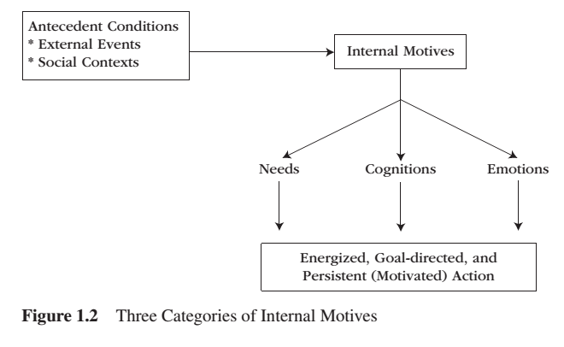
Three Categories of Internal Motives

Slide 5
Motivation
The study of motivation concerns those internal processes that give behaviour its energy, direction and persistence.
Energy implies that behaviour has strength – that it is relatively strong, intense, and hardy or resilient.
Direction implies behaviour that has purpose – that it is aimed or guided towards achieving some particular goal or outcome.
Persistence implies that the behaviour has endurance – that it sustains itself over time and across different situations.
Needs are conditions within the individual that are essential and necessary for the maintenance of life and for the nurturance of growth and well-being.
Cognitions refer to the mental events, such as thoughts, beliefs, expectations, plans, goals, strategies, appraisals, attributions and the self-concept. Cognitive sources of motivation revolve around the person’s way of thinking.
Emotions are complex but coordinated feelings-arousal-purposive-expressive reactions to the significant events in our lives. Emotions generate brief, attention-getting bursts of emergency-like adaptive behaviour.

Slide 6
Discuss With your Group
What motivated you to perform that activity?
  What caused the you to perform the activity? (ANTECEDENT CONDITIONS and INTERNAL MOTIVES)
  How engaged were you with the activity? How much ENERGY did you give to your performance in the activity?
  Why did you choose to perform that activity as opposed to something else? Why did you DIRECT yourself towards that action over another one?
  How long did you perform the activity for? How PERSISTENT were you at maintaining your participation in the activity?

Slide 7
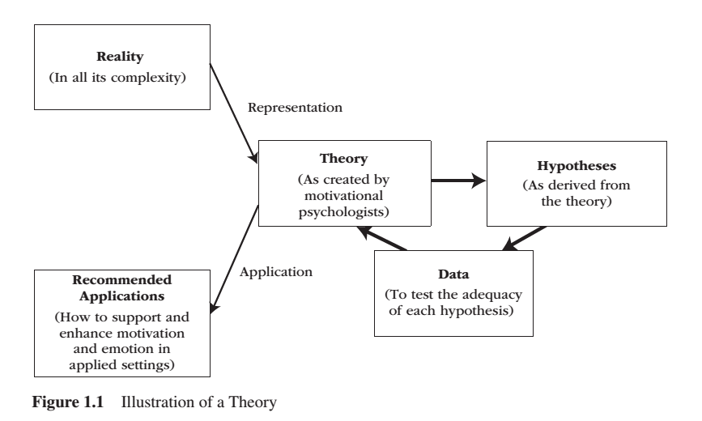
Motivational Science

Slide 8
Expressions of Motivation
Behaviour
Engagement
Psychophysiology
Brain Activations
Self-Report

Slide 9
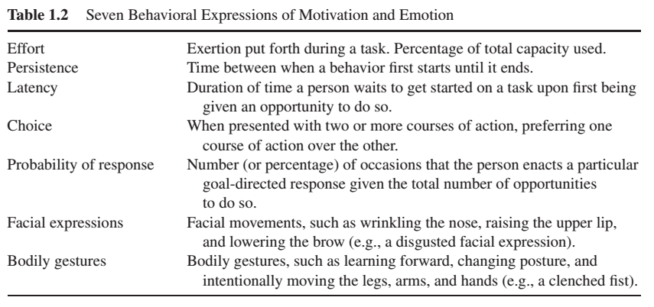
Seven Behavioral Expressions of Motivation and Emotion

Slide 10
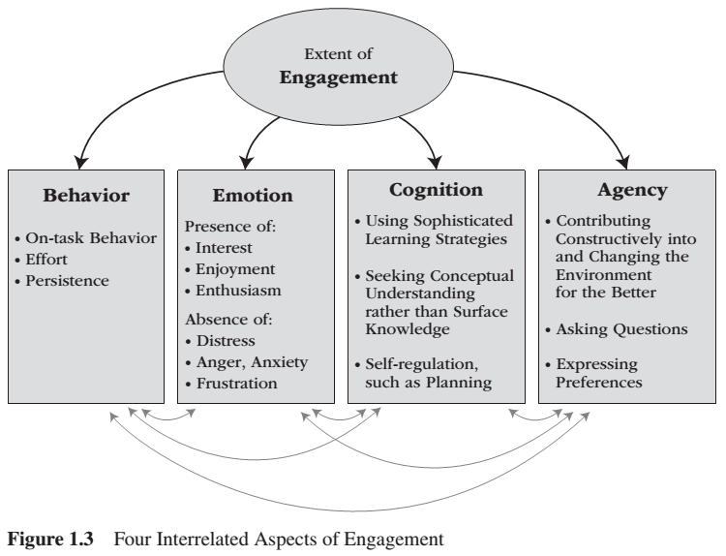
Extent of Engagement

Slide 11
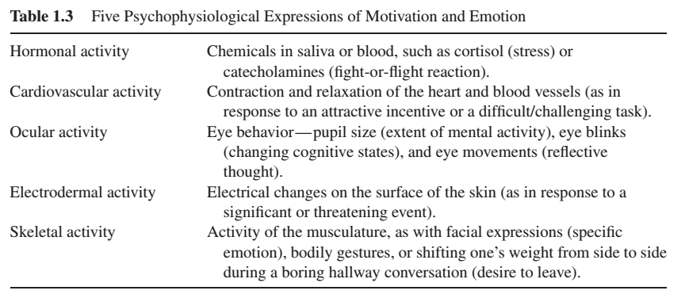
Five Psychophysiological Expressions of Emotion

Slide 12
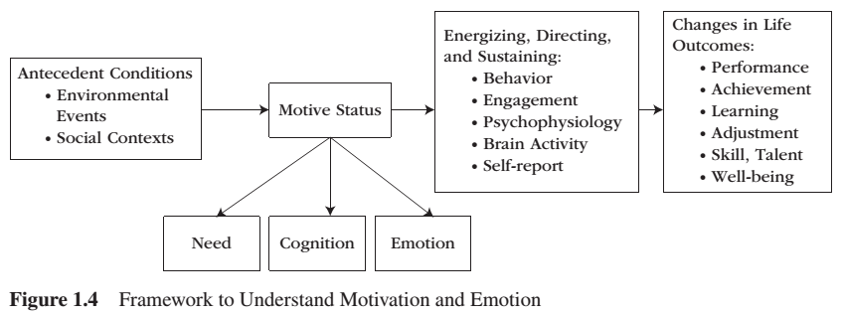
Framework to Understand Motivation and Emotion

Slide 13
Ten Unifying Themes
1 – Motivation and emotion benefit adaptation and functioning
2 – Motivation and emotion direct attention
3 – Motivation and emotion are ‘intervening variables’
4 – Motives vary over time and influence the ongoing stream of behaviour
5 – Types of motivations exist
6 – We are not always consciously aware of the motivational basis of our behaviour
7 – Motivation study reveals what people want
8 – To flourish, motivation needs supportive conditions
9 – When trying to motivate others, what is easy to do is rarely what is effective
10 – There is nothing so practical as a good theory

Slide 14
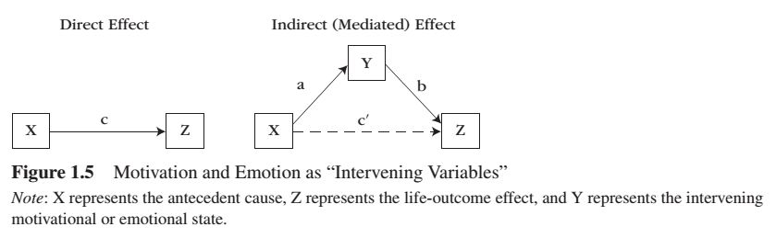
Intervening Variables

Slide 15
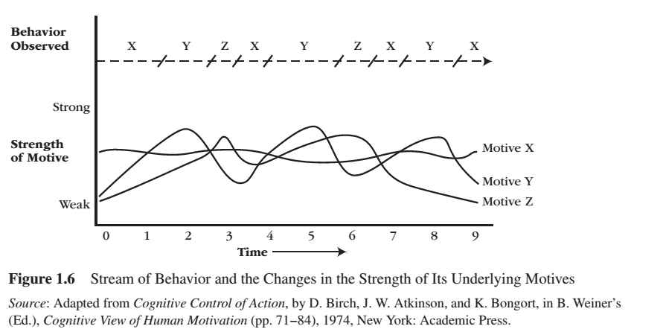
Behaviour Stream

Slide 16
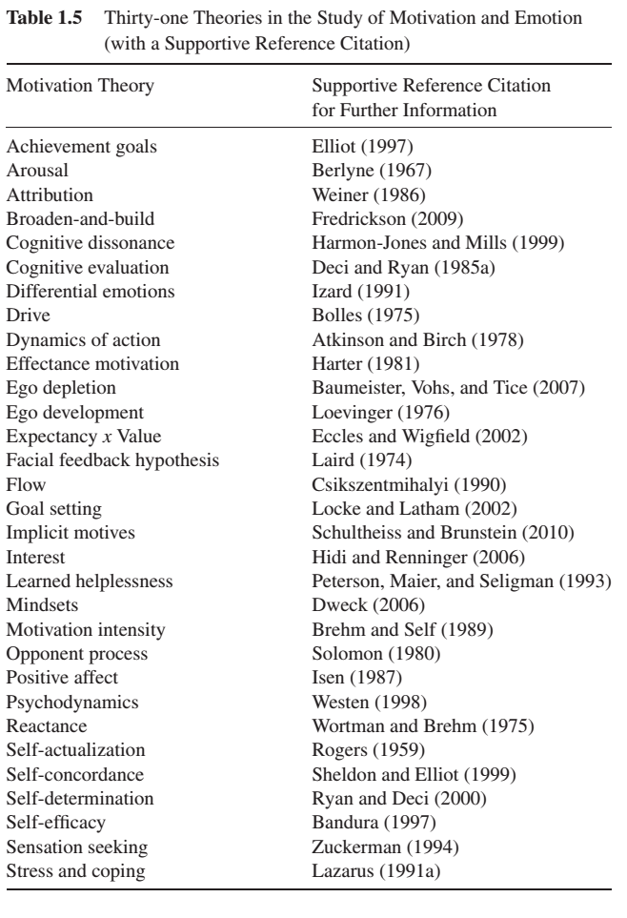

Slide 17
Learning Check
1 – Please reproduce the ‘Three Categories of Internal Motives’ chart. Also, explain each point on the chart.
2 – What do the following terms mean in reference to motivation: energy, direction, persistence, needs, cognitions, emotions.
3 – Please explain how motivational science typically understands representation and application. How do motivational scientists generate hypotheses and test them? Please describe figure 1.1, illustration of a theory.
4 – Please name and describe the five expressions of motivation.
5 – Please name and describe the seven behavioural expressions of motivation.
6 – Please name and describe the four interrelated aspects of engagement.
7 – Please name and describe the five psychophysiological expressions of motivation.
8 – Please recreate the chart of the framework to understand motivation and emotion (figure 1.4).
9 – Please name and describe the ten unifying themes of motivational and emotion.
10 – What does it mean that motivation is an intervening variable?
11 – What is a behaviour stream and how does it relate to motivation?

Slide 18
Homework!
Think about why you do the things you do!
Please make sure you read Chapter 2 – Motivation in a Historical Perspective

Slide 19
Bibliography
The information obtained to create this PowerPoint slide was obtained from:
Reeve, J. (2018) Understanding Motivation and Emotion, 7th ed. John Wiley and Sons

