Slide 1
Economic Restructuring
Erik Chevrier
January 15th, 2019

Slide 2
Labour
Do you presently work?
What do you want to do as employment after you graduate from Concordia? Why?
What are the labour conditions that you expect from the job you want to obtain after you graduate?
What are the typical power structures in that labour environment?
What kinds of benefits do you expect?
What kinds of issues do you foresee?
What is important for you in seeking employment?
What other kind of labour do you participate in (non-capitalist, or alternative)?
What other kinds of labour do you want to participate in?
Would you shift come of your labour to reproduce parts of yourself, family, or community?

Slide 3
Discussion – What kind of a consumer are you? How do you acquire that you want and need?
What do you spend your money on? Daily? Weekly? Monthly? Yearly? Future Plans?
Do you hold material items in high regards (are you materialistic)?
Are you impulsive or plan purchases?
Are you a compulsive consumer?
Do you prioritize ethical products?
Do you self-produce anything?
Do you shop more for necessity or pleasure?
Do you prioritize fair trade?
Do you use any alternative currencies?
Do you participate in barter networks?
Do you buy stuff on the illegal market(s)?
Do you steal (share) things?
Do you dumpster dive for food?
What other kinds of ways to you acquire goods and services?

Slide 4
What is your Ecological Footprint?
Measure your ecological footprint
How often do you eat meat?
What is your main source of transportation (public transit, car, etc.)?
Do you prioritize local production?
Do you live in an energy efficient house or apartment?
Do you travel by plane frequently?
Do you produce a lot of garbage?
Do you strive for a zero waste lifestyle?

Slide 5
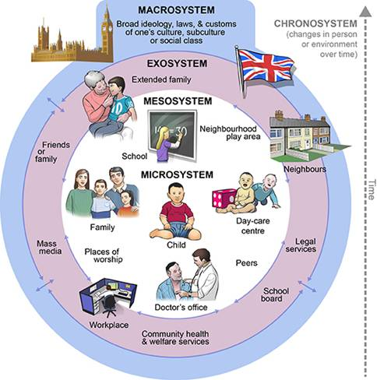
Ecological Systems Theory of Development

Slide 6
RECAP – Aristotle Aristotle. Aristotle in 23 Volumes, Vol. 21, translated by H. Rackham. Cambridge, MA, Harvard University Press; London, William Heinemann Ltd. 1944.
Chrematistics – art of acquisition – limitless accumulation unnatural and problematic
Oikonomia – management of the household – true form of an economy

Slide 7
RECAP – Karl Marx Marx, K. Capital Volume 1, Penguin Classics.
C – C – Basic barter C – M – C – The way classical economists viewed basic barter with money M – C – M’ – What really happens when barter systems incorporate money – Limitless accumulation M – M’ – Usury capital system – Limitless accumulation

Slide 8
RECAP – Karl Polanyi Polanyi, K. (2001) The Great Transformation; The Political and Economic Origins of Our Time, Beacon Press
Types of economic practices:
Markets (exchange)
Household economy
Redistribution
Reciprocity

Slide 9
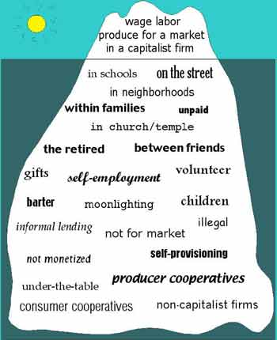
RECAP – Take back the Economy Gibson Graham Gibson-Graham, J.K., Cameron, J., Healy, S. (2013) Take Back the Economy: An Ethical Guide for Transforming Communities, University of Minnesota Press
Katherine Gibson Interview Playlist

Slide 10
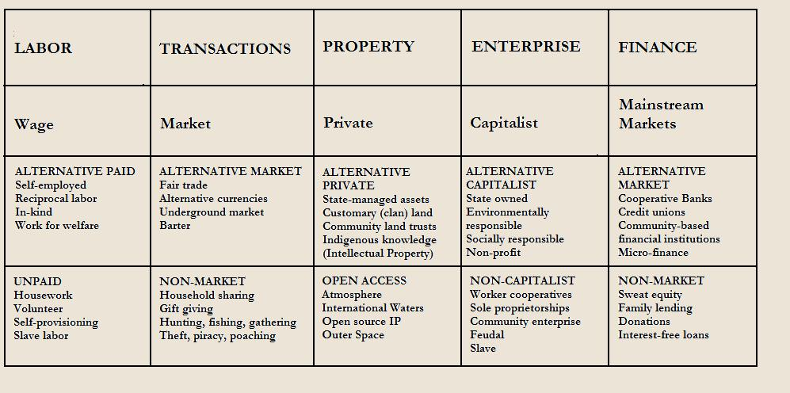
RECAP – Take back the Economy Gibson Graham Gibson-Graham, J.K., Cameron, J., Healy, S. (2013) Take Back the Economy: An Ethical Guide for Transforming Communities, University of Minnesota Press

Slide 11
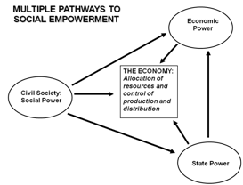
RECAP – Envisioning Real Utopias Erik Olin Wright Olin Wright, E. (2010) Envisioning Real Utopias, Verso

Slide 12
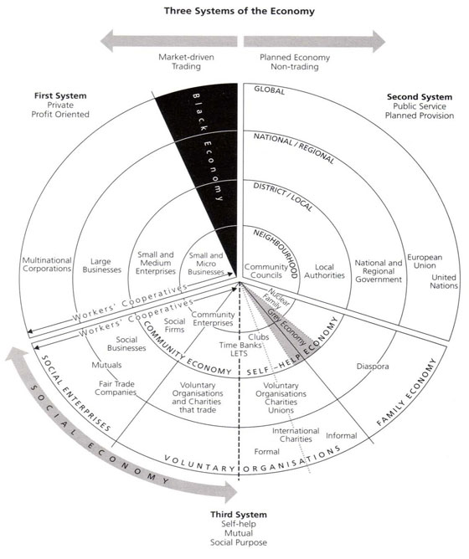
RECAP – Three Systems of an Economy – John Pierce Pearce, J. (2009) Social Economy: Engaging as a Third System, In Amin, A. The Social Economy; International Perspectives on Economic Solidarity, p. 26.

Slide 13
RECAP – Importance of Action Based Research
Why are action based projects important?
It is important to challenge the problematic dominant epistemological understandings of food.
Instead we should produce ontological formations of the world we want by co-creating and co-recreating social relations that produce positive outcomes on people and the planet.
Action based learning theories incorporate students and facilitators as co-learners and co-collaborators. Together, they learn by doing. They also connect with the community.
Epistemology – A term meaning “theory of knowledge,” which gets at the how we know about the social world that lies behind all theoretical approaches. (Frampton, Kinsman, Thompson, Tileczek, (2006))
Ontology – Assumptions relating to how the social comes into being that inform all theories and ways of writing the social. (Frampton, Kinsman, Thompson, Tileczek, (2006))

Slide 14
An Economic Politics for Our Times
The Economy as a site of difference
Performing diverse economies
Genealogy of Diverse Economy Research
Katherine Gibson Interview
A Performative Ontological Politics
Expanding the Scope of Participatory Action Research
How does this apply to geography and urban planning?

Slide 15
Discussion Question
What examples does Erik Olin Wright provide as ‘alternative’ economies?
What do you know about these examples?
Where can we find these examples in the ‘real world’?
How do these examples apply to things you are interested in (work, consumption, geography and urban planning)?

Slide 16
Discussion About Envisioning Real Utopias
What is participatory budgeting? Where does it exist?
Participatory Budgeting Project
25 Years for Participatory Budgeting Worldwide
Wikipedia Wikimedia
Mondragon
Unconditional Basic Income
Ontario Experiment

Slide 17
Discussion
What does Erik Olin Wright mean by ‘emancipatory social science’?
How can we understand emancipatory social science?
What is human flourishing?
What is the radical democratic egalitarian understanding of justice?
What is social justice?
What is political justice?
How do these terms apply to things you are interested in (work, consumption, geography and urban planning)?

Slide 18
How Can we Envision Social/Economic/Political Change?
Consequences = Intended / Unintended – Positive / Negative
Grand design?
Rate of change?
Role of people vs institutions?
Emancipatory social science
Diagnosis and critique
Formulating alternatives
Elaborating strategies of transformation
Emancipatory identifies a central moral purpose in the production of knowledge – the elimination of oppression and the creation of the conditions for human flourishing.
Transformation of the social world

Slide 19
Diagnosis and Critique
Radical Democratic Theory of Justice
Social Justice
In a socially just society, all people would have broadly equal access to the necessary materials and social means to live flourishing lives.
Equal access vs equal opportunity
Political Justice
In a politically just society, all people would have broadly equal access to the necessary means to participate meaningfully in decisions about things which affect their lives. This includes both freedom of individuals to make choices that affect their own lives as separate persons, and their capacity to participate in collective decisions which affect their lives as members of a broader community.

Slide 20
Discussion
What does Erik Olin Wright suggest about ‘alternative’ economic structures?
How do these ‘alternatives’ apply to things you are interested in (work, consumption, geography and urban planning)?

Slide 21
Viable Alternatives
Desirable
Viable
Achievable

Slide 22
Discussion
What does Erik Olin Wright suggest about theories of transformation?
How do these theories apply to things you are interested in (work, consumption, geography and urban planning)?

Slide 23
Transformation
A Theory of Social Reproduction
A Theory of the Gaps and Contradictions Within the Process of Reproduction
A Theory of the Underlying Dynamics and Trajectory of Unintended Social Change
A Theory of Collective Actors, Strategies and Struggles

Slide 24
Questions or Concerns?
For next week, answer the following question:
What is capitalism? What is communism? What is anarchism?
Thanks!
Have a great day!

