Slide 1
Media, Technology and Politics
The history of Canadian mass media
Erik Chevrier
January 18, 2019

Slide 2
General Framework
Paul Nesbitt-Larking. Politics, Society and the Media (2nd Edition). Broadview Press. 2009.

Slide 3
Let’s Analyze the New Gillette Commercial
Gillette Ad

Slide 4
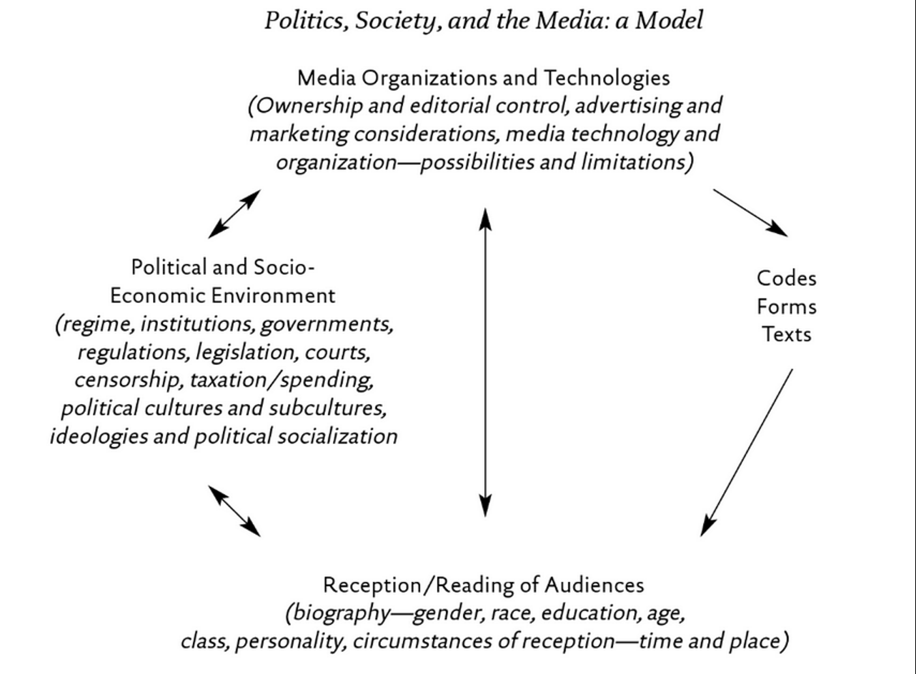
Focus of this class

Slide 5
General History of Media
Rituals/oral history/drawings/festivals
1300s – Moving metallic types
1400s – Printing press
1900s – Radio
1880s – Motion picture
1920s – Motion picture with sound
1950s – Television
1980s – Internet
1990s – Proliferation of Telecommunications

Slide 6
General Outlook of History of Canadian Media
Aboriginal communication is not commodified, it exists through tradition, dance, oral history, etc.
Colonizers replaced traditional Indigenous forms of communication with commodified ones
Feudalism and monarchies change to capitalism
Media technology develops rapidly (industrialization of the means of production & supporting infrastructure)
United States colonies declare independence from Brittan (1776), some loyalists flee to Canada
Loyalists clash with reformers in Canada
Canada is concerned about American media intrusion & formation of national identity
English and French clash over status of Quebec and language
Development of public broadcasting corporations and regulators
Neo-liberalism: shifting away from publicly funded broadcasting
Rapidly developing communication technology
Private media concentration - Rogers, Shaw, Bell and Telus own 68.7% of the media market in Canada
Access
Content

Slide 7
Precolonial History of Media
Aboriginal Populations
Appropriation of voice
Reclaiming voice – Idle No More Flash Mob Round Dance Ellen Gabriel UNIST’OT’EN Camp
Oral Tradition Icons/symbols Rituals/festivals Music/singing Elder knowledge Inukshuit Blackfoot Confederacy The means of communication do not ‘belong to anyone’
Inukshuk (1970) First attempts to create Inuit film and video production centers in the North to counter the negative impact of American television on young Inuit audiences.
Anik Satalite (1973)
Report in Royal Commission on Aboriginal Peoples
Truth and Reconciliation Commission of Canada

Slide 8
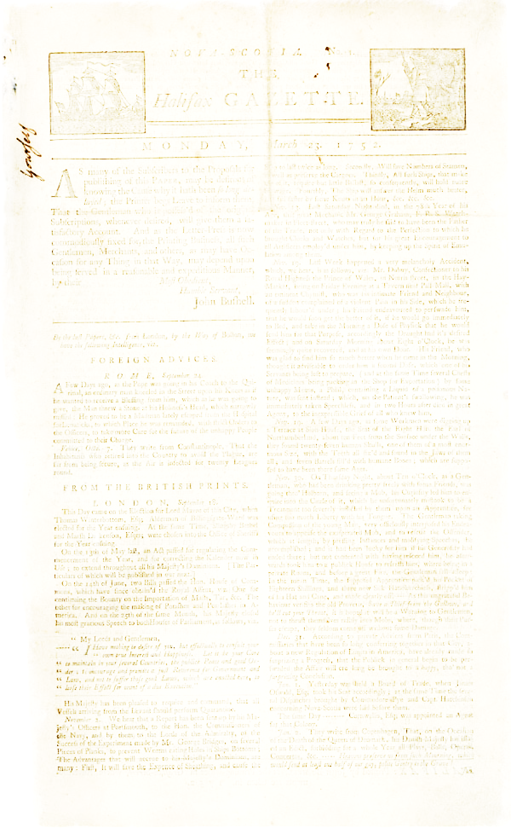
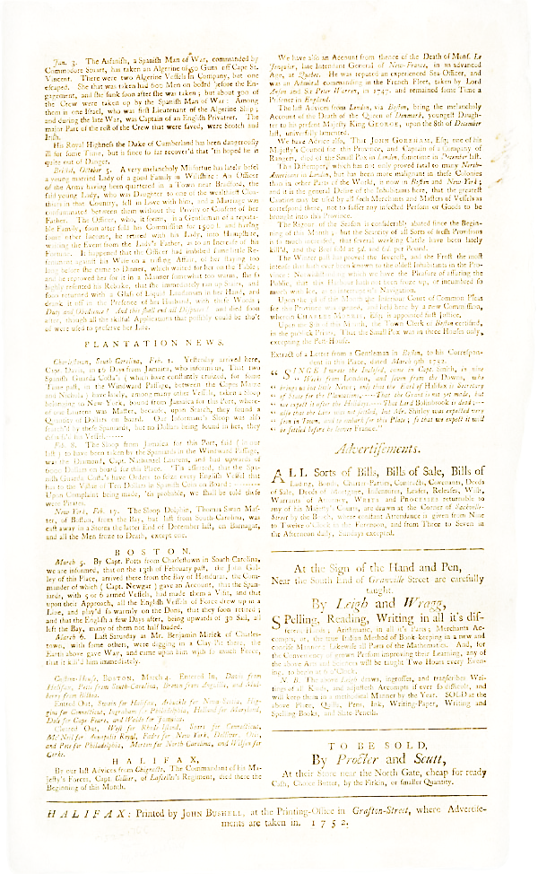
Foundation of Newspapers in Canada
French settlers were largely illiterate – communication mainly oral
In 1759, British overpower French in their stronghold terrorises
1752 – Halifax Gazette – John Bushell
1785 – Christopher Sower became King’s Printer for New Brunswick
Late 1700s – British North America established a limited number of gazettes in a variety communities including Montreal, Halifax, Quebec, Newark (Capital of Upper Canada, now Niagara on the Lake).
1800 - 1810 – Independent press began
Irish Vindicator (1828) – William Lyon Mackenzie
Colonial Advocate (1824) – William Lyon Mackenzie
Le Canadien (1806) – French independent press
Funding began coming from subscriptions and advertising
Most owners were writers and printers

Slide 9
Nineteenth Century Political Culture and Media
Loyalists vs reformers
Reformers include:
William Lyon Mackenzie
Joseph Howe – Charged with libel and acquitted
Etienne Parent – Le Canadien
Bartimus Ferguson – Niagara Spectator
Amor de Cosmos – British Colonist
About ¼ of the participants at the Charlottetown Conference were journalists, editors and publishers
1843 – Defendants can defend libel by demonstrating the truth

Slide 10
Technology & Media in the 1800s
1800- 1867: Small scale competition among a plethora of small operators
Means of producing media were expensive, therefore owned by wealthy individuals
Advances in technology lead to advances in media production in Canada:
1750 – Printing press – printing plates
1840 – 1850s – Telegraph & Trans Atlantic cable 1858
1868 – Typewriter (slugs) – stereos (stereotyping)
1871 – Development of Canadian Pacific Railways
Late 1800s – Media companies depended upon innovation, advertisers and readers
Newspaper owners become more concentrated
1869 – First popular mass daily newspaper (Montreal Star)
1880 – 1940s – Right to Vote

Slide 11
Beginnings of a Mass Media
1900 – Increase size and circulation of news print media 1900-1910 – Radio becomes established 1913 – 138 daily newspapers each with their own publisher 1902-1914 – Development of movie theatres 1918 – First popular radio broadcast: WXA broadcast of a public lecture given to the Royal Society of Canada 1920s – Advertising revenue becomes important to decrease cost of subscriptions – Writing improved (fact checking) – Writing became more neutral because media companies competed for market share
1931 – 1/3 of Canadians had a radio 1940 – ¾ Canadians have radios 1950 – Radios universal – 3600 Canadians had televisions 1960 – ¾ people had television sets 1970 – 116 Daily papers but far fewer publishers 1980s – Canadians begin to connect to the internet Today – Media Ownership Chart

Slide 12
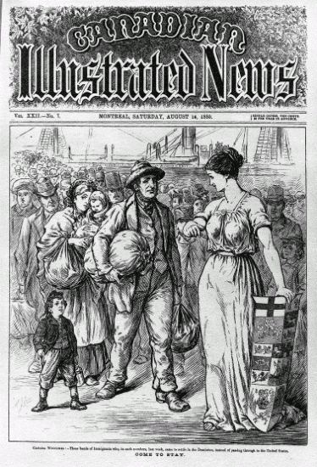
Media and Nation Building in Canada
First wave – Print and telegraph allowed people to communication across distances, to other communities. Print also was used to advertise Canada.
Second wave – Between east and west in 1930 & 40s because of radio transmission
Four distinct factors contributed to each wave of nation building:
Canada was becoming more independent from Brittan
Each Canadian public policy action was in part a reaction to American presence
Influence of the state in building communication infrastructure
Canada was growing internally and establishing its own roots by defying geography and connecting people nationally – Railroads & Radio Transmitters

Slide 13
Emergence of Broadcast Regulations
Public vs Private
1929 – John Aird Commission on the future control, organizations and financing of broadcasting
Canadians want Canadian programming
Should be controlled by the public and not private interests
Series of 50 000-watt public transmitting stations should be set up across the country
Public broadcasting company; revenues from licence fees, indirect advertisements & government subsidies
Opposed by the Canadian Association of Broadcasters (CAB – established in 1924)
1930 – Canadian Radio League
Promote Canadian broadcasting (CRL) – Graham Spry
1932 – First Broadcasting Act - Canadian Radio Broadcasting Commission (CRBC)
Became the Canadian Broadcasting Corporation (CBC)
Bilingual

Slide 14
Emergence of Broadcast Regulations
Prime Minister Bennett vs Mackenzie King & Mr. Sage Advertisements
In 1936 – CRBC to CBC
Political broadcasts were banned on CBC
CBC was given the mandate of:
Producing radio broadcasts
Regulating private radio stations
Because of funding cuts in 1953, the CBC became a government/semi-independent hybrid in 1958
Société du Radio Canada (SRC) was founded in 1941
Broadcasting acts from 1932 – 1965 promoted national unity and cultural exchange between linguistic groups
Fowler Committee Report 1965 – CBC does not represent French Canada properly – private stations provide external content
1991 Progressive Conservatives removed national unity mandate
Maintaining it artificially and violation to freedom of expression
Provisions for rights of aboriginal peoples to broadcast in aboriginal language
Television North Canada (1999) Aboriginal Peoples Television Network
Beginning of deregulating the media in Canada
Government can overrule CRTC decisions
2003 Standing Committee on Canadian heritage – Two nations approach

Slide 15
Development of the CRTC
The CBC was under scrutiny for being a regulator and competitor to private broadcasting companies
1949 – Massey Commission determined that broadcasting should be directed and controlled by the public through a body that answers to parliament
Advent of television was too much for Canada to regulate
1958 – Diefenbaker's Progressive Conservatives passed 1958 Broadcasting Act and created the Board of Broadcast Governors (BBG) to arbitrate between CBC and competitors. CBC funds were also restricted
1968 – Canada Radio and Television Commission (CRTC)

Slide 16
CRTC Mandate
1968 – The CRTC was set up to:
Make regulations governing broadcasting
Issue broadcasting licences
Administer policy
Five substantive facets that allowed the CRTC to pursue its mandate:
Nurture and develop Canadian programming (values, ideas, visions)
Promote the culture, social and economic fabric of Canada
Be reflective of Canadas basic political culture (linguistic, multicultural, gender, and aboriginal)
Promote use of Canadian talent
Balance information, entertainment
CRTC was bullied and swayed by private interests
1998 – CRTC requires 50% Canadian contend television shows between 6PM and midnight and 35% Canadian radio content

Slide 17
Canadian Film Industry
1939 – National Film Board
1967 – Canadian Film Development Corporation
1983 – Telefilm Canada

Slide 18
Globalization and Canadian Media
Media corporations are global multinational companies
Funding to Canadian public broadcasting is being continuously reduced although liberal government has restored some of the funding
Media corporations in Canada have changed ownership frequently over the last 15 years
A few powerful corporations control most of the media in Canada

Slide 19
Source

Slide 20
CRTC Regulations
CRTC Businesses and Licensing
Diversity of Voices Polity
2 out of 3 – Newspaper, Television, Radio Station in same market
Ownership caps – 35% - 45% potentially threatening, over 45% rejected
Incumbent telephone and cable companies cannot consolidate to ‘control the internet’
Vertical integration of programming – ¾ have to be produced from outside sources, 25% Canadian programming from independent producers
Examples of CRTC rulings regarding these regulations are contained in this report

Slide 21
Discussion
What should be the role of public broadcasting?
What should be the role of the government in regards to regulating public broadcasting?
Regulation content?
Making sure content is Canadian?
In formation of national identity?
What should be the role of the government in regards to issuing broadcasting licences?
Should they allow media companies to control the media markets?

Slide 22
Instructions for Short Paper
Chose a media product – message, campaign, blog post, video, movie, song
Perform an analysis of the media product using the Nesbitt-Larking Model of Politics, Society and the Media (page 2 of the course-pack)
Must be no more than 3 pages (not including references & title page)
Must include at least 5 references (peer-reviewed journals and/or reliable and valid sources of information)
Point allocation:
8 points – Comprehension of the Nesbitt-Larking Model: Politics, Society and the Media — How well did you describe your media product according to the model? Did you take into consideration each concept (owners & tools, texts, readings, socio-political environment) and the relationships between these concepts?
5 points – The clarity of the report – Are the arguments clear and concise? Is the report organized properly? - When in doubt, use this formula – main argument, support, evidence
5 points – Information in the report – Is the evidence convincing, relevant, and valid/reliable?
2 points – Grammar and citation– Has the report been properly proofread? Is every reference properly cited? Does it adhere to the page requirement guidelines?

Slide 23
General Framework
Paul Nesbitt-Larking. Politics, Society and the Media (2nd Edition). Broadview Press. 2009.
Example: Next Slide

Slide 24
Analyze the Red Campaign
Red Campaign
Jimmy Kimmel
Red Campaign Shopathon
Bike Ride with Bono
Red Song
Bono & Oprah News
Bono on Oprah

Slide 25
Thanks!
Questions or concerns?

