Slide 1
Economic Restructuring
Erik Chevrier
January 22nd, 2019

Slide 2
Videos
Crises of Capitalism
The Story of Stuff

Slide 3
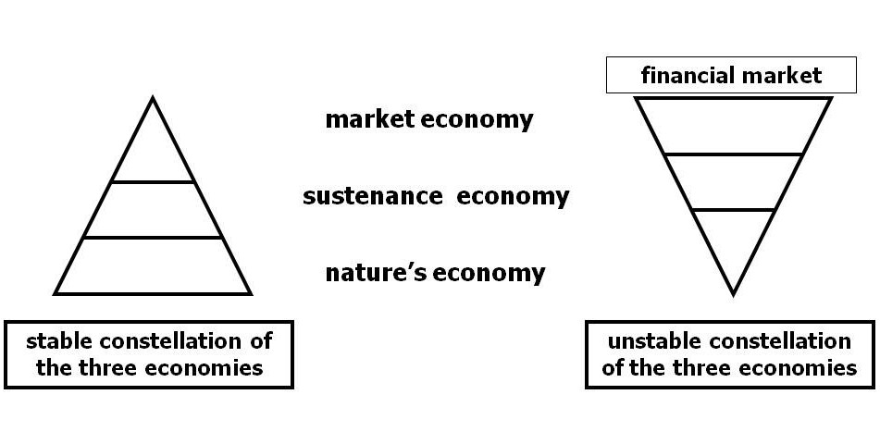
Living Economies – Vandana Shiva

Slide 4
What is Capitalism?
What features of a economic, social and political system does capitalism have?

Slide 5
What is Capitalism?
Markets Profit Private ownership of the means of production Money based system Financial markets Private property Alienation Exploitation Wage Labour Externalities Expendable work force Inequality Advertising Consumerism Firms Institutions Imperialism Colonialism Exchange Free (non-slave) labour Cycles and crisis Growth Competition

Slide 6
Discussion About Readings
Get into Groups of 3 or 4.
We will discuss each critique of capitalism by Erik Olin Wright

Slide 7
Questions or Concerns?
Thanks!
Have a great day!

