Slide 1
Motivation and Emotion in Daily Life
Physiological Needs
January 23st, 2019
Erik Chevrier

Slide 2
Discussion
Food
How frequently do you eat in a day?
Meals, snacks?
What do you typically eat as a meal?
Breakfast, lunch dinner?
What foods best appease your appetite?
What foods leave you feeling hungry soon after you eat them?
What time of the day do you experience hunger most?
What season do you experience hunger most?

Slide 3
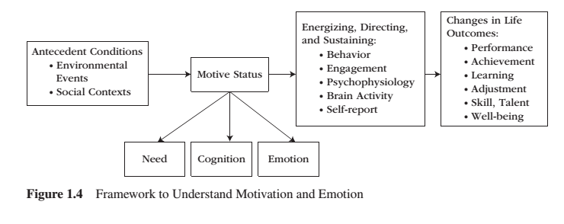
REVIEW – Framework to Understand Motivation and Emotion

Slide 4
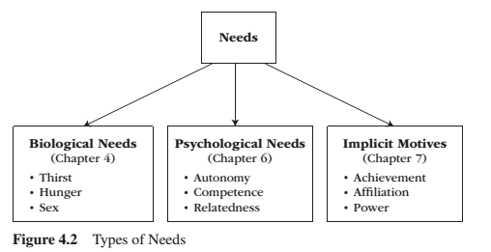
REVIEW – Needs
Need – A condition within the person that is essential and necessary for growth, well-being and life.
Deficiency needs – Are responses to a state of deprivation and generate tension-packed, urgency-laden emotions, such as pain, relief, anxiety, frustration, stress, etc.…
Growth needs – Gently guide behaviour toward a developmental trajectory of growth and well-being. They typically generate positive emotions, such as interest, enjoyment, hope and vitality.

Slide 5
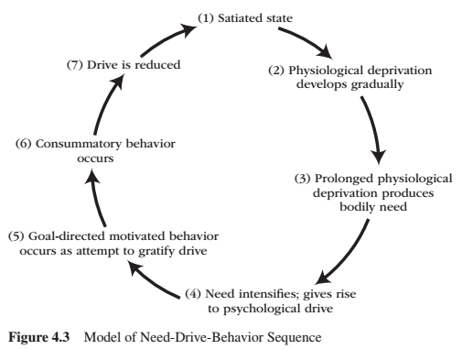
REVIEW – Model of Need-Drive-Behaviour Sequence

Slide 6
REVIEW – Seven Core Regulatory Processes
Physiological need describes a deficient biological condition.
Psychological drive is not a biological term. It is the conscious manifestation of underlying unconscious physiological need.
Homeostasis is a term that describes the body’s tendency to maintain a stable internal state (see next slide).
Negative feedback refers to homeostasis’ physiological stop system. Drive activates behaviour, negative feedback stops it.
Multiple Inputs/Multiple Outputs Drive arises from a number of different sources and motivate a number of goal directed behaviour (see Drive as an Intervening Variable slide).
Intraorganismic Mechanisms include the biological regulatory systems within the person that act in concert to activate, maintain, and terminate the biological needs that underlie drive.
Extraorganismic Mechanisms include all the environmental influences that play a part in activating, maintaining, and terminating phycological drive. i.e. cognitive, environmental, social, cultural.

Slide 7
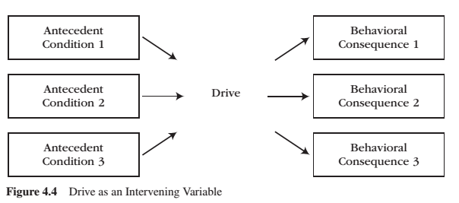
REVIEW – Drive as an Intervening Variable

Slide 8
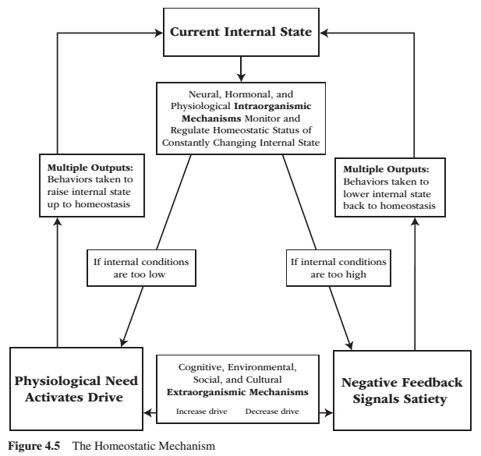
REVIEW – Homeostatic Mechanism

Slide 9
REVIEW – Thirst
Our bodies are about 2/3rds water
2% reduction in water volume makes you thirsty
3% causes dehydration
Physiological Regulation
Intracellular fluids – Inside cells (40% body weight) – osmometric thirst (cellular de/hydration)
Extracellular fluids – Outside cells (20% body weight) – volumetric thirst (hypo/hypervolemia)
Double-depletion model
Osmometric thirst is the primary cause of thirst activation
Hypothalamus (blood/salt volume) – Pituitary gland (antidiuretic hormone – ADH) – Kidneys (conserve water)
Negative feedback mechanisms
Number of swallows (small influence)
Stomach (small influence)
Bloodstream (small influence)
Cellular hydration (greatest influence)
Reasons why people drink
Thirst-related replenishment – Biological need
Non-thirst-related taste – Flavour incentive
Non-thirst-related attraction to or addiction to a substance in water

Slide 10
REVIEW – Homeostatic Mechanism – Practice With Thirst

Slide 11
Hunger
Involves
Short-term homeostatic-based models
Long-term genetic and metabolism energy balance models
Cognitive-social-environmental models

Slide 12
Homeostatic Mechanism

Slide 13
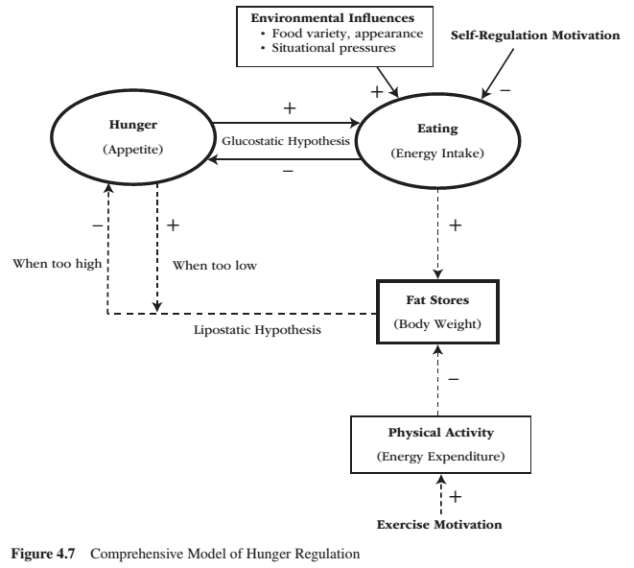
Comprehensive Model of Hunger Regulation

Slide 14
Short-term Appetite
Glucostatic hypothesis is a homeostatic model of short-term appetite
When blood glucose drops, people feel hungry and want to eat
Cells require glucose to produce energy
When blood glucose is low, the LIVER sends an excitatory signal to the LATERAL HYPOTHALAMUS (LH)
The VENTROMEDIAL HYPOTHALAMUS (VMH) is responsible for negative feedback.
The liver detects high levels of glucose, the stomach bloats and the gut peptide CHOLECYSTOKININ (CCK) is released
Other factors that influence short-term appetite is the stomach and body temperature
Stomach distension
60% empty = hint of hunger
90% empty = maximum hunger
High protein & high fiber meals produce the greatest satiety

Slide 15
Long-term Energy Balance
Lipostatic hypothesis – when the mass of fat stored drops below its homeostatic balance, adipose tissue secrets hormones into the bloodstream to promote hunger that increase food intake
Hormones that play a key role in hunger
Ghrelin – Manufactured in stomach, circulated in the blood, detected and monitored by the lateral hypothalamus (LH) via stomach and intestines
Ghrelin fluctuates throughout the day and peaks around breakfast, lunch, dinner
Eating food causes a rapid fall in ghrelin
Ghrelin was chronically higher when people were on a diet than if they were not on a diet
Leptin – Manufactured by fat cells throughout the body, circulated in the blood, detected and monitored by the ventromedial hypothalamus (VMH) via stomach and intestines
Responsible for negative feedback
Set-Point Theory - Each individual has a biologically determined body weight or “fat thermostat” that is set by genetics either at birth or shortly thereafter.
Hunger is determined by the size of the fat cells, not the number of cells

Slide 16
Comprehensive Model of Hunger Regulation

Slide 17
Environmental & Self-Regulatory Influences
There are many ENVIRONMENTAL FACTORS that influence hunger
Time, smell of food, seeing food, social occasion/facilitation/pressure, etc.
SELF-REGULATED INFLUENCES include:
Cognitively Regulated Eating Style
Dieters have issues with having willpower over our physiology; getting environmental cues and our own feelings
Dieters need to deaden internal cues and substitute cognitive controls
Restraint-Release Situations
Under conditions of stress, anxiety, alcohol, depression, and/or exposure to high calorie foods, dieters become susceptible to disinhibition (restraint-release) of their cognitively regulated eating style

Slide 18
Comprehensive Model of Hunger Regulation

Slide 19
How Your Belly Controls Your Brain
Video: How Your Belly Controls Your Brain

Slide 20
Learning Check
What is a need? What are the three categories of needs mentioned by Reeve? Please name and describe them?
Please reproduce the model of Need-Drive-Behaviour sequence? Please describe the model.
What is a physiological need?
What is a psychological drive?
What is homeostasis? What is the homeostatic mechanism (diagram)? Please reproduce the homeostatic mechanism diagram and use thirst to illustrate the diagram.
What is negative feedback?
What does multiple inputs/outputs refer to?
What are intraorganismic and extraorganismic mechanisms?
Please describe the physiological regulation of thirst.
Please describe how hunger works? How is short term appetite regulated? How is long term energy balance regulated?
What is set point theory?
What are cognitively regulated eating styles?
What is restraint-release situations? What occurs in these situations?
Please reproduce and describe the comprehensive model of hunger regulation.

Slide 21
Thank you!
Questions? Concerns?

Slide 22
Bibliography
The information obtained to create this PowerPoint slide was obtained from:
Reeve, J. (2018) Understanding Motivation and Emotion, 7th ed. John Wiley and Sons

