Slide 1
Motivation and Emotion in Daily Life
Extrinsic Motivation
January 28th, 2019
Erik Chevrier

Slide 2
Midterm Exam 1
The exam will consist of:
25 multiple choice questions
1 (of 2) essay questions
Grade distribution:
1 point per multiple choice question = 25 points
10 points for the essay question = 10 points
Total = 35 points
Short Answer – Points (0 – 10)
0 = You wrote nothing
1 – 2 = You wrote something but it is not right at all
3 – 5 = You wrote something that is partially true but mainly wrong
6 = You are correct but extremely vague
7 = You are correct but slightly vague
8 – 9 = You are correct and clear. You provide appropriate examples to demonstrate your knowledge of the subject matter.
10 = You are spot on. You provide a range of examples to demonstrate your knowledge of the subject matter. Your answer is full. You don’t leave anything out. Each part of your answer is completely correct.

Slide 3
Example Questions
Engagement is a multidimensional expression of motivation. Which of the following aspect of engagement is not central to understanding the person’s underlying motive status?
behavioral engagement
cognitive engagement
emotional engagement
social engagement
none of the above, they are all central to understanding the person’s underlying motive status

Slide 4
Extent of Engagement

Slide 5
Example Questions
Engagement is a multidimensional expression of motivation. Which of the following aspect of engagement is not central to understanding the person’s underlying motive status?
behavioral engagement
cognitive engagement
emotional engagement
social engagement
none of the above, they are all central to understanding the person’s underlying motive status
What are rewards and punishers? What is the difference between a reward and reinforcer? What consequences occur when punishers and rewards are used?

Slide 6
REVIEW - Hunger
Involves
Short-term homeostatic-based models
Long-term genetic and metabolism energy balance models
Cognitive-social-environmental models

Slide 7
REVIEW - Short-term Appetite
Glucostatic hypothesis is a homeostatic model of short-term appetite
When blood glucose drops, people feel hungry and want to eat
Cells require glucose to produce energy
When blood glucose is low, the LIVER sends an excitatory signal to the LATERAL HYPOTHALAMUS (LH)
The VENTROMEDIAL HYPOTHALAMUS (VMH) is responsible for negative feedback.
The liver detects high levels of glucose, the stomach bloats and the gut peptide CHOLECYSTOKININ (CCK) is released, sends signals to the VMH.
Other factors that influence short-term appetite is the stomach and body temperature
Stomach distension
60% empty = hint of hunger
90% empty = maximum hunger
High protein & high fiber meals produce the greatest satiety

Slide 8
REVIEW - Long-term Energy Balance
Lipostatic hypothesis – when the mass of fat stored drops below its homeostatic balance, adipose tissue secrets hormones into the bloodstream to promote hunger that increase food intake
Hormones that play a key role in hunger
Ghrelin – Manufactured in stomach, circulated in the blood, detected and monitored by the lateral hypothalamus (LH) via stomach and intestines
Ghrelin fluctuates throughout the day and peaks around breakfast, lunch, dinner
Eating food causes a rapid fall in ghrelin
Ghrelin was chronically higher when people were on a diet than if they were not on a diet
Leptin – Manufactured by fat cells throughout the body, circulated in the blood, detected and monitored by the ventromedial hypothalamus (VMH) via stomach and intestines
Responsible for negative feedback
Set-Point Theory - Each individual has a biologically determined body weight or “fat thermostat” that is set by genetics either at birth or shortly thereafter.
Hunger is determined by the size of the fat cells, not the number of cells

Slide 9
REVIEW - Environmental & Self-Regulatory Influences
There are many ENVIRONMENTAL FACTORS that influence hunger
Time, smell of food, seeing food, social occasion/facilitation/pressure, etc.
SELF-REGULATED INFLUENCES include:
Cognitively Regulated Eating Style
Dieters have issues with having willpower over our physiology; getting environmental cues and our own feelings
Dieters need to deaden internal cues and substitute cognitive controls
Restraint-Release Situations
Under conditions of stress, anxiety, alcohol, depression, and/or exposure to high calorie foods, dieters become susceptible to disinhibition (restraint-release) of their cognitively regulated eating style

Slide 10
REVIEW - Comprehensive Model of Hunger Regulation
Sight, smell, social facilitation, etc.
Restraint-Release
Cognitive Regulation
Liver → LH
Leptin fat cells throughout the body → blood → VMH stomach and intestines
Liver → stomach bloats CCK→ VMH
Set-Point Theory
Ghrelin in stomach, → blood → (LH) via stomach and intestines

Slide 11
Extrinsic Motivation
Extrinsic motivation
Arises from environmental incentives and consequences.
Arise from consequences separate from the activity itself
Operant conditioning
S : R → C
Situational Cue (incentive) : Behavioural Response → Consequence
Incentives – An environmental event that attracts or repels a person towards or away from initiating a particular course of action – they precede behaviour.
Reinforcers – Any environmental object or event that increases that behaviour.
Reward – Is any offering from one person given to another person in exchange for his/her services or achievement
All positive reinforcers are rewards but only some rewards function as positive reinforcers – they work when unexpected and imminent
Incentives differ from consequences on the basis of:
When each occur (incentives occur before a behaviour)
How it motivates behaviour (increases or decreases the persistence of the behaviour)

Slide 12
Basic Example to Illustrate How Reinforcers Work
Reinforcers vary in quality
Immediacy of reinforcers partly determines effectiveness

Slide 13
Historical Explanations of Why Reinforcers Increase Behaviour

Slide 14
Reinforcement vs Punishment
 | Positive Applies Stimulus | Negative Removes Stimulus
Reinforcement Increases the frequency of desired behaviour | Positive Reinforcement | Negative Reinforcement
Punishment Decreases the frequency of undesired behaviour | Aversive Punishment | Response Cost

Slide 15
Activity
Please come up with five examples of:
Positive reinforcement
Negative reinforcement
Aversive punishment
Response cost

Slide 16
Immediate and Long-Term Consequence of Corporal Punishment

Slide 17
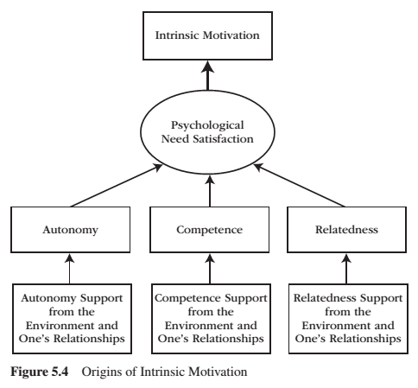
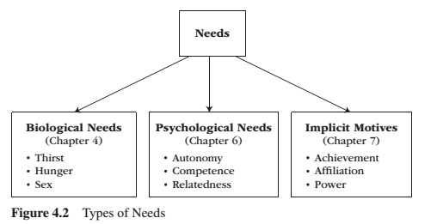
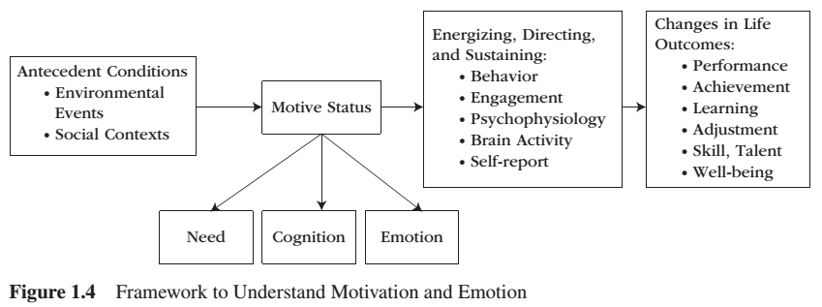
Intrinsic Motivation

Slide 18
Intrinsic Motivation
Intrinsic motivation is the inherent propensity to seek out novelty and challenge, to extend and exercise one’s capacities, to explore, and to learn.
It is a natural inclination towards exploration, spontaneous interest, and environmental mastery that emerges from innate strivings for personal growth and from experiences of psychological needs satisfaction.

Slide 19
Intrinsic Motivation
People who are intrinsically motivated will:
Engage with the task
Be more creative
Use more effective learning strategies
Have optimal functioning and experience well-being
Please name five activities that you are intrinsically motivated to perform
Please describe the your performance in these activities according to the list above
i.e. I enjoy playing drums
I frequently play on my own, on average, 10 hours a week
I write my own songs and play a variety of cover songs that I enjoy
I practice rudiments and play along to complex songs to develop better skills
I really enjoy playing, I can’t get enough

Slide 20
Hidden Cost of Reward

Slide 21
Hidden Cost of Reward
Expected and tangible are the most detrimental to intrinsic motivation
If someone has no intrinsic motivation to perform a task, refrain from expected tangible rewards
Limit the use of rewards to tasks that have little or no intrinsic but high social importance
Four reasons not to use extrinsic motivators for intrinsically uninteresting tasks

Slide 22
Cognitive Evaluation Theory
Cognitive evaluation theory asserts that all external events have both a controlling aspect and an informational aspect
Controlling someone takes away their need for autonomy
The informational aspect interferes with people’s need for competence
Set of three propositions
External events that promote an internal perceived locus of causality (PLOC) promote intrinsic motivation because these events involve or satisfy the need for autonomy. External events that promote an external PLOC, promote extrinsic motivation because these events neglect the need for autonomy and instead establish an if-then contingency between a behaviour and a forthcoming consequence.
External events that increase perceived competence promote intrinsic motivation, whereas events that decrease perceived competence undermine it.
The relative salience of whether an event is mostly controlling or mostly informational determines its effects on intrinsic motivation.
Two examples = praise & competition
Cognitive evaluation theory does not apply to inherently uninteresting activities

Slide 23
How an External Event Will Affect Motivation

Slide 25
Types of Extrinsic Motivation

Slide 26
Types of Extrinsic Motivation
External Regulation is the prototype of non-self-determined extrinsic motivation – behaviours performed to obtain a reward, to avoid a punisher, or to satisfy some external demand.
Introjected Regulation involves taking in, but not truly accepting or self endorsing, other people’s demands to think, feel or behave in a particular manner – i.e. being motivated out of guilt.
Identified Regulation represents mostly internalized and autonomous (or self-determined) extrinsic motivation – i.e. practices are extrinsic but freely chosen.
Integrated Regulation is the process of taking in a value or way of behaving – the process through which individuals fully transform their identity values and behaviour onto the self. It involved self-examination to bring new ways of thinking, feeling, and behaving into an unconflicted congruence with the self’s preexisting ways of thinking, feeling and behaving.
Internalization refers to the process through which an individual transforms a formerly externally prescribed regulation (rule), behaviour, or value into an internally endorsed one – eventually, it actually arises from the self.
Amotivation means, without motivation.

Slide 27
Four Types of Extrinsic Motivation

Slide 28
Types of Extrinsic Motivation

Slide 29
Learning Check
Please identify five activities that you commonly do that fall under each category of extrinsic motivation.
External Regulation I am taking this course because I thought it would be an easy A. I don’t care for psychology, nor motivation and emotion as a subject.
Introjected Regulation I am taking this course because my parents believe that it is good for me. Although, I may have taken another course, I know it is important to them.
Identified Regulation I took this course on my on volition because I want to be a psychologist when I am older and it is important for me to know about motivation and emotion.
Integrated Regulation I am someone who is hyper aware of people’s emotional states. I am an empathetic person and want to learn as much as I can about motivation and emotion so I can continuously improve myself.

Slide 30
Amotivation

Slide 31
Fostering Intrinsic Motivation
Motivating for uninteresting tasks
Provide explanatory rationales
Suggest interest-enhancing strategies
Instead of punishing
Provide differential reinforcement
Scaffold them
Provide observational learning opportunities
Refrain from giving expected, tangible rewards

Slide 32
Thank you!
Questions? Concerns?
STUDY HARD!

Slide 33
Bibliography
The information obtained to create this PowerPoint slide was obtained from:
Reeve, J. (2018) Understanding Motivation and Emotion, 7th ed. John Wiley and Sons

