Slide 1
Motivation and Emotion in Daily Life
Extrinsic Motivation
January 30th, 2019
Erik Chevrier

Slide 2
REVIEW – Extrinsic Motivation
Extrinsic motivation
Arises from environmental incentives and consequences.
Arise from consequences separate from the activity itself
Operant conditioning
S : R → C
Situational Cue (incentive) : Behavioural Response → Consequence
Incentives – An environmental event that attracts or repels a person towards or away from initiating a particular course of action – they precede behaviour.
Reinforcers – Any environmental object or event that increases that behaviour.
Reward – Is any offering from one person given to another person in exchange for his/her services or achievement
All positive reinforcers are rewards but only some rewards function as positive reinforcers – they work when unexpected and imminent
Incentives differ from consequences on the basis of:
When each occur (incentives occur before a behaviour)
How it motivates behaviour (increases or decreases the persistence of the behaviour)

Slide 3
Reinforcement vs Punishment
 | Positive Applies Stimulus | Negative Removes Stimulus
Reinforcement Increases the frequency of desired behaviour | Positive Reinforcement | Negative Reinforcement
Punishment Decreases the frequency of undesired behaviour | Aversive Punishment | Response Cost

Slide 4
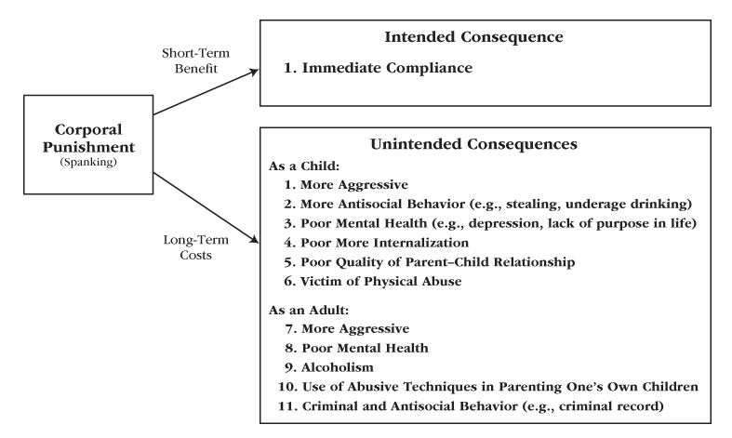
Immediate and Long-Term Consequence of Corporal Punishment

Slide 5
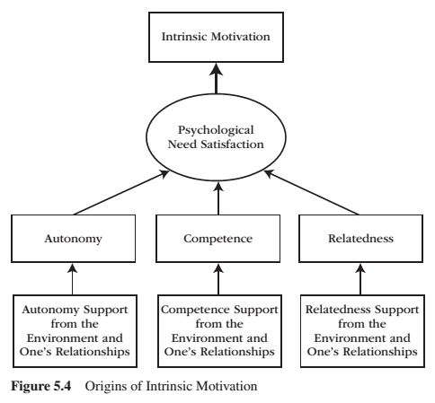
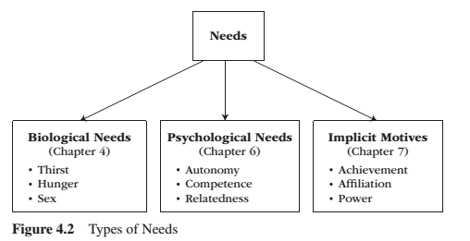
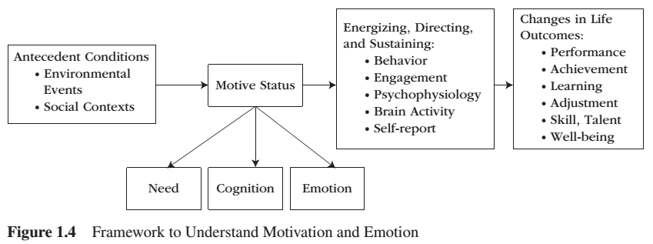
Intrinsic Motivation

Slide 6
Intrinsic Motivation
Intrinsic motivation is the inherent propensity to seek out novelty and challenge, to extend and exercise one’s capacities, to explore, and to learn.
It is a natural inclination towards exploration, spontaneous interest, and environmental mastery that emerges from innate strivings for personal growth and from experiences of psychological needs satisfaction.

Slide 7
Intrinsic Motivation
People who are intrinsically motivated will:
Engage with the task
Be more creative
Use more effective learning strategies
Have optimal functioning and experience well-being
Please name five activities that you are intrinsically motivated to perform
Please describe the your performance in these activities according to the list above
i.e. I enjoy playing drums
I frequently play on my own, on average, 10 hours a week
I write my own songs and play a variety of cover songs that I enjoy
I practice rudiments and play along to complex songs to develop better skills
I really enjoy playing, I can’t get enough

Slide 8
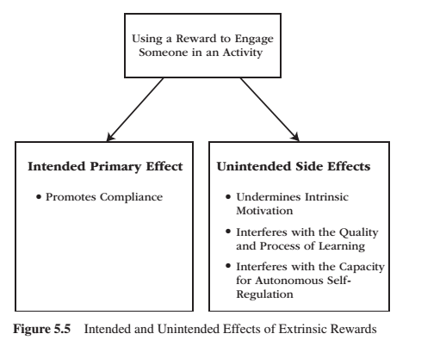
Hidden Cost of Reward

Slide 9
Hidden Cost of Reward
Expected and tangible are the most detrimental to intrinsic motivation
If someone has no intrinsic motivation to perform a task, refrain from expected, and tangible rewards
Limit the use of rewards to tasks that have little or no intrinsic but high social importance
Four reasons not to use extrinsic motivators for intrinsically uninteresting tasks

Slide 10
Cognitive Evaluation Theory
Cognitive evaluation theory asserts that all external events have both a controlling aspect and an informational aspect
Controlling someone takes away their need for autonomy
The informational aspect interferes with people’s need for competence
Set of three propositions
External events that promote an internal perceived locus of causality (PLOC) promote intrinsic motivation because these events involve or satisfy the need for autonomy. External events that promote an external PLOC, promote extrinsic motivation because these events neglect the need for autonomy and instead establish an if-then contingency between a behaviour and a forthcoming consequence.
External events that increase perceived competence promote intrinsic motivation, whereas events that decrease perceived competence undermine it.
The relative salience of whether an event is mostly controlling or mostly informational determines its effects on intrinsic motivation.
Two examples = praise & competition
Cognitive evaluation theory does not apply to inherently uninteresting activities

Slide 11
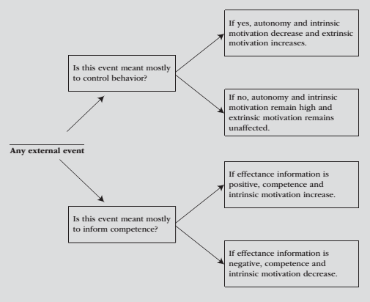
How an External Event Will Affect Motivation

Slide 13
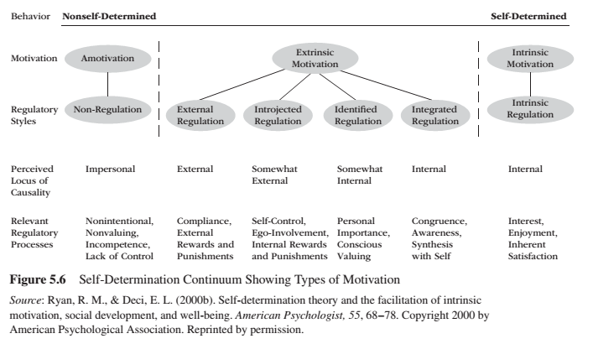
Types of Extrinsic Motivation

Slide 14
Types of Extrinsic Motivation
External Regulation is the prototype of non-self-determined extrinsic motivation – behaviours performed to obtain a reward, to avoid a punisher, or to satisfy some external demand.
Introjected Regulation involves taking in, but not truly accepting or self endorsing, other people’s demands to think, feel or behave in a particular manner – i.e. being motivated out of guilt.
Identified Regulation represents mostly internalized and autonomous (or self-determined) extrinsic motivation – i.e. practices are extrinsic but freely chosen.
Integrated Regulation is the process of taking in a value or way of behaving – the process through which individuals fully transform their identity values and behaviour onto the self. It involved self-examination to bring new ways of thinking, feeling, and behaving into an unconflicted congruence with the self’s preexisting ways of thinking, feeling and behaving.
Internalization refers to the process through which an individual transforms a formerly externally prescribed regulation (rule), behaviour, or value into an internally endorsed one – eventually, it actually arises from the self.
Amotivation means, without motivation.

Slide 15
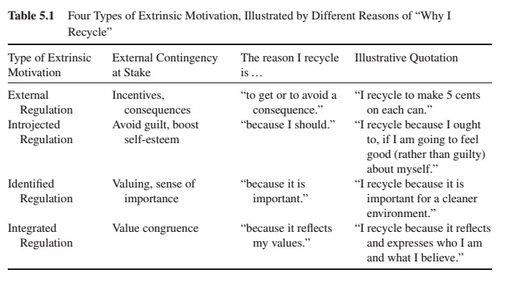
Four Types of Extrinsic Motivation

Slide 16
Practice
Please identify five activities that you commonly do that fall under each category of extrinsic motivation.
External Regulation I am taking this course because I thought it would be an easy A. I don’t care for psychology, nor motivation and emotion as a subject.
Introjected Regulation I am taking this course because my parents believe that it is good for me. Although, I may have taken another course, I know it is important to them.
Identified Regulation I took this course on my on volition because I want to be a psychologist when I am older and it is important for me to know about motivation and emotion.
Integrated Regulation I am someone who is hyper aware of people’s emotional states. I am an empathetic person and want to learn as much as I can about motivation and emotion so I can continuously improve myself.

Slide 17
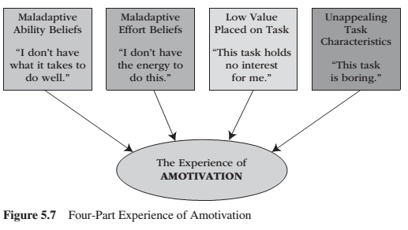
Amotivation

Slide 18
Fostering Intrinsic Motivation
Motivating for uninteresting tasks
Provide explanatory rationales
Suggest interest-enhancing strategies
Instead of punishing
Provide differential reinforcement
Scaffold them
Provide observational learning opportunities
Refrain from giving expected, tangible rewards

Slide 19
Learning Check
What is extrinsic motivation?
What is intrinsic motivation?
Compare and contrast intrinsic vs extrinsic motivation.
What are incentives and consequences? How do they motivate behaviour?
What is operant conditioning? How does it work?
What is a positive and negative reinforcer? How do they influence behaviour? What are examples of positive and negative reinforcers?
What is aversive and response cost punishment? How do them work? What are examples of aversive and response cost punishers?
What are the untended and unintended consequences of corporal punishment?
What are the intended and unintended effects of using rewards to engage someone in an activity?
Do punishers work to motivate behaviour?
What is the effect of expected and tangible rewards?
Are there benefits to using extrinsic factors to motivate behaviour?
What is cognitive evaluation theory?
What do praise and competition do to motivate behaviour?
How can you predict how an external event will affect motivation?
Name and describe the different types of extrinsic motivation.
What is internalization and integration in relation to motivation?
How can we motivate others to perform uninteresting tasks?
What is amotivation? What factors contribute to amotivation?

Slide 20
Thank you!
Questions? Concerns?
STUDY HARD!

Slide 21
Bibliography
The information obtained to create this PowerPoint slide was obtained from:
Reeve, J. (2018) Understanding Motivation and Emotion, 7th ed. John Wiley and Sons

