Slide 1
Motivation and Emotion in Daily Life
Psychological needs
February 11th, 2019
Erik Chevrier

Slide 2
Discussion
Please name and describe:
Relationship conditions that are satisfying…why?
Relationship conditions that are NOT satisfying…why?
Things you feel competent doing…why?
Things you feel NOT competent doing…why?
Things that you like engaging in autonomously…why?
Things that you DON’T like engaging in autonomously…why?

Slide 3
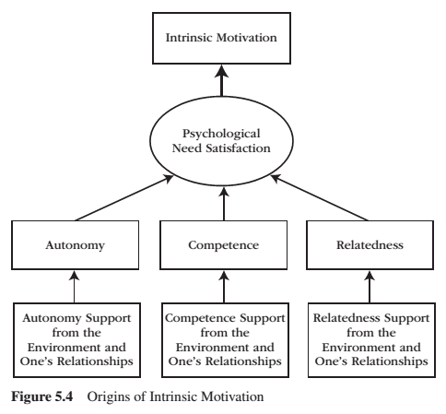
REVIEW: Intrinsic Motivation
Intrinsic motivation is the inherent propensity to seek out novelty and challenge, to extend and exercise one’s capacities, to explore, and to learn.
It is a natural inclination towards exploration, spontaneous interest, and environmental mastery that emerges from innate strivings for personal growth and from experiences of psychological needs satisfaction.

Slide 4
REVIEW – Psychological Needs
Competence Relatedness Autonomy
When an activity taps into and involves our psychological needs, we feel interest.
When an activity satisfies a psychological need, we feel enjoyment.
The energy generated by psychological needs are proactive.
Autonomy, competence, and relatedness are organismic needs.

Slide 5
REVIEW – Organismic Needs
Organismic needs theories:
Get their name from the word organism, which means alive and in active exchange with the environment.
When environments are supportive and provide what is needed, organisms thrive – when environments are hostile and withhold what is needed, organisms suffer.
Organisms need flexibility to accommodate a changing environment.
Organismic theories are the opposite of mechanistic approaches.
The focus of organismic theories is on how organisms initiate interactions with the environment, how environments change, and how organisms learn, adapt, change, and grow as a function of those environmental transactions.

Slide 6
REVIEW – Benefits of Need Satisfaction
Engagement
Personal growth
Intrinsic motivation
Internalization
Health
Well-being

Slide 7
REVIEW: Extent of Engagement

Slide 8
REVIEW – Person-Environment Dialectic

Slide 9
REVIEW – Dual-Process Model in Supportive and Thwartive Relationships

Slide 10
REVIEW – Person-Environment Synthesis vs Conflict
A person uses their inner motivational resources to interact with and change the environment, while the environment in turn changes and produces new forms of motivation for the person to internalize.
When an environment is supportive, the person’s inner motivational resources are vitalized, and autonomous forms of extrinsic motivation are internalized. The outcome is one of synthesis.
When environments are frustrating, the person’s inner motivational resources are deadened and controlled forms of extrinsic motivation are introjected (and external). The outcome is one of conflict.

Slide 11
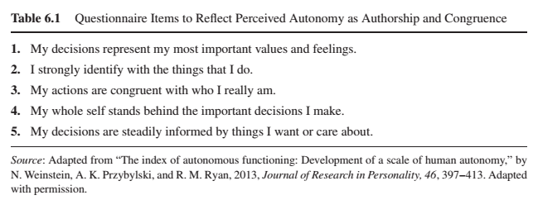
Autonomy
Autonomy is the psychological need to experience self-directed and personal endorsement in the initiation and regulation of one’s behaviour.
The hallmarks of autonomy are volitional action and wholehearted self-endorsement of that action.
Behaviour is autonomous when our interests, preferences and wants guide our decision-making process to engage or not engage in a particular activity.
Perceived Autonomy - Trait

Slide 12
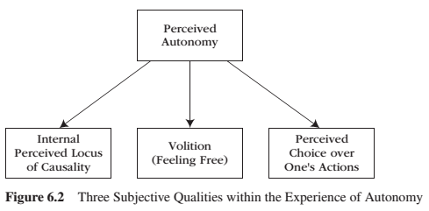
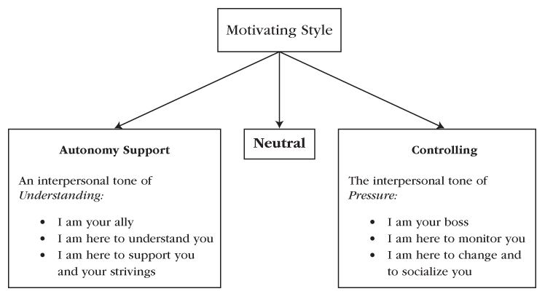
Autonomy
Autonomy is the psychological need to experience self-directed and personal endorsement in the initiation and regulation of one’s behaviour.
Behaviour is autonomous when our interests, preferences and wants guide our decision-making process to engage or not engage in a particular activity.
Perceived Autonomy - State

Slide 13
Autonomy
Perceived locus of causality (PLOC) – an individuals understanding of the causal sources of his or her motivational actions.
Volition – is a heartfelt and unpressured willingness to engage in an activity.
Perceived choice – is a subjective experience that one has decision-making flexibility to act or not to act, or to pursue one course of action rather than another course of action.
(Not taken from the 7th edition of the textbook)

Slide 14
The Conundrum of Choice
Choice sometimes but not always motivates people.
Choice between prescribed options does not foster a need for autonomy.
Picking is different than choosing.
When people are allowed to make choices that truly reflect their personal values, goals, and interests, then they DO feel a sense of need-satisfying autonomy.
Satisfying the need for autonomy leads to positive post-choice functioning in terms of enhanced intrinsic motivation, effort, creativity, preference for challenge, and performance.
Choice can be offered in an informational or controlling way. Information and explanation leads to more autonomous choices. Controlling ways impede autonomy.

Slide 15
Autonomy vs Control (Not from the 7th edition of the text)

Slide 16
Encouraging & Thwarting Need for Autonomy
Encouraging Need for Autonomy
Nurture Inner Motivational Resources
Take the Other’s Perspective
Provide Explanatory Rationales
Listen Empathetically, Relying on Informational Language (use invitational language)
Display Patience
Acknowledge and Accept Expressions of Negative Affect
Thwarting Need for Autonomy
Nurture Outer Motivational Resources
Providing Your Own Perspective Only
Does Not Provide Explanatory Rationales
Uses Controlling Pressuring Language
Displays Impatience
Counters and Tries to Change Negative Affect

Slide 17
Benefits from Autonomy Support

Slide 18
Benefits or Giving and Receiving Autonomy Support
The quality of the relationship between people is enhanced when autonomy, relatedness, and competence are supported.
Think of the names of five of your friends.

Slide 19
Benefits or Giving and Receiving Autonomy Support
The quality of the relationship between people is enhanced when autonomy, relatedness, and competence are supported.
Do you have a reciprocal relationship where you both try to foster a nurturing environment for each other? What would you answer to the questions below in regards to your interaction with the five people you listed?
My friend believes that I provide him/her with choices and options (giving autonomy support)
My friend tries to understand how I see things (receiving autonomy support)
When I am with my friend, I feel free to be who I am (autonomy)
When I am with my friend, I feel like a competent person (competence)
When I am with my friend, I feel loved and cared about (relatedness)

Slide 20
Competence
Competence is the psychological need:
to be effective in interactions with the environment, and it reflects the desire to exercise and extend one’s capacities and skills and, in doing so, to seek out and master optimal and developmentally appropriate challenges.
that generates the willingness to seek out optimal challenges, take them on, and exert persistent effort and strategic thinking until we master them.
The hallmarks of competence are experiences of effectance, mastery, and making progress.
What kinds of activities can you perform competently?

Slide 21
The Pleasure of Optimal Challenge
When we engage in a task that offers a level of difficulty and complexity that is precisely right for our current skills and talents, we feel interest.
When we make progress on developing and extending our skills, our psychological need for competence is satisfied – we feel enjoyment.
People experience the greatest pleasure following the success of an optimal challenge.
People get feedback to inform them about their performance, then experience the psychological experience of being challenged.

Slide 22
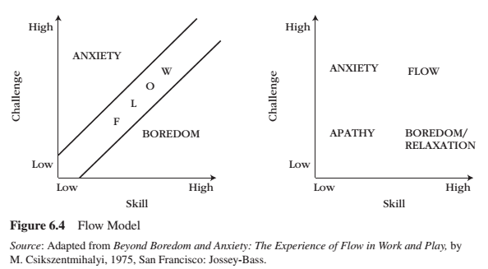
Flow
Flow is:
a state of concentration that involves a holistic absorption and deep involvement in an activity.
such a pleasurable experience that the person often repeats the activity with the hope of experiencing flow again.
when the challenges and skills are perfectly matched.

Slide 23
Flow
Environments that provide structure are more likely to induce a flow state. The following factors provide structure:
clear goals, directions, and learning objectives
helpful guidance and monitoring
clear, constructive, and skill-building feedback
Feedback comes from four sources (not from 7th edition of text book):
The task itself
Comparisons of one’s current performance with one’s own past performances
Comparisons of one’s current performance with the performance of others
Evaluations of others
Failure tolerance:
Failure produces unique opportunities because it has 3 features:
Failure urges people to identify its causes (and eventually its remedy)
Failure prompts people to revise and update their quality of their coping strategies.
Failure prompts people to recognize their need for advice and instruction.

Slide 24
Relatedness
Relatedness is the psychological need to:
establish close emotional bonds and attachments with other people, and it reflects the desire to be emotionally connected and interpersonally involved in warm relationships.
be to care and feel cared for, to love and reel loved.
engage in meaningful social interactions.
The hallmarks of relatedness are feeling socially connected and both giving and receiving care and benevolence to those people (and social organizations) we deem to be significant in our lives.
People tend to become close with people who look out for their well-being and who are trust worthy.
People tend to drift away from those who are not trust worthy and do not look out for their well-being.
Satisfying Relatedness:
Responsiveness
Understanding – Communicates authenticity
Validation – Communicates liking and acceptance
Caring – Communicates concern for one’s well-being
Social Bond:
Cares about welfare
Likes me
Authentic self

Slide 25
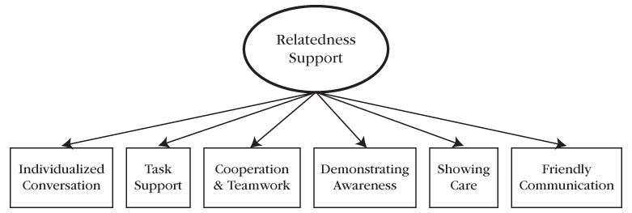
Relatedness
When someone can express their true self, they are more satisfied in the relationship.
Communal relationships (instead of exchange relationships) satisfy the need for relatedness.
Friendship can be established because of proximity and spending time together.
The benefits of relatedness need satisfaction are the fruits of any psychological need satisfaction – namely engagement, developmental growth health and well-being. Relatedness promotes positive functioning because it provides the social context for internalization to occur.
Internalization flourishes in relationships that provide a rich supply of:
relatedness need satisfaction
personally satisfying rationales that explain why others’ prescriptions and proscriptions will benefit the self

Slide 26
Satisfying Psychological Needs

Slide 27
Satisfying Psychological Needs

Slide 28
Vitality
Vitality is the energy that is available to the self.
Psychological need involvement and satisfaction offer us the psychological nutriments we need to feel vital and well, and the presence of vitality is a rather clear signal that our psychological needs are being met and are well.

Slide 29
Discussion
You and your friend have made plans to eat well and begin exercising. Two weeks into the plan, your friend begins to show signs of ambivalence towards the plan. How can you create a nurturing environment to help your friend stay motivated?
You are working with a group of children and have to get them to study for an upcoming standardized test. How can you create a nurturing environment to help them to stay motivated to do well?
Your partner is doing a graduate degree and is near completion. While they are writing their thesis, they are having trouble staying motivated. How can you create a nurturing environment to help your partner stay motivated?

Slide 30
Thank you!
Questions? Concerns?

Slide 31
Bibliography
The information obtained to create this PowerPoint slide was obtained from:
Reeve, J. (2015) Understanding Motivation and Emotion, 6th ed. John Wiley and Sons
Reeve, J. (2018) Understanding Motivation and Emotion, 7th ed. John Wiley and Sons

Slide 32
Learning Check
What are psychological needs? What are organismic psychological needs? What are benefits of need satisfaction? What is need frustration? How does it affect well being? What is the dial-process model in supportive and thwartive relationships?
What is autonomy? What is autonomy support? What are the contrasting interpersonal tones that define autonomy supportive and controlling motivational styles? What are interpersonal behaviours associated with autonomy support? What is the conundrum of choice? What are benefits that people get from an autonomy supportive environment?
What is competence? What is an optimal challenge? What is flow? Please describe the flow model by naming each component in the graph and describing how it relates to motivation and well-being? How can the environment be structured to facilitate flow? How does failure tolerance relate to the need for competence?
What is relatedness? What constitutes a satisfying relationship? What are ways to support relatedness? What are three ways to support responsiveness? What is a communal and exchange relationship? Which is more satisfying? What are the benefits of relatedness? Please describe the engagement model to illustrate the motivational significance of autonomy support, structure and involvement (Figure 6.7).
What is vitality and how does it relate to psychological needs?

