Slide 1
Media, Technology and Politics
Political Economy of the media in canada
Erik Chevrier
February 15, 2019

Slide 2
REVIEW – Characteristics of ‘Media Shock’(Taras, 2015)
1 – Media changes rapidly and suddenly
2 – Web-based media have permeated virtually every aspect of life
3 – Individuals can alter top down flows of information
4 – There is a greater concentration of media than ever before
5 – Media is converging
6 – Traditional media is loosing audience
7 – Television continues to dominate public and cultural life but in radically new ways
8 – Media facilitates global communication
9 – Social media have created a new cultural, business and political dynamic
10 – Government, political parties and corporations are gathering vast amounts of personal information

Slide 3
Discussion – Carried Over from Last Class
According to Taras:
  Media changes rapidly and suddenly. How has media forms changed over the course of your life?
  Web-based media have permeated virtually every aspect of life. How has web-based media changed our relationship to work and leisure time?
  Individuals can alter top down flows of information. Are you a media producer, blogger, vlogger, or internet troll? How have you noticed yourself or other individuals altering top down flows of information?
  Television continues to dominate public and cultural life but in radically new ways. Please describe your television habits. How much time do you spend watching TV? Do you stream shows or subscribe to cable?
  Social media have created a new cultural, business and political dynamic. Does the internet create a desire to become political or cause internet ‘slactivism’ and ‘peek-a-boo citizens’?
  Government, political parties and corporations are gathering vast amounts of personal information. Do you readily share personal information via the internet? Do you use apps and devices that track information?
  Media facilitates global communication. What has your experience been in accessing information from across the globe? Do you skype or chat with family members in other countries? Do you get news information from other countries via the internet? ]
  Media is converging. Do you have a ‘smartphone’? Why or why not? If yes, what do you use it for?

Slide 4
The Birth of Consumerism
You are a commodity to be sold to advertisers!
We Deliver Young People
YUL-LAB
Advertising and the End of the World

Slide 5
Why does it matter who owns the media?
  The media industry plays a central role in shaping social, cultural and political life (Noam, 2016, p. 1180)
  Noam Chomsky – Manufacturing Consent – (Short)
  Noam Chomsky – Manufacturing Consent – (Long)

Slide 6
Why does it matter who owns the media?
  The media industry plays a central role in shaping social, cultural and political life (Noam, 2016, p. 1180)
  Noam Chomsky – Manufacturing Consent – (Short)
  Noam Chomsky – Manufacturing Consent – (Long)
  Propaganda Model
  - Selection of topics - Determine
  - Distribution of concerns - Select
  - Emphasis - Shape
  - Framing of issues - Control
  - Filtering of information - Restrict
  - Bounding of debate - Serve the interest of a select elite group

Slide 7
Who owns the media?
It is important to understand…
  There are various types of ownership
    Non-commercial arrangements (governments, semi-independent public corporations, charities)
    Private ownership (individuals, families, partnerships, shareholders, institutional investors, private equity funds, venture capitalists, coops and non-profits)
    Depending on the type of ownership, the proprietor may not control managerial decisions (allocative owners vs operational owners)
    Private, public, not-for-profit (Nesbitt-Larking p. 107)
  Media owners provide platforms (means of production, methods of distribution)
  Media owners provide messages (content – propaganda model)
  Tom Kent (in Nesbitt-Larking, p. 108)
  Managers are often shareholders
  Managers can be fired if they stray from what is required
  Shareholders are not a homogenous group

Slide 8
Davey Report & Kent Commission
  Davey Report
  - Establish a Press Ownership Review Board to approve and reject acquisitions and mergers of newspapers and periodicals
  Kent Commission (1981)
  - Corporate mindset takes over newsrooms
  - Media concentration reduces the range of diversity of viewpoints
  - Media concentration increases pro-business editorializing
  - Growing commercialization leads to reliance on American sources
  - Corporate media concentration leads to reduced accountability
  - Large corporations bully the government for tax breaks and subsidies

Slide 9
CRTC Regulations
CRTC Businesses and Licensing
Diversity of Voices Polity
  2 out of 3 – Newspaper, Television, Radio Station in same market
  Ownership caps – 35% - 45% potentially threatening, over 45% rejected
  Incumbent telephone and cable companies cannot consolidate to ‘control the internet’
  Vertical integration of programming – ¾ have to be produced from outside sources, 25% Canadian programming from independent producers
  Examples of CRTC rulings regarding these regulations are contained in this report

Slide 10
Canadian Media Concentration Research Project
Canadian Media Concentration Research Project Website
An updated report on Media Ownership and Concentration in Canada by Dwayne Winseck is available via this link

Slide 11
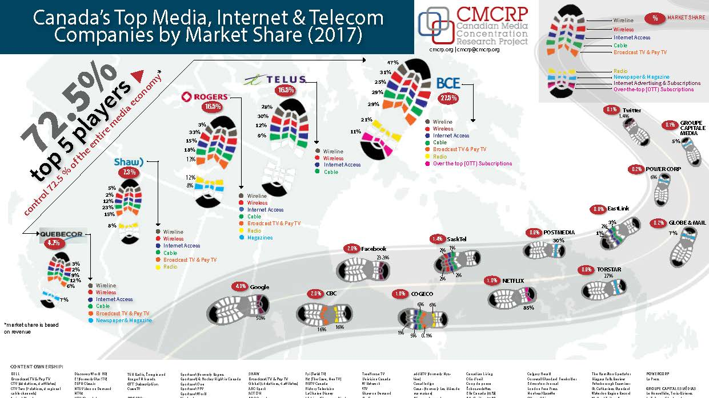

Slide 12
Comparison of Canada vs USA (2015)
Source

Slide 13
Schools of Thought Regarding Media Concentration
School 1: Gales of Creative Destruction and Free Market Fantasies
School 2: Media Ownership and Media Bias, By the Numbers
School 3: Radical Criticisms of Media Concentration and the Threat to Democracy
School 4: Digital Dominance—Consolidation and Cross-Cutting Dynamics in the Digital, Internet-centric Media Industries
Source

Slide 14
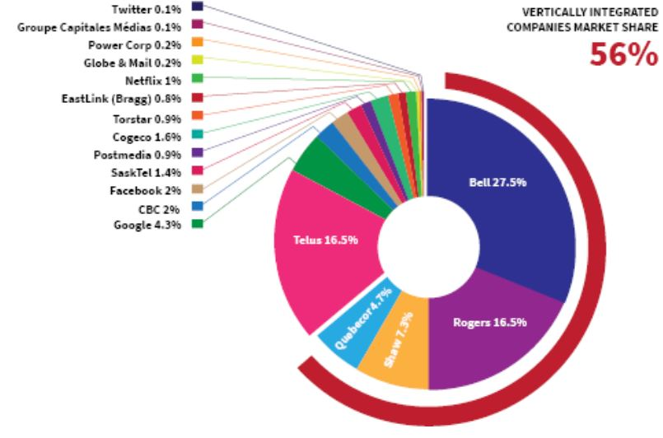
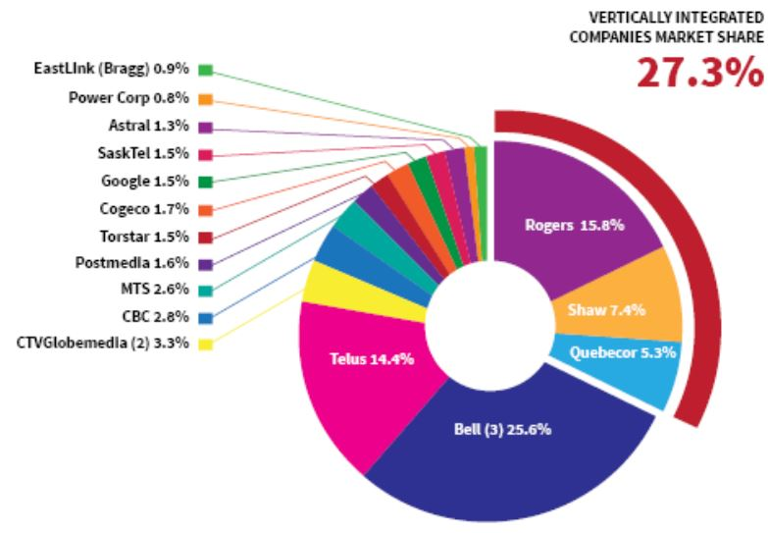
Vertical Integration Canada 2010 - 2017

Slide 15
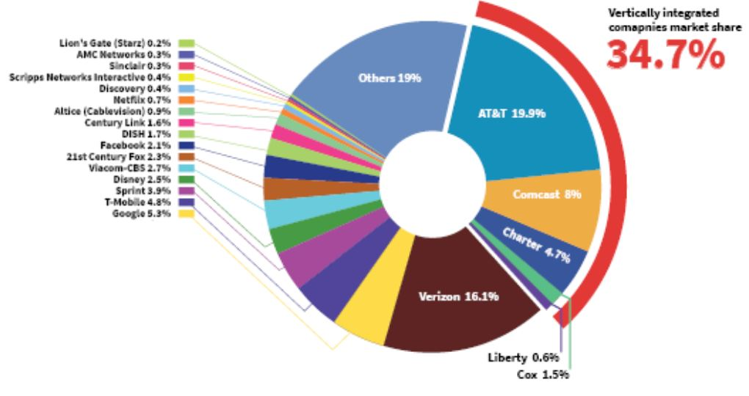
Vertical Integration USA

Slide 16
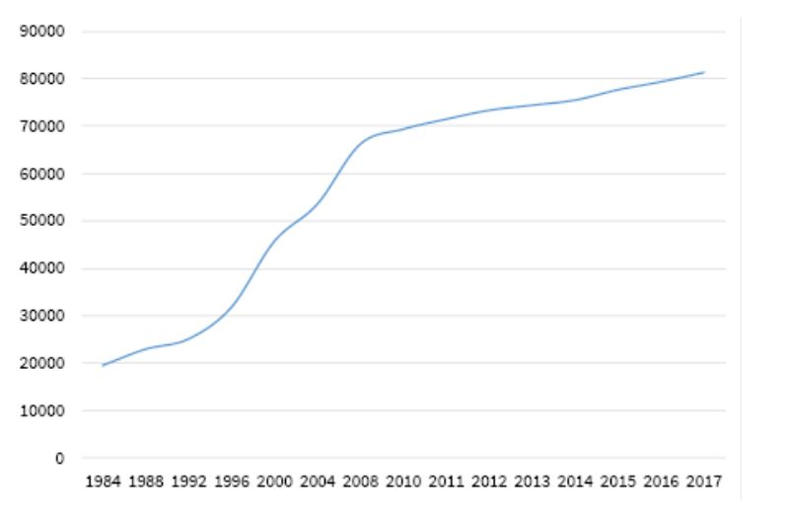
Growth of Media Revenues in Canada

Slide 17
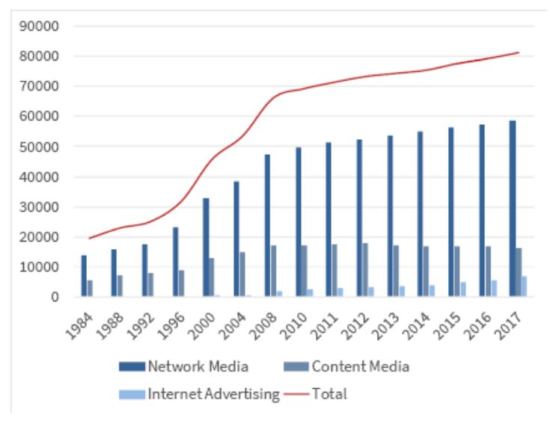
Growth of Media Revenues in Canada

Slide 18
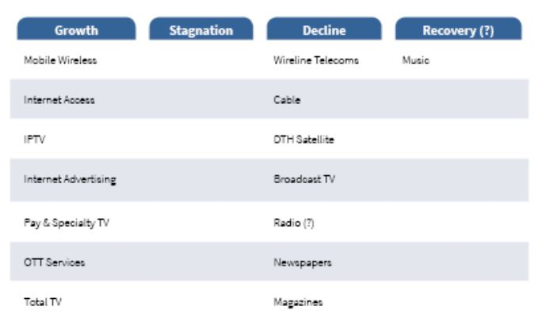
Growth, Recovery, Decline, Stagnation

Slide 19
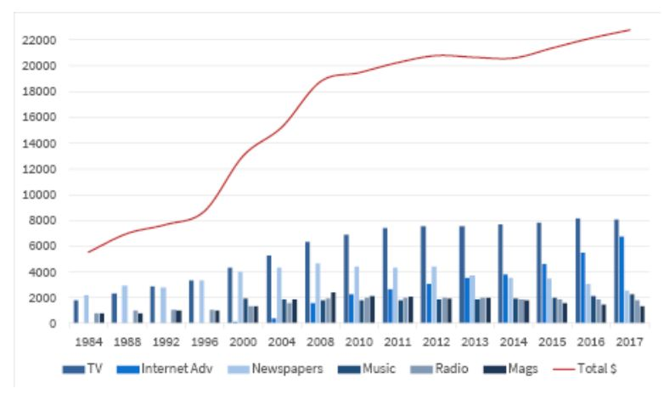
Content Industries

Slide 20
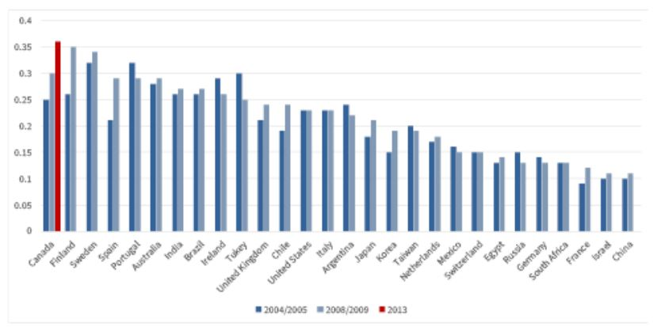
Vertical Integration and Cross-Media Ownership

Slide 21
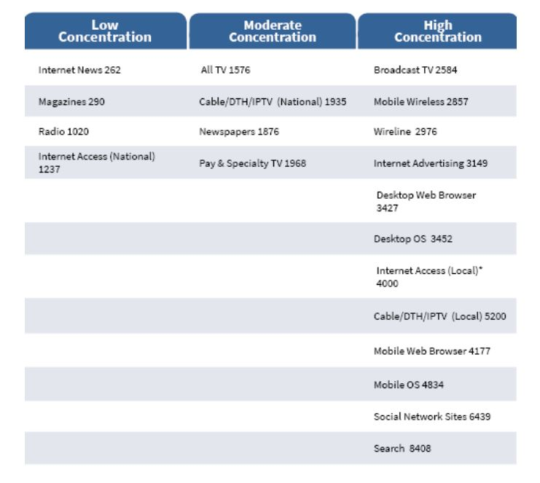
Canada Media Concentration

Slide 22
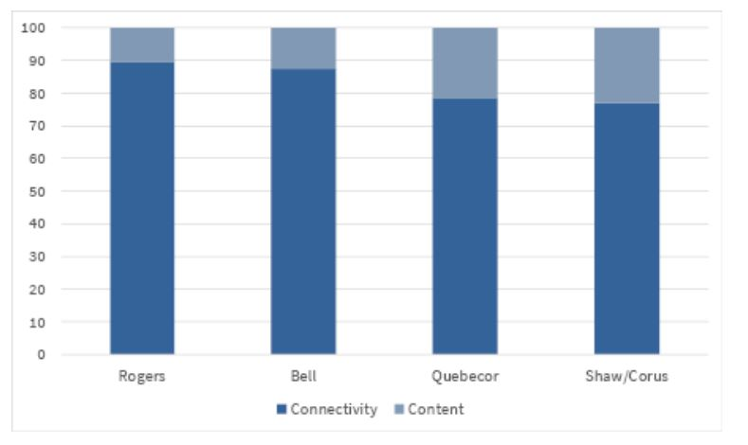
Content vs Connectivity

Slide 23
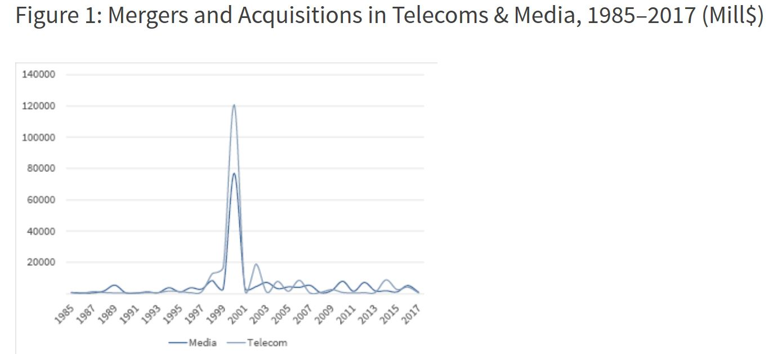
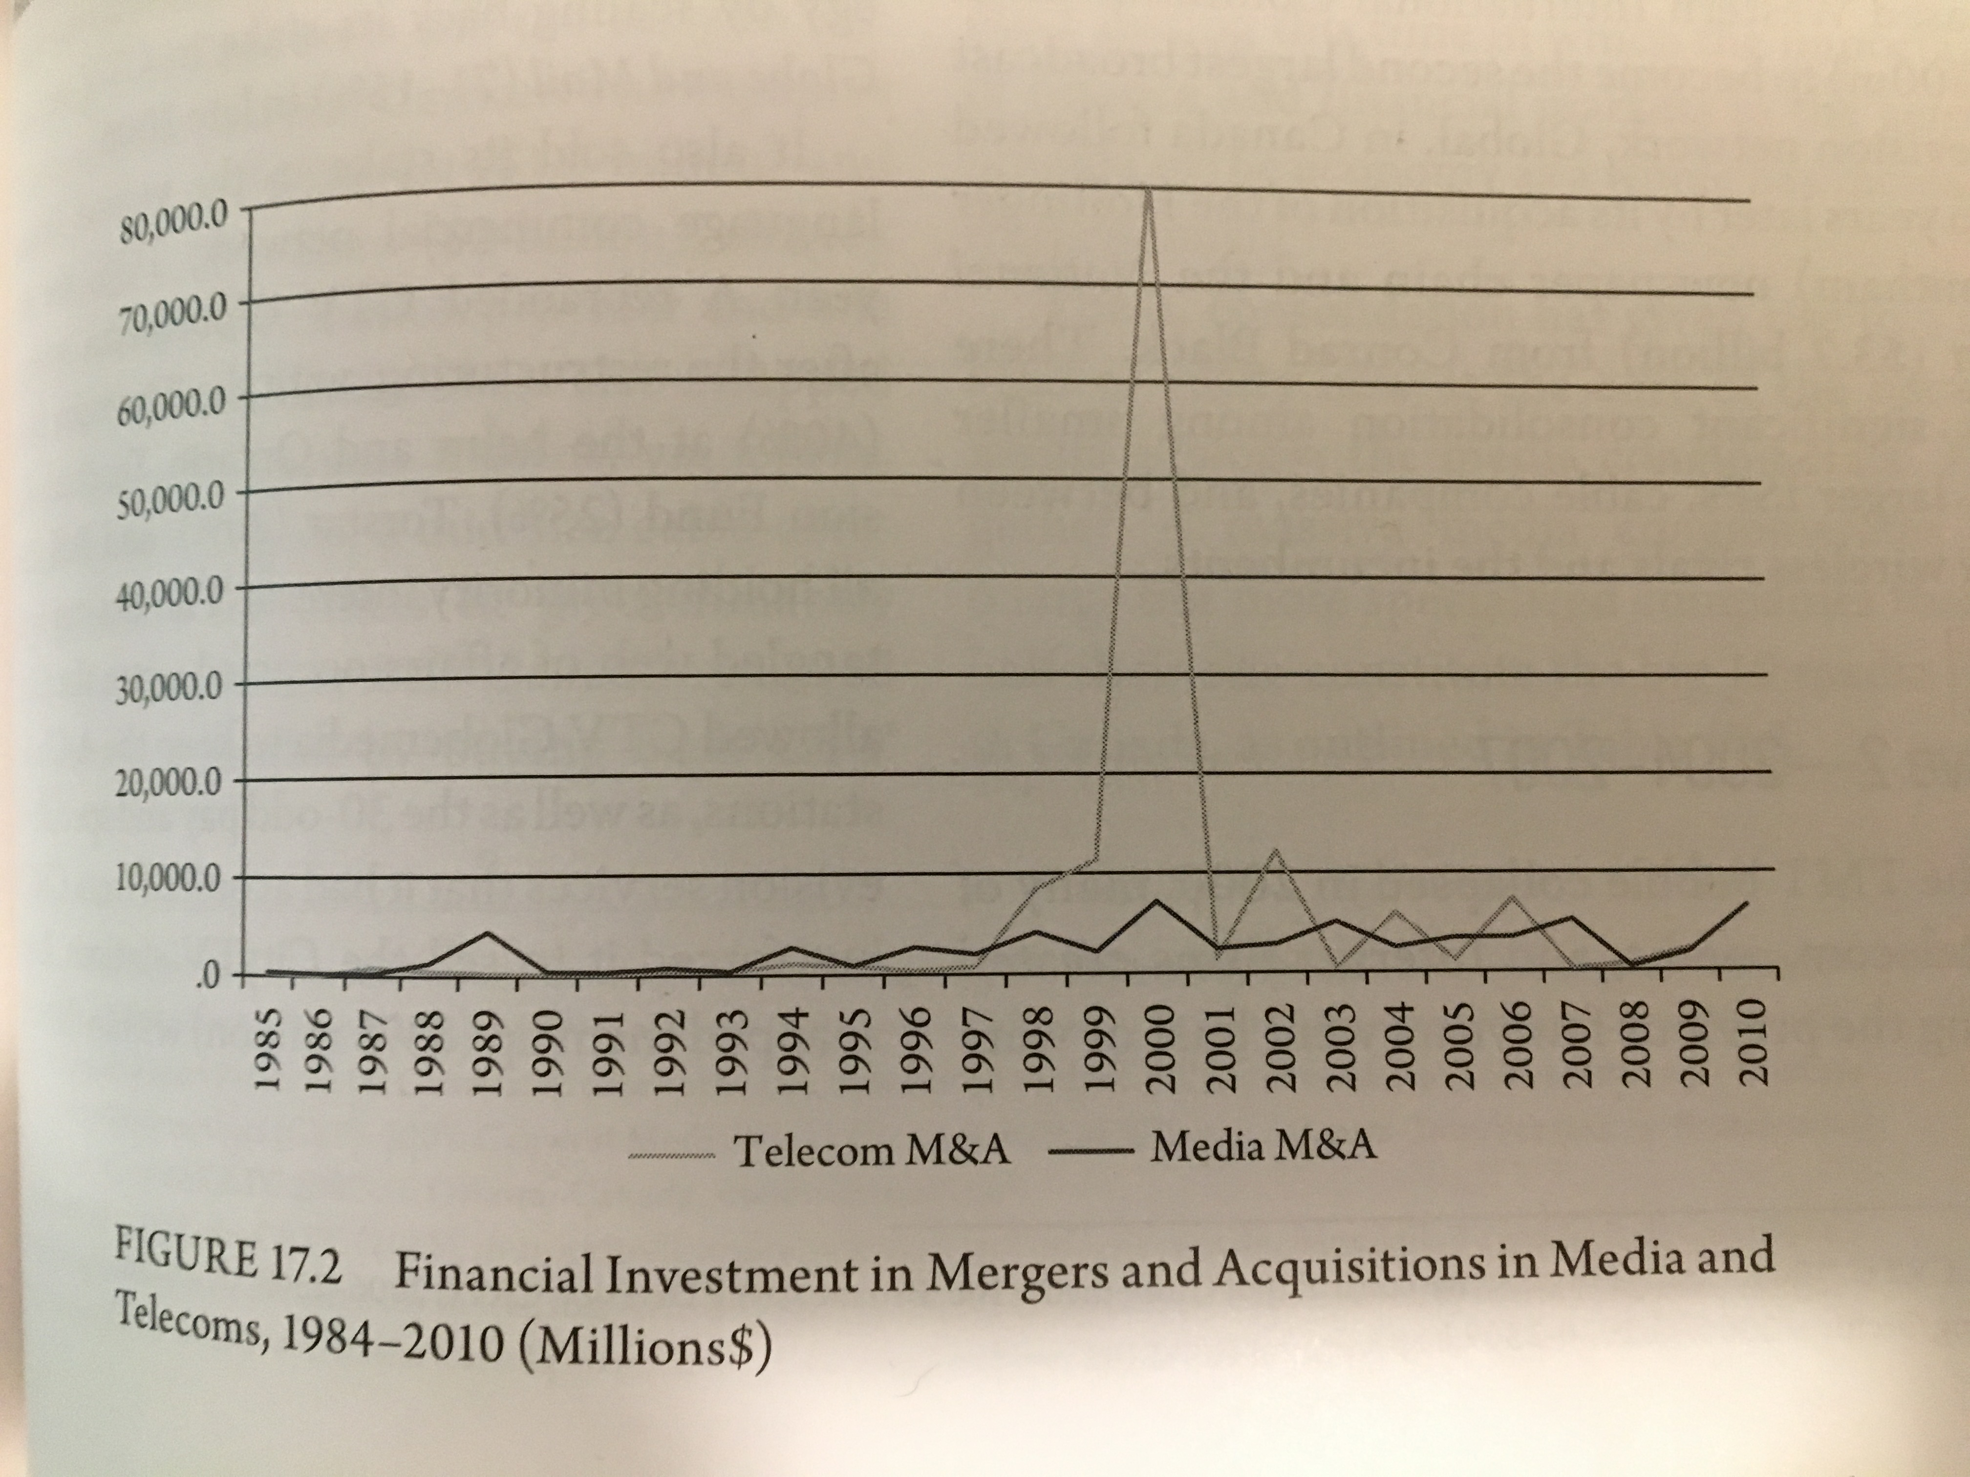
Waves of Media Consolidation

Slide 24
Trends from Wave Analysis
Acquisitions and mergers happen periodically rather than being a constant process towards greater consolidation or competition
No media company is immune to consolidation
Consolidation gives rise to the media conglomerate
Internet ownership is not ‘solving’ the media concentration problem; mobile wireless is the most concentrated media sector

Slide 25
Wave One – 1994 - 2000
1994
Rogers took Maclean-Hunter
Conrad Black (Hollinger) took Southam
1998 - 2001
BCE took CTV and the Globe and Mail
Quebecor took Videotron, TVA and the Sun
Canwest took Western International Communications (Global Television)
Canwest took Hollinger, (Southam, National Post)
TELUS took Clearnet
A more detailed account of these acquisitions are available here.

Slide 26
Wave Two – 2004 - 2007
Rogers took Microcell (Fido)
Canwest had financial troubles sold small dailies to Transcontinental and Osprey
Craig Media created Toronto One channel
Quebecor took Toronto One after Craig Media went bankrupt
CHUM sold to Bell Globemedia
Bell Globemedia scaled back holdings in CTV and Globe and Mail
Rogers took City TV from CTV Globemedia
Astral Media took Standard Broadcasting
Quebecor took Osprey
Canwest and Goldman Sachs Alliance Atlantis (13 specialty pay channels)
A more detailed account of these acquisitions are available here.

Slide 27
Wave 3 – 2010 - 2017
Postmedia took Canwest newspapers
Shaw took Canwest TV stations
Bell Canada took back CTV
Bell took Astral Media
TELUS took Public Mobile
Rogers took Mobilicity
Postmedia took Quebecor’s English papers
Shaw acquires Wind
Bell acquires MTS
Torstar and Postmedia swap 41 community and free metro newspapers (37 were then closed)
A more detailed account of these acquisitions are available here.

Slide 28
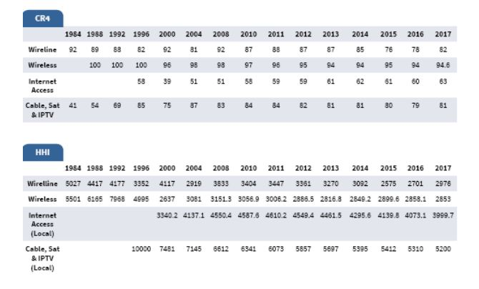
Network Media

Slide 29
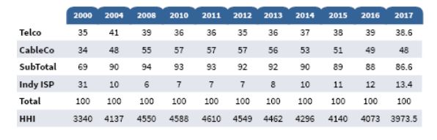
Residential Internet

Slide 30
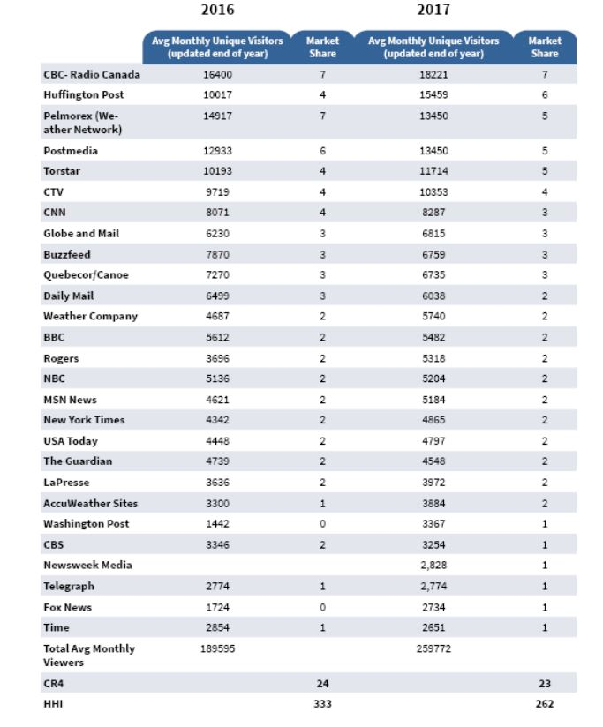
Internet News

Slide 31
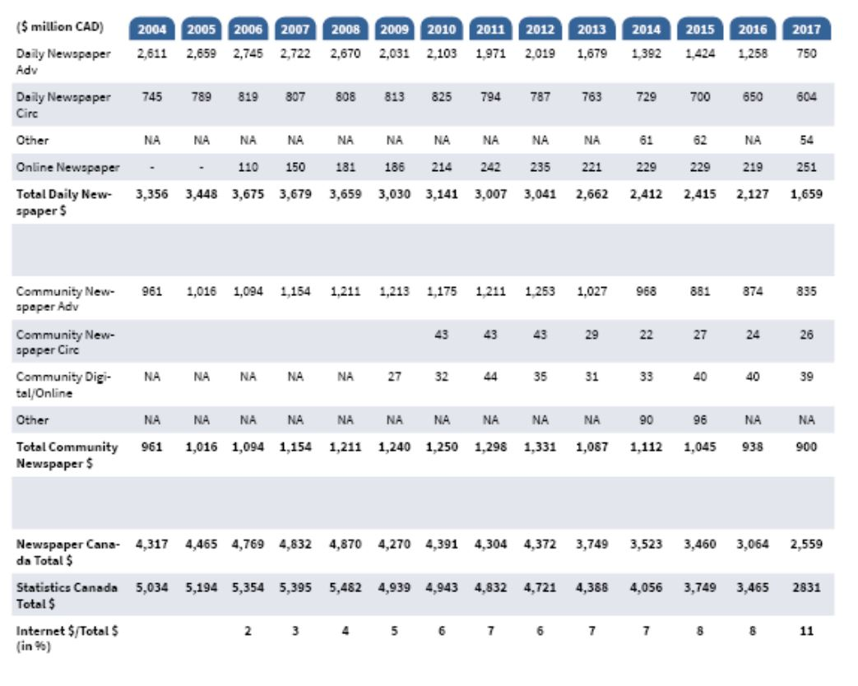
News Papers

Slide 32
Internet Advertising Revenue

Slide 33
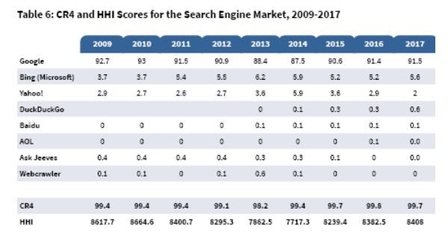
Internet Search

Slide 34
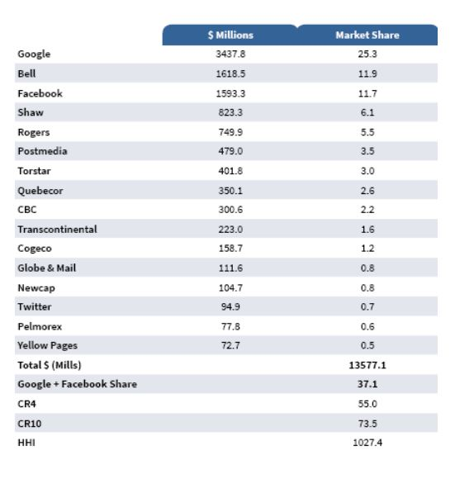
Advertising Across All Media

Slide 35
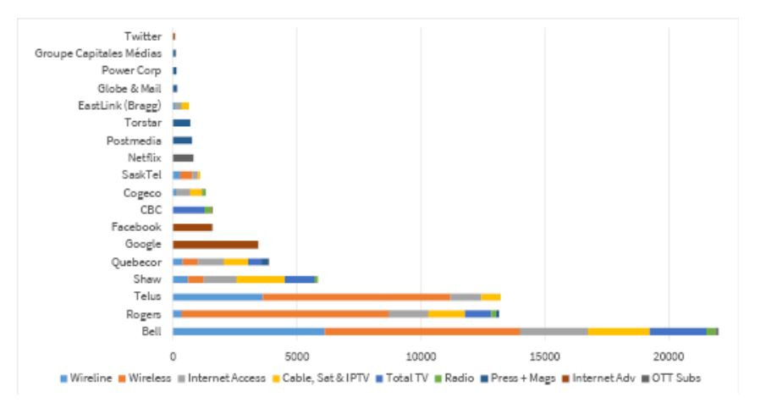
Media Companies Revenue

Slide 36
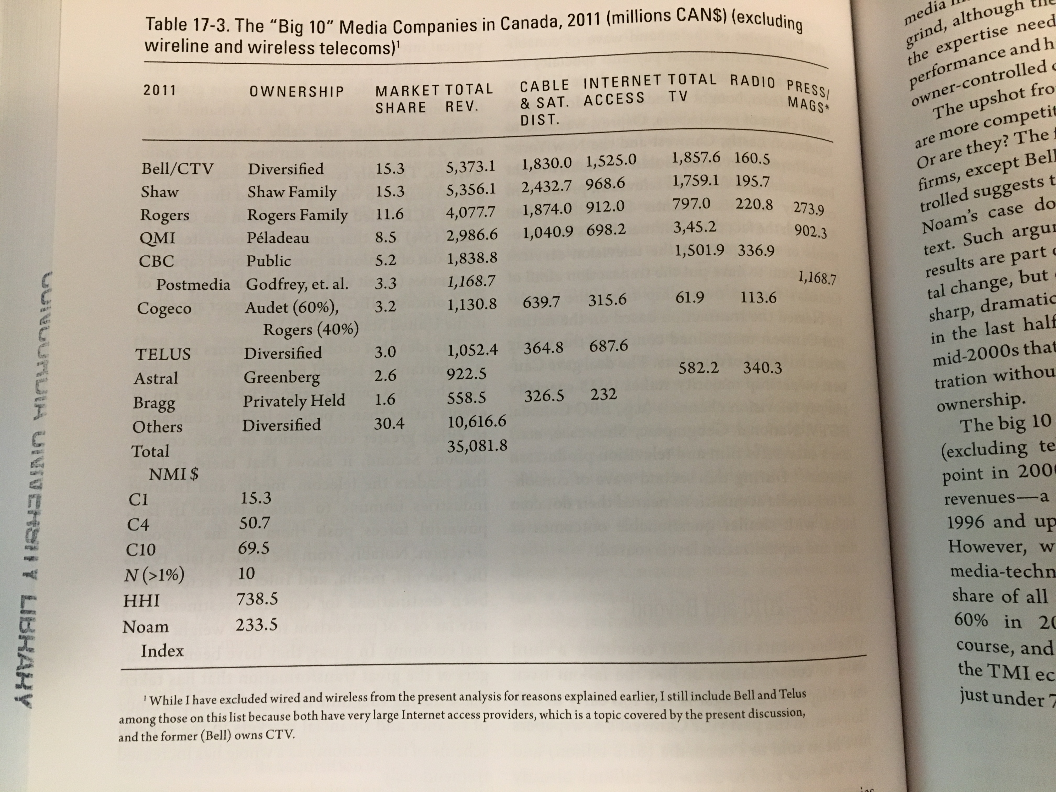
From the Assigned Readings – Up to 2011

Slide 37
Who Owns the World Media
(Noam, E. M. (2016) Who Owns the World’s Media? Media Concentration and Ownership around the World, Oxford Press, p. 1172)
Top 10 Media Companies by Revenue | Revenue 2011 in Millions
Government of China | $201 366
AT&T (USA) | $124 611
Verizon (USA) | $104 767
NTT (Japan – 33% public) | $89 716
Telefonica (Spain) | $85 895
Comcast (USA) | $75 954
Deutsche Telekom (Germany – 38% public) | $69 558
Vodafone (UK) | $62 366
Softbank (Japan) | $55 707
Grupo Carso (Mexico) | $55 559

Slide 38
Who Owns the World Media
(Noam, E. M. (2016) Who Owns the World’s Media? Media Concentration and Ownership around the World, Oxford Press, p. 1177)
Top 10 Media Content Companies | Revenue 2013 in Millions
Murdoch Group (USA) | $32 516
Government of China | $27 936
Google (USA) | $26 747
Comcast (USA) | $26 307
Redstone Group (USA) | $18 041
Disney (USA) | $16 481
Bertelsmann (Germany) | $13 650
Time Warner (USA) | $12 554
BBC (UK – public) | $12 301
DirecTV (USA) | $10 571

Slide 39
Fagstein Blog
Fagstein Blog

Slide 40
Questions?
Questions or concerns?

