Slide 1
Motivation and Emotion in Daily Life
Psychological needs
February 6th, 2019
Erik Chevrier

Slide 2
Questions/Discussion
Get into groups of 3 (-) 1 (+)
How are you doing today?
What happened during the day to affect you positively or negatively?

Slide 3
Questions/Discussion
Get into groups of 3 (-) 1 (+)
How were your needs for autonomy, competency and relatedness achieved or thwarted.
How did synthesis or conflict with psychological needs lead to you feeling bad or good about your day?

Slide 4
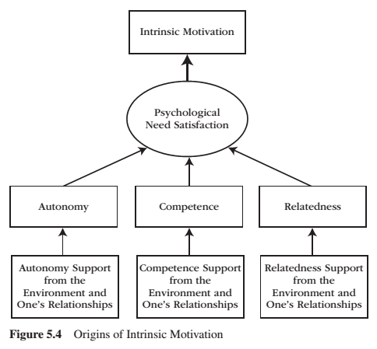
REVIEW: Intrinsic Motivation
Intrinsic motivation is the inherent propensity to seek out novelty and challenge, to extend and exercise one’s capacities, to explore, and to learn.
It is a natural inclination towards exploration, spontaneous interest, and environmental mastery that emerges from innate strivings for personal growth and from experiences of psychological needs satisfaction.

Slide 5
Psychological Needs
Competence Relatedness Autonomy
When an activity taps into and involves our psychological needs, we feel interest.
When an activity satisfies a psychological need, we feel enjoyment.
The energy generated by psychological needs are proactive.
Autonomy, competence, and relatedness are organismic needs.

Slide 6
Organismic Needs
Organismic needs theories:
Get their name from the word organism, which means alive and in active exchange with the environment.
When environments are supportive and provide what is needed, organisms thrive – when environments are hostile and withhold what is needed, organisms suffer.
Organisms need flexibility to accommodate a changing environment.
Organismic theories are the opposite of mechanistic approaches.
The focus of organismic theories is on how organisms initiate interactions with the environment, how environments change, and how organisms learn, adapt, change, and grow as a function of those environmental transactions.

Slide 7
Benefits of Need Satisfaction
Engagement
Personal growth
Intrinsic motivation
Internalization
Health
Well-being

Slide 8
REVIEW: Extent of Engagement

Slide 9
REVIEW: Types of Extrinsic Motivation

Slide 10
Person-Environment Dialectic

Slide 11
Dual-Process Model in Supportive and Thwartive Relationships

Slide 12
Person-Environment Synthesis vs Conflict
A person uses their inner motivational resources to interact with and change the environment, while the environment in turn changes and produces new forms of motivation for the person to internalize.
When an environment is supportive, the person’s inner motivational resources are vitalized, and autonomous forms of extrinsic motivation are internalized. The outcome is one of synthesis.
When environments are frustrating, the person’s inner motivational resources are deadened and controlled forms of extrinsic motivation are introjected (and external). The outcome is one of conflict.

Slide 13
Learning Check
Get into groups of 3 (-) 1 (+)
Think of an experience where the environment provided supportive motivational resources.
What psychological needs were met/not met?
What developmental tendencies were fostered/not fostered – integration or differentiation?
Why did you participate in the activity – what goals and interests were met/not met?
What types of motivation were fostered – external, introjected, identified, integrated?
What affordances and external events were experienced?
What types of relationships were fostered/not fostered?
Think of an experience where the environment frustrated motivational resources.
What psychological needs were met/not met?
What developmental tendencies were fostered/not fostered – integration or differentiation?
Why did you participate in the activity – what goals and interests were met/not met?
What types of motivation were fostered – external, introjected, identified, integrated?
What affordances and external events were experienced?
What types of relationships were fostered/not fostered?

Slide 14
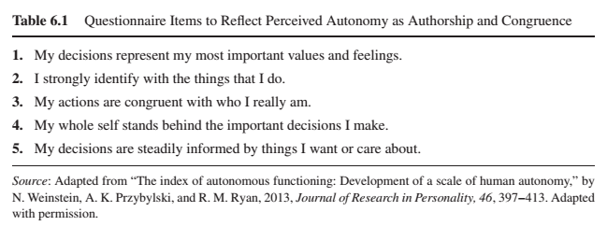
Autonomy
Autonomy is the psychological need to experience self-directed and personal endorsement in the initiation and regulation of one’s behaviour.
The hallmarks of autonomy are volitional action and wholehearted self-endorsement of that action.
Behaviour is autonomous when our interests, preferences and wants guide our decision-making process to engage or not engage in a particular activity.
Perceived Autonomy - Trait

Slide 15
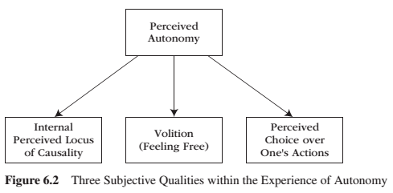
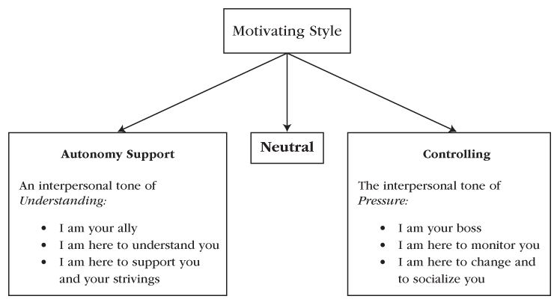
Autonomy
Autonomy is the psychological need to experience self-directed and personal endorsement in the initiation and regulation of one’s behaviour.
Behaviour is autonomous when our interests, preferences and wants guide our decision-making process to engage or not engage in a particular activity.
Perceived Autonomy - State

Slide 16
Autonomy
Perceived locus of causality (PLOC) – an individuals understanding of the causal sources of his or her motivational actions.
Volition – is a heartfelt and unpressured willingness to engage in an activity.
Perceived choice – is a subjective experience that one has decision-making flexibility to act or not to act, or to pursue one course of action rather than another course of action.

Slide 17
The Conundrum of Choice
Choice sometimes but not always motivates people.
Choice between prescribed options does not foster a need for autonomy.
Picking is different than choosing.
When people are allowed to make choices that truly reflect their personal values, goals, and interests, then they DO feel a sense of need-satisfying autonomy.
Satisfying the need for autonomy leads to positive post-choice functioning in terms of enhanced intrinsic motivation, effort, creativity, preference for challenge, and performance.
Choice can be offered in an informational or controlling way. Information and explanation leads to more autonomous choices. Controlling ways impede autonomy.

Slide 18
Autonomy vs Control

Slide 19
Encouraging & Thwarting Need for Autonomy
Encouraging Need for Autonomy
Nurture Inner Motivational Resources
Take the Other’s Perspective
Provide Explanatory Rationales
Listen Empathetically, Relying on Informational Language (use invitational language)
Display Patience
Acknowledge and Accept Expressions of Negative Affect
Thwarting Need for Autonomy
Nurture Outer Motivational Resources
Providing Your Own Perspective Only
Does Not Provide Explanatory Rationales
Uses Controlling Pressuring Language
Displays Impatience
Counters and Tries to Change Negative Affect

Slide 20
Benefits from Autonomy Support

Slide 21
Benefits or Giving and Receiving Autonomy Support
The quality of the relationship between people is enhanced when autonomy, relatedness, and competence are supported.
Think of the names of five of your friends.

Slide 22
Benefits or Giving and Receiving Autonomy Support
The quality of the relationship between people is enhanced when autonomy, relatedness, and competence are supported.
Do you have a reciprocal relationship where you both try to foster a nurturing environment for each other? What would you answer to the questions below in regards to your interaction with the five people you listed?
My friend believes that I provide him/her with choices and options (giving autonomy support)
My friend tries to understand how I see things (receiving autonomy support)
When I am with my friend, I feel free to be who I am (autonomy)
When I am with my friend, I feel like a competent person (competence)
When I am with my friend, I feel loved and cared about (relatedness)

Slide 23
Discussion
You and your friend have made plans to eat well and begin exercising. Two weeks into the plan, your friend begins to show signs of ambivalence towards the plan. How can you create a nurturing environment to help your friend stay motivated?

Slide 24
Thank you!
Questions? Concerns?

Slide 25
Bibliography
The information obtained to create this PowerPoint slide was obtained from:
Reeve, J. (2015) Understanding Motivation and Emotion, 6th ed. John Wiley and Sons
Reeve, J. (2018) Understanding Motivation and Emotion, 7th ed. John Wiley and Sons

