Slide 1
Chapter 8:
Diverse Economies, Ecologies and Ethics
Rethinking Rural Transformation in the Philippines
Andrea Brennan & Alexa Rivas
URBS 450 Economic Restructuring
Professor Erik Chevrier
March 12, 2019
Notes:
(Andrea)
Today we are going to be looking at Chapter 8 of Making other worlds possible, diverse economies, ecologies and ethics: Rethinking rural transformation in the Philippines and beyond. We are going to be focusing on how some of the concepts we’ve been discussing in class thus far apply in the rural setting considering the unique challenges of rural life.
Feel free to ask questions throughout
How many of you have read or skimmed through the chapter?

Slide 2
Overview
Summary of Chapter 8 (15 minutes)
Activity 1: Start your own local project! (10-15 minutes)
Arctic Resilience Report (10 minutes)
Activity 2: Case Studies! (10-15 minutes)
Conclusion (5 minutes)
Notes:
Andrea

Slide 3
Rural Representations | What is rural?
Agriculture-based economies? Informal? Local?
OR
Diverse economies with a potentially global reach?
(Gibson, Cahill, & McKay 2015)
Notes:
(Andrea)
> What is rural?
Pose question to the class.
- There are many assumptions about what rural economies are capable of. They are often assumed to be primarily agriculture-based, underdeveloped, restrained to local economies, maybe even informal.
- The truth however is that rural places have diverse economies with a potentially global reach. And they can be formal, and they can be advanced.
- The point is they can be very diverse and dynamic.

Slide 4
Performativity | The power of language and discourse
“Performativity is the power of language to effect change in the world: language does not simply describe the world but may instead (or also) function as a form of social action.” (Cavanaugh, 2015)
Notes:
· (Andrea)
> This brings us to our next point and this is Performativity. This is a concept that the chapter makes a point of being really cognizant about. Performativity is just a fancy word for the power of language to effect change in the world. It’s a theory that stresses that language does not simply describe the world but may also function as a form of social action.
- The point the authors are trying to make here is that they want to challenge the rationale behind our portrayal of rural identity and dynamics
- They want to challenge the effects of these portrayals. So, how have these discourses interfered with rural development, what is the result and what could have been the result without such interference. And how can we counter this interference by allowing other discourses to come through unhindered and unburdened?

Slide 5
Rural Representations | What is the discourse of rural identity and dynamics?
Unidirectional processes associated with the international expansion of the capitalist growth machine:
Commoditization
Proletarianization
Agricultural mechanization
Modernization
Monetization
Out-migration
Non-market to market
Agriculture to industry
Rural to urban
Diverse processes rooted in local practices and alternative pathways:
Ecological dynamics
Ethical dynamics
Economic dynamics
(Gibson, Cahill, & McKay 2015)
Notes:
(Andrea)
> That being said, now that we are aware of the effect of discourse, we ask what does determine rural change? What is the discourse of change and what is the reality of change? In order to understand the reality, we have to understand what dominates the discourse. So that’s why we’ve divided rural processes into two categories. On the left, what
- Often what comes through are unidirectional processes and these are associated with the international expansion of the capitalist growth machine. We have many processes here some of which are discussed by Erik Olin Wright in his critiques of capitalism.
§ Commoditization – which is the privatization of land and resources
§ Proletarianization – which means we privatize the means of production and turn everyone into workers§ Agricultural mechanization – which are technological advances in agriculture
§ Modernization – which means that we are constantly innovating and upgrading our built infrastructure and our modes of production
§ Monetization – which means we seek to convert all available resources and assets into revenue
§ Out-migration – which means we lose strong, able, creative workers to external economies and we often see that they become indentured migrant workers
- Furthermore we see transitions of rural economies from:
§ Nonmarket to market
§ Agriculture to industry
§ Rural to urban
> So, how do these “determinants” undermine the resilience of rural communities?
- We see that all of these processes assume that there is only one way forward and that is toward a more developed form of capitalism
- So, what the authors of this chapter argue, is that we need to allow alternative dynamics to make gains and these are the processes on the right. We have:
§ Ecological dynamics – which deals with nature’s systems, these are systems that are millions of years old and therefore might actually know a thing or two about survival
§ Ethical dynamics – which are forces of transformation that are informed by ecological and cultural moral principles. This is how communities are inspired by their environment and their cultural history to maintain their livelihoods.
§ Economic dynamics - which encompasses diverse economic opportunities in rural areas and doesn’t pigeonhole anyone or any region.

Slide 6
What is the central claim of the chapter?
The chapter asks:
Can we reframe rural identity and dynamics to create more resilient communities?
The chapter argues:
The capitalist growth machine is inadequate, imposing and unsustainable in rural communities.
By changing the language of traditional rural economics, alternative strategies can be put forward on even ground.
This will strengthen resilience and wellbeing.
(Gibson, Cahill, & McKay 2015)
Notes:
(Andrea)
That was an introduction with a lot information and some new concepts to absorb so let’s take a step back and look at the central claims of the chapter.
The chapter asks: Can we reframe rural identity and dynamics to create more resilient communities?
And to answer its own question, the chapter argues that traditional economics has historically ignored the natural environment and often interferes with alternative economic approaches that are more sustainable. By changing the language of traditional rural economics, alternative strategies can be put forward on even ground. This will help strengthen resilience in rural communities and offer better standards of living and wellbeing.

Slide 7
Ecological Theory (Robert Chambers)
Stems from ecological understandings of natural systems
In nature, disturbances can threaten an ecosystem’s health but biodiversity equips nature with greater ability to recover (“resiliency”)
In ecological theory, this is applied to humans, suggesting that increased diversity of social reproduction strategies allows for increased human resilience
(Gibson, Cahill, & McKay 2015)
Notes:
(Andrea)
Now we are going to talk about some of the theories and approaches that the chapter covers starting with Robert Chambers’ ecological theory. This theory stems from ecological understandings of natural systems. In nature, biodiversity provides ecosystems with resilient natural processes that allow a greater potential for recovery from natural and unnatural disturbances. This is known as “resiliency” and can also be applied to humans, suggesting that increased diversity social reproduction strategies allows for increased biological, social, cultural and economic resilience. This means:
- Reduce vulnerability
- Greater wellbeing
- Independence
- Happier individual experiences

Slide 8
Sustainable Livelihoods Approach (SLA)
What is SLA?
A practical and theoretical approach to community intervention
Looks at the multiple forms of social reproduction engaged in by poor rural households
Critiques:
Represents rural communities in terms of trade-offs between the five “capitals” – natural, physical, financial, human and social
Methods therefore promote the strengthening of these five capitals and tends toward reaffirming the capitalist paradigm
Uses unidirectional logic
(Gibson, Cahill, & McKay 2015)
Notes:
(Andrea)
The ecological theory inspired a number of approaches that the chapter discusses. One of them is the SLA.
Sustainable Livelihoods Approach:
> A practically and theoretically based approach to intervention that looks at “the multiple livelihood practices engaged in by poor rural households”
However, the authors of the chapter found that this approach was inadequate and did not go into enough depth. For example they critique SLA for its:
> representation of rural communities in terms of trade-offs between the five “capitals” – natural, physical, financial, human and social
- methods often promote the strengthening of these five capitals and reaffirm the capitalist paradigm
> still uses unidirectional logic

Slide 9
The Nature of Economies (Jane Jacobs) | The 3 dynamics approach
Jacobs’ argument: Suggests imitating ecological processes to ensure economic sustainability of regions
1. Habitat maintenance
Supporting the conservation of ecological and cultural health in a community
2. Diversity and resilience
Promoting diversity of niches creates resiliency
Circulation of energy in a system: the more energy is re-used, the stronger and more resilient the economy (what Jacobs calls “self-refueling”)
3. Interdependence of developments and co-developments
One development triggers multiple and related co-developments
Needs monitoring and assessment
(Gibson, Cahill, & McKay 2015)
Notes:
Alexa

Slide 10
Philippines Case Study | Habitat Maintenance
“A knowledge and a specific language is needed in order to understand the complex dynamics of survival.”
Jacob’s ideas used to include the processes of both social and natural habitat maintenance
Assets-based approach
identified specific practices and guiding ethics, and how they contribute to habitat maintenance
negative (community undermining)
positive (community strengthening)
Social capital
Ethics and practices contribute to governance and habitat maintenance
(Gibson, Cahill, & McKay 2015)
Notes:
Alexa

Slide 11
Philippines Case Study | Diversity and Resilience
“Local economic development is connected to the expansion or decline of diversity and resilience” (Jacobs)
Resilient economies
Diverse range of economic activities that support well being
Different project niches and sectoral activities
Self provisioning sectors
Import replacing activities
“Range of transactions, forms of labour remuneration, and surplus appropriation and distribution”
Challenges of rural livelihoods
Formal knowledge nonexistent
Non credibility of local ecologies and presence
Participatory inventory
Gibson-Grahams diverse economy framing and components of Jagnas’ diverse economy
Language of economic diversity: alternative and nonmarket transactions, alternatively paid and unpaid labor, and alternative capitalist and non-capitalist enterprises
(Gibson, Cahill, & McKay 2015)
Notes:
Alexa

Slide 12
Philippines Case Study | Development and Co- development
Maintaining the sustainability of a system in order to create sustainable futures and resilient habitats
Delicate processes of balancing and correcting
Diversity creation and destruction
Local actions and international connections
Economic application
Uncover counteracting experiments
Effect of interventions producing developments and co-developments
Undermine diversity and sustainability
Modernizing development interventions
Green Revolution (Wet rice growing in vulnerable ecosystems (Bohol 1970s))
Promotion of export crops
Regulations to ban gleaning (coconuts, mangoes, ginger and bananas)
Correct, sustain and strengthen local habitats
People-to-people fair-trade arrangement
Exporting bananas to japanese consumers (NGO Alter-Trade Japan (2009)
Collective project of sealing the farm-to-market road
(Gibson, Cahill, & McKay 2015)
Notes:
Alexa

Slide 13
Activity: Start your own local project!
Get into groups
Choose a sub-group:
You are a group of elderly residents in sub-arctic Northern Quebec
You are a group of teenagers in the prairies of Manitoba
You are a group of middle-aged adults in sub-tropical Morocco
You are a group of women with children in tropical Ecuador
Make a list of your local assets
Come up with a community enterprise idea
Prepare to share your ideas with the class
*Hint: When thinking about assets, think about physical (climate, landscape, resources, infrastructure), institutional (banks, governments, charities), social (traditional knowledge, cultural activities) and individual (skills, traits) needs and assets.
Notes:
Andrea/Alexa

Slide 14
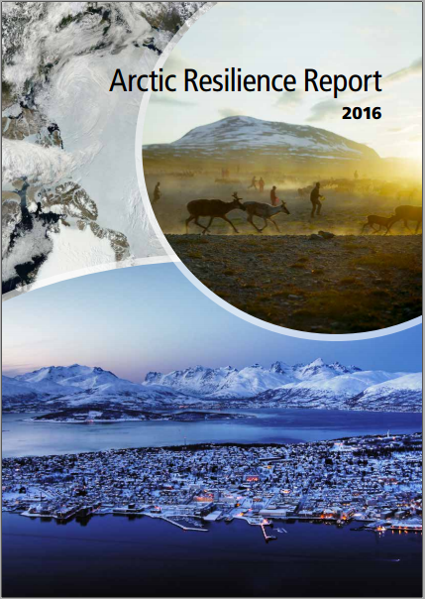
Arctic Resilience
Report
What is the Arctic Resilience Report?
220-page report about Indigenous and rural livelihoods across 8 Arctic countries!
What does it say about rural transformation?
It says arctic communities are continuously adapting to changing circumstances!
What does it say about resilience?
Resilience is crucial because of extreme conditions!
Social and ecological processes can build or erode resilience
(Huitric, Peterson & Rocha, 2016)
Notes:
(Andrea)
In order to further our understanding and demonstrate the relevance of this chapter, we’ve decided to look at a case study that is relevant here in Canada.
So what is the Arctic Resilience Report?
This report is the result of 5 years of research across eight countries with land rights in the Arctic — Canada, the US, Russia, Scandinavia and Greenland. It is a collaborative effort between Indigenous peoples, allies and researchers.
It’s all about the arctic and the rural and indigenous communities that live there!
One of the reasons we’ve chosen to look at the arctic is because life there is characterized by unpredictable and extreme conditions. The landscape, the seasons and the weather bring enormous, abrupt and sometimes dangerous shifts. Global weather patterns are changing the physical landscape at an alarming rate and this poses fundamental challenges to the way people live. Canada particularly, has historically failed to support the well-being and independence of Indigenous people so this report acts as an important step toward decolonization.
This report is an effort to better understand the nature of Arctic change, including the factors that support resilience and the kinds of choices that strengthen the capacity of populations to adapt
Resilience, including the capacity for rural transformation, has always been crucial to the communities living in the Arctic – and it is even more so amid the rapid changes presently taking place. A key first step towards enhancing resilience across the Arctic is to understand the social, cultural, economic and ecological processes that are already there building or eroding resilience.

Slide 15
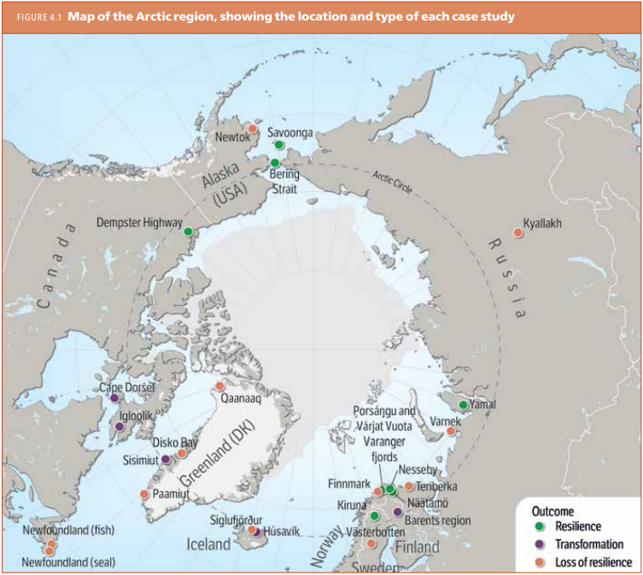
Arctic Resilience
Report | 25 Case
Studies
Resiliency occurs when identity, function and structure is maintained despite disturbances to a community, showing an ability to self-organize, experiment, learn and adapt
Loss of resilience occurs when identity, function and structure is diminished
Transformation occurs when purposeful changes to identity, function or structure are used to mitigate disturbances
(Huitric, Peterson & Rocha, 2016)
Notes:
(Andrea)
EXPLANATION OF THE CASE STUDIES: This chapter compares 25 case studies where resilience has been maintained or lost, or where transformation has occurred. The case studies demonstrate that indigenous and rural communities in the Arctic have unique and complex ways of reproducing themselves and building better livelihoods and these are intimately rooted in their surroundings.
The findings have important implications for the design of policies to build resilience in the Arctic that go beyond traditional economic discourse.
In our second activity, I'm going to give you guys a chance to explore some of these cases. But first I need to explain how the case studies were organized and what they signify. The cases were organized according to their resiliency, loss of resiliency and transformation.
Resiliency occurs when identity, function and structure is maintained despite disturbances to a community, showing an ability to self-organize, experiment, learn and adapt. Loss of resilience occurs when identity, function and structure in a community is diminished due to disturbances.
Transformation occurs when purposeful changes to the identity, function or structure of a community are used to mitigate the effects of disturbances and to better suit the needs of the people.
This categorization is useful because it allows us to learn from both successful and unsuccessful examples.

Slide 16
Activity: Case Studies!
Read the case study
Based on the definitions below, is it an example of resilience, loss of resilience or transformation? Why?
Identify the alternative economic pathways used. Discuss.
Prepare to summarize your case study to the class and describe your findings.
Resiliency occurs when “the social-ecological system has been able to maintain its identity, function and structure despite changes in the broader social or ecological context. It has the ability to self-organize and the ability to experiment, learn and thus adapt.”
Loss of resilience occurs when “there has been a loss of livelihoods, identity, function and structure.”
Transformation occurs when “people have acted to purposefully modify the system’s identity, function and structure to better suit their needs”
(Huitric, Peterson & Rocha, 2016, p. 100-101)
Notes:
(Andrea)
Answers:
Resilient:
Yupik whaling, Savoonga, Alaska
Reindeer herding, Yamal Peninsula, Russia
Sheep farming and reindeer herding, Unjarga/Nesseby, Norway
Non-resilient:
Seal industry, Great Northern Peninsula, Newfoundland
Cod fishery, Great Northern Peninsula, Newfoundland
Transformation:
Hunting and art, Cape Dorset, Nunavut
Food security in an Arctic Inuit community, Igloolik, Nunavut

Slide 17
Arctic Resilience: Key Factors
Self-organization → using local knowledge, monitoring and assessment, and collaborative decision making
Adoption of policies that enable and support self-organization
Navigation of change and uncertainty
Diversification
Combination of different types of knowledge
Transformation → adapting ways of living and connecting to nature while maintaining identity
(Huitric, Peterson & Rocha, 2016)
Notes:
(Andrea)
KEY FINDINGS FROM THE REPORT AND CONCLUSION OF ACTIVITY:
One of the most important factors for resilience in the Arctic is the ability of people to self-organize. When this ability is denied, there is a loss of resilience. Self-organization requires knowledge, monitoring, and the ability of communities to define problems, create a plan and follow through with implementation.
• Historically, many policies of Arctic nations have eroded and restricted self-organization, but adopting new policies that enable and support this can rebuild resilience.
• additional factors that contribute to resilience include the ability of people to navigate change and uncertainty, nurture diversity, and learn by combining different types of knowledge.
• There are multiple examples of Arctic people transforming how they live and connect to nature while maintaining their identity. Several cases of communities developing new forms of art, food production and tourism were observed in the case studies.
In the end, Arctic nations should invest in supporting initiatives that enable local people to construct their own resilient futures using their traditional and local knowledge of the land.

Slide 18
Conclusion
Theory is presented in the foreground
Unclear how rural communities can rely on the capitalist growth machine
New development pathways to be imagined and implemented
Current representations of rural change deny credibility and reflect capitalist development pathways
Community based enterprises bringing credibility to the non-market economic activities
Activities promote habitat maintenance and economic resilience and diversity
Possibilities for post-capitalist regional development
“Think of strategies better suited to imagining and enacting different futures”
Notes:
Alexa

Slide 19
References
Huitric, M., Peterson, G., & Rocha, J. C. (2016). What factors build or erode resilience in the Arctic? In M. Carson and G. Peterson (Eds), Arctic resilience report, pp. 96-125. Stockholm, SE: Stockholm Environment Institute and Stockholm Resilience Centre. Retrieved from https://oaarchive.arctic-council.org/handle/11374/1838
Cavanaugh, J. R. (2015). Performativity. Oxford bibliographies. Retrieved from http://www.oxfordbibliographies.com/view/document/obo-9780199766567/obo-9780199766567-0114.xml
Gibson, K., Cahill, A., & McKay, D. (2015). Diverse economies, ecologies, and ethics: Rethinking rural transformation in the Philippines. In G. Roelvink, K. S. Martin, & J. K. Gibson-Graham (Eds.), Making other worlds possible: Performing diverse economies (pp.194-224). Minneapolis, MN: University of Minnesota Press.
Olin Wright, E. (2010). Envisioning real utopias. London, UK: Verso

